Slide 1

The Case Against Lightning
Short talk + Long Q&A
Paul Sztorc – CEO LayerTwo Labs
@truthcoin on X | @psztorc on Telegram truthcoin.info | drivechain.info | LayerTwoLabs.com TabConf – Oct 15, 2025 – (12:30 – 1:30 PM)

Slide 2
Overview
Thesis: Lightning is a waste of time (and money).
People will regret associating with it.
Talk: (15 minutes)
- Just a review of everything I’ve said since 2022
Q&A: (45 minutes)
- Take your best shot!

Slide 3
In A Nutshell
The “channels” idea is fundamentally unworkable.
There is not enough blockspace (on L1) for even 1% of the Earth’s population to use Bitcoin via Lightning.
The “Channels” themselves are difficult to operate and maintain. They offer a poor UX and are unreliable in practice.
It matter who you open a channel with – this steers the idea toward “brands” – and away from cypherpunkism.
The cost/benefit ratio does not meet the required standard.
Demonstrations of it “worked” are rooted in misunderstanding.
Most testimony comes from laypeople (easily duped, and their testimony is worthless).
Payment networks have network effects (ie, “Venmo me”) – so scaling to 8 billion is mandatory (for LN).
Lightning insiders are already abandoning it.
Quotes from experts, especially Burak (the creator of ARK).
From Lightning to Covenants.
The stragglers are fools (or dupes) who have no idea what they are shilling.
The hype of lightning is mostly rooted in deception (and self-deception).
Lightning was born out of Blocksize War politics, and never left.
The cultural relevance of lightning is rooted in peer pressure / conformity / emotion – it is a cult, not a scientific idea.
Lightning has skillfully evaded and suppressed criticism, in ways that make “Shitcoins” look honorable by comparison.
Lightning creates a “developer grift”.
A parallel “prestige world” where developers use technobabble to impress gullible investors, and take their money.
The arcane vocabulary is just another tool for muddying the waters and painting Lightning with an illusion of respectability.
Lightning damages Bitcoin – by “crowding out” good ideas.
Notes:
I mean, other than that Mrs. Lincoln, how did you like the play?

Slide 4
My Lightning Timeline
May 2015 – Tadge / Joseph SF Bitcoin Meetup LN Presentation – I watched it on Youtube. Over this year, there would be thousands of reddit posts (pro and anti lightning) – yet, this one video never had more than 350 views (at that time). The people who argue about lightning, don’t know about lightning.
Dec 2015 – Scaling II in Hong Kong – wide agreement that Lightning is the thing to try. ( + soft forks, + scaling in layers ). Mar 2016 – I research the technology, and post a variant: “Lightning Network for Hivemind” (P2P oracle + prediction market thing – basically PolyMarket on Bitcoin). I knew exactly how Lightning Worked, in 2016.
Feb 2019 – Bitcoin Meetup in Mexico – everyone is thrilled by a new “Lightning Wallet” (BlueWallet) – I download it and instantly receive 8 satoshis from the person next to me – I ask “is it custodial?” – this room (full of 25 people) has no idea what I’m even talking about. All lightning supporters are dupes.
Feb 2022 – On bitcoin-dev, “ZmnSCPxj” incorrectly says that L2 blockchains don’t scale, because “you have to show your transaction to everyone” (both false and irrelevant). I point out that you must “show everyone” an LN channel open txn, and there is not enough space. – No Response – April 2022 – I publish “Lightning Network: Fundamental Limitations” – It is a bullet point at the large Miami BitDevs (coincident with the large conference), but again there is no response. In fact, two high-level lightning engineers, messaged me to say “until I read your 2022 article, I didn’t realize how lightning works”. Even the “experts” / mailing list crowd, cannot show us how the Lightning Network might work, at scale.
Late 2022 – While doing fundraising for L2L I had one solitary slide (of like 60) about how LN doesn’t work and we deserve better. People often reacted badly to this slide and suggested I take it out. Telling the truth about LN will hurt your career.
June 2023 – Burak (who crashed the entire public LN for fun a few times), inventing ARK – “I’ve always been a big critic of Lightning. I had severe objections, right? ..from inbound liquidity, to inbound receiving interactivity … I wanted [with ARK] to address the inbound liquidity problem, but I really couldn’t find a cure for it. … I fail to see Lightning scaling.” April 2023 – a very big LN name, pulls me aside in the hallway and complains “If I try to present honestly about problems at Lightning Conferences, then I get disinvited.” – Mar 2024 – I collect many quotes and publish “the LN Blackpill” – again no response. The experts all know Lightning is doomed and are covering it up.
June 2025 – I “debate” Alex Gladstein – his argument for lightning boiled down to “I have an email from someone in Keyna who says they used it once” – I “debate” Harsha Goli, he basically says “the hype is more important than the technology” and when pressed about technical issues says “take it to the mailing list” – unaware that I already did that 3.5 years before. I’m an idiot for even still talking about LN. I should just move on.

Slide 5
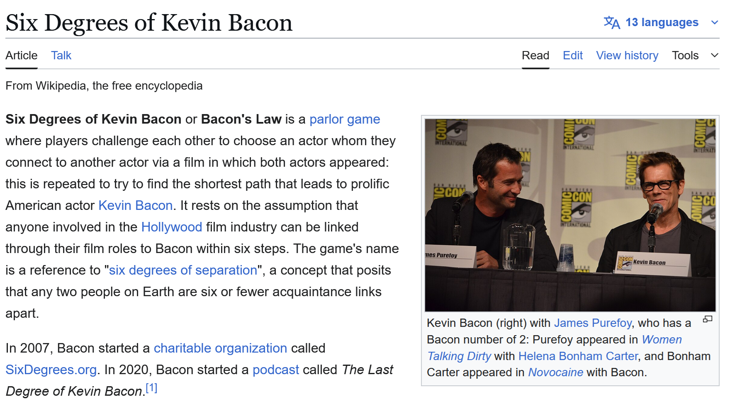
What is Lightning?
Blockchain (L1)
“Scalable off-chain instant payments”
Don’t transact on L1
(Scale without Blocksize increase)
“via a network of channels”
Offload txns away from L1
Onto: a network of micropayment channels
Using: the HTLC
Channels
2 people = 1 channel
Payer wants to pay.
Receiver wants to receive. ($)
How to entice 3rd parties to facilitate your txn? HTLC.
Lightning
HTLCs
Use HTLCs to make use of other people’s channels.

Slide 6
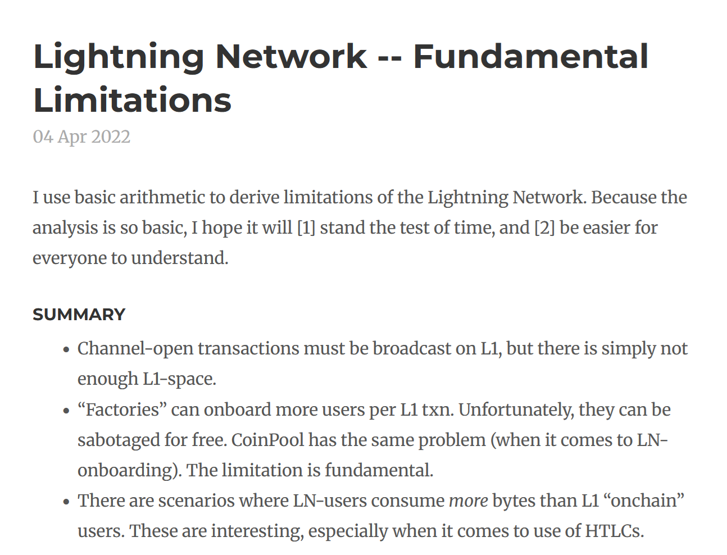
The Channel Idea & the HTLC Idea Both Don’t Work

Slide 7
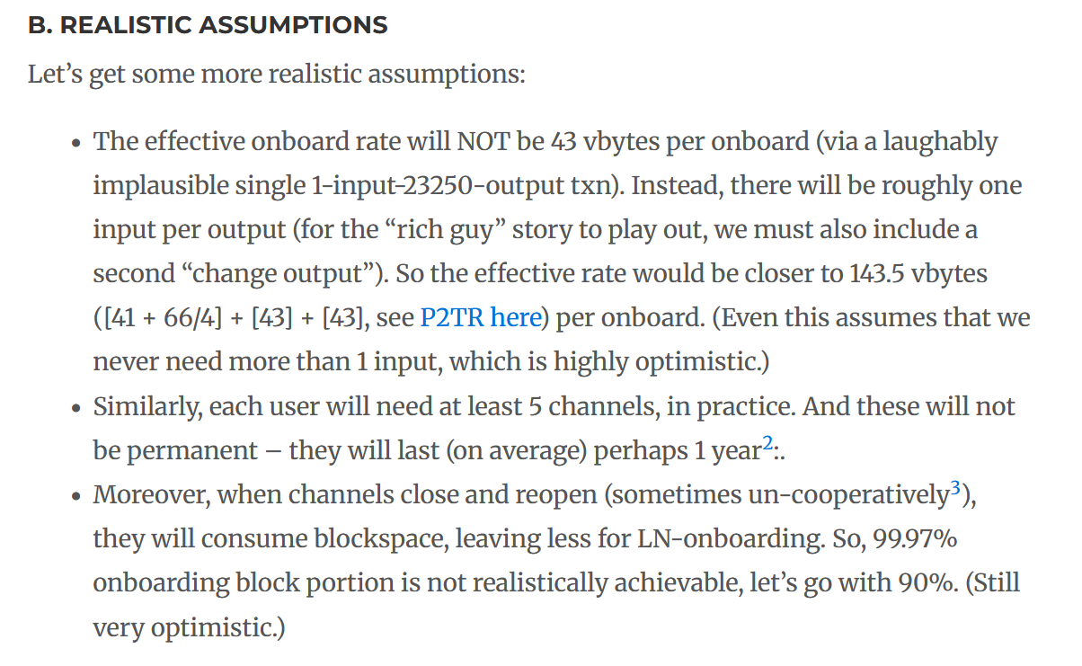
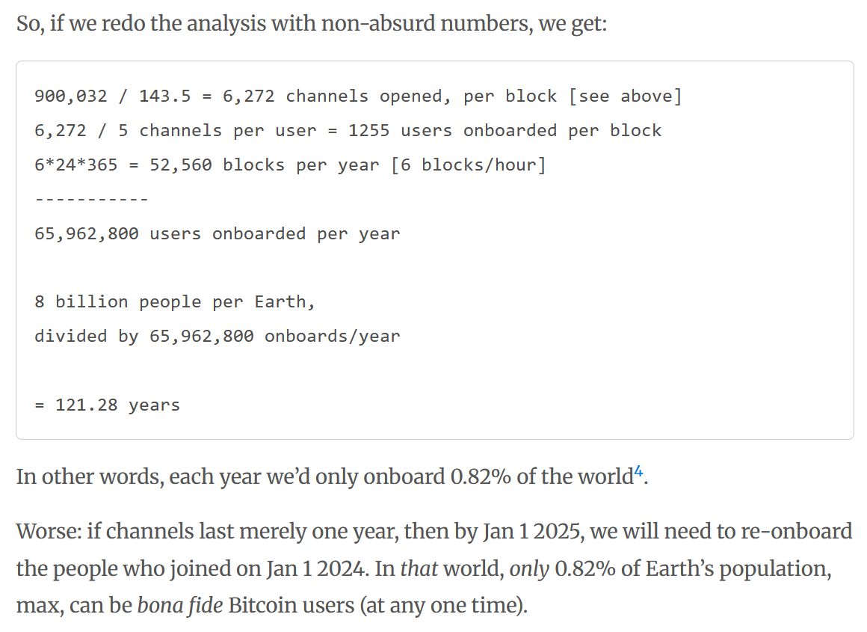
Channels

Slide 8
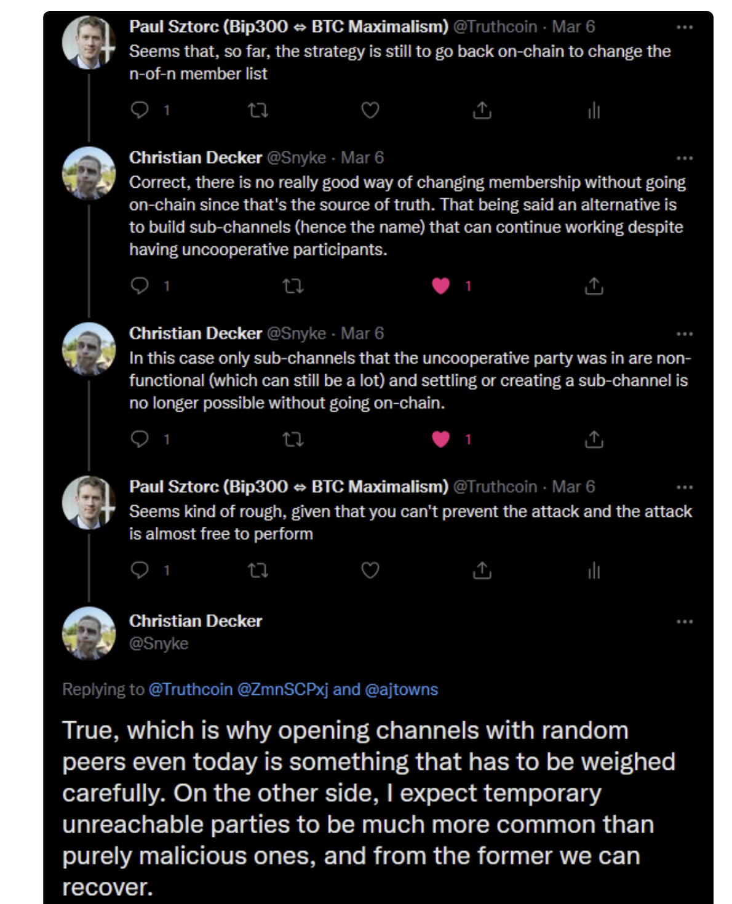
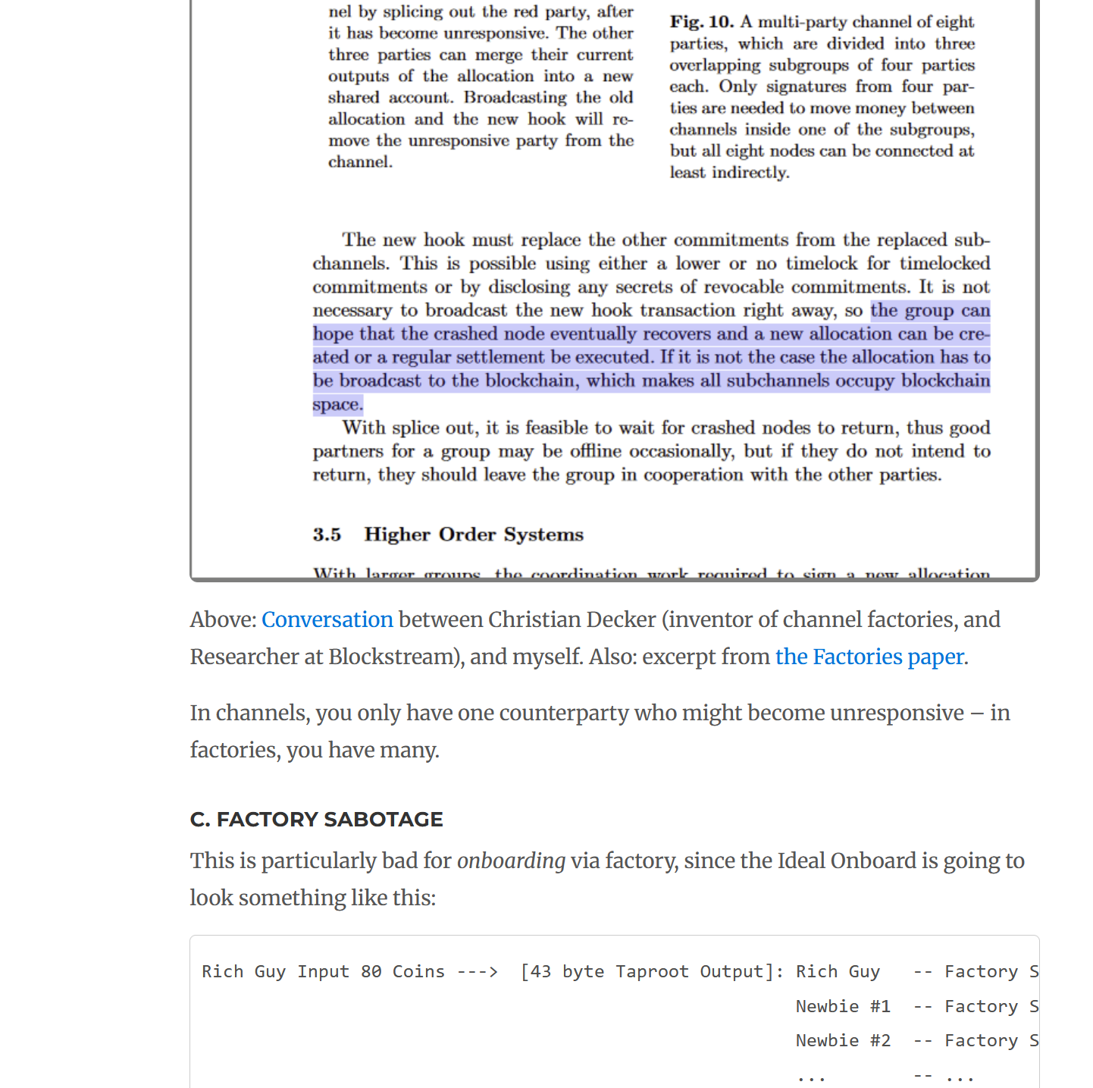
Do channel factories help? No

Slide 9
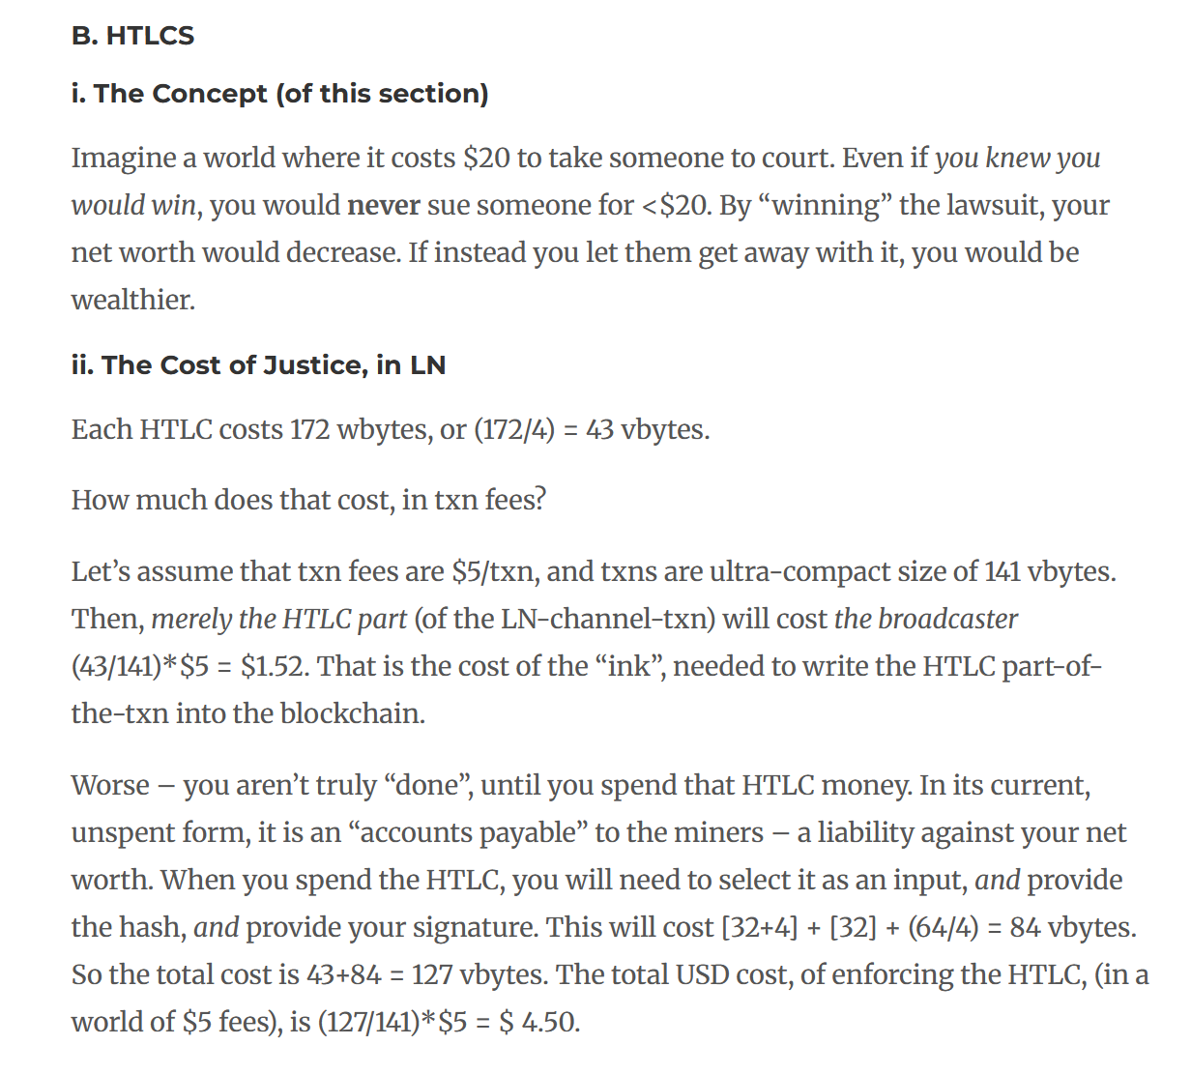
HTLCs
HTLCs hurt your bottom line
They expand the size of two transactions you need to broadcast in order to claim the money.
Catch-22
When fee-rates are high, you can’t use HTLCs. And the “network” of channels is useless.
When fee-rates are low, you can just use on-chain txn. LN is uncompetitive.

Slide 10
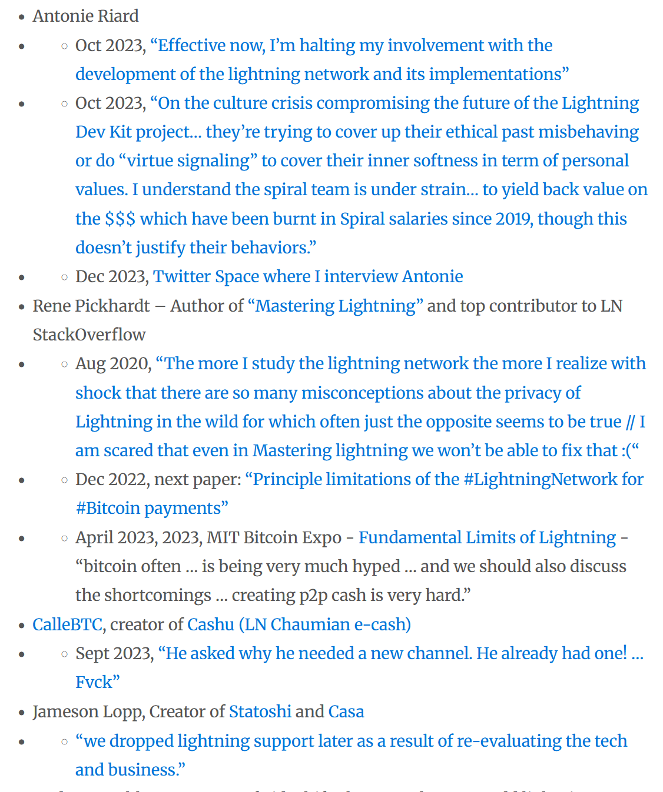
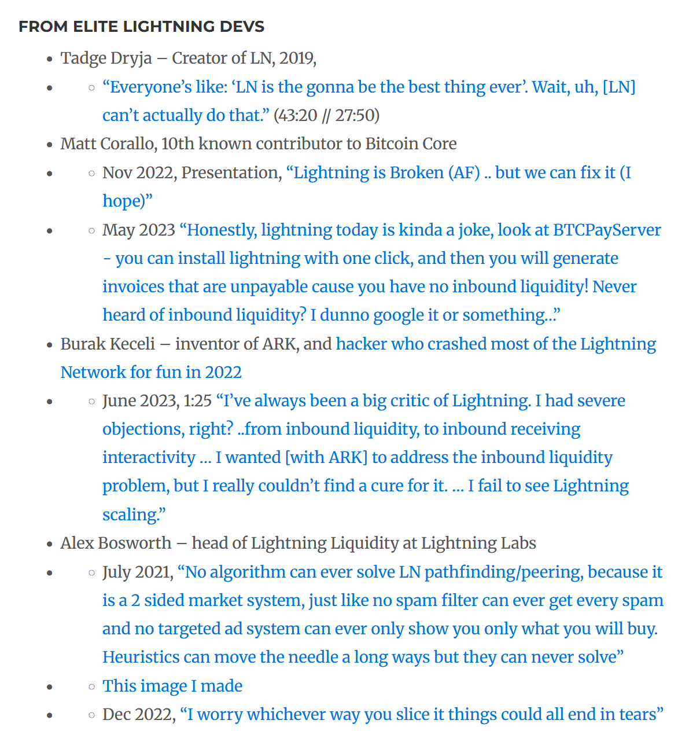
Don’t Take My Word For It

Slide 11
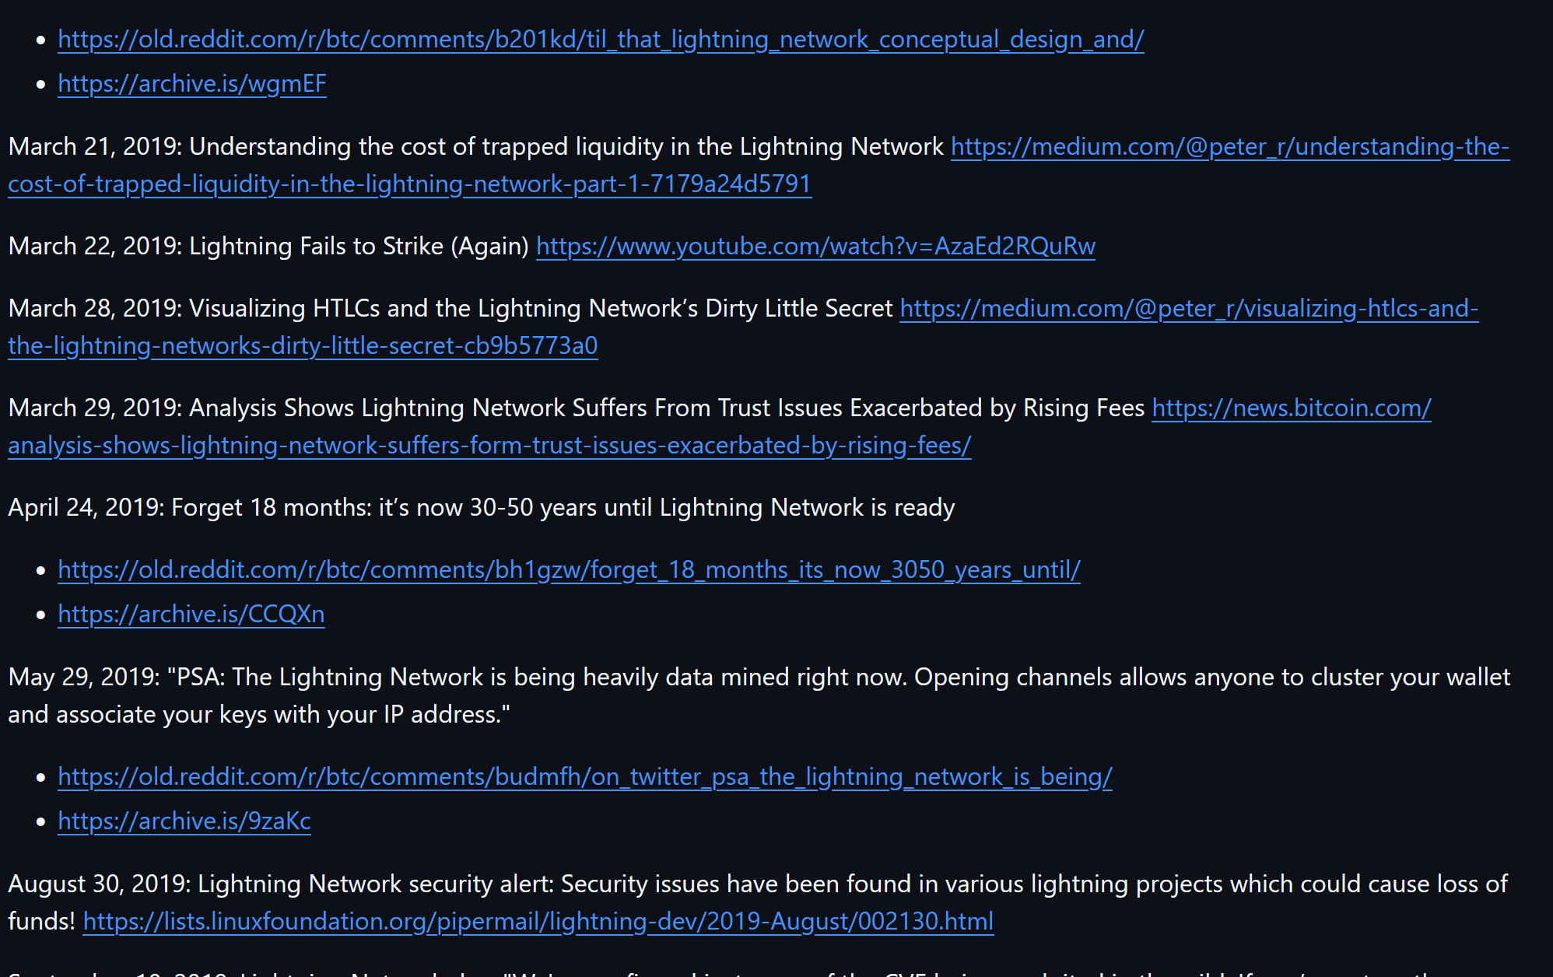
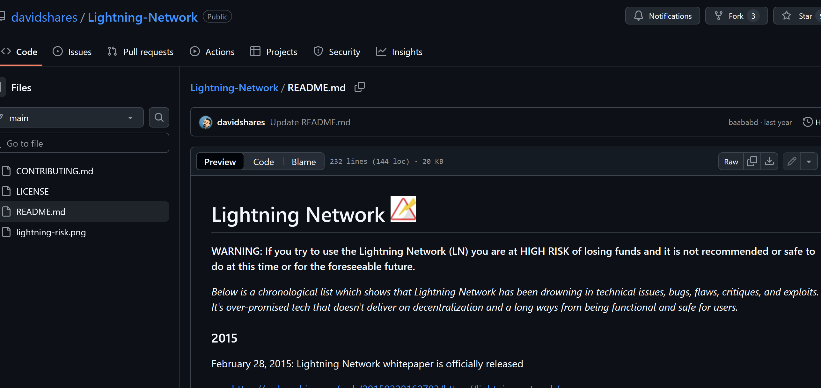
Other People Have Made Similar Lists

Slide 12
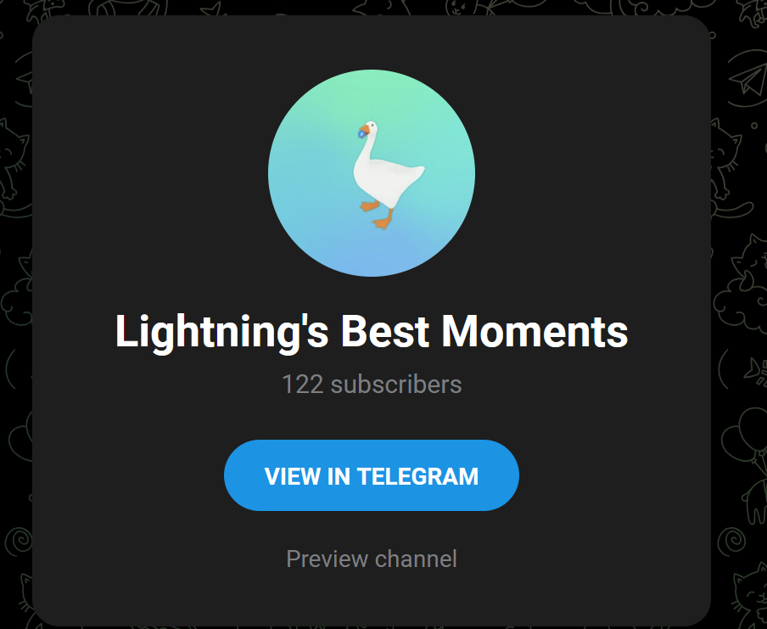
t.me/LightningFantasy

Slide 13
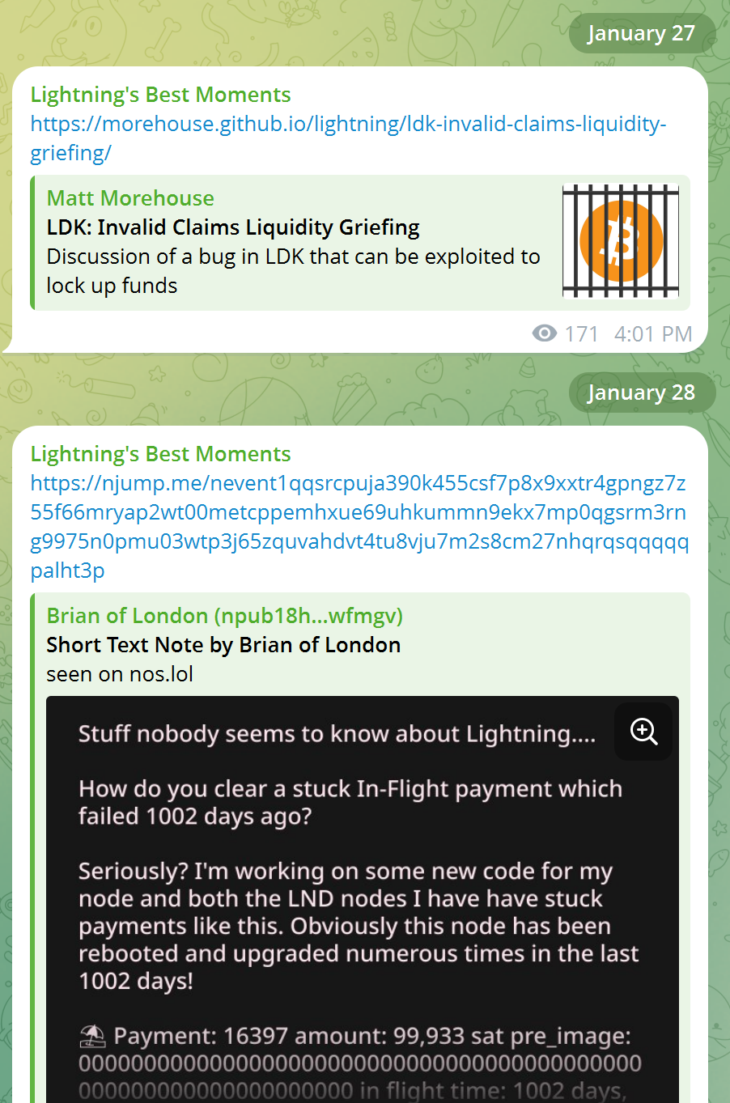
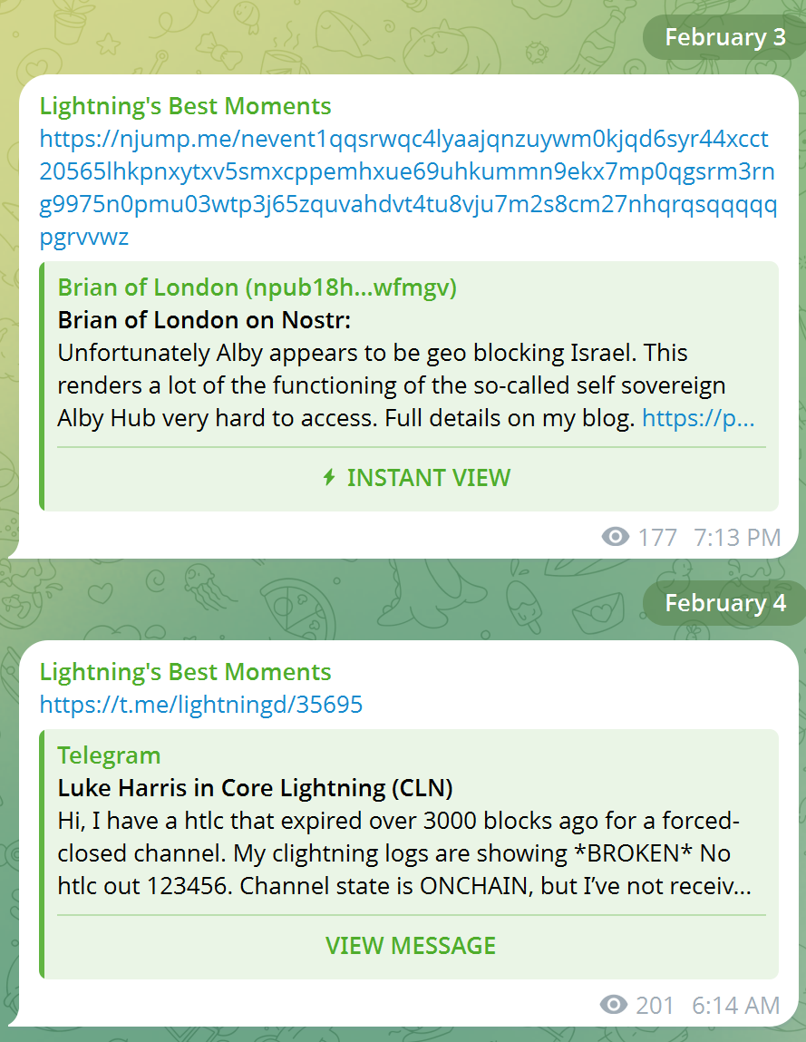
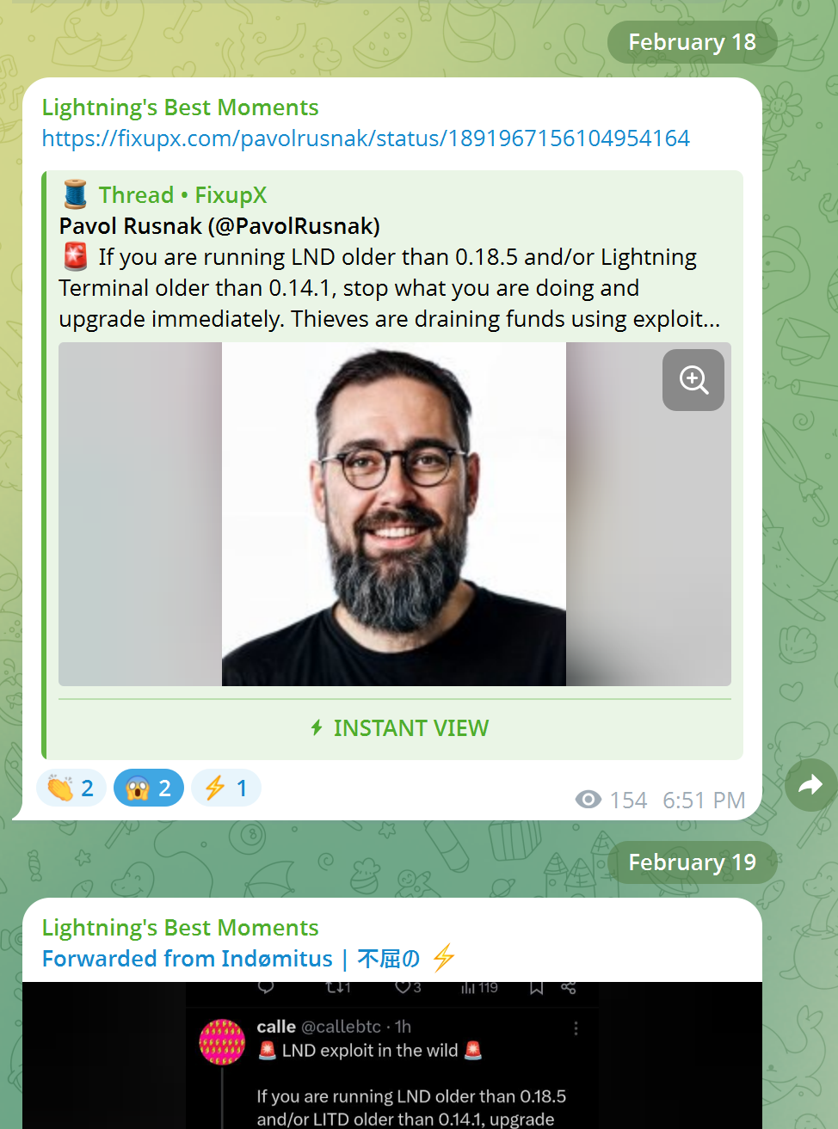

Slide 14
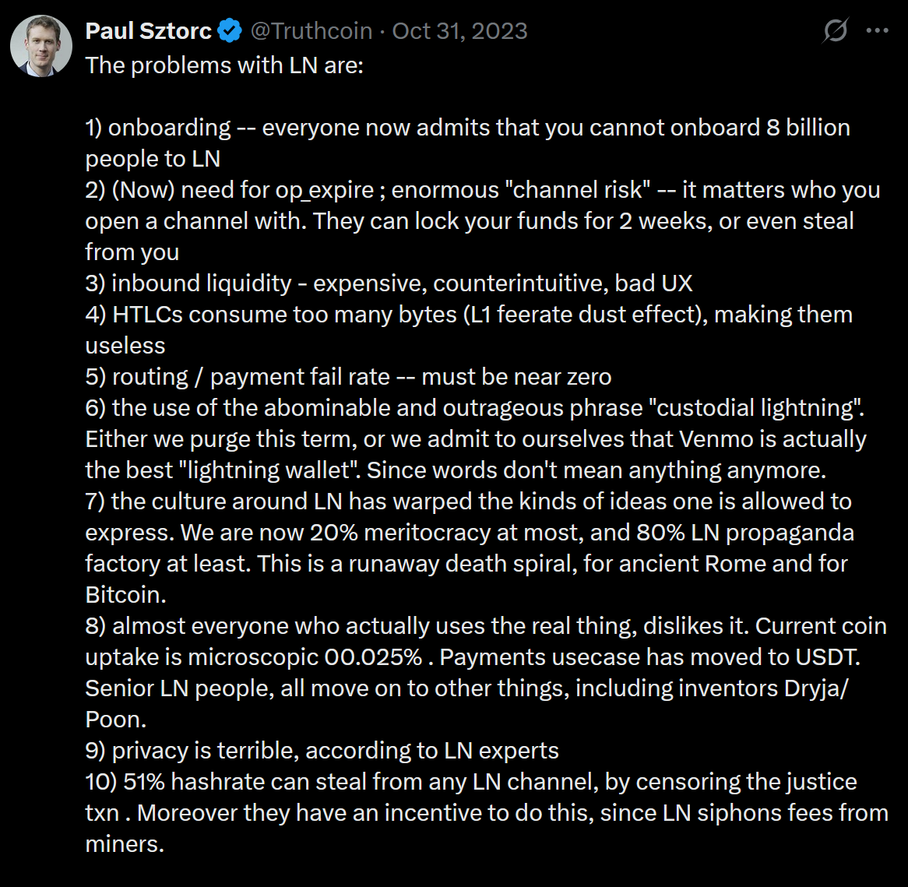
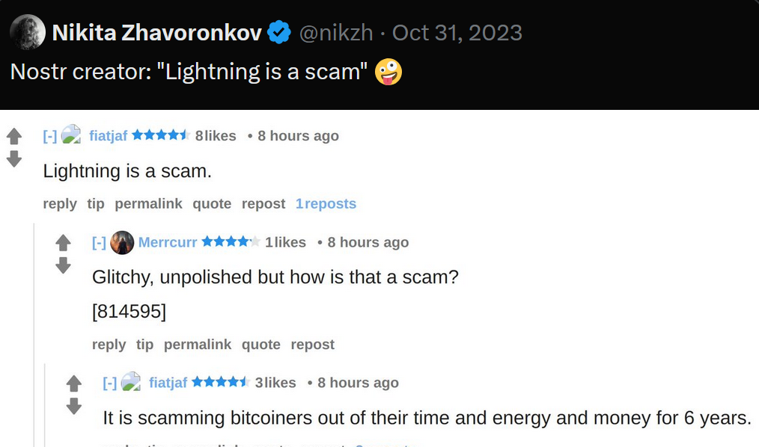
A Tweet

Slide 15
Some Other Points (Quickly I Hope)….

Slide 16
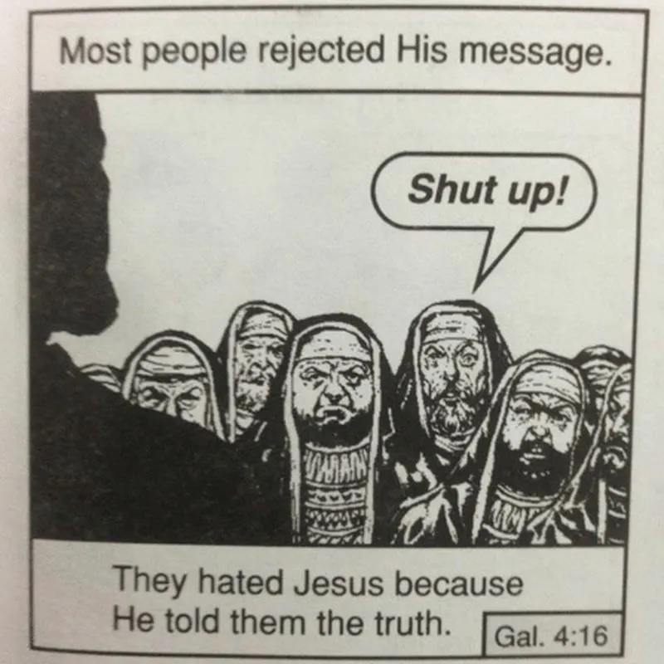
Lightning Derangement Syndrome
Lightning Sucks
You tell the truth about how it sucks.
People get angry, and defensive, and they say: you suck.
As a result: lightning evades future criticism – because people don’t want to put up with being harassed by idiots.
We are all lying to ourselves.

Slide 17
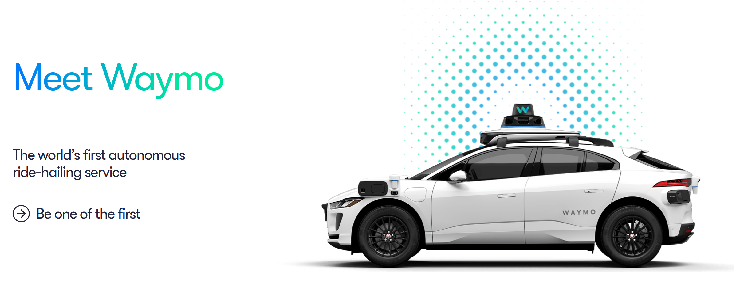
Custodial Lightning
Imagine getting in a “driverless Waymo”…
…and yet – lo and behold – a human driver, is in the front seat.
He drives the car to your destination (with his eyes and hands).
Finally, as you leave…the driver says: “Waymo is the future of taxis; because a computer can drive cheaper and safer than any human driver”.
You would immediately think:
“Wow, this guy is SO stupid, that it’s a waste of my time to even talk to him.”
And what would you say? Out loud? Probably: “Yeah – thank you. See you later! Bye.”
Custodial = all the proof of work, blockchain, key management – it is all a waste.
When we are born, we cry – that we are come to this great stage of fools. – William Shakespeare

Slide 18
Types of Problems
Every new technology has problems.
Examples of unrelated (normal) problems:
“We hired the wrong guy, he had a bad work ethic. We fired him, but it has set us 4 months behind schedule.”
“The idea is new, and our customers aren’t used to it yet.”
“I underestimated how much work it would be to finish.”
In contrast, these are examples of a problem related to the heart of the idea:
“Hi everyone, we just noticed that it is possible to attack a lightning channel by doing New Thing XYZ. This attack imposes a new cost (or risk) on the channel-owner. Luckily, we can fix the problem (I think) with New Complex ABC solution (which is also brand new and you’re all hearing about it for the first time, right now).”
The LN problems (pinning, liquidity, flood-and-loot, etc) are this second type.
“Vitalik has said he will fix it” | BitShares technical whack-a-mole.

Slide 19
The Appearance of Success
Date | Event
2003–2004 | Elizabeth Holmes founds Theranos as a 19-year-old Stanford dropout. It promises to perform hundreds of blood tests with just a finger prick of blood.
2004–2007 | Raises $6.9 million at a $30 million valuation; by 2007, raises $43 million at $197 million valuation.
2009–2011 | Holmes recruits a star-studded board—former Secretaries of State Henry Kissinger and George Shultz, General Jim Mattis, and former top executives like Richard Kovacevich. This lends enormous credibility to Theranos despite their lack of scientific expertise.
2010 | Theranos achieves a $1 billion valuation by 2010 as it continued raising funds.
2013: Public Launch and Media Blitz | Theranos emerged from stealth mode with a strategic PR wave. Holmes appeared in major outlets like Fortune, Forbes, and TEDMED, presenting herself as a visionary. The press mostly echoed the company’s claims without peer-reviewed validation.
2014 (10 years in) | Theranos reached an almost $9–10 billion valuation, raising over $400 million in funding and making Holmes one of the richest self-made women on paper. High-profile investors such as Rupert Murdoch, the DeVos family, and the Walton family each invested tens to hundreds of millions of dollars. Walgreens and Safeway signed partnerships to bring Theranos tests to retail clinics. This is seen as proof of scalability and trustworthiness.
Early to Mid-2015: Mainstream Acceptance | The company’s technology was increasingly adopted in pilot programs. Health insurer Capital BlueCross designated Theranos as a preferred lab provider for 725,000 customers in Pennsylvania—one of several corporate deals suggesting industry validation. The firm advertised performing over 200 tests from a few drops of blood.

Slide 20
Simulation
With drivechain / Bip300 – I have actually simulated what the L2 network would look like, with 8 billion daily users.
As a result, we can actually see:
How many coins are on each L2?
What Txn fee does each user pay?
How does the software perform?
What are the bandwidth requirements and full node requirements?
What is the ratio of L2 txns to L1 txns?
How much revenue is earned by miners?
Why doesn’t lightning do this? (Because it’s not even possible.)

Slide 21

“But -- users don’t want to use Bitcoin to transact. They use it as a store of v--”
Well just don’t talk about lightning then!
Reality: This is cope/lame. Blame the users! For your shitty product. Anything to evade taking responsibility.

Slide 22
Make Your Choice
Orthodox View | My Alternative
Channels work. They are the future of Bitcoin. Problems will be solved with engineering. | They don’t work. It’s a waste of time. The engineers are playing pretentious games.
Paul is here to FUD lightning and shill Drivechains. Paul wants more clout / attention, so that he can get Bip300 activated. | Tidwell had to practically drag me here, I have very little interest in doing this. LN will collapse on its merits ; and Bip300 will activate without code changes to Core – and it will do so because of its affect on miner revenues, ASIC valuations, and UX. I don’t need anything from you.
Everyone just can’t be wrong! Lightning has all these smart and nice people. Is Paul really smarter than everyone in lightning? Probably not. | LN came from the Blocksize war and is inherently propaganda. It will never shed this baggage. People are emotionally unwilling to admit they are wrong. Leading to peer pressure. Groupthink/ cults are common. The prestige economy / funding bias exacerbates this.
Paul did invent his own Lightning Technology in 2016 – his knowledge is now old and obsolete. | I was early. Both times: in joining LN; and in leaving. You’ll be joining me eventually.

Slide 23
Question Time
I’m making myself vulnerable – by leaving plenty of time for questions.

