Slide 1
MRA-RFM Analysis By KUNAL Sarkar

Slide 2
agenda
The Problem
Exploring the Data
Univariate / Bivariate and Multivariate Analysis
Why RFM analysis and How RFM analysis can help
Understanding customers
Business Recommendations
Strategic recommendations

Slide 3
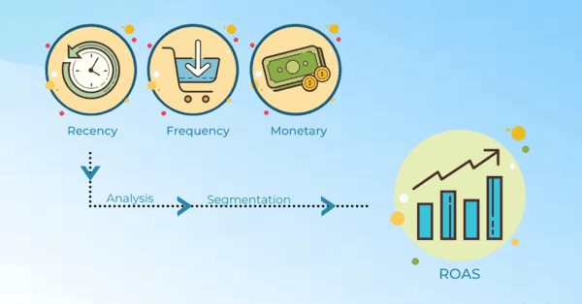
The Problem
An automobile parts manufacturing company with 3 years of transactional data wants to have a clear picture of the segments that its customers can be put to with the objective of identifying marketing opportunities appropriate for each segment for preservation and expansion.

Slide 4
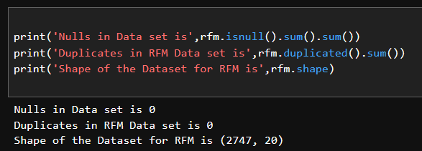
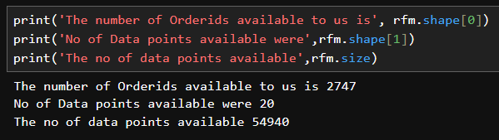
Exploring the Data
The adjacent screenshot is taken from The Jupiter Notebook, used for basic exploration of the data.
The codes used were the find Nulls, duplicates an over view of the Data, no of rows and columns along with total no of data points.
As a result, we found that there were no duplicates or nulls in the dataset.
The total Data points available were 54940 which was when total no of Orders : 2747 is multiplied by 20 data points

Slide 5
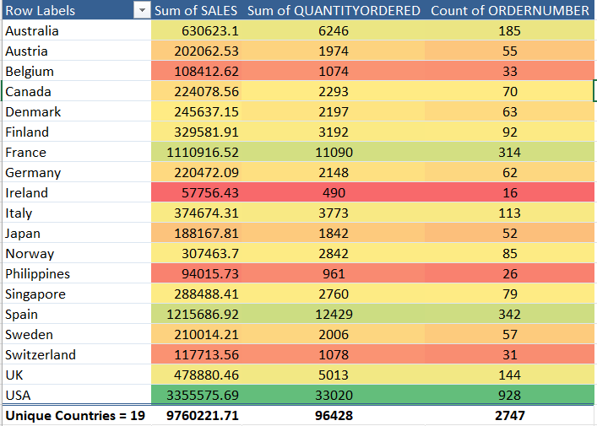
Pivoting on Global sales
The adjacent screenshot is taken from MS Excel.
Where a Pivot table was created to have a basic idea about the data available. No of countries we have customers from = 19
Highest number of orders placed was by accounts in USA with a total of 928 in 2.75 years, lowest was made by accounts in Ireland only 16.
Business implication : The enterprise can judge based on this data where exactly the products have a higher acceptance and allocate the marketing budget in response to performance

Slide 6
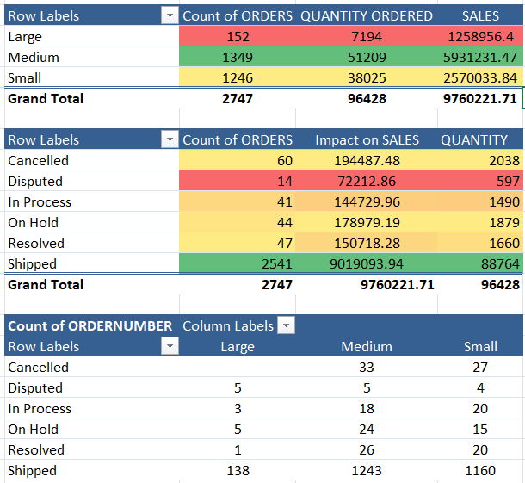
Pivot Chart on Order categories
The adjacent screenshot is taken from MS Excel.
Where a Pivot table was created to have a basic idea about the data available.
It can be observed that medium sized orders are the mostly prevalent indicative of customers preferred average volume.
It can also be observed that the no of cancelled orders and orders put on hold is quite huge when put together if added the disputed becomes note worthy.
Business implication : The organization must take note of the incidents behind the order related discrepancies in order to ensure the impact of external factors on overall revenue is minimized. As these factors impact the goodwill the most important intangible asset.

Slide 7
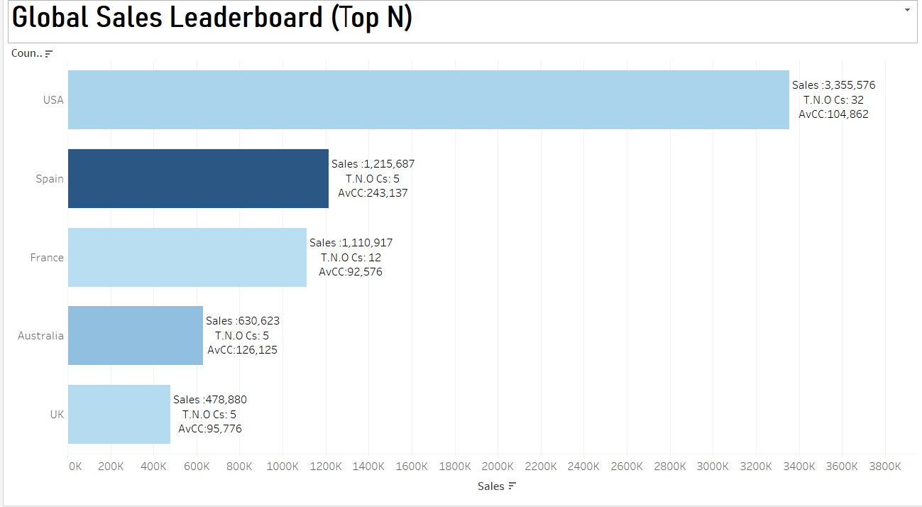

Slide 8
Global Sales Leaderboard n=5
The Global Sales Leaderboard: This chart highlights total sales and customer counts by country, revealing that United States leads with 17 customers, followed by Spain, UK and France.
High-Value Outlier – Spain: Although Spain has only 5 customers, they account for 1,215,687 in sales—outpacing the France’s 12 customers, whose combined sales barely reach 1110917.
Average Customer Contribution (AvCC): Spain tops the AvCC metric (total sales ÷ customer count), indicating that Spanish accounts deliver the highest per-customer value which is 243,137.
Business Implication: These insights suggest prioritizing marketing and support investments in Spain to capitalize on its exceptional per-account performance, while exploring strategies to boost customer value in other key markets.

Slide 9
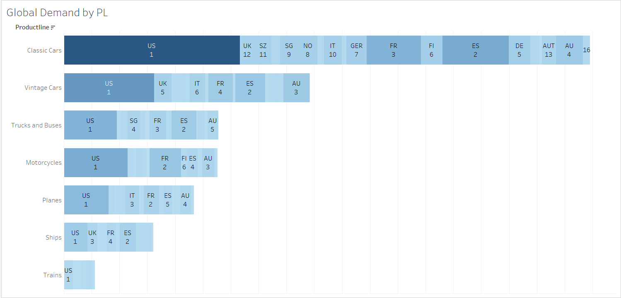

Slide 10
Global Sales Leaderboard
U.S. Market Leadership: The United States ranks first across all seven product lines, underscoring its dominant role in global demand.
Spain’s Strong Secondary Position: Spain holds the #2 spot in five out of seven categories, making it the most reliable runner-up market.
France’s Consistent Mid-Tier Strength: France places third in four product lines, second in two, and fourth in one, reflecting solid performance across the portfolio.
Emerging and Niche Markets: Australia, the U.K., Italy, Japan, and Singapore also contribute meaningfully, each securing top-four positions in various product lines.
Business Implication: These insights should guide the global outreach strategy—prioritizing the U.S. for growth initiatives, leveraging Spain’s high uptake with targeted promotions with tailored-offerings and supply-chain allocations to maximize France’s mid-market potential and emerging opportunities in Australia, U.K, Italy, Japan, and Singapore.

Slide 11
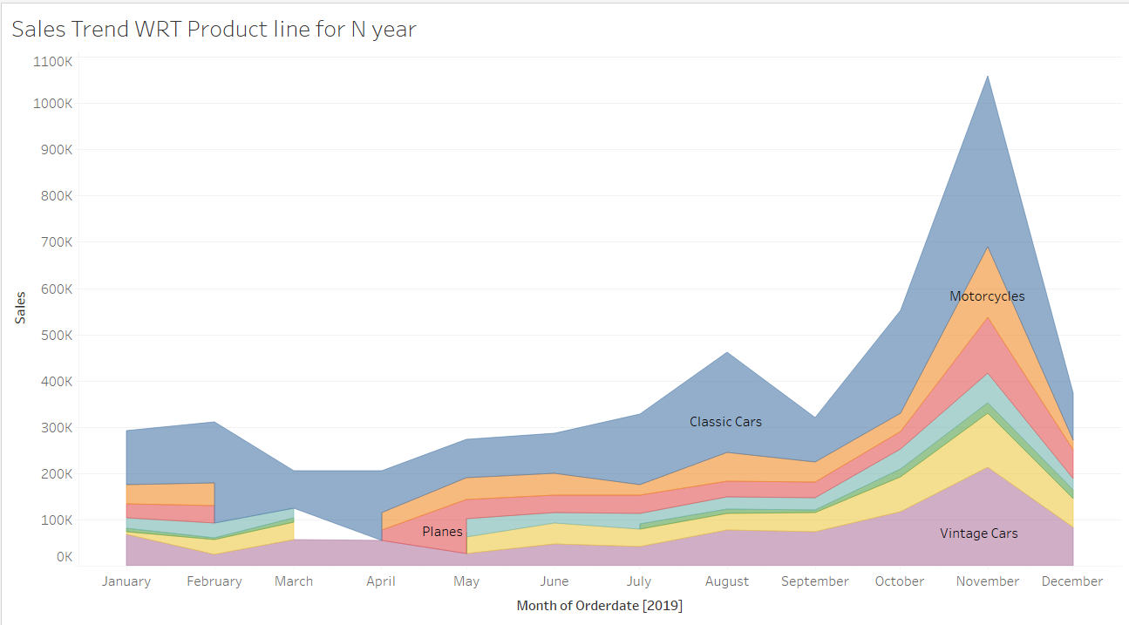

Slide 12
The Yearly Line Graph
The Overview of 2019 Sales Trends: This multi‐series line chart compares monthly sales performance across all product lines throughout 2019. Year-End Build-Up: Sales for every line accelerate beginning in October and culminate in a November peak, suggesting customers stock up ahead of the holiday and vacation season in December and January.
Mid-Year Spikes by Category:
Classic Cars, Vintage Cars & Motorcycles: Noticeable uplift in August, indicating a late-summer demand surge.
Planes & Ships: Two pronounced peaks—one in February and another in May—perhaps tied to specific shipping cycles or industry events
Vintage cars , Trucks and Buses Elevated sales from March through June.
Planes: Steady increase from May to July.
Trains : Distinct growth phases in March and again in July.
Implications for Inventory & Marketing: By pinpointing these seasonal upticks, we can optimize production schedules, tailor promotional campaigns, and adjust inventory levels to meet each product line’s unique demand cycle.

Slide 13
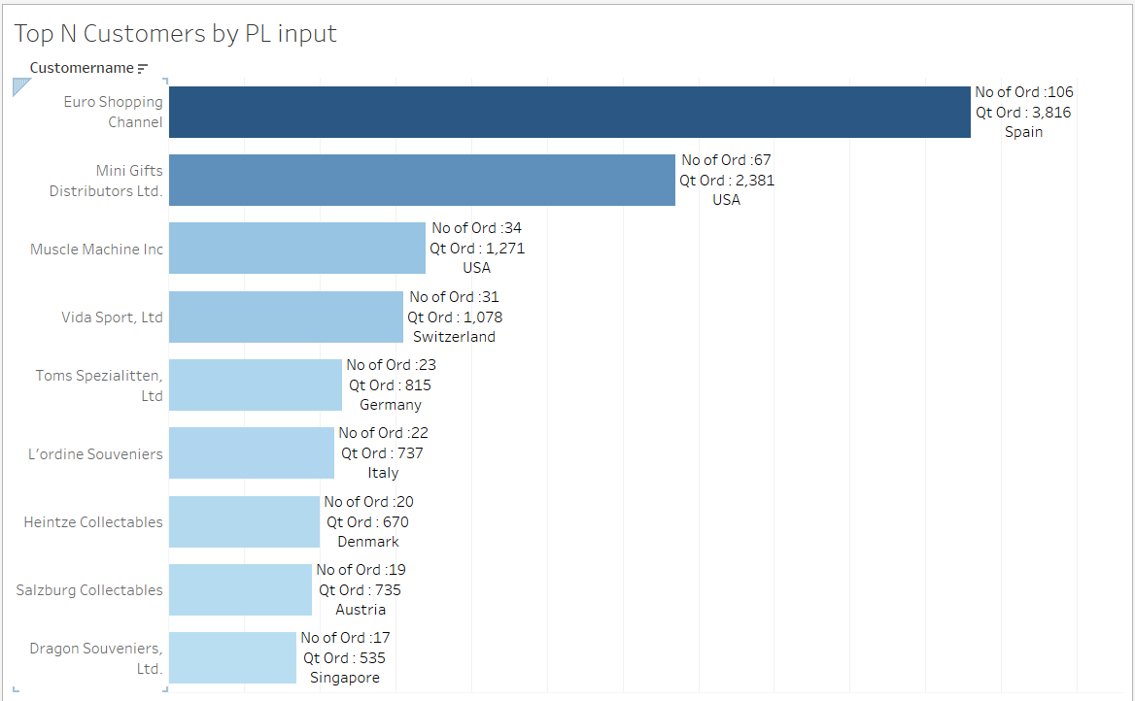

Slide 14
Customers wRT Orders
The illustration is intended to highlight the Top N(input by user)no of customers by total quantity ordered with customers belonging to X(input by the user) Product Line.
The greatest number of orders were placed by the Customer Euro Shopping Channel from Spain where the no of orders all through out the customers tenure.
Total quantity ordered =3816, number of orders = 106.
The N Value selected was 9 but interestingly there was no Product Line chosen which signifies that the chart in Tableau shows a customer who has purchased the most across all the product lines.

Slide 15
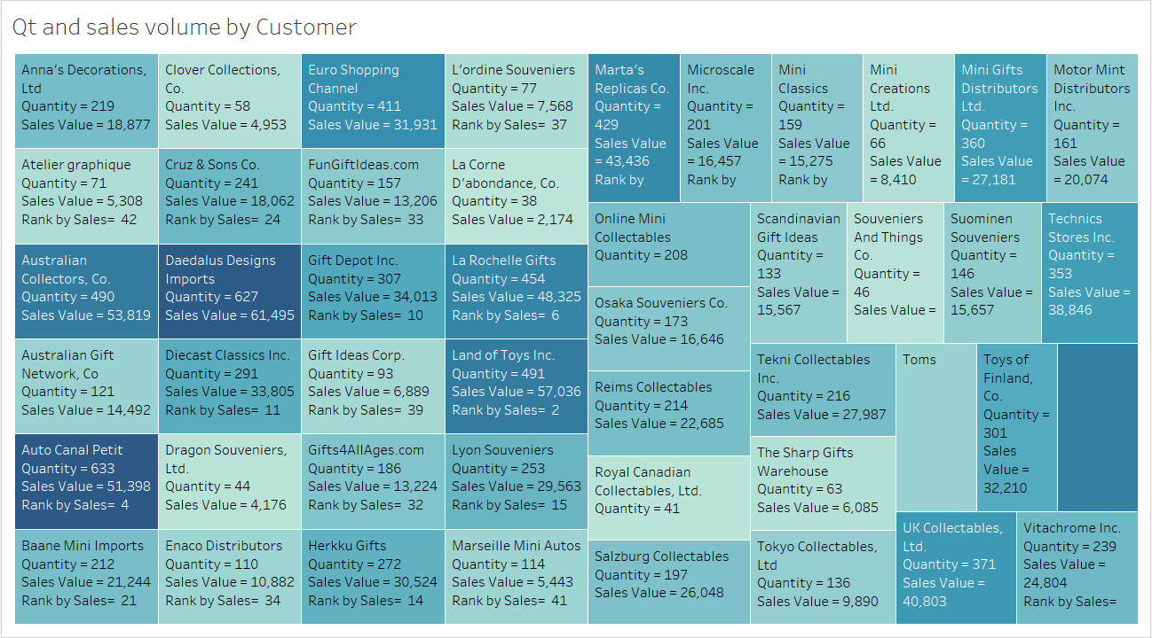

Slide 16
Customers ranked by Qt ordered
Tree map Overview: This tree map visualizes our highest-value customers by displaying each account’s total sales alongside the quantity of items ordered
Revenue Concentration: By sizing each tile according to revenue and coloring by order volume, it clearly highlights which customers contribute the greatest share of sales.
Actionable Insight: Identifying these top-performing accounts enables us to allocate premium support, prioritize strategic outreach, and tailor service levels to maximize retention and growth.

Slide 17
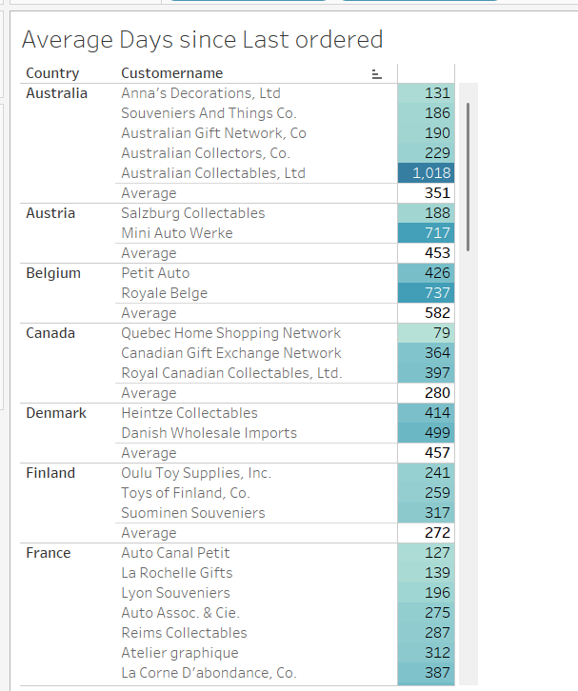
How recent are the customers
The table aims to illustrate the average of days since the last order was placed by the customers.
The days since last order metric aims to forecast how recently the customer has placed the order.
This tables helps will help the organization have an idea about the country with the highest number of active customers as the recency factor is indicative of customer’s trust and active association.
The lesser the factor more does it signify the active engagement.
Business Implication : Organization can provide the customers with loyalty benefits such as priority delivery, credit facilities.

Slide 18
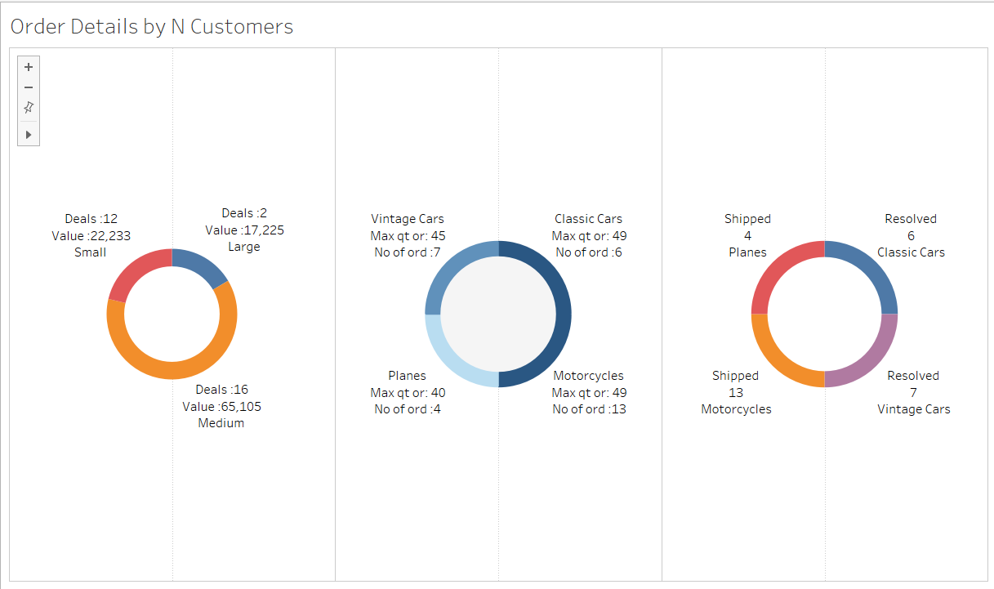

Slide 19
Order Pattern by N Customers
The illustration aims to present the details of customers entire order history in 3 donuts, the 1st about the Deal size, Total value of the deals and no of deals.
The 2nd Donut represents the max quantity ordered by the customer number of orders by Product Line.
The 3rd Donut represents the status of the order and the Product Line.
Business implication: Customers have made the most number of medium sized deals which is indicative of the customer’s preference as the most frequent order category was medium.
Product bundles can be designed to target the orders to meet the mark that not only help upsell/cross sell within the customer’s comfort.

Slide 20
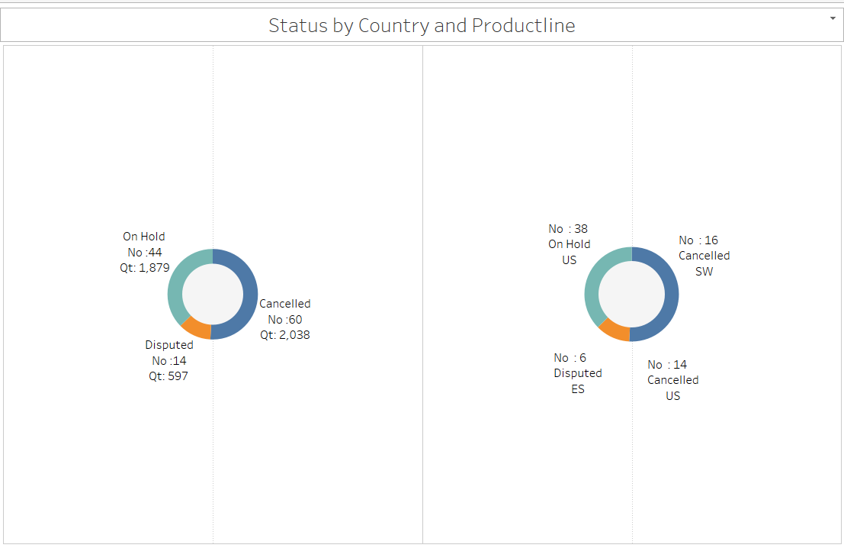

Slide 21
Countries with order disputes
The illustration aims to highlight the Countries with the highest number of orders which were either put on hold or cancelled or are Disputed.
The highest no of orders was in UK followed by USA with a big chunk kept on hold.
The objective of this illustration is to find out the reason for the cancellation and address the issue.
In the illustration a product line called ‘Classic Cars’ was chosen.
The illustration reflects an overall cancellation ratio to be at 60/2747, On-Hold 44/2747 and 14/2747 to be Disputed

Slide 22
RFM in a B2b context
In a B2B context, RFM segmentation enables the enterprise to tailor the marketing, sales and support strategies to the unique needs of each partner:
Recency highlights accounts most likely to re-order, allowing you to prioritize outreach and anticipate demand.
Frequency reflects the strength of the ongoing relationship, serving as a proxy for customer trust and satisfaction.
Monetary quantifies the financial impact of each account, ensuring that your highest-value customers receive appropriate attention and resources.
Today’s B2B enterprises must balance cost efficiency, prompt delivery, robust post-purchase support and flexible payment terms—such as credit lines or cash-discount incentives—to maintain long-term partnerships. RFM analysis empowers enterprises to identify which customers merit premium service levels, which require re-engagement campaigns and which present the enterprises cross- or up-sell opportunities. By aligning your operational and marketing efforts with each segment’s behavior and value, enterprises can both strengthen customer loyalty and optimize profitability which in the B2B landscape keep the customers hooked as sustenance is as crucial as is profit in the 21st century Business world. Thus to segment, understand and provide the partner what it wants and needs is why this analysis is so relevant.

Slide 23
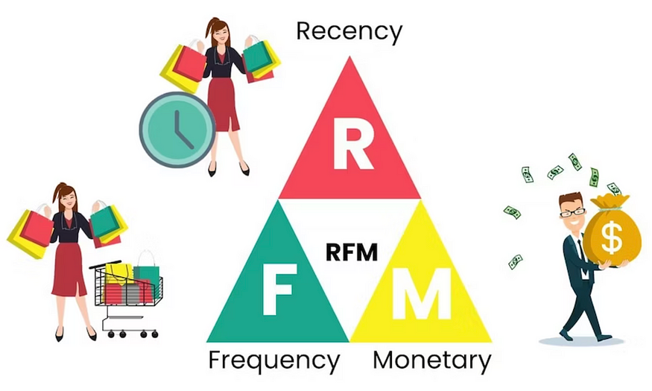
Problems that can be solved with RFM
Segments customers based on their purchase behavior.
Helps enterprise identify the segment of customers where :
Post sales service is required.
To offer cash discount
Discount on Bulk
Prioritize delivery
Opportunities of upselling.
Helps enterprise manage stock to respond to seasonal ups and downs.
Identify big ticket customers and ensure they stay associated to ensure flow of revenue.
Potential customers to formulate new partnerships and optimize revenue growth.
Decide which customers to let go.
23

Slide 24

RFM using Knime
Algorithms Used
Group BY : Used to group the data by the most important factors.
Auto Binner : To statistically segregate the data based on a calculated bin size.
Value Lookup : To re-arrange the value reciprocating the logic used in binning

Slide 25
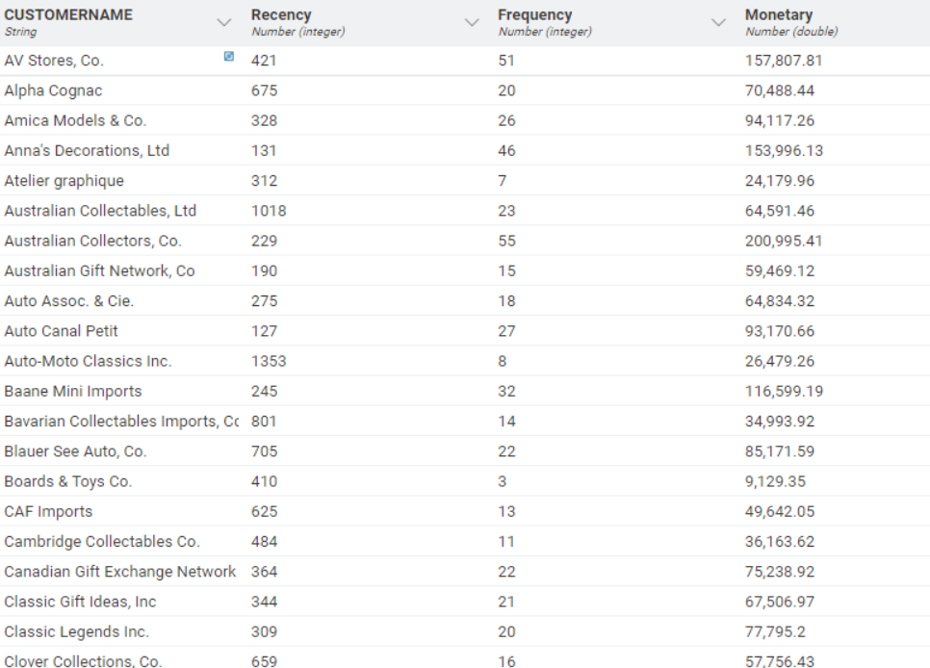

Slide 26
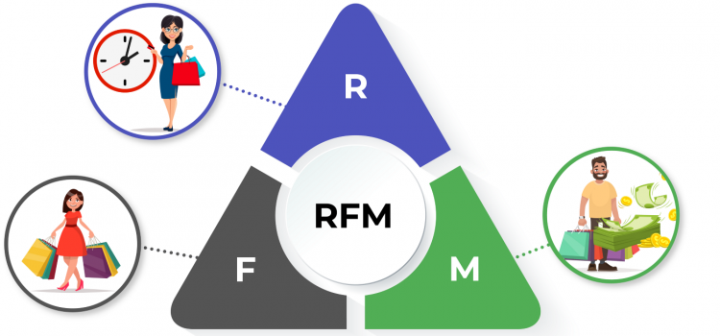
Navigating through the output
The preceding screenshot was captured from the KNIME analytics platform, where we’ve applied statistical techniques to segment customers along the three core RFM dimensions—Recency, Frequency, and Monetary value.
Within KNIME, we leveraged built-in nodes to cluster customers by their most recent purchase date, highest order counts, and greatest total spend.
Segmenting the customer based on their purchase pattern will then help us further segmenting the analyzed data with a rank.

Slide 27
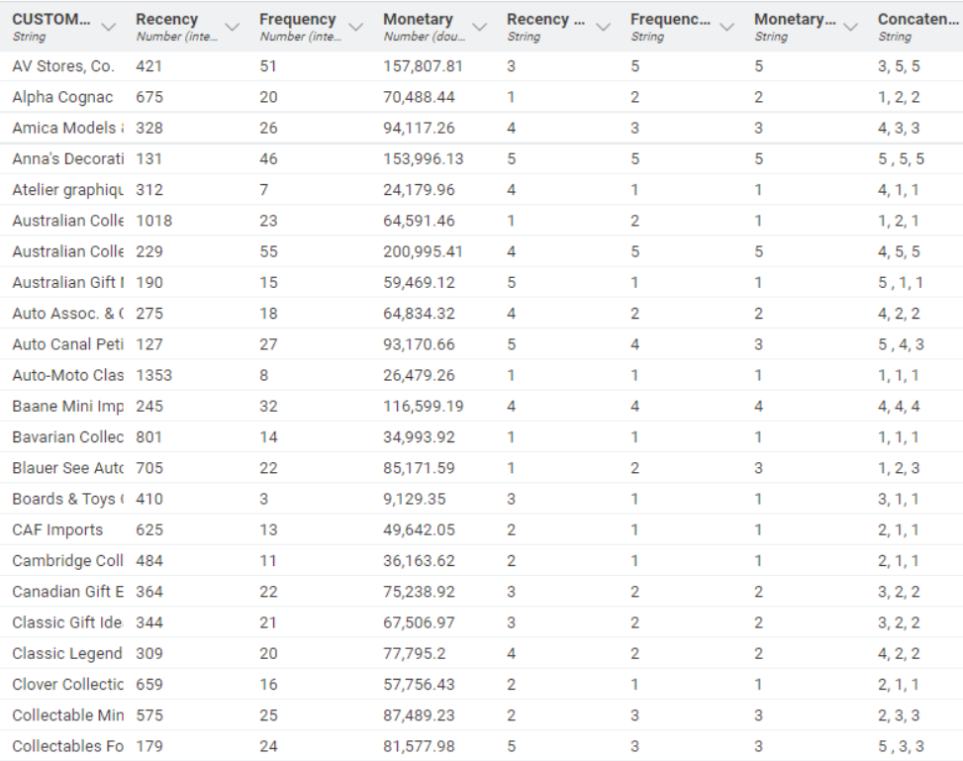

Slide 28

Ranking the outcomes
Each R, F, and M metric is translated into a ranked score—using consistent business logic—to classify every customer into an RFM segment.
Business Implications: This structured ranking enables precise targeting and tailored strategies for each distinct customer group.
The Recency Factor : The lesser the better.
The Frequency & Monetary Factor : The higher the better

Slide 29
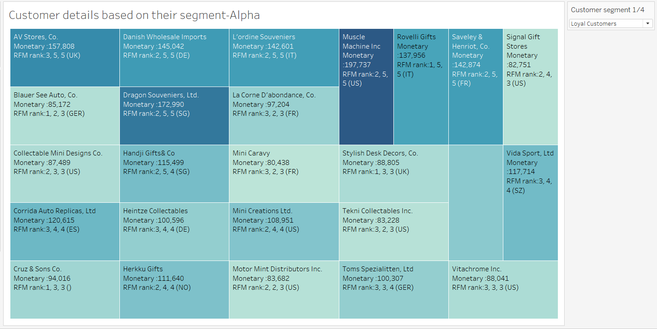

Slide 30
The Core analysis
After statistically churning out the RFM ranks we are going to create segments based on logical understanding of the outcome
We have 5 segments for the entire customer base
The New Accounts : Customers with very good(Low) Recency score. This customers logically have found us for the first time and have made a trial purchase or an emergency purchase which logically means that their Monetary score will range from low to medium and Frequency score would as well be low
Big spenders : The Customers who believe in bulk purchase and prefer to purchase on off seasons to leverage the price cuts announced. These Customers will have low to medium Recency and Frequency value but very high Monetary value.
Loyal Customers : These Customers buy repeatedly from the same vendors to reap the benefits of customer loyalty. They have an above medium to high Frequency and recency value with low to Medium Monetary score.
Accounts at risk : These accounts have once transacted frequently or only purchase to meet their seasonal shortfalls but have discontinued for various reasons. These accounts can have dynamic monetary score will have very bad Recency score and Frequency score.
Churned: Customers who have already left the system.

Slide 31
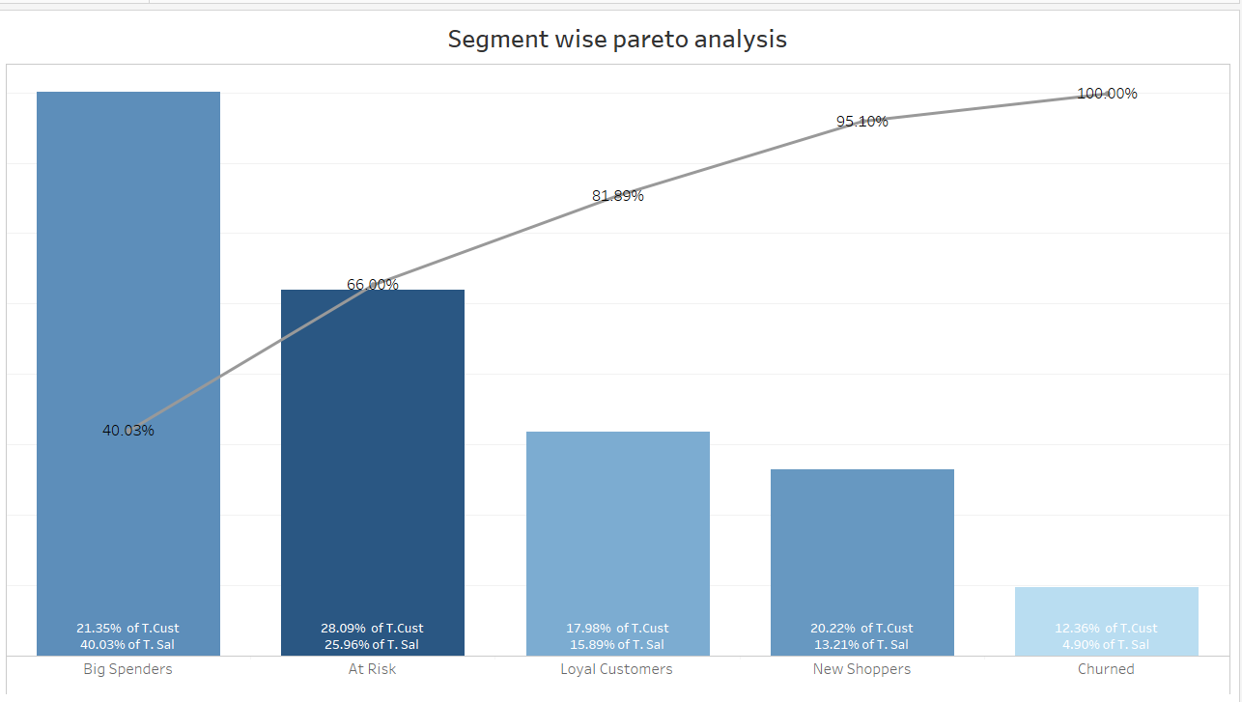
Understanding the contribution
We can clearly observe that the 40.03% of the Total sales is single handedly spearheaded by the big spenders, who are 21.35% of the population.
Loyal Customers contribute to 15.89% of the total Sales who are 17.98% of the pop’.
New shoppers constitute 13.21% of the total Sales who are 20.22% of the pop’n.
If we combine these 3 the total population% combined = 59.55% and % contribution to Sales = 69.13 %.
If we combine the At risk% of population that would be 95.08%

Slide 32
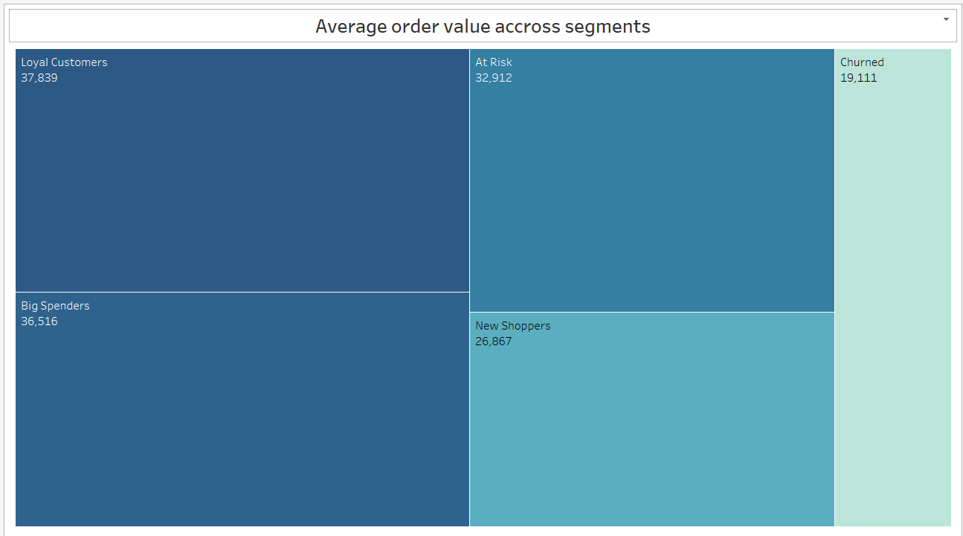

Slide 33
Marketing Budget allocation
The marketing plan should be designed primarily keeping in mind the very interests of the Big spenders and Loyal Customers because that would secure 50% of the sales.
The second priority should be the customers at risk and New shoppers as they would bring the other 45% of the Revenue.

Slide 34

Recommendations for cRM
Customized Engagement Strategies by Customer Segment
New Accounts
Incentives: We can offer introductory cash‐discounts and delivery credits to encourage repeat ordering.
Value Add: We can provide complimentary seasonal demand forecasts to demonstrate the commitment to helping them navigate peak periods.
Rationale: These clients are either trialing our products, addressing one-off shortages or entering new markets—early rewards and planning support will build trust and loyalty.
Loyal Customers
Flexible Terms: We can extend revolving credit lines and instant bulk‐order discounts.
Bundled Offers: We can create tailored product bundles with preferential pricing.
Logistics Perks: We can also include expedited shipping or free delivery thresholds.
Rationale: Sustaining these high‐frequency buyers is critical—they form the foundation of steady revenue.

Slide 35

Customized Engagement Strategies by Customer Segment
3.Big Spenders
Premium Recognition: We can send guaranteed gift incentives or VIP rewards on their next purchase to accelerate reorder cycles.
White-Glove Service: We can provide dedicated post‐sales support and priority in technical assistance.
Infrastructure Subsidies: Offset warehousing or storage costs for top-tier accounts to enable larger, more frequent orders and position them as regional hubs or dealers.
Rationale: These high-value clients drive a disproportionate share of revenue; exceptional treatment cements long-term partnerships and frequent engagements.
4.At-Risk Customers
Re-Engagement Campaigns: We can deploy personalized newsletters and targeted promotional schemes to recapture their interest.
Win-Back Offers: We can combine time-limited discounts with service guarantees (e.g., faster turnaround, dedicated account check-ins).
Rationale: Proactive outreach can reverse early signs of churn; where it fails, you’ll have clarity to reallocate resources effectively..

Slide 36
Strategic recommendations
Strategic Recommendations
Super-Stockist Program in Southern Europe
Target Markets: Spain, France, Italy, and the U.K.
Action: We can identify and appoint high-performing Spanish accounts as “Super-Stockists” to centralize regional inventory, streamline intra-Europe shipments, and reduce per-unit logistics costs.
Benefit: Leverage Spain’s outsized per-account spend, lowers cross-border freight expenses, and ensures rapid local fulfillment without inflating end-customer prices.

Slide 37
Strategic recommendations
2. Bulk-Purchase & Credit Facilities for U.S. Accounts
Target Markets: United States
Action: We can roll out tiered bulk-order discounts and extend short-term credit lines for strategic U.S. partners.
Benefit: Encourages higher purchase volumes from America’s many lower-average-value accounts, boosts overall order size and strengthens long-term customer loyalty through flexible payment terms.
Bulk purchase opportunities to accounts in USA as they are the leaders across all the product lines but their individual average account contribution is low. Providing credit opportunities on bulk purchase.
Opening a manufacturing cum recycling / post sales service unit in USA might seem profitable as accounts in USA purchase the most, collecting the spare parts and re-using them on products might prove to be a trust booster for the customers and also tackle wasteage or logistics related concerns.
Integrated Service & Recycling Hub in North America
Target Markets: United States
Action: We can establish a combined post-sales service and parts-recycling center to collect, refurbish, and redeploy components.
Benefit: Enhances customer trust by offering rapid maintenance support, reduces waste and logistics complexity, and creates a new revenue stream from remanufactured spare parts.

Slide 38
Thank you
Kunal Sarkar
9903779913
iamkunalsarkar@live.com

