Slide 1


CS F437 - Generative Artificial Intelligence
Mamba
Linear-Time Sequence Modeling with Selective State Spaces
Paper Study & Partial Reproduction
Krish Mathur • Sahid Alam • Yashraj Soni • Tanya Khathuria • Pranshul Arora
Gu & Dao (2023) • arXiv:2312.00752

Slide 2
Agenda
Paper study • Implementation • Reproduction results
01
The Core Problem & Motivation
07
Limitations of Mamba
02
State Space Models — Background
08
Our Reproduction Approach
03
Mamba Innovations
09
Implementation & Workflow
04
Paper Benchmark Methodology
10
Our Benchmark Results
05
Key Results from the Paper
11
Mamba-2 & Mamba-3 Lineage
06
Mamba vs Transformer
12
Conclusion & Future Directions
Two-part structure: paper study → experimental reproduction
Generative AI Course Project • Mamba Reproduction
2 / 24

Slide 3
The Core Problem
Why a new sequence model was needed in 2023
Transformers scale quadratically
Attention is O(n²) in both compute and memory with sequence length n.
KV-cache explodes for long context
Inference memory grows linearly with every generated token; long contexts are impractical.
Prior SSMs were too rigid
S4 and HiPPO were efficient but content-agnostic — they could not selectively focus or forget.
Compute / memory vs sequence length
O(n²) Transformer
O(n) Mamba (selective SSM)
cost
sequence length →
Quadratic-vs-linear scaling intuition (Gu & Dao, 2023)
Generative AI Course Project • Mamba Reproduction
3 / 24

Slide 4
Motivation
Requirements for a modern sequence model
01
02
03
04
05
Linear time
Long memory
Selectivity
Constant state
High throughput
Must scale O(n) with sequence length
Capture long-range dependencies reliably
Decide what to keep or forget per token
Bounded memory at inference time
Practical for real generative AI workloads
Goal: match Transformer quality while scaling linearly in sequence length.
Gu & Dao (2023) — Section 1, Introduction
Generative AI Course Project • Mamba Reproduction
4 / 24

Slide 5
State Space Models
Background • HiPPO → S4 → Mamba
Continuous dynamical system, discretized for sequences
Treats input as a continuous signal, then discretized for neural networks.
Hidden state compresses entire history
Fixed-size state h_t carries information forward — no growing cache.
HiPPO and S4 laid the foundation
Provided principled long-range memory and efficient O(n) computation.
Linear time, constant memory
Theoretical edge over O(n²) attention.
But — content-agnostic dynamics
Fixed (A, B, C) parameters can't selectively focus or forget.
Linear State Space Recurrence
Continuous (s4-style):
h′(t) = A · h(t) + B · x(t)
y(t) = C · h(t)
Discretized recurrence:
h_t = A̅ · h_{t-1} + B̅ · x_t
y_t = C · h_t
Linear in n, constant memory — but A, B, C are fixed (input-independent).
Gu et al. (S4, HiPPO) — foundations cited in Mamba (Gu & Dao, 2023)
Generative AI Course Project • Mamba Reproduction
5 / 24

Slide 6
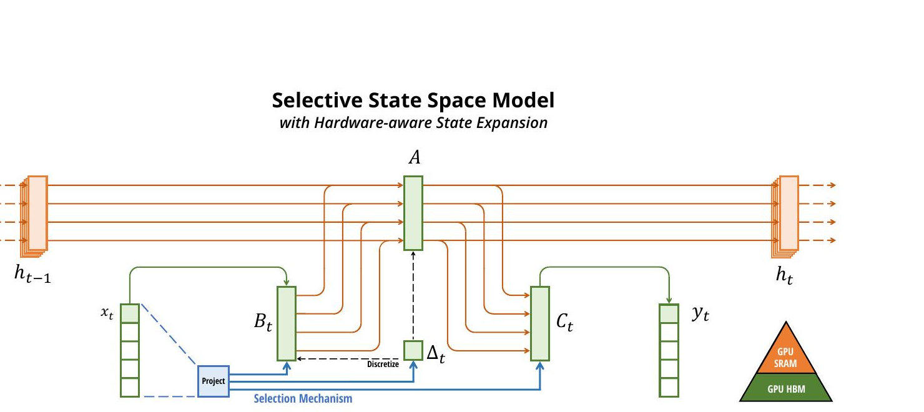
Mamba Innovation — Selective SSM (S6)
Input-dependent parameters enable content-based reasoning
What changed
B, C, Δ become functions of the current input token x_t
Model can selectively propagate or forget information
Solves the content-blindness of prior fixed SSMs
Hardware-aware scan keeps the recurrence efficient
Selection mechanism
Input-dependent dynamics
B_t , C_t , Δ_t = s(x_t)
Parameters depend on the current input.
Figure 1, Gu & Dao (2023) — Selective State Space Model overview
Generative AI Course Project • Mamba Reproduction
6 / 24

Slide 7
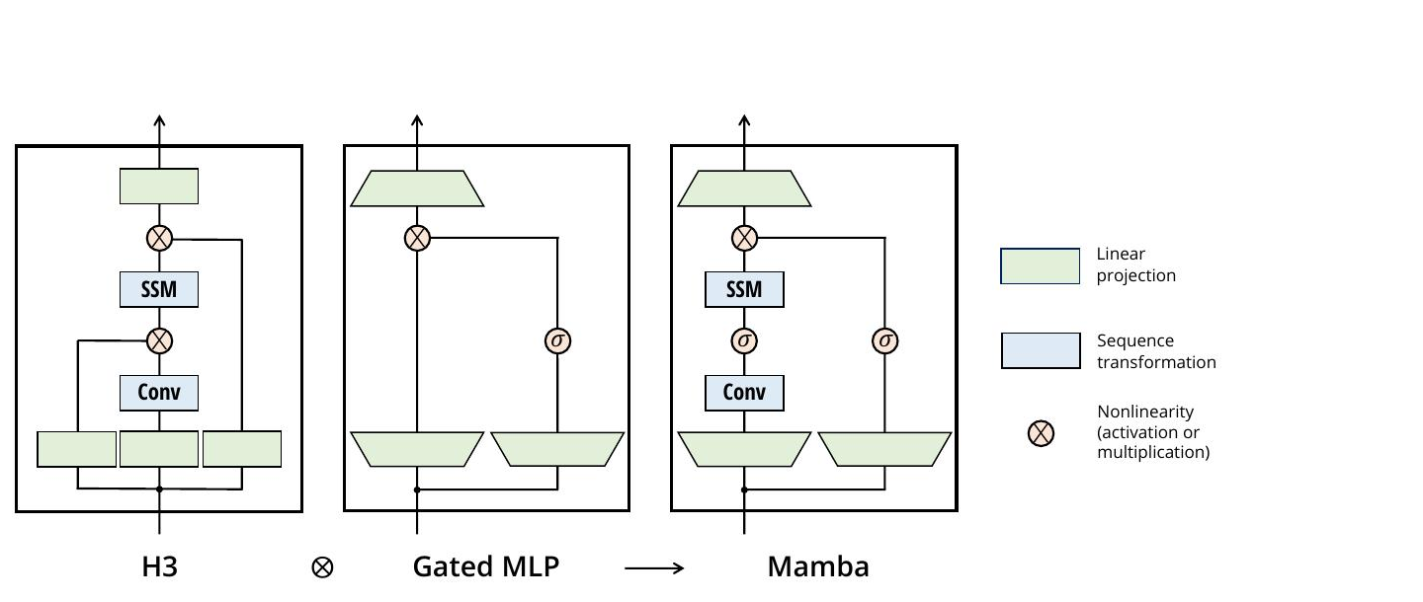
Mamba Block — Simplified Architecture
No attention, no separate MLP — repeated homogeneous block
Design choices
Combines H3 + Gated MLP
Selective SSM merged with the gated-MLP idea into one block.
No attention mechanism
Recurrent computation replaces self-attention entirely.
Hardware-aware parallel scan
Custom CUDA scan keeps the recurrence GPU-efficient.
Linear scaling end-to-end
Time and memory grow linearly with sequence length.
Figure 3, Gu & Dao (2023) — H3, Gated MLP, and Mamba block
Generative AI Course Project • Mamba Reproduction
7 / 24

Slide 8
Paper Benchmark Methodology
Multi-modal evaluation across language, audio, and DNA
Language
Long-Range
Audio
DNA
The Pile • 300B tokens
LRA & induction heads
SC09 • YouTubeMix
HG38 • GenomicsBenchmark
Pretraining perplexity
Zero-shot downstream
Models 125M – 2.8B params
Synthetic copying tasks
Sequence length up to 1M
Tests selectivity directly
Autoregressive bits-per-byte
Sample quality (FID, IS)
Sequence length up to 1M
Bits-per-byte on genomes
Species classification
Sequence length up to 1M
Reported metrics
Perplexity • Bits-per-byte • Zero-shot accuracy • Inference throughput (tok/s) • Memory consumption
Gu & Dao (2023) — Section 4 (Empirical Evaluation)
Generative AI Course Project • Mamba Reproduction
8 / 24

Slide 9
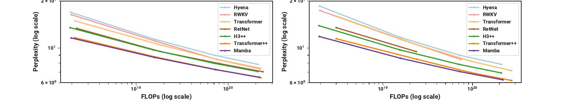
Key Results from the Paper
Mamba matches Transformer quality at linear cost
5×
O(n)
≈2×
≥1M
higher inference throughput at long context
linear scaling in sequence length
Mamba-3B approaches Transformer quality at lower compute cost
sequence lengths show continued gains
Pretraining scaling laws on The Pile — Mamba is the first attention-free model to match Transformer++.
Figure 4, Gu & Dao (2023) — Scaling Laws on The Pile
Generative AI Course Project • Mamba Reproduction
9 / 24

Slide 10
Mamba vs Transformer
Architectural and computational trade-offs
Aspect
Transformer
Mamba
Time complexity
O(n²) attention
O(n) selective scan
Memory at inference
KV-cache grows with n
Constant-size hidden state
Long-context
Degrades sharply
Linear, well-behaved
Core mechanism
Self-attention + FFN
Selective SSM (S6)
Quality (paper)
Strong baseline
Matches / exceeds same size
Same modeling power at fundamentally different cost curves.
Summary based on Gu & Dao (2023)
Generative AI Course Project • Mamba Reproduction
10 / 24

Slide 11
Limitations of Mamba
Honest critical analysis from the paper and follow-up work
01
04
Weaker exact state tracking
Less mature ecosystem
Some retrieval and copy tasks favor attention's direct lookup.
Tooling, pretrained checkpoints, and tutorials still catching up.
02
05
Hardware kernel dependence
Single-modality focus in original paper
Custom CUDA scan is essential — no efficient CPU path.
Strongest evidence is on language; broader modalities follow up later.
03
Overhead at short sequences
Selective mechanism only pays off above ~1k tokens.
Discussion in Gu & Dao (2023) and follow-up SSM literature
Generative AI Course Project • Mamba Reproduction
11 / 24

Slide 12
Our Reproduction Approach
Scope, comparison, and what we set out to validate
Mamba-130M
The Pile
BF16 / A100
512 → 8192
vs GPT-2 Transformer baseline
subset, GPT-NeoX tokenizer
single-GPU training & benchmarking
sequence-length scaling sweep
Step 1
Step 2
Step 3
Step 4
Step 5
Tokenize
▶
Train
▶
Evaluate
▶
Benchmark
▶
Compare
subset of
The Pile
Mamba & GPT-2
baselines
perplexity, BPB,
generation
throughput &
memory sweep
validate paper's
claims
Goal: empirically test the paper's central claim — linear scaling at long context.
Project repository: seriouslysahid/genai-mamba-assignment
Generative AI Course Project • Mamba Reproduction
12 / 24

Slide 13
Implementation Setup
Hardware, libraries, and model configurations
Software & Hardware Stack
Model Configurations
Hardware
NVIDIA A100-SXM4-80GB
Mamba-130M
Transformer-130M
Precision
BF16 (bfloat16)
129.1M parameters
125.2M parameters
Framework
PyTorch 2.6 + CUDA 12.6
Mamba library
mamba-ssm 2.2.4 + causal-conv1d 1.5
24 layers
d_model = 768
d_state = 16
RMSNorm + tied embeddings
20,000 training steps
Batch 4
seq_len 2048
expand = 2
lr = 6e-4
grad_accum = 4
GPT-2 architecture
12 layers
d_model = 768
12 attention heads
20,000 training steps
Batch 4
seq_len 2048
12 attention heads
dropout = 0.1
lr = 6e-4
grad_accum = 4
Tokenizer
EleutherAI/gpt-neox-20b (50,277 vocab)
Dataset
monology/pile-uncopyrighted
Token shards
train: 427.4M • val: 6.6M (uint16)
Codebase
seriouslysahid/genai-mamba-assignment
scripts/train_mamba.py — see DEFAULTS, MAMBA_CFG, TRANSFORMER_CFG
Generative AI Course Project • Mamba Reproduction
13 / 24

Slide 14
Training Budget & Fairness Notes
Identical optimization config across both models
Model
Batch Size
Steps
Seq Len
Approx Tokens Seen
Mamba
4
20,000
2048
≈ 163.8 M
Transformer
4
20,000
2048
≈ 163.8 M
Matched optimization configuration
Both models trained with identical batch size, optimizer steps, sequence length, and token budget. This eliminates batch-size and step-count as confounding variables in the quality comparison.
Same data
Same tokenizer
Same precision
Same sequence length
identical Pile shard
GPT-NeoX • 50,277 vocab
BF16 on a single A100
2048 tokens during training
Generative AI Course Project • Mamba Reproduction
14 / 24

Slide 15
Training & Evaluation Workflow
Five-stage pipeline from raw data to plots
Stage 1
Stage 2
Stage 3
Stage 4
Stage 5
Prepare data
Train models
Evaluate
Benchmark
Plot results
Stream The Pile
Tokenize into uint16 binary shards
Using BF16 on A100
Logging Loss, Validation Perplexity and Throughput
1) Held-out Perplexity 2) Bits-Per-Byte 3) Sample Generations
Sweep sequence lengths
512 to 4096
Measure tokens/second and peak memory used
Training curves
Throughput
Memory
Speedup
prepare_data.py
train_mamba.py
evaluate_mamba.py
benchmark_mamba.py
plot_results.py
Logged at every stage
training loss • validation perplexity • bits-per-byte • tokens / second • peak GPU memory
Outputs: out/mamba_log.json • out/transformer_log.json • out/*_eval.json • out/benchmark_results.json
Scripts in scripts/ ; outputs land in out/
Generative AI Course Project • Mamba Reproduction
15 / 24

Slide 16
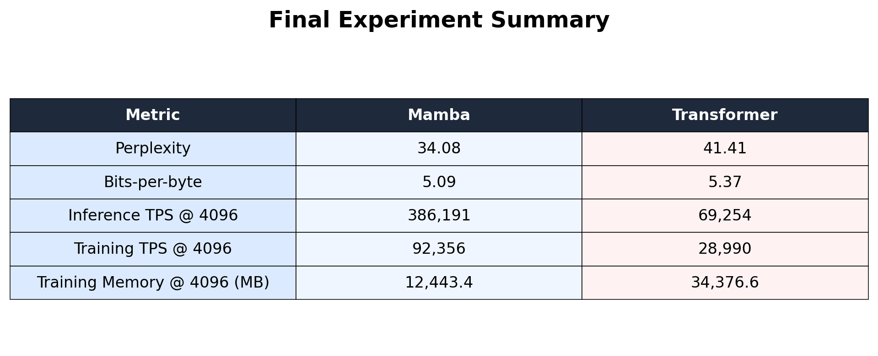
Our Benchmark Results
Final summary • Mamba vs Transformer • same parameter budget
Headline numbers
−18 % perplexity
Mamba 34.08 vs Transformer 41.41
5.58× inference @ 4096
Speedup over Transformer at long context
−64 % memory @ 4096
Training peak memory at long context
All metrics from out/benchmark_results.json and out/*_eval.json — A100-80GB, BF16.
Generative AI Course Project • Mamba Reproduction
16 / 24

Slide 17
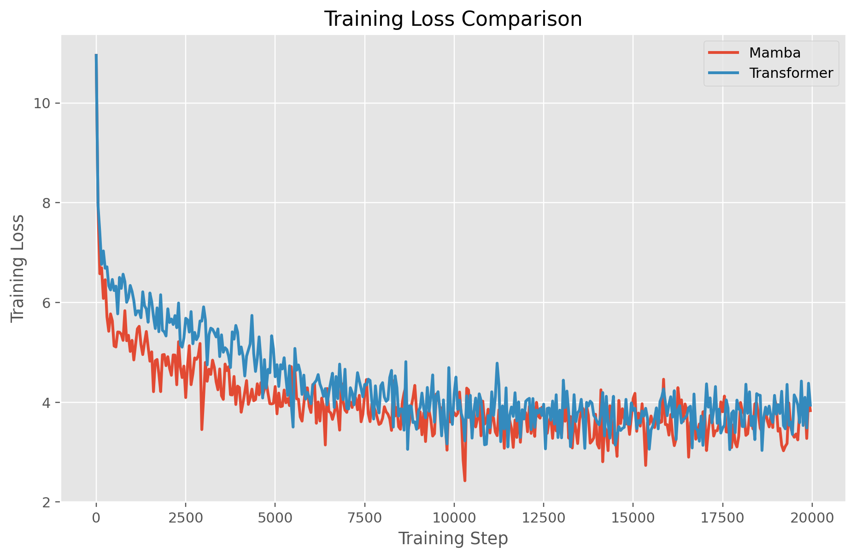
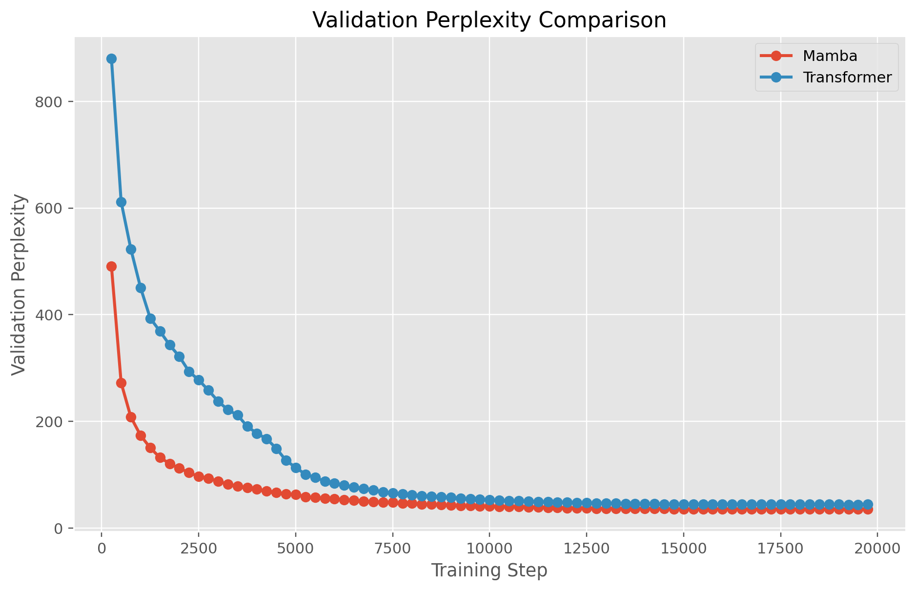
Training Dynamics
Loss curves and validation perplexity over training
Training loss vs steps
Validation perplexity vs steps
Source: scripts/plot_results.py from out/*_log.json
Observation
Mamba shows faster early-phase convergence and a smoother trajectory; both models approach similar regimes by step 20,000, with Mamba retaining a measurable edge in final perplexity.
Generative AI Course Project • Mamba Reproduction
17 / 24

Slide 18
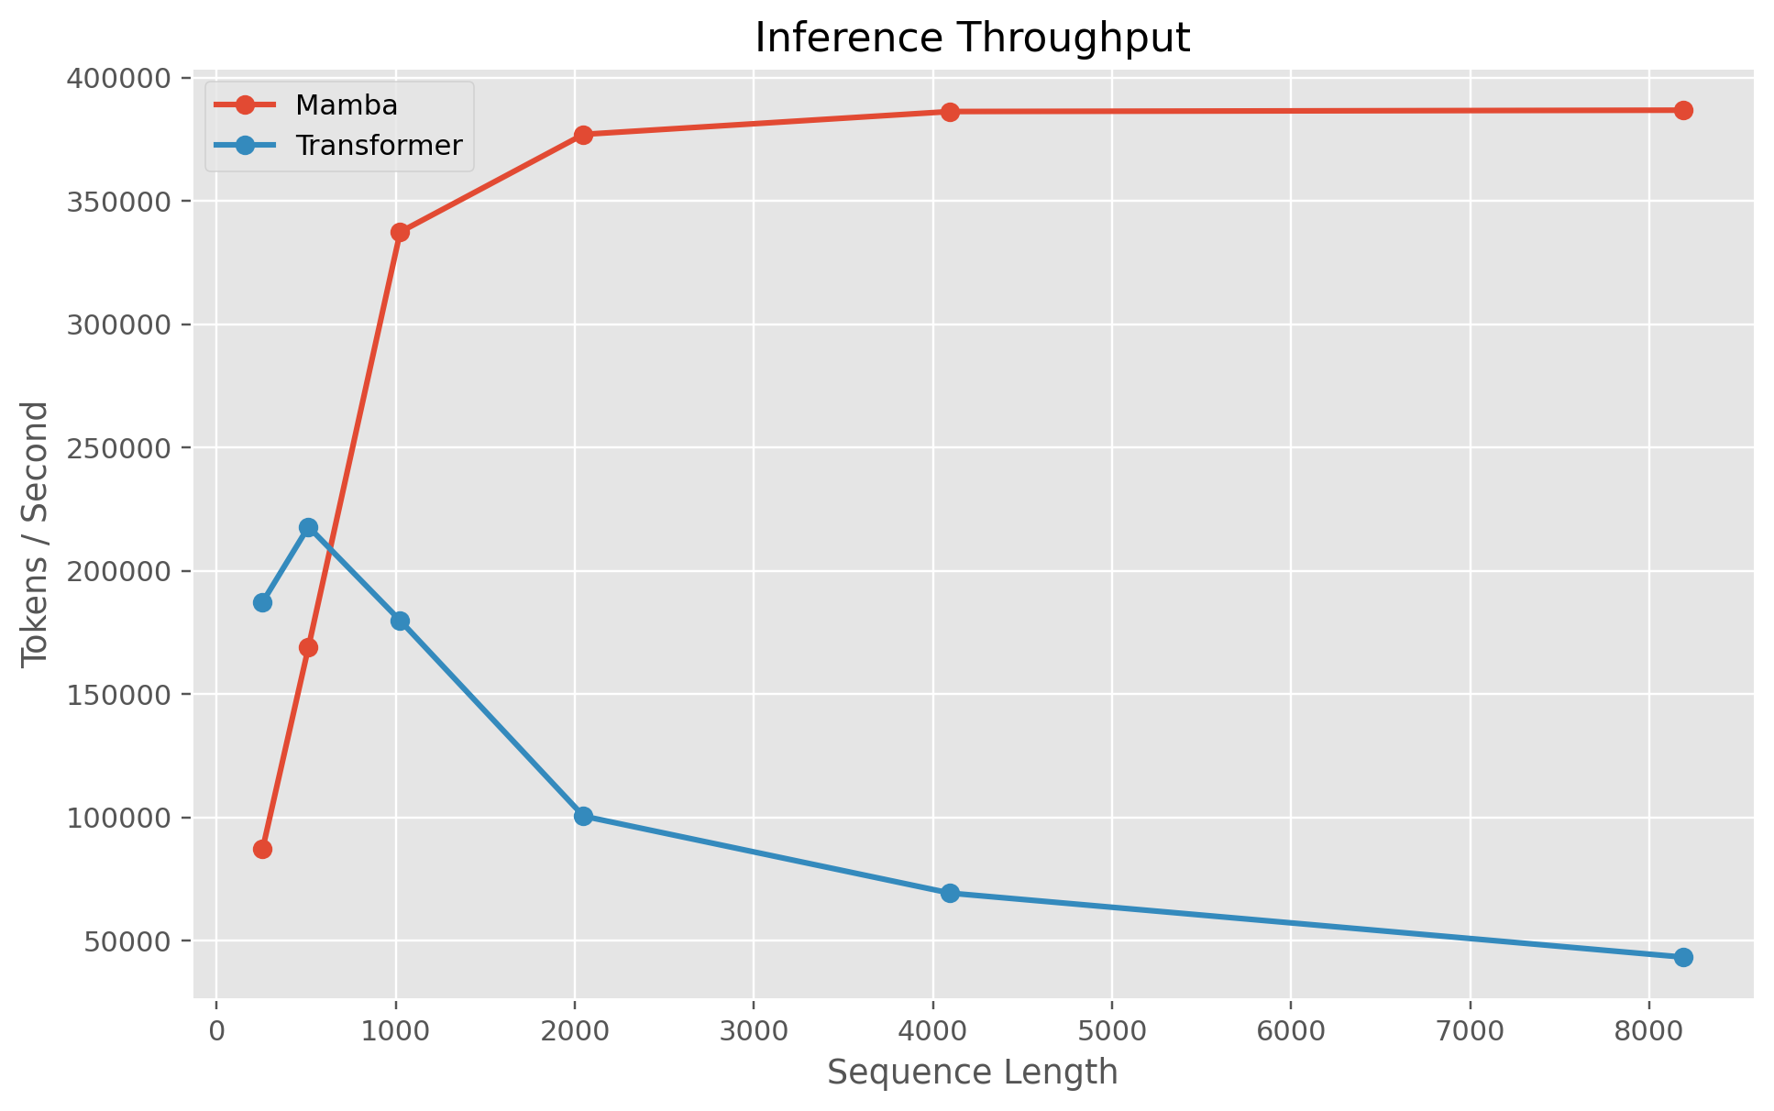
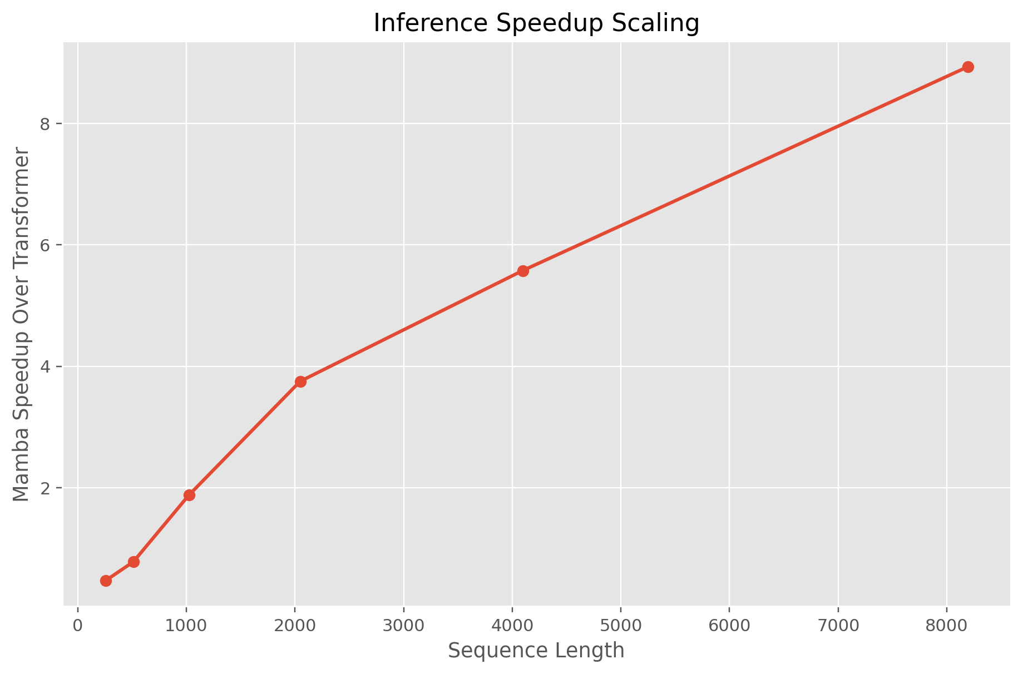
Throughput Scaling
Inference tokens / second • Speedup ratio across context lengths
0.78×
1.88×
3.75×
5.58×
8.93×
@ 512
@ 1024
@ 2048
@ 4096
@ 8192
Transformer faster
Mamba takes lead
Clear advantage
Long-context regime
Trend accelerates
Benchmarks measured on NVIDIA A100-80GB using BF16 precision • out/benchmark_results.json
Generative AI Course Project • Mamba Reproduction
18 / 24

Slide 19
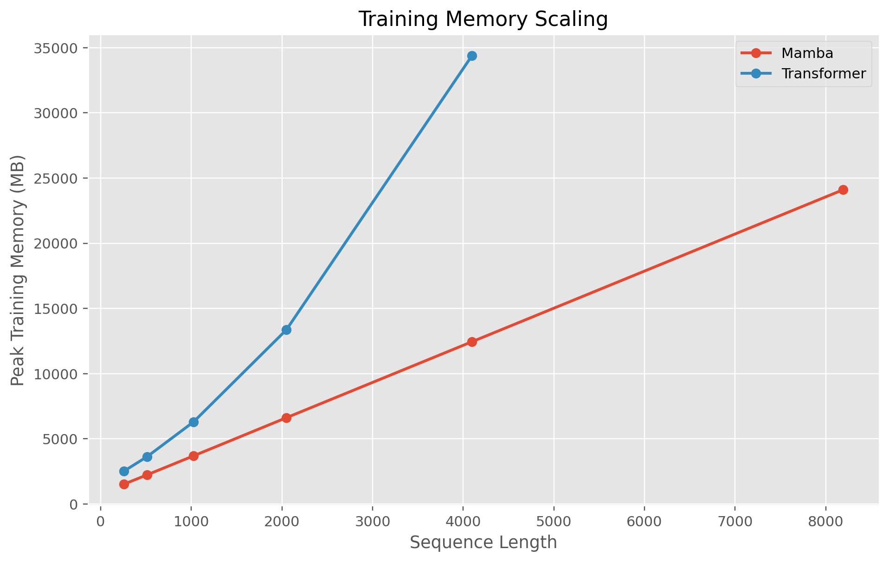
Memory Scaling
Peak training memory • constant-state vs growing KV-cache
Training peak memory (MB)
Seq len
Mamba
Transformer
Reduction
512
2,239
3,634
38%
1024
3,692
6,297
41%
2048
6,615
13,355
51%
4096
12,443
34,377
64%
8192
24,098
OOM
—
Hard wall at 8192
Transformer training OOMs at seq_len 8192 on an 80 GB A100; Mamba completes it at 24 GB. Constant-state vs growing KV-cache.
Benchmarks measured on NVIDIA A100-80GB using BF16 precision • out/benchmark_results.json
Generative AI Course Project • Mamba Reproduction
19 / 24

Slide 20
Implementation Observations
Practical notes from running the experiments
Setup
CUDA kernels
mamba-ssm needs precise CUDA / PyTorch ABI matching — we used PyTorch 2.6 + CUDA 12.6 prebuilt wheels.
Custom selective-scan kernels are essential — no viable CPU fallback at this scale.
Training stability
Memory patterns
Mamba's loss curves are noticeably smoother than the Transformer baseline.
Constant Mamba memory vs quadratic Transformer KV-cache, confirmed across 512–4096.
Crossover at ~1k tokens
Reproducibility
Below 1024 tokens the Transformer is faster; selective-scan overhead amortizes only at longer context.
Single seed per run; no large hyperparameter sweep.
Notes from training, evaluation, and benchmarking runs
Generative AI Course Project • Mamba Reproduction
20 / 24

Slide 21
Mamba Lineage & Recent SSM Developments
From Mamba-1 (2023) to Mamba-2 (2024) and Mamba-3 (2026)
2023
2024
2026
Mamba
Mamba-2
Mamba-3
Selective state space (S6) and hardware-aware scan; first attention-free model to match Transformer++.
Structured State Space Duality framework; SSMs reformulated as matmul-friendly operations.
Inference-first design; complex-valued states and MIMO formulation for higher quality at fixed latency.
Selective B, C, Δ
Parallel scan kernel
Linear-time recurrence
2–8× faster training
Larger states (N=64–256+)
Connects SSM ↔ attention
Better quality / latency
Complex-valued states
MIMO formulation
Each generation builds on the selective-SSM foundation introduced in 2023.
Gu & Dao (2023) • Dao & Gu (2024) • Mamba-3 (2026)
Generative AI Course Project • Mamba Reproduction
21 / 24

Slide 22
Conclusion & Future Directions
What our reproduction confirms and what comes next
What our reproduction confirms
Future directions
Linear scaling holds in practice
Mamba throughput is roughly flat in n; Transformer degrades sharply and OOMs at seq=8192.
Long-context efficiency
5.58× speedup at 4096 tokens, 8.93× at 8192; 64% memory reduction at 4096.
Quality at smaller scale
Lower perplexity (34.08 vs 41.41) under matched optimization config.
Smoother early convergence
Mamba converges faster in the early phase; both models approach similar regimes by 20k steps.
Scale up parameters
Move from 130M toward 1B–10B and re-test scaling laws.
Diverse downstream tasks
Beyond LM perplexity — reasoning, retrieval, code, long-doc QA.
Hybrid SSM + Attention
Most promising direction in 2024–2026; combines complementary strengths.
Apply to new modalities
Vision, audio, multimodal — leveraging long-context efficiency.
Selective state space models are a strong long-context alternative to attention-heavy Transformers.
Generative AI Course Project • Mamba Reproduction
22 / 24

Slide 23
Thank You
Questions & Discussion
References
Gu, A. & Dao, T. (2023). Mamba: Linear-Time Sequence Modeling with Selective State Spaces. arXiv:2312.00752
Dao, T. & Gu, A. (2024). Transformers are SSMs (Structured State Space Duality). arXiv:2405.21060
Project repository: github.com/seriouslysahid/genai-mamba-assignment
Official Mamba code: github.com/state-spaces/mamba
Generative AI Course Project • Group 5 • April 2026

