Slide 1
AI Alignment paper: second model (InternVL2.5-8B)
25.10.2026

Slide 2
Second model: InternVL2.5-8B
The only non-Qwen open model evaluated in the MoMentS paper (InternLM2.5 language model, InternViT vision).
  Release used: OpenGVLab/InternVL2_5-8B-MPO-hf (runs natively in transformers).
Same as Qwen: 598 questions, six conditions, prompts, option orders, 64 frames, both follow-up questions.
  Each frame is one 448x448 image; letter probabilities sum to 1.0 in every condition.
Explanations coded by the same two judges, same prompt (notebook 09).
  Agreement: kappa 0.87 dialogue, 0.85 visual, 0.99 insufficient, 0.73 missing visual.
Comparison in notebook 10.

Slide 3
Both models, 598 questions
Q_noE (no "Cannot tell"): confidently wrong 16.6% Qwen, 15.2% InternVL.
 | Model | Q | T | T_told | VT | VTmis
Abstained | Qwen | 61.7% | 47.5% | 61.9% | 29.4% | 41.6%
 | InternVL | 58.7% | 42.0% | 53.8% | 13.7% | 15.7%
Best A-D answer right | Qwen | 45.3% | 54.7% | 55.2% | 56.2% | 52.5%
 | InternVL | 43.0% | 51.2% | 52.7% | 56.4% | 49.0%
Confidently wrong (>= 0.8) | Qwen | 9.0% | 12.0% | 8.0% | 13.9% | 15.1%
 | InternVL | 9.2% | 10.5% | 7.7% | 14.0% | 13.9%

Slide 4
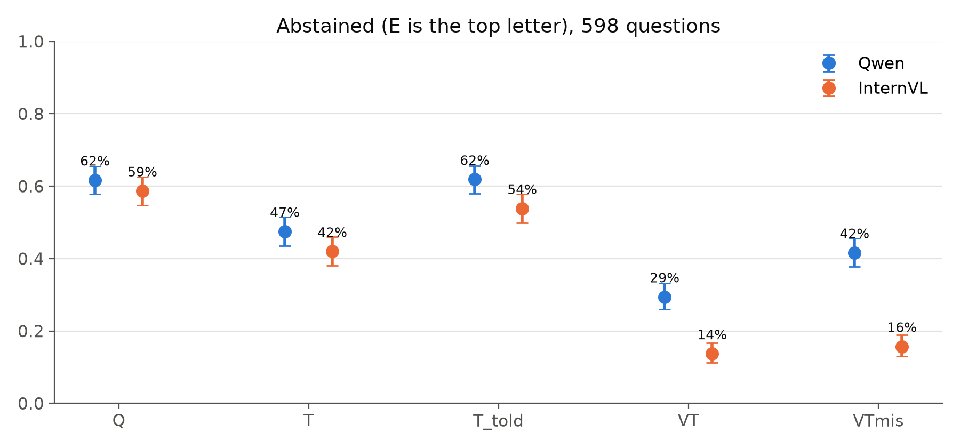
Abstention: same pattern, except for the wrong video
Both abstain less with more evidence, more when told a video exists.
Wrong video: Qwen 29% to 42% (p < 0.001), InternVL 14% to 16% (p = 0.22).

Slide 5
InternVL: the wrong video hurts, unnoticed
Best A-D answer right: 56.4% with the right video, 49.0% with the wrong one (81 lost, 37 gained, p < 0.001).
  Below the transcript alone (51.2%): the wrong video misleads it.
Yet it abstains only 2 points more, and still says it used a video in 48%.
Qwen: smaller loss (56.2% to 52.5%, p = 0.04), but abstains 12 points more.
Neither model's explanations notice a wrong video (0 of 598 each, both judges).
  The one InternVL explanation flagged (right video) disputes the question's premise.

Slide 6
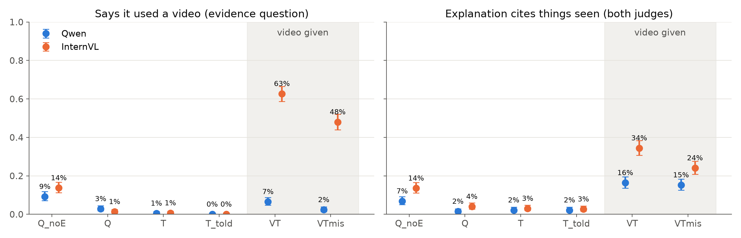
Self-report: a video, not its relevance
InternVL claims a video in 63% (right), 48% (wrong video), 14% (none).
Qwen rarely claims one; both cite things seen with the wrong video.

Slide 7
Told a video exists (T_told): replicates
Both abstain more: Qwen 47.5% to 61.9% (87 start, 1 stops), InternVL 42.0% to 53.8% (72 start, 1 stops).
Mostly across the board: P("Cannot tell") rises only a little more where the video mattered.
  Qwen +0.14 vs +0.11; InternVL +0.10 vs +0.07 (both p < 0.001).
Explanations rarely name the missing video: Qwen 7.9%, InternVL 3.7%.
InternVL: 5 T_told explanations refer to "the audio", though no audio is ever given.

Slide 8
Takeaways
Replicates across model families:
  abstention follows the evidence (C1); blanket caution when told evidence is missing;
  no explanation notices a video from the wrong film (C2).
Differs: InternVL's abstention ignores the wrong video, though its accuracy drops.
  It reports using a video often, but about as often for the wrong one: self-report tracks
  whether a video is there, not whether it is relevant (C2).
Caveats: two 7-8B open models; explanation codes are LLM-judge labels (not hand-checked).
Next: write the study section of the paper.

