Slide 1
Network Programming
Chapter 1
網路程式設計
Tien-Hsiung Weng
翁添雄
靜宜資訊學院
thweng@pu.edu.tw
Lecture 1

Slide 2
Introduction
In order to write programs that communicate across a computer network, one must first invent a protocol, an agreement on how those programs will communicate.
  a Web server is a long-running program (or daemon) that sends network messages only in response to requests from the network.
  a Web client, such as a browser, which always initiates communication with the server.
  Client/Server is used by most network-aware applications.
  Deciding that the client always initiates requests tends to simplify the protocol as well as the programs themselves.
  More complex network applications also require asynchronous callback communication (server initiates a message to the client).

Slide 3

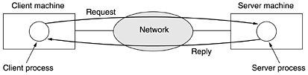
Introduction
Clients normally communicate with one server at a time

Slide 4
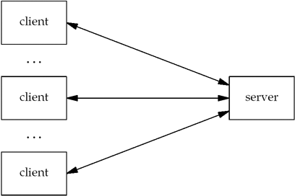
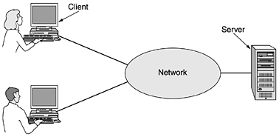
Introduction
It is not unusual for a server to be communicating with multiple clients.

Slide 5
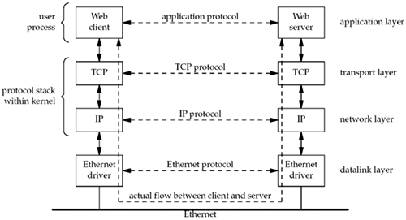
Introduction
The client and the server application communicate via a network protocol (multiple layers of network protocols). We focus on the TCP/IP protocol suite, also called the Internet protocol suite.
Web clients/servers communicate using the Transmission Control Protocol, or TCP. TCP, in turn, uses the Internet Protocol, or IP, and IP communicates with a datalink layer of some form. If the client and server are on the same Ethernet, the arrangement is shown above

Slide 6
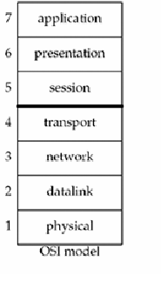
Introduction

Slide 7
Introduction
Even though the client and server communicate using an application protocol, the transport layers communicate using TCP.
(actual flow of info between the client and server goes down the protocol stack on one side, across the network, and up the protocol stack on the other side
TCP and IP are not the only protocols to be discussed. Some clients/servers use UDP instead
There are IPv4 and IPv6

Slide 8
Introduction
Even though the client and server communicate using an application protocol, the transport layers communicate using TCP.
(actual flow of info between the client and server goes down the protocol stack on one side, across the network, and up the protocol stack on the other side
TCP and IP are not the only protocols to be discussed. Some clients/servers use UDP instead
There are IPv4 and IPv6

Slide 9
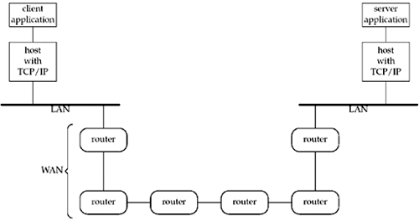
Introduction
Client/Server need not be attached to the same LAN
Client/Server on different LANs, with both LANs connected to WAN using routers
Routers are the building blocks of WANs. The largest WAN today is the Internet

Slide 10
A Simple Daytime Client
intro/daytimetcpcli.c
1 #include "unp.h"
2 int
3 main(int argc, char **argv)
4 {
5 int sockfd, n;
6 char recvline[MAXLINE + 1];
7 struct sockaddr_in servaddr;
8 if (argc != 2)
9 err_quit("usage: a.out <IPaddress>");
10 if ( (sockfd = socket(AF_INET, SOCK_STREAM, 0)) < 0)
11 err_sys("socket error");
12 bzero(&servaddr, sizeof(servaddr));
13 servaddr.sin_family = AF_INET;
14 servaddr.sin_port = htons(13); /* daytime server */
15 if (inet_pton(AF_INET, argv[1], &servaddr.sin_addr) <= 0)
16 err_quit("inet_pton error for %s", argv[1]);
17 if (connect(sockfd, (SA *) &servaddr, sizeof(servaddr)) < 0)
18 err_sys("connect error");
19 while ( (n = read(sockfd, recvline, MAXLINE)) > 0) {
20 recvline[n] = 0; /* null terminate */
21 if (fputs(recvline, stdout) == EOF)
22 err_sys("fputs error");
23 }
24 if (n < 0)
25 err_sys("read error");
26 exit(0);
27 }
How to compile:
gcc –o daytimetcpcli daytimetcpcli.c
To run:
./daytimetcpcli 206.168.112.96

Slide 11
A Simple Daytime Client
1 #include "unp.h"
2 int
3 main(int argc, char **argv)
4 {
5 int sockfd, n;
6 char recvline[MAXLINE + 1];
7 struct sockaddr_in servaddr;
8 if (argc != 2)
9 err_quit("usage: a.out <IPaddress>");

Slide 12
A Simple Daytime Client
10 if ( (sockfd = socket(AF_INET, SOCK_STREAM, 0)) < 0)
11 err_sys("socket error");
Create TCP socket
10–11 The socket function creates an Internet (AF_INET) stream (SOCK_STREAM) socket, which is a fancy name for a TCP socket.
The function returns a small integer descriptor that we can use to identify the socket in all future function calls
(e.g., the calls to connect and read that follow).

Slide 13
A Simple Daytime Client
12 bzero(&servaddr, sizeof(servaddr));
13 servaddr.sin_family = AF_INET;
14 servaddr.sin_port = htons(13); /* daytime server */
15 if (inet_pton(AF_INET, argv[1], &servaddr.sin_addr) <= 0)
16 err_quit("inet_pton error for %s", argv[1]);
Specify server's IP address and port
12–16 Fill in an Internet socket address structure (sockaddr_in structure named servaddr) with the server's IP address and port number.
Set the entire structure to 0 using bzero
Set the address family to AF_INET, set the port number to 13 (which is the well-known port of the daytime server on any TCP/IP host that supports this service and set the IP address to the value specified as the first command-line argument (argv[1]).
The IP address and port number fields in this structure must be in specific formats: We call the library function htons ("host to network short") to convert the binary port number, and we call the library function inet_pton ("presentation to numeric") to convert the ASCII command-line argument (such as 206.62.226.35 when we ran this example) into the proper format.

Slide 14
A Simple Daytime Client
17 if (connect(sockfd, (SA *) &servaddr, sizeof(servaddr)) < 0)
18 err_sys("connect error");
Establish connection with server
17–18 The connect function, when applied to a TCP socket, establishes a TCP connection with the server specified by the socket address structure pointed to by the second argument. We must also specify the length of the socket address structure as the third argument to connect, and for Internet socket address structures, we always let the compiler calculate the length using C's sizeof operator

Slide 15
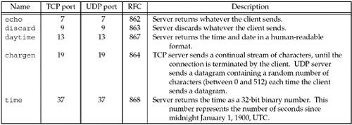
A Simple Daytime Client
Standard TCP/IP services provided by most implementations

Slide 16
A Simple Daytime Client
19 while ( (n = read(sockfd, recvline, MAXLINE)) > 0) {
20 recvline[n] = 0; /* null terminate */
21 if (fputs(recvline, stdout) == EOF)
22 err_sys("fputs error");
23 }
24 if (n < 0)
25 err_sys("read error");
26 exit(0);
27 }
Read and display server's reply
19–25 read the server's reply and display the result using the standard I/O fputs function. (must be careful when using TCP because it is a byte-stream protocol with no record boundaries). The server's reply is normally a 26-byte string of the form.
Mon May 26 20 : 58 : 40 2003\r\n
With a byte-stream protocol, these 26 bytes can be returned in numerous ways: a single TCP segment containing all 26 bytes of data, in 26 TCP segments each containing 1 byte of data, or any other combination that totals to 26 bytes.
Normally, a single segment containing all 26 bytes of data is returned, but with larger data sizes, we cannot assume that the server's reply will be returned by a single read. Therefore, when reading from a TCP socket, we always need to code the read in a loop and terminate the loop when either read returns 0 (i.e., the other end closed the connection) or a value less than 0 (an error).
exit terminates the program. Unix always closes all open descriptors when a process terminates, so our TCP socket is now closed

Slide 17
IPv6 version
1 #include "unp.h"
2 int
3 main(int argc, char **argv)
4 {
5 int sockfd, n;
6 char recvline[MAXLINE + 1];
7 struct sockaddr_in6 servaddr;
8 if (argc != 2)
9 err_quit("usage: a.out <IPaddress>");
10 if ( (sockfd = socket(AF_INET6, SOCK_STREAM, 0)) < 0)
11 err_sys("socket error");
12 bzero(&servaddr, sizeof(servaddr));
13 servaddr.sin6_family = AF_INET6;
14 servaddr.sin6_port = htons(13); /* daytime server */
15 if (inet_pton(AF_INET6, argv[1], &servaddr.sin6_addr) <= 0)
16 err_quit("inet_pton error for %s", argv[1]);
17 if (connect(sockfd, (SA *) &servaddr, sizeof(servaddr)) < 0)
18 err_sys("connect error");
19 while ( (n = read(sockfd, recvline, MAXLINE)) > 0) {
20 recvline[n] = 0; /* null terminate */
21 if (fputs(recvline, stdout) == EOF)
22 err_sys("fputs error");
23 }
24 if (n < 0)
25 err_sys("read error");
26 exit(0);
27 }
We need to make a program protocol-independent

Slide 18
wrapper function for the socket function
int
Socket(int family, int type, int protocol)
{
int n;
if ( (n = socket(family, type, protocol)) < 0)
err_sys("socket error");
return (n);
}

Slide 19
Types of Networking APIs
TCP socket
UDP socket
raw socket over IP (bypass TCP/UDP)
datalink (bypass IP)
  BPF (BSD Packet Filter)
  DLPI (SVR4 Data Link Provider Interface)

Slide 20
A Simple Daytime Server
intro/daytimetcpsrv.c
1 #include "unp.h".
2 #include <time.h>
3 int
4 main(int argc, char **argv)
5 {
6 int listenfd, connfd;
7 struct sockaddr_in servaddr;
8 char buff[MAXLINE];
9 time_t ticks;
10 listenfd = Socket(AF_INET, SOCK_STREAM, 0);
11 bzeros(&servaddr, sizeof(servaddr));
12 servaddr.sin_family = AF_INET;
13 servaddr.sin_addr.s_addr = htonl(INADDR_ANY);
14 servaddr.sin_port = htons(13); /* daytime server */
15 Bind(listenfd, (SA *) &servaddr, sizeof(servaddr));
16 Listen(listenfd, LISTENQ);
17 for ( ; ; ) {
18 connfd = Accept(listenfd, (SA *) NULL, NULL);
19 ticks = time(NULL);
20 snprintf(buff, sizeof(buff), "%.24s\r\n", ctime(&ticks));
21 Write(connfd, buff, strlen(buff));
22 Close(connfd);
23 }
24 }

Slide 21
A Simple Daytime Server
intro/daytimetcpsrv.c
1 #include "unp.h".
2 #include <time.h>
3 int
4 main(int argc, char **argv)
5 {
6 int listenfd, connfd;
7 struct sockaddr_in servaddr;
8 char buff[MAXLINE];
9 time_t ticks;
10 listenfd = Socket(AF_INET, SOCK_STREAM, 0);
11 bzeros(&servaddr, sizeof(servaddr));
12 servaddr.sin_family = AF_INET;
13 servaddr.sin_addr.s_addr = htonl(INADDR_ANY);
14 servaddr.sin_port = htons(13); /* daytime server */
15 Bind(listenfd, (SA *) &servaddr, sizeof(servaddr));
11–15 The server's well-known port (13 for the daytime service) is bound to the socket by filling in an Internet socket address structure and calling bind. We specify the IP address as INADDR_ANY, which allows the server to accept a client connection on any interface, in case the server host has multiple interfaces. Later we will see how we can restrict the server to accepting a client connection on just a single interface.

Slide 22
A Simple Daytime Server
16 Listen(listenfd, LISTENQ);
17 for ( ; ; ) {
18 connfd = Accept(listenfd, (SA *) NULL, NULL);
19 ticks = time(NULL);
20 snprintf(buff, sizeof(buff), "%.24s\r\n", ctime(&ticks));
21 Write(connfd, buff, strlen(buff));
22 Close(connfd);
23 }
24 }
16 By calling listen, the socket is converted into a listening socket, on which incoming connections from clients will be accepted by the kernel. These three steps, socket, bind, and listen, are the normal steps for any TCP server to prepare what we call the listening descriptor (listenfd in this example).
The constant LISTENQ is from our unp.h header. It specifies the maximum number of client connections that the kernel will queue for this listening descriptor.

Slide 23
A Simple Daytime Server
17–21 Normally, the server process is put to sleep in the call to accept, waiting for a client connection to arrive and be accepted. A TCP connection uses what is called a three-way handshake to establish a connection. When this handshake completes, accept returns, and the return value from the function is a new descriptor (connfd) that is called the connected descriptor. This new descriptor is used for communication with the new client. A new descriptor is returned by accept for each client that connects to our server.
The style used throughout the book for an infinite loop is
for ( ; ; ) { . . . } The current time and date are returned by the library function time, which returns the number of seconds since the Unix Epoch: 00:00:00 January 1, 1970, Coordinated Universal Time (UTC). The next library function, ctime, converts this integer value into a human-readable string such as
Mon May 26 20:58:40 2003 A carriage return and linefeed are appended to the string by snprintf, and the result is written to the client by write.
16 Listen(listenfd, LISTENQ);
17 for ( ; ; ) {
18 connfd = Accept(listenfd, (SA *) NULL, NULL);
19 ticks = time(NULL);
20 snprintf(buff, sizeof(buff), "%.24s\r\n", ctime(&ticks));
21 Write(connfd, buff, strlen(buff));
22 Close(connfd);
23 }
24 }

Slide 24
A Simple Daytime Server
16 Listen(listenfd, LISTENQ);
17 for ( ; ; ) {
18 connfd = Accept(listenfd, (SA *) NULL, NULL);
19 ticks = time(NULL);
20 snprintf(buff, sizeof(buff), "%.24s\r\n", ctime(&ticks));
21 Write(connfd, buff, strlen(buff));
22 Close(connfd);
23 }
24 }
22 The server closes its connection with the client by calling close. This initiates the normal TCP connection termination sequence: a FIN is sent in each direction and each FIN is acknowledged by the other end. We will say much more about TCP's three-way handshake and the four TCP packets used to terminate a TCP connection

Slide 25
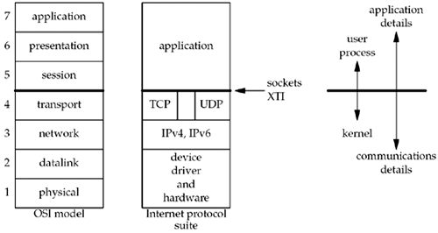
OSI Model
Open Systems Interconnection (OSI)
we need not concern ourselves with the bottom two layers of OSI other than being aware of some properties of the datalink, such as the 1500-byte Ethernet maximum transfer unit (MTU)
it is possible for an application to bypass the transport layer and use IPv4 or IPv6 directly. This is called a raw socket.

Slide 26
Discovering Details of Your Local Network
To find out interfaces: netstat -ni
To find out routing table: netstat -rn
To find out details of an interface: ifconfig
To discover hosts on a LAN: ping
To test and verify the DNS: nslookup
To find the exact path a network packet takes to from A to B: traceroute

