Slide 1
Network Programming
Chapter 2
網路程式設計
Tien-Hsiung Weng
翁添雄
靜宜資訊學院
thweng@pu.edu.tw
Lecture 2

Slide 2
Transport Layer: TCP and UDP
Overview of TCP/IP protocols
Comparing TCP and UDP
TCP connection: establishment, data transfer, and termination
Allocation of port numbers
Size matters: MTU, datagram, MSS, buffer
Standard Internet services and applications
Debugging techniques and tools

Slide 3
The Transport Layer: TCP, UDP, and SCTP
Goal:
  Understand how to use the protocols
  Focuses on the transport layer: TCP, UDP, and SCTP
  Most client/server applications use either TCP or UDP
  SCTP is a newer protocol, originally designed for transport of telephony signaling across the Internet.

Slide 4
Raw Sockets
These transport protocols (TCP,UDP,SCTP) use the network-layer protocol IP, either IPv4 or IPv6
Can use IPv4 or IPv6 directly bypassing the transport layer, this technique, often called raw sockets, is used much less frequently.

Slide 5
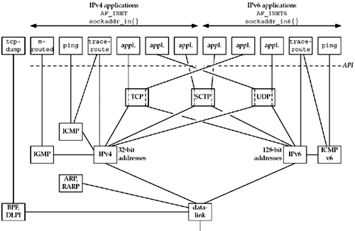
Overview of TCP/IP protocols

Slide 6
User Datagram Protocol (UDP)
UDP is its lack of reliability
  No guarantee:
    a datagram will reach its final destination
      If a datagram reaches its final destination but the checksum detects an error, it is not delivered to the UDP socket and is not automatically retransmitted
    the order will be preserved
    Datagram arrive only once
To make sure that a datagram reaches its destination, we can build lots of features into our application:
  acknowledgments from the other end, timeouts, retransmissions, and the like.

Slide 7
UDP
Each datagram has a length
  The length of a datagram is passed to the receiving application along with the data
TCP is a byte-stream protocol, without any record boundaries at all, which differs from UDP
UDP provides a connectionless service, as there need not be any long-term relationship between a UDP client and server
  i.e, a UDP client can create a socket and send a datagram to a given server and then immediately send another datagram on the same socket to a different server. Similarly, a UDP server can receive several datagrams on a single UDP socket, each from a different client.

Slide 8
Transmission Control Protocol (TCP)
provides connections between clients and servers
  A TCP client establishes a connection with a given server, exchanges data with that server across the connection, and then terminates the connection
provides reliability
  When TCP sends data to the other end, it requires an acknowledgment in return. If an acknowledgment is not received, TCP automatically retransmits the data and waits a longer amount of time. After some number of retransmissions, TCP will give up, with the total amount of time spent trying to send data typically between 4 and 10 minutes (depending on the implementation).
Note that TCP does not guarantee that the data will be received by the other endpoint, as this is impossible.
  It delivers data to the other endpoint if possible, and notifies the user (by giving up on retransmissions and breaking the connection) if it is not possible. Therefore, TCP cannot be described as a 100% reliable protocol

Slide 9
TCP
TCP has algorithms to estimate the round-trip time (RTT) between a client and server dynamically to knows how long to wait for an acknowledgment
  i.e, the RTT on a LAN can be milliseconds while across a WAN, it can be seconds. Furthermore, TCP continuously estimates the RTT of a given connection, because the RTT is affected by variations in the network traffic
TCP also sequences the data by associating a sequence number with every byte that it sends
  i.e, assume application writes 2,048 bytes to a TCP socket, causing TCP to send two segments, the first containing the data with sequence numbers 1–1,024 and the second with 1,025–2,048
  (A segment is the unit of data that TCP passes to IP)
  If the segments arrive out of order, the receiving TCP will reorder the two segments based on their sequence numbers before passing the data to the receiving application.
  If TCP receives duplicate data from its peer (say the peer thought a segment was lost and retransmitted it, when it wasn't really lost, the network was just overloaded), it can detect that the data has been duplicated (from the sequence numbers), and discard the duplicate data.

Slide 10
TCP
TCP provides flow control
  Always tells its peer exactly how many bytes of data it is willing to accept from the peer at any one time (the advertised window).
  At any time, the window is the amount of room currently available in the receive buffer, guaranteeing that the sender cannot overflow the receive buffer.
  The window changes dynamically over time: As data is received from the sender, the window size decreases, but as the receiving application reads data from the buffer, the window size increases. It is possible for the window to reach 0: when TCP's receive buffer for a socket is full and it must wait for the application to read data from the buffer before it can take any more data from the peer.
  UDP provides no flow control.
  a fast UDP sender can transmit datagrams at a rate the UDP receiver cannot keep up with
  TCP connection is full-duplex.
  means that an application can send and receive data in both directions on a given connection at any time.

Slide 11
TCP vs UDP
Reliable:
  TCP is reliable transmission of data comes at a price (speed)
  UDP is not reliable, the application is responsible for reliability

Slide 12
TCP vs UDP
TCP is designed for reliable transmission of data
  If data is lost or damaged in transmission, TCP ensures that the data is resent
  if packets of data arrive out of order, TCP puts them back in the correct order
  if the data is coming too fast for the connection, TCP throttles the speed back so that packets won't be lost
A program never needs to worry about receiving data that is out of order or incorrect
  the reliability comes at a price (speed).
  Establishing and tearing down TCP connections can take a fair amount of time, particularly for protocols such as HTTP, which tend to require many short transmissions.
UDP is an alternative protocol for sending data over IP that is very quick, but not reliable
  when you send UDP data, you have no way of knowing whether it arrived, much less whether different pieces of data arrived in the order in which you sent them. However, the pieces that do arrive generally arrive quickly.

Slide 13
UDP
an unreliable protocol
if you have data worth sending, you care about whether the data arrives correctly? Clearly, UDP isn't a good match
there are many kinds of applications in which raw speed is more important than getting every bit right. i.e., in real-time audio or video, lost or swapped packets of data simply appear as static. Static is tolerable, but awkward pauses in the audio stream, when TCP requests a retransmission or waits for a wayward packet to arrive, are unacceptable.
In other applications, reliability tests can be implemented in the application layer
i.e., if a client sends a short UDP request to a server, it may assume that the packet is lost if no response is returned within an established period of time; this is one way the Domain Name System (DNS) works. (DNS can also operate over TCP.)

Slide 14
UDP
In fact, you could implement a reliable file transfer protocol using UDP, and many people have: Network File System (NFS), Trivial FTP (TFTP), and FSP, a more distant relative of FTP, all use UDP. (The latest version of NFS can use either UDP or TCP.)
In these protocols, the application is responsible for reliability; UDP doesn't take care of it. That is, the application must handle missing or out-of-order packets. This is a lot of work, but there's no reason it can't be done—although if you find yourself writing this code, think carefully about whether you might be better off with TCP.

Slide 15
SCTP
provides applications with reliability, sequencing, flow control, and full-duplex data transfer, like TCP.
SCTP provides associations between clients and servers.
An association refers to a communication between two systems, which may involve more than two addresses due to multihoming.

Slide 16
SCTP
Unlike TCP, SCTP is message-oriented. It provides sequenced delivery of individual records. Like UDP, the length of a record written by the sender is passed to the receiving application.
SCTP can provide multiple streams between connection endpoints, each with its own reliable sequenced delivery of messages.
A lost message in one of these streams does not block delivery of messages in any of the other streams. This approach is in contrast to TCP, where a loss at any point in the single stream of bytes blocks delivery of all future data on the connection until the loss is repaired

Slide 17
SCTP
SCTP also provides a multihoming feature, which allows a single SCTP endpoint to support multiple IP addresses.
This feature can provide increased robustness against network failure. An endpoint can have multiple redundant network connections, where each of these networks has a different connection to the Internet infrastructure.
SCTP can work around a failure of one network or path across the Internet by switching to another address already associated with the SCTP association.Similar robustness can be obtained from TCP with help from routing protocols.
For example, BGP connections within a domain (iBGP) often use addresses that are assigned to a virtual interface within the router as the endpoints of the TCP connection. The domain's routing protocol ensures that if there is a route between two routers, it can be used, which would not be possible if the addresses used belonged to an interface that went down, for example. SCTP's multihoming feature allows hosts to multihome, not just routers, and allows this multihoming to occur across different service providers, which the routing-based TCP method cannot allow.

Slide 18
TCP vs UDP
The difference between TCP and UDP
TCP is like the phone system.
When you dial a number, the phone is answered and a connection is established between the two parties. As you talk, you know that the other party hears your words in the order in which you say them. If the phone is busy or no one answers, you find out right away.
UDP, is like the postal system. You send packets of mail to an address. Most of the letters arrive, but some may be lost on the way. The letters probably arrive in the order in which you sent them, but that's not guaranteed. The farther away you are from your recipient, the more likely it is that mail will be lost on the way or arrive out of order. If this is a problem, you can write sequential numbers on the envelopes, then ask the recipients to arrange them in the correct order and send you mail telling you which letters arrived so that you can resend any that didn't get there the first time. However, you and your correspondent need to agree on this protocol in advance. The post office will not do it for you.

Slide 19
TCP vs UDP
Both the phone system and the post office have their uses. Although either one could be used for almost any communication, in some cases one is definitely superior to the other. The same is true of UDP and TCP. The last several chapters have all focused on TCP applications, which are more common than UDP applications. However, UDP also has its place; in this chapter, we'll look at what you can do with UDP in Java.
Multicasting relies on UDP; a multicast socket is a fairly simple variation on a UDP socket.

Slide 20
Three-Way Handshake
TCP's state transition diagram is used to help debug using the netstat
The following scenario occurs when a TCP connection is established:
The server must be prepared to accept an incoming connection. This is normally done by calling socket, bind, and listen and is called a passive open.
The client issues an active open by calling connect. This causes the client TCP to send a "synchronize" (SYN) segment, which tells the server the client's initial sequence number for the data that the client will send on the connection. Normally, there is no data sent with the SYN; it just contains an IP header, a TCP header, and possible TCP options (which we will talk about shortly).
The server must acknowledge (ACK) the client's SYN and the server must also send its own SYN containing the initial sequence number for the data that the server will send on the connection. The server sends its SYN and the ACK of the client's SYN in a single segment.
The client must acknowledge the server's SYN.

Slide 21
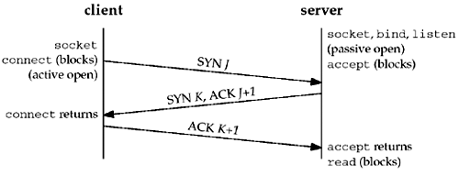
TCP Connection: Establishment
TCP options (in SYN): MSS (maximum segment size) option,
window scale option (advertized window up to 65535x2^14, 1GB),
timestamp option (the latter two: long fat pipe options)

Slide 22
TCP Connection: Data Transfer
client server
write
read(blocks)
request
read returns
(server processes request)
reply
ack of request
write
read(blocks)
read returns
ack of reply

Slide 23
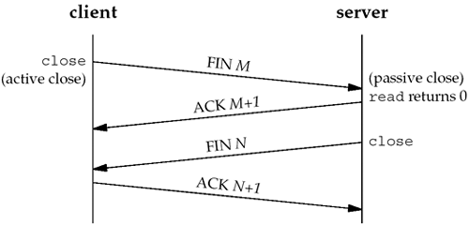
TCP Connection: Termination
Four-way handshake
TIME_WAIT to allow old duplicate segment to expire for reliable termination
(the end performing active close might have to retx the final ACK)

Slide 24
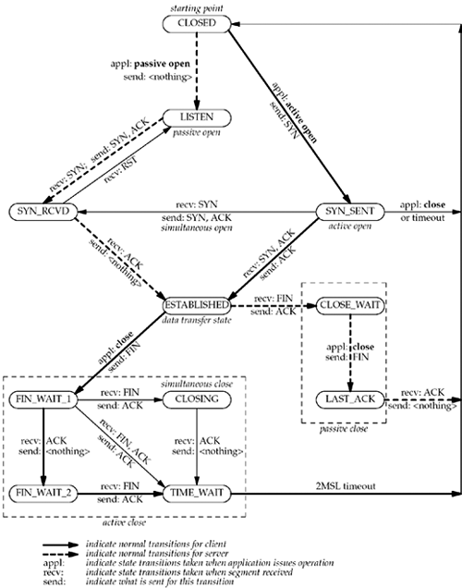
TCP State Transition Diagram
Packets exchanged when a TCP connection is closed

Slide 25
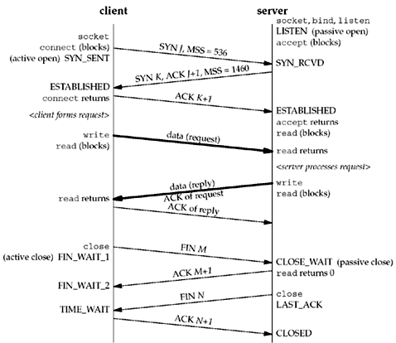
TCP State Transition Diagram
Packets exchanged when a TCP connection is closed

Slide 26
TIME_WAIT State
one of the most misunderstood aspects of TCP with regard to network programming is its TIME_WAIT state

Slide 27
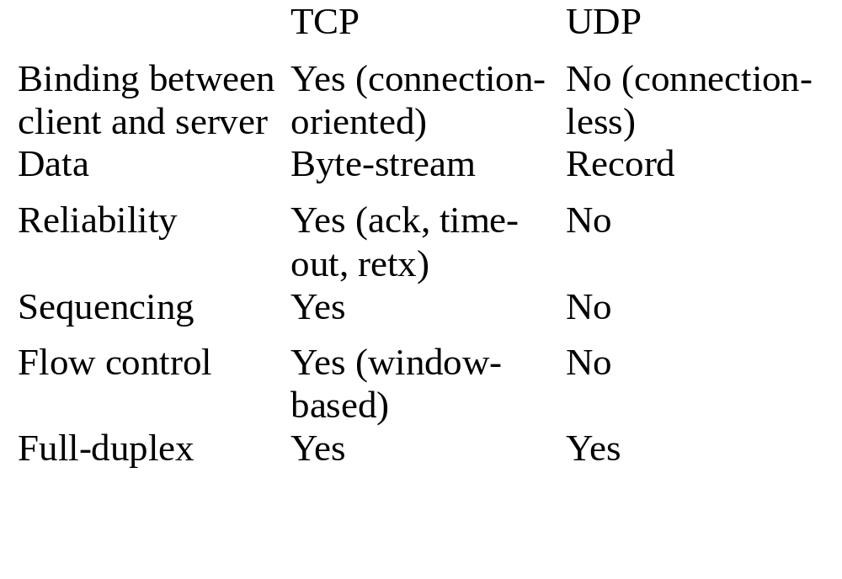
Comparing TCP and UDP

Slide 28
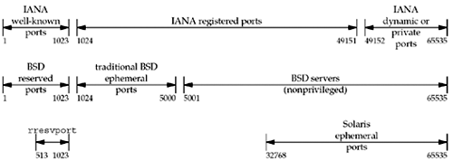
Allocation of Port Numbers

Slide 29
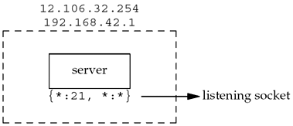
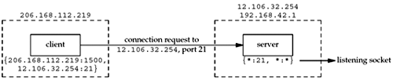
Multiple Sockets with the Same Port
All TCP segments destined for port 21, with socket pairs different from (206.62.226.35.21,198.69.10.2.1500) and (206.62.226.35.21,198.69.10.2.1501), are delivered to the original server with the listening socket.

Slide 30
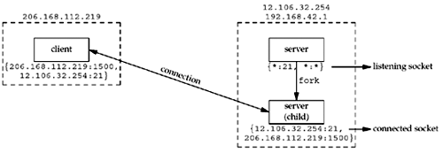
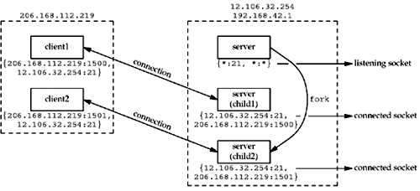
Multiple Sockets with the Same Port
(in Concurrent Server)
All TCP segments destined for port 21, with socket pairs different from (206.62.226.35.21,198.69.10.2.1500) and (206.62.226.35.21,198.69.10.2.1501), are delivered to the original server with the listening socket.

Slide 31
Size Matters:
MTU, datagram, TCP MSS, buffer
Link MTU (maximum transmission unit): Ethernet MTU: 1500 bytes, PPP MTU: configurable
Path MTU: the smallest link MTU in the path, can be discovered by IP DF (don’t fragment) bit
Maximum IP datagram: 65535 (IPv4), 65575 (IPv6) (IPv6 has 32-bit jumbo payload option), minimum IP reassembly buffer size
TCP MSS (maximum segment size): actual value of reassembly buffer size, often the link MTU minus IP and TCP headers, to avoid fragmentation

Slide 32
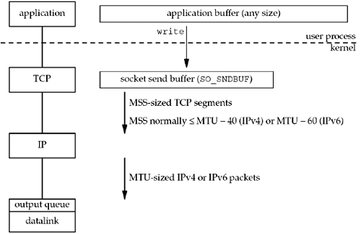
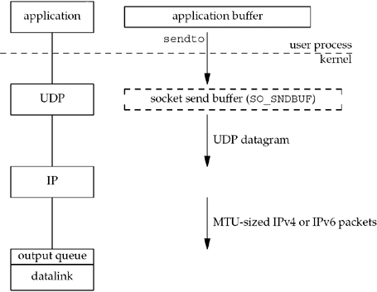
TCP Output and UDP Output

Slide 33
Standard Internet Services and Applications
Standard services provided by inetd daemon: echo/port7/RFC862, discard/port9/RFC863, daytime/port13/RFC867, chargen/port19/RFC864, time/port37/RFC868
tested by “telnet machine service”, service mapped by /etc/services
Common application types: diagnostic, routing protocol, datagram, virtual circuit, etc.

Slide 34
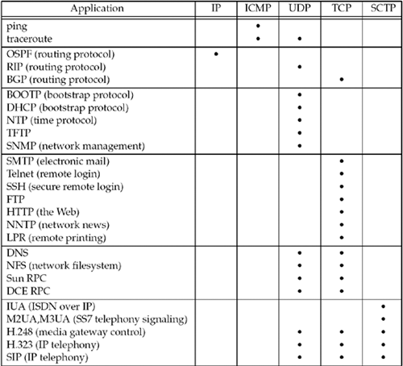
Protocol Usage of Various Common Applications

Slide 35
Debugging Techniques and Tools
System call tracing: truss (in SVR4), ktrace & kdump (in BSD) (Note that socket is a system call in BSD, while putmsg and getmsg are the actual system calls in SVR4)
sock developed by W.R. Stevens: used to generate special case conditions, as stdin/stdout client, stdin/stdout server, source client, sink server
tcpdump: dump packets matching some criteria
netstat: status of interfaces, multicast groups, per-protocol statistics, routing table, etc.
lsof (list open files): which process has a socket open on a specified IP address or port

