Slide 1

Content-Conditioned Positional Encoding
for Patch-Level Diffusion in
Time Series Forecasting
xCPE-TimeDART
Deep Learning - Spring 2026
MSML 612 - Group 1
Serjius Infanto Athreya Sudarshan Tharunkumar Chandrasekaran Anto Delin Xavier

Slide 2
1. INTRODUCTION
Project Overview
Time Series Forecasting Challenge
Predicting future values from historical sequential data is critical for energy grids, climate science, and industrial monitoring. State-of-the-art models like PatchTST and TimeDART achieve strong results by dividing time series into fixed-length patches and processing them with Transformer encoders.
Current Approach
The Problem
The Gap
Fixed positional encodings assign the same bias to every position, regardless of local signal dynamics
Real-world time series are non-stationary - statistical properties shift substantially over time
Models with fixed embeddings may confuse structurally similar dynamics at different positions

Slide 3
1. INTRODUCTION
Problem Statement
Research Question
Can replacing the fixed positional embedding in TimeDART with a content-conditioned encoding that adapts to local patch statistics improve forecasting accuracy on non-stationary benchmarks?
Why This Matters
Non-Stationarity
Fixed Encoding Limitation
Forecasting Challenge
ETTh1 and Weather datasets show significant distribution shifts across train/val/test splits
Standard positional embeddings cannot adapt to changing statistical properties over time
Longer horizons (720 steps) require models that generalize beyond training distribution

Slide 4
2. PROPOSED SOLUTION
Content-Conditioned Positional Encoding (xCPE)
Core Innovation: Encode position based on what a patch looks like, not where it sits. Two patches with identical local dynamics receive identical positional embeddings, regardless of their absolute position in the sequence.
Three-Step Process
Neighbourhood Gathering
Local Statistics Extraction
MLP Projection & Position Bias
For each patch i, collect the 3-token window:
Nᵢ = {xᵢ₋₁, xᵢ, xᵢ₊₁}
Zero-padding at sequence edges.
Collapse d-dimensional embeddings to scalar magnitudes.
Compute three scalars capturing neighbourhood dynamics:
μᵢ - local mean (level)
σ²ᵢ - local variance (volatility)
sᵢ - finite-diff slope (trend)
cᵢ = [μᵢ, σ²ᵢ, sᵢ]ᵀ ∈ ℝ³
2-layer MLP with GELU:
MLP : ℝ³ → ℝ⁶⁴
x̃ᵢ = xᵢ + MLP(cᵢ)
Only ~12K parameters
Position-invariant by design
Dropout 0.1 for regularization

Slide 5
3. TOOLS AND TECHNOLOGIES
Technology Stack
PyTorch
Framework
Hugging Face Accelerate
Training
Deep learning framework for model implementation and training
FP16 mixed precision training to fit 8GB VRAM constraint
NumPy & Pandas
Data Processing
Plotly
Visualization
Data preprocessing, normalization, and time series manipulation
Interactive visualizations for EDA and results analysis
Weights & Biases
MLOps
Git & GitHub
DevOps
Experiment tracking, hyperparameter logging, and metrics monitoring
Version control, collaboration, and code management

Slide 6
4. ARCHITECTURE
TimeDART Pipeline with xCPE
Diffusion
Head
Channel
Independence
Patch
Tokenization
P=16
Linear
Embedding
P→d
xCPE
Module
Causal
Transformer
×3 layers
Input
B×T×C
Forecast
Head
Model Configuration
Architecture: d_{model}=64 , n_{heads}=4 , n_{layers}=3 , dff=256 , dropout=0.1
Pre-training: AdamW (lr=1e-4) , 50 epochs , Batch size 32 , 50% patch masking
Fine-tuning: AdamW (lr=5e-5) , 5 warm-up epochs + 30 training epochs , MSE loss
Hardware: NVIDIA RTX 4070 (8GB VRAM) , FP16 mixed precision via Accelerate

Slide 7
4. ARCHITECTURE
xCPE Module - Detailed Architecture
INPUT
STATISTICS
MLP & OUTPUT
μᵢ = (1/3) Σⱼ vⱼ
2-Layer MLP
ℝ³ → ℝ⁶⁴ → ℝ⁶⁴
Patch Embeddings
x ∈ ℝB×L×d
Local Mean
(level)
GELU activation
Dropout 0.1
12K parameters
Neighbourhood Gathering
Nᵢ = {xᵢ₋₁, xᵢ, xᵢ₊₁}
Zero-pad at edges
σ²ᵢ = (1/3) Σⱼ (vⱼ-μᵢ)²
Local Variance
(volatility)
Feature Collapse
vⱼ = (1/d) Σₖ xⱼ,ₖ
Average over features
Position Bias
x̃ᵢ = xᵢ + MLP(cᵢ)
sᵢ = (vᵢ₊₁ - vᵢ₋₁)/2
3 scalar magnitudes
per neighbourhood
Local Slope
(trend)
Position-invariant
Content-conditioned
cᵢ = [μᵢ, σ²ᵢ, sᵢ]ᵀ ∈ ℝ³

Slide 8
5. LIVE DEMO
LIVE DEMONSTRATION

Slide 9
6. EVALUATION
Performance Evaluation Setup
Benchmark Datasets
ETTh1
Weather
Steps: 17,420
Steps: 52,696
Variates: 7
Variates: 21
Frequency: 1h
Frequency: 10min
Split: 60/20/20
Split: 70/10/20
Performance Metrics
Experimental Design
MSE (Mean Squared Error)
Primary metric: MSE = (1/n) Σ(ŷᵢ - yᵢ)²
MAE (Mean Absolute Error)
Secondary metric: MAE = (1/n) Σ|ŷᵢ - yᵢ|
Forecast Horizons: H ∈ {96, 192, 336, 720} steps
Model Variants: 5 (baseline, xCPE all/early/late, RoPE)
Random Seeds: 3 per configuration (42, 123, 456)
Total Experiments: 60 runs per dataset

Slide 10
7. RESULTS
ETTh1 Dataset - Performance Results
MSE (Mean Squared Error) - Lower is Better
Variant
H=96
H=192
H=336
H=720
Key Findings
Baseline
0.419
0.466
0.521
0.639
xCPE (All) achieves lowest MSE at H=192, 336, 720
RoPE
0.425
0.477
0.529
0.650
Improvement grows with horizon length
xCPE (All)
0.422
0.457
0.508
0.613
4.0% MSE reduction at H=720 vs baseline
xCPE (Early)
0.433
0.487
0.538
0.658
RoPE underperforms - content-conditioning is key
xCPE (Late)
0.434
0.482
0.520
0.646
Early layers benefit more from xCPE than late layers
Best Performance at H=720: xCPE (All) = 0.613 Baseline = 0.639 Improvement: 4.0%

Slide 11
7. RESULTS
Weather Dataset - Performance Results
MSE (Mean Squared Error) - Lower is Better
Variant
H=96
H=192
H=336
H=720
Key Findings
Baseline
0.158
0.204
0.256
0.331
xCPE (All) outperforms all variants across all horizons
RoPE
0.161
0.209
0.262
0.338
Consistent improvements demonstrate robustness
xCPE (All)
0.155
0.196
0.244
0.313
5.5% MSE reduction at H=720 vs baseline
xCPE (Early)
0.160
0.207
0.252
0.327
Stronger gains on Weather than ETTh1
xCPE (Late)
0.156
0.201
0.251
0.329
xCPE excels on highly non-stationary data (21 variates)
Best Performance at H=720: xCPE (All) = 0.313 Baseline = 0.331 Improvement: 5.5%

Slide 12
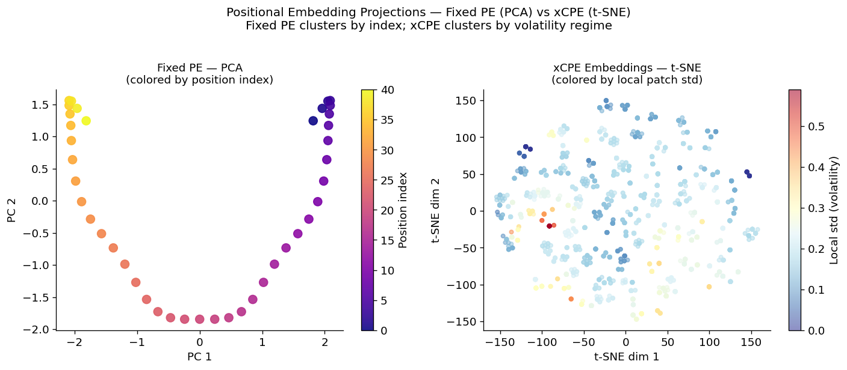
7. RESULTS
Fixed Position Embedding - PCA
xCPE Embedding- t-SNE

Slide 13
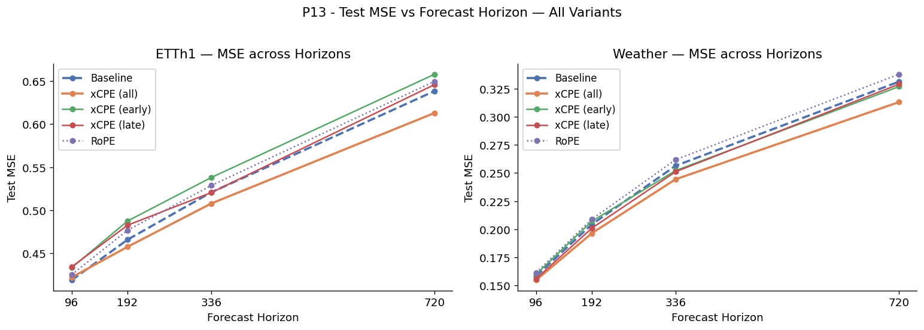
7. RESULTS
Test MSE vs Forecast Horizon

Slide 14
8. LIMITATIONS
Limitations & Constraints
Model Scale
Dataset Coverage
Small Transformer architecture (d_{model}=64, 3 layers) constrained by 8GB VRAM
Primary evaluation on 2 datasets (ETTh1, Weather) from similar domain
Impact: May underestimate xCPE's potential on larger models
Impact: Additional benchmarks needed to confirm cross-domain robustness
Fixed Statistics
3-neighborhood window with predetermined statistics (μ, σ², slope)
Impact: Learnable aggregation functions or adaptive windows unexplored

Slide 15
8. FUTURE SCOPE
Future Research Directions
Scale & Performance
Theoretical Analysis
Train on larger Transformers (d_{model}=256+, 8+ layers)
Fourier analysis of learned positional patterns
Evaluate on production-scale datasets
Attention map visualization and interpretation
Optimize inference for real-time applications
Formal analysis of position-invariance properties
Architectural Extensions
Learnable aggregation functions vs fixed statistics
Adaptive neighborhood size (vs fixed 3-token window)
Integration with attention mechanisms

Slide 16
Conclusion
Key Contributions
Novel Adaptation: Successfully adapted xCPE from 3D point clouds to 1D time series forecasting
Empirical Validation: Demonstrated 4-5.5% MSE reduction on non-stationary benchmarks (ETTh1, Weather)
Content vs Flexibility: Proved content-conditioning outperforms positional flexibility (RoPE comparison)
Scaling Properties: Confirmed improvement scales with forecast horizon - stronger gains at H=720
Efficiency: Achieved position-invariance with only ~12K additional parameters
Impact & Significance
Content-conditioned positional encoding offers a principled approach to handling non-stationarity in time series forecasting. By encoding position based on local dynamics rather than absolute index, xCPE provides a robust inductive bias that generalizes effectively across distribution shifts.

Slide 17
References
[1] Wang, Y., et al. TimeDART: A Diffusion Auto-Regressive Transformer for Self-Supervised Time Series Representation. International Conference on Learning Representations (ICLR), 2025. https://github.com/Melmaphother/TimeDART
[2] Wu, X., et al. Point Transformer V3: Simpler, Faster, Stronger. IEEE/CVF Conference on Computer Vision and Pattern Recognition (CVPR), 2024. https://github.com/Pointcept/ PointTransformerV3
[3] Nie, Y., et al. A Time Series is Worth 64 Words: Long-term Forecasting with Transformers. International Conference on Learning Representations (ICLR), 2023.
[4] Ho, J., Jain, A., and Abbeel, P. Denoising Diffusion Probabilistic Models. Advances in Neural Information Processing Systems (NeurIPS), 2020.
[5] Su, J., et al. RoFormer: Enhanced Transformer with Rotary Position Embedding. arXiv:2104.09864, 2021.
[6] Zhou, H., et al. Informer: Beyond Efficient Transformer for Long Sequence Time-Series Forecasting. AAAI Conference on Artificial Intelligence, 2021.

Slide 18
Thank You
Group 1 MSML 612 Deep Learning - Spring 2026
Serjius Infanto Athreya Sudarshan Tharunkumar Chandrasekaran Anto Delin Xavier

