Slide 1

Project Task
1. Create book store management web application
2. Apply MySQL database to accessing and managing data
3. Focus on performance optimization
Notes:
<number>
<number>

Slide 2

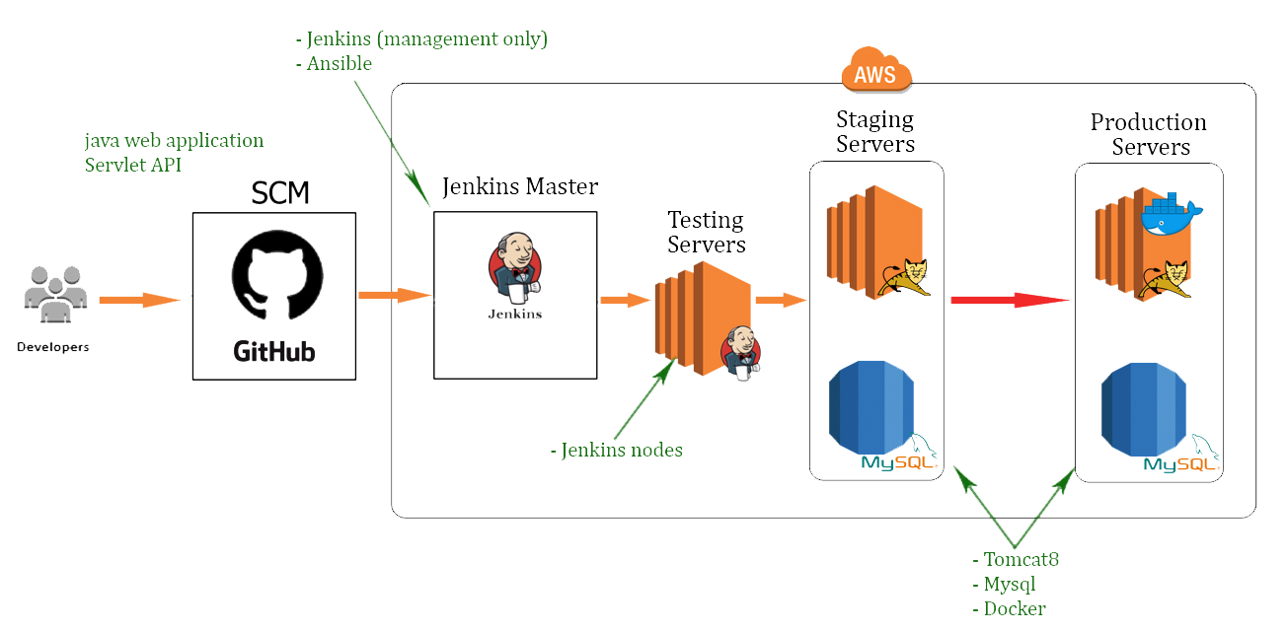
CI/CD Pipeline
Notes:
<number>
<number>

Slide 3
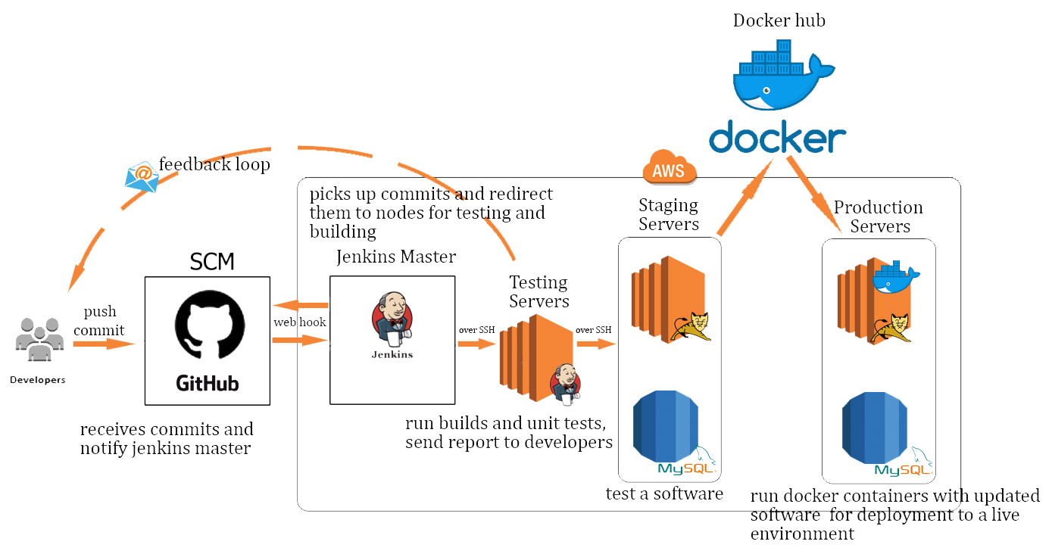
CI/CD Stages
Notes:
<number>
<number>

Slide 4


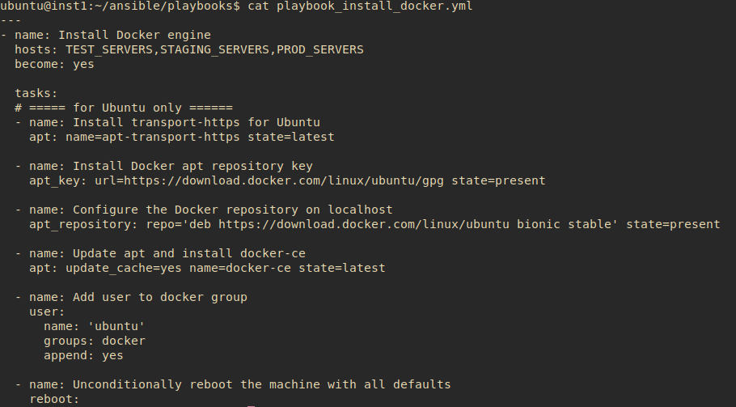
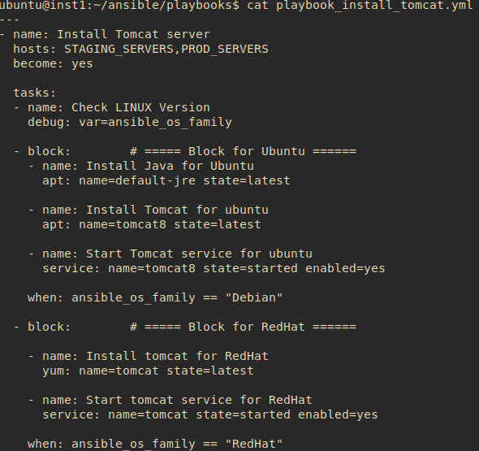
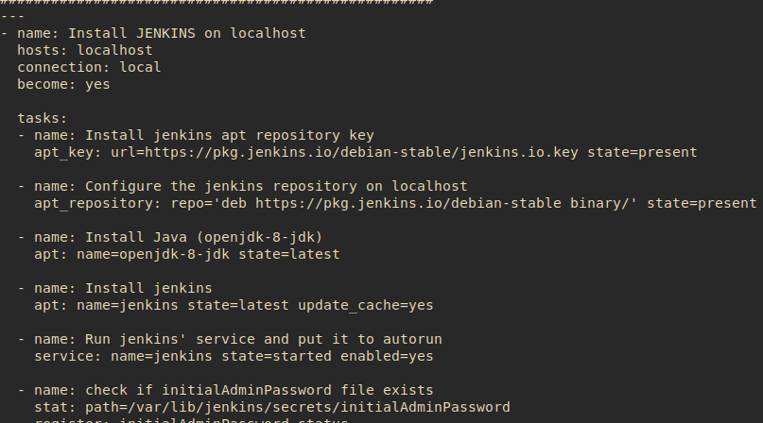
Servers Configuration with Ansible Playbooks
1. Install Ansible on Jenkins Master server
2. Run Ansible Playbook for Jenkins Master to
configure required software on it
3. Setup required software on all servers
by running Ansible Playbooks
Notes:
<number>
<number>

Slide 5


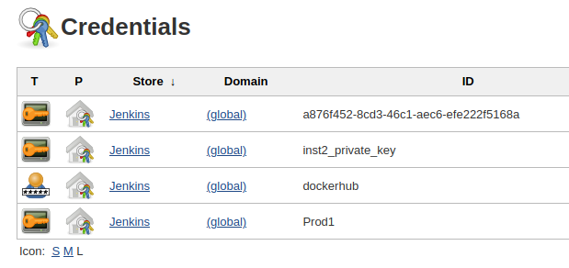
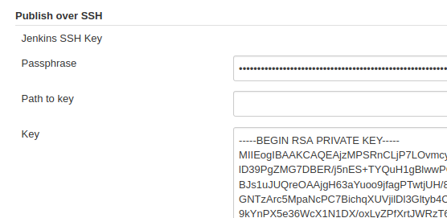
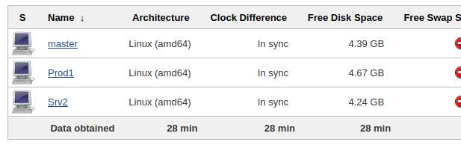
Jenkins Configuration
1. Setup plugins for Jenkins
2. Add required credentials for GitHub, Nodes etc.
3. Create and configure the pipeline
Builds run on jenkins nodes only !
Notes:
<number>
<number>

Slide 6



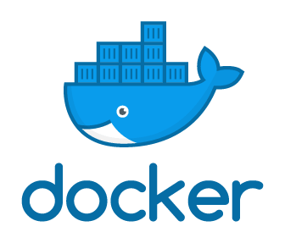
Building And Unit Testing
- Unit testing - JUNIT
- Maven builds war archive
- Feedback Loops
Testing Environment
- Publishing release on Staging servers
- Tests
- Sending Docker image with new version of release to Docker Hub
Deploying To Production
- Run Docker container with the desired version of software on production servers
Notes:
<number>
<number>

Slide 7
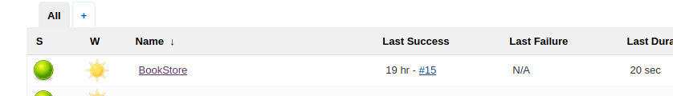
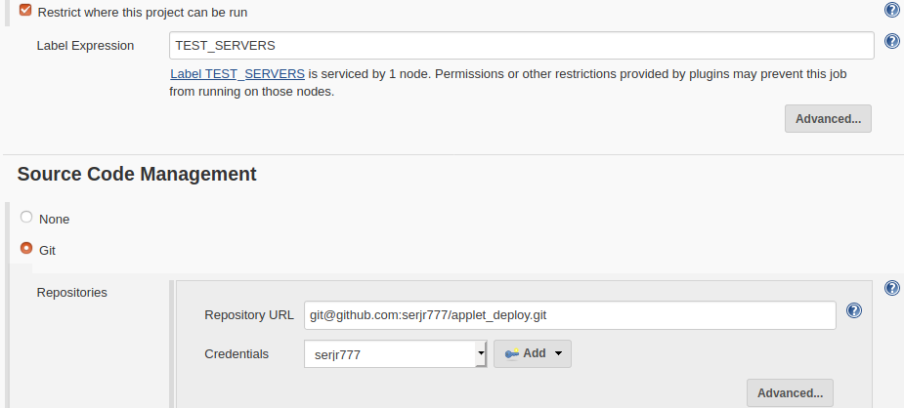
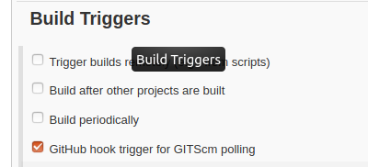
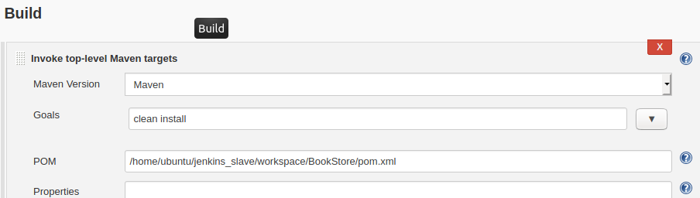
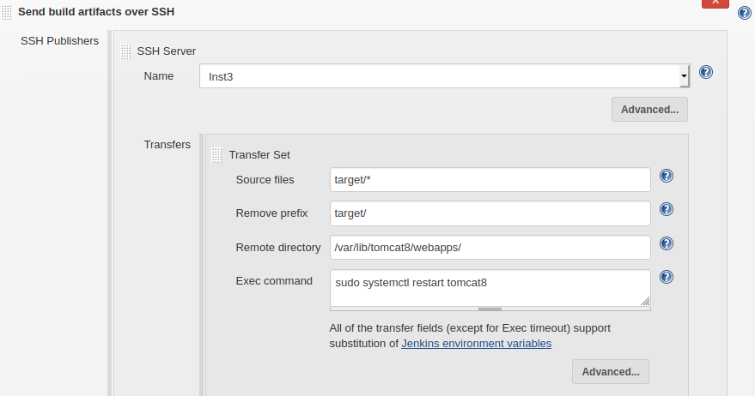
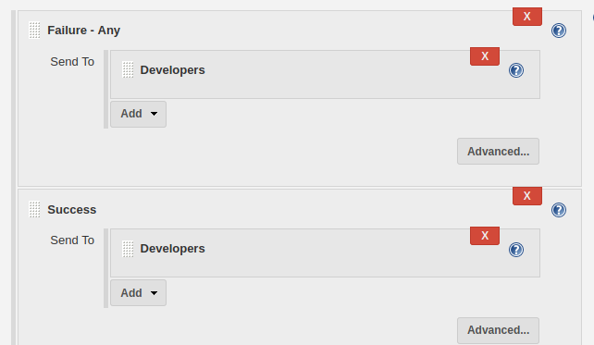
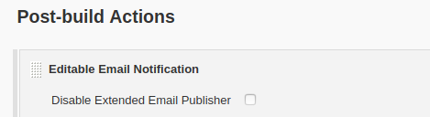
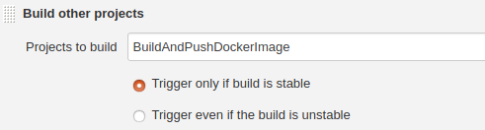
Jobs Implementation
Notes:
<number>
<number>

Slide 8
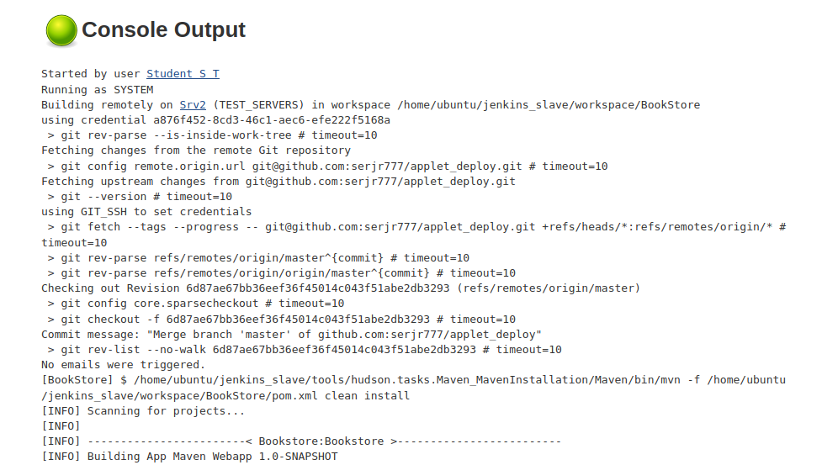
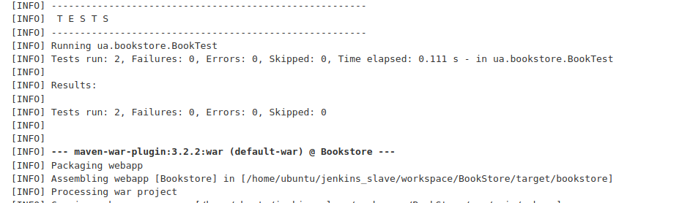
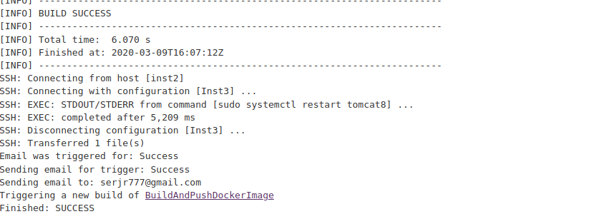
Jobs Implementation
Notes:
<number>
<number>

Slide 9
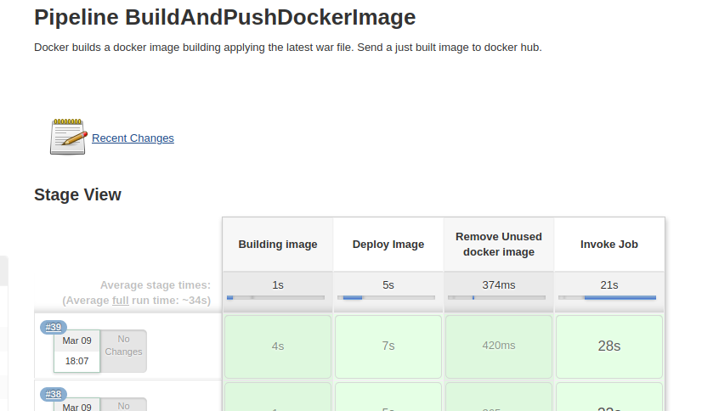
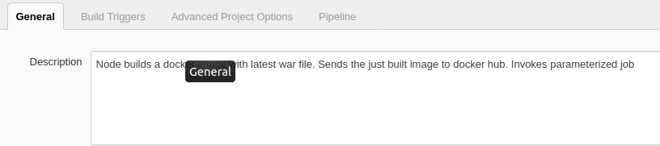
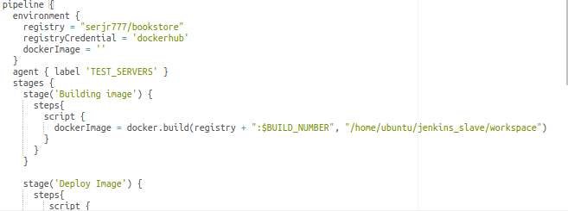
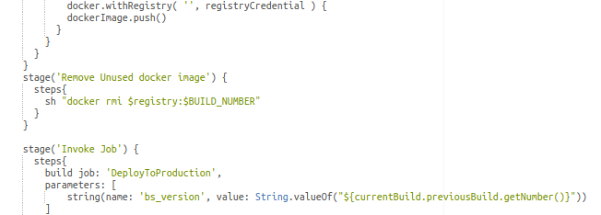

Jobs Implementation
Notes:
<number>
<number>

Slide 10
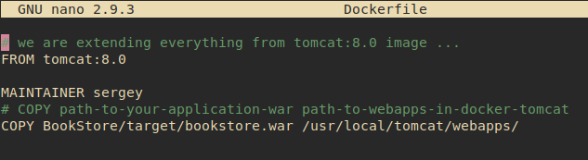
Jobs Implementation
Notes:
<number>
<number>

Slide 11

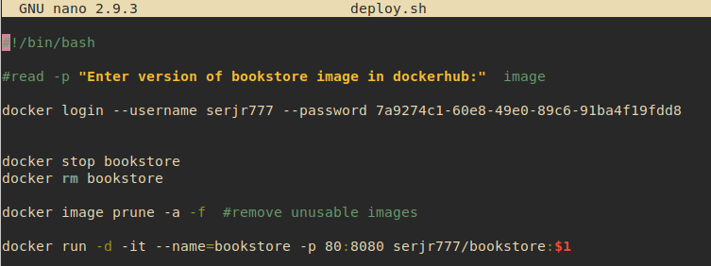
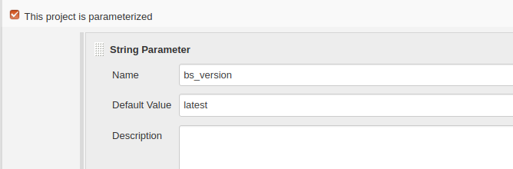
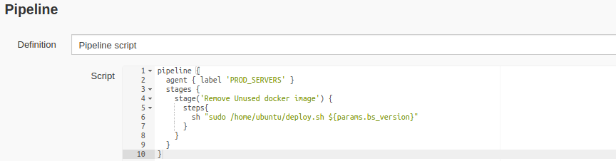
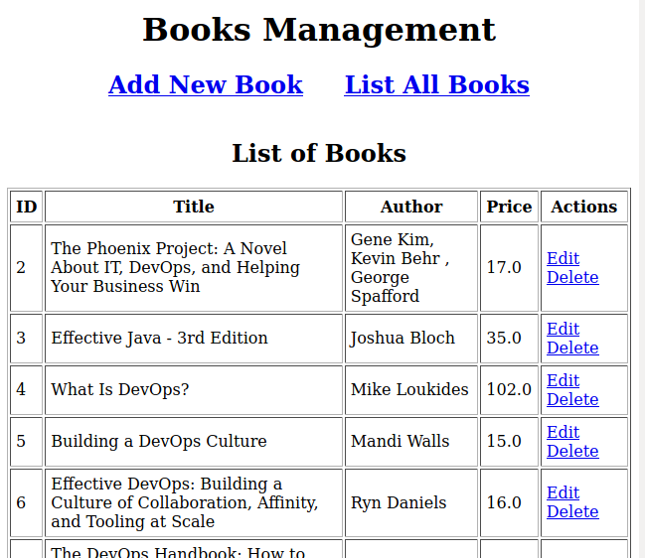
Jobs Implementation
Notes:
<number>
<number>

Slide 12

Pros and Cons

Slide 13
Questions

Slide 14
Thank you !

