Slide 1
Pose Recognition Web App
AI-Powered Real-Time Pose Detection with Local Model Support
Replit Development Team
July 09, 2025

Slide 2
What is Pose Recognition App?
Real-time pose detection using webcam input
Offline functionality - no internet required after setup
Customizable settings for 1-7 poses
Local model support with Teachable Machine integration
Distance calibration for optimal positioning
Audio feedback and visual guidance

Slide 3
Core Features
Pose Recognition System:
• Support for 1-7 customizable poses
• Real-time confidence scoring (30-90% threshold)
• Visual pose comparison with reference images
• Skeletal tracking with 17 keypoints
Customization Options:
• Adjustable recognition delay (1-10 seconds)
• Custom pose names (editable labels)
• Audio beep toggle for success feedback
• Distance calibration with real-time guidance

Slide 4
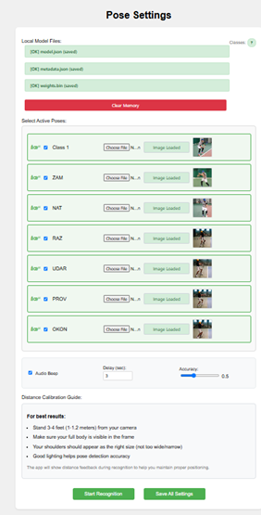
GUI: Settings Interface
Key Features:
• Local model file uploads (model.json, metadata.json, weights.bin)
• Pose selection checkboxes for 1-7 poses
• Reference image uploads for each pose
• Audio, delay, and accuracy threshold controls
• Distance calibration guide

Slide 5
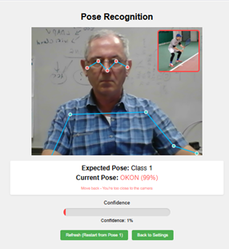
GUI: Recognition Interface
Real-time Features:
• Live webcam feed with pose detection
• Current vs Expected pose display
• Confidence bar with color coding (green = correct, red = incorrect)
• Reference image comparison
• Refresh and back to settings controls

Slide 6
Technical Specifications
AI Framework:
• TensorFlow.js with Teachable Machine models
• PoseNet for 17-keypoint skeletal tracking
• Local storage with IndexedDB for offline use
Compatibility:
• Modern browsers with WebRTC support
• Optimized for Windows compatibility
• Automatic image compression for storage
• Multiple camera resolution fallback

Slide 7
Easy Setup Process
1. Train Your Model: Use Teachable Machine to create pose model
2. Upload Files: Import model.json, metadata.json, weights.bin
3. Configure Poses: Select 1-7 poses and upload reference images
4. Adjust Settings: Set audio, delay, and accuracy preferences
5. Start Recognition: Begin real-time pose detection
Fully Offline: Works completely without internet after initial setup

Slide 8
Advanced Features
Distance Calibration:
• Auto-detection of user distance from camera
• Real-time feedback for optimal positioning (3-4 feet)
• Visual cues: Green = perfect, Red = adjust distance
Data Management:
• Save all settings and model files locally
• Clear memory function with confirmation
• Auto-save for pose selections and custom names
• Persistent settings across browser sessions

Slide 9
Use Cases
• Fitness Training: Monitor exercise form and technique
• Yoga Practice: Guide through pose sequences with feedback
• Physical Therapy: Track rehabilitation exercises
• Sports Coaching: Analyze athletic movements
• Education: Teach proper posture and movement
• Accessibility: Assistive technology for movement training

Slide 10
Key Benefits
Privacy & Security:
• No data sent to external servers
• Local processing ensures privacy
• Offline functionality protects user data
User Experience:
• Instant feedback with audio and visual cues
• Customizable difficulty and timing
• Clear progress tracking through pose sequences

Slide 11
Get Started Today!
Transform your training experience with Pose Recognition Web App
Available on Replit: Easy deployment and sharing
Open Source: Customizable for your needs
No Installation: Run directly in your browser
Ready to Use:
• Deploy instantly on Replit
• Share with your team or students
• Customize for specific use cases

