Slide 1
Serkan EROL
150122619
Yusuf Emir ONAN
524125010
Başak AKYÜZ
150122827
BattleGrid
Web-Based Multiplayer Battleship
CSE3044 Software Engineering Project

Slide 2
1. Problem Definition

Slide 3
What is the project about?
BattleGrid is a web-based multiplayer version of the classic Battleship game.
Registered players log in, are matched by rank, and compete in turn-based online matches.
The project addresses the need for a fair and synchronized online version of Battleship by handling matchmaking based on rankings, ship placement validation, turn control, result calculation, ranking, leaderboard, and match history through a server-based system.
Course term project for CSE3044 Software Engineering

Slide 4
Problem Statement
Battleship is traditionally played between two players
Multiplayer real-time gameplay requires synchronization
Rules must be enforced consistently
Server-side management is required

Slide 5
Motivation and why it matters
Provides a fair, structured, competitive online multiplayer experience for the classic strategy game.
Demonstrates full software engineering; requirements, design, implementation, testing, and deployment.
Combines REST APIs for persistence with SignalR for real-time matchmaking and gameplay. This implementation demonstrates problem solving skills by finding middle ground between performance and data persistence.

Slide 6
2. Project Aims

Slide 7
Project aims
Implement ranking-based matchmaking for fair competition.
Validate ship placements and player actions according to game rules.
Provide real-time turn-based gameplay between two players.
Maintain player statistics, rankings, and match history.
Administrative controls (ban players, season/leaderboard management).
Ultimately, develop a web-based multiplayer version of the classic Battleship game.
Deploy and enjoy!

Slide 8
3. Related Work

Slide 9
Similar systems and our contribution
Classic Battleship: Local or hot-seat play; limited online ranking and persistence.
Other web-based versions that either;
Do not implement in-memory game play. These systems have a high response time problem.
Implement in-memory game play but do it so in a manner that jeopardizes the security and fairness of the games.
Generic ASP.NET SignalR demos: Real-time messaging without full game rules or matchmaking.
BattleGrid adds:
PostgreSQL-backed accounts and player stats for persistence,
Ranking-based queue logic,
Seasons and ranking carry over calculations for new seasons
Match replay,
Admin moderation.
Design Decisions:
Ranking-based matchmaking over random FIFO for fair competition.
In-memory game management for performance
Batched DB writes (placements after both ready, moves after match end) for persistence.

Slide 10
4. Scope

Slide 11
Constraints and assumptions
In Scope
Web browser clients
User registration, authentication, and authorization
Rank-based matchmaking
Ship placement validation
Real-time multiplayer gameplay
Server-side rule enforcement
Leaderboard and ranking system
Match History tracking
Match replay capability
Administrative controls

Slide 12
Out of Scope:
AI opponent and
In-game chat
were future requirements. As the team anticipated, given timeframe was not enough to reach these goals
Spectator mode
was also a future requirement. The team could not reach it but implemented something that could count as a first step towards this functionality: Match replay capability
Tournament system
Mobile-native apps
were marked as out of scope from the start. Since the team’s knowledge and experience were limited in this field, the time frame was limited, and each platform required its own platform specific language, mobile apps were deemed as not feasible for this project

Slide 13
Other targets, constraints and assumptions:
NFR targets:
Login/register under 2s
In-game actions under 200ms
10+ concurrent players.
Assumption:
Stable internet on both our server and client’s side
Clients use a modern web browser that support standard technologies, like HTTPS
Players know Battleship rules
We know better and we know people to cheat. So, rules enforcement is completely on the server side
Deployment:
Production on Render (HTTPS at edge)
Docker for local and cloud containers.

Slide 14
5. Methodology and Technical Approach

Slide 15
Architecture and Technology Stack
A Client-Server style system architecture is used to ensure the system met the requirements
Client / Frontend: Blazor Server (browser UI, server-side rendering)
Server / Backend: ASP.NET Core .NET 10
API, Application, Domain, Infrastructure, Contracts layers
RESTful API: Controllers for auth, users, ships, matches, admin, leaderboard, replay
Security: JWT access and base64 refresh tokens. HttpOnly cookies on Web. CORS for production origins. BCrypt for securely hashed and saved passwords
SignalR: Real-time communication between server and client. QueueHub (/queue) for matchmaking; GameHub (/game/{matchId}) for real-time play
Data:
PostgreSQL 18 database
Entity Framework Core as ORM
Testing: xUnit, SwaggerUI, in-house console app
Deployment
Docker
Render

Slide 16
Development Methodology
Agile like iterative development approach with informal 2-week sprints: Features implemented incrementally. Implement, then test/validate. Order:
Database
Backend services and domain game logic
SignalR hubs
Blazor frontend
Extras.
Continuous testing development
Unit tests and manual testing performed throughout the project
API tested via Swagger and integration tests
Game logic tested independently with xUnit and console app
Git and GitHub used for version control
Key algorithms
MatchmakingCoordinator: Finds suitable opponents based on player’s ranking and elapsed time in queue
Ranking change after a game: Based on the ranking difference between opponents

Slide 17
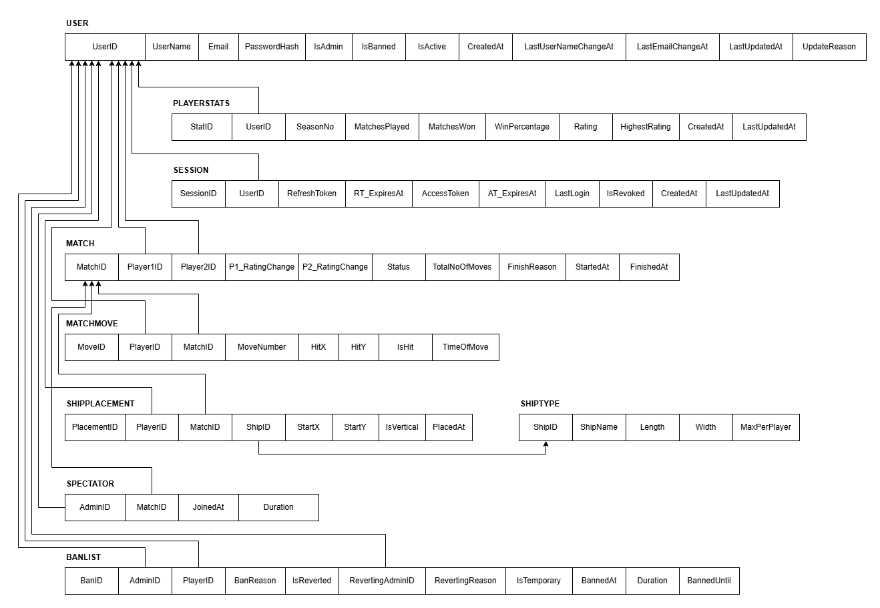
Database Structure

Slide 18
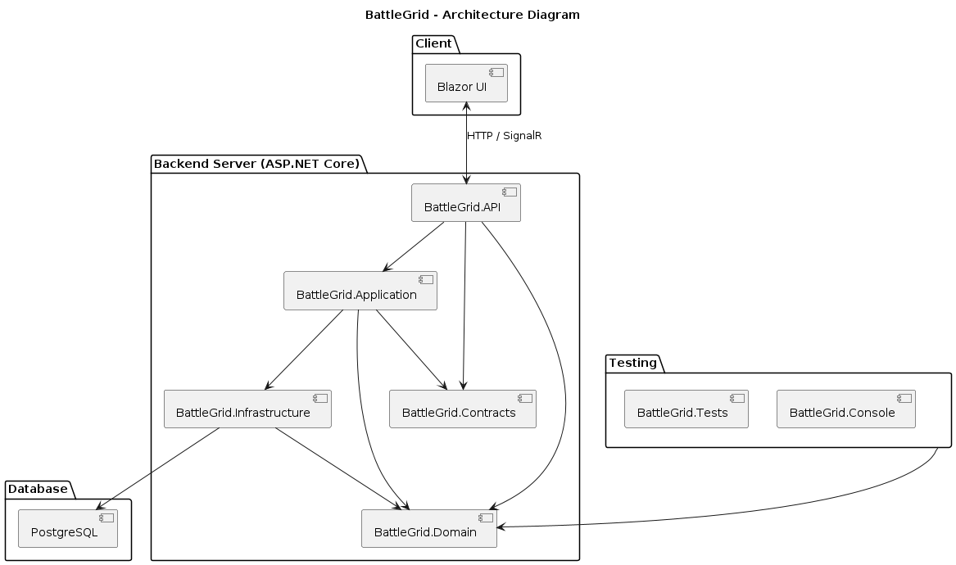
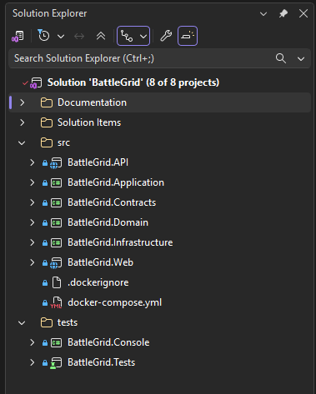
System Architecture
BattleGrid follows a layered architecture consisting of API, Application, Domain, Infrastructure, Contracts, and Presentation layers.

Slide 19
System Architecture
API → Handles client requests
Application → Coordinates business workflows
Domain → Implements game rules
Infrastructure → Database operations
Contracts → DTO definitions
Blazor UI → User interface

Slide 20
Real-Time Multiplayer Communication
SignalR is used for real-time communication
QueueHub manages matchmaking requests
GameHub synchronizes game actions between players
Server-side validation ensures fair gameplay

Slide 21
6. Tasks Accomplished

Slide 22
Completed deliverables
Requirements: RSD with functional/non-functional requirements and UML use cases.
Design: DSD with per-component narratives (API, Application, Domain, Infrastructure, Contracts).
Database: ER/relational diagrams, SQL scripts, Docker/Render PostgreSQL.
Backend: All planned services, Swagger, JWT, SignalR hubs, background jobs.
Frontend: Auth, dashboard, queue, game UI, leaderboard, history, admin, settings, replay.
Testing: Unit and integration tests; console app and Swagger UI for manual/dynamic testing.
Deployment: Dockerfiles; live production on Render - fully functional.

Slide 23
Core Functionality Implemented
User registration and authentication
JWT based authorization
Real-time queueing system
Real-time multiplayer gameplay
Ship placement validation
Turn-based game management
Server-side rule enforcement
Match end detection and result calculation

Slide 24
Additional Features Implemented
Ranking system
Leaderboard
Match history
Administrative controls
User settings
Match replay functionality

Slide 25
Infrastructure & Deployment
PostgreSQL database integration
Docker-based development environment
RESTful API controlled data operations
SignalR real-time communication
Render deployment production environment
Automated unit and integration testing

Slide 26
7. Implementation and Screenshots

Slide 27
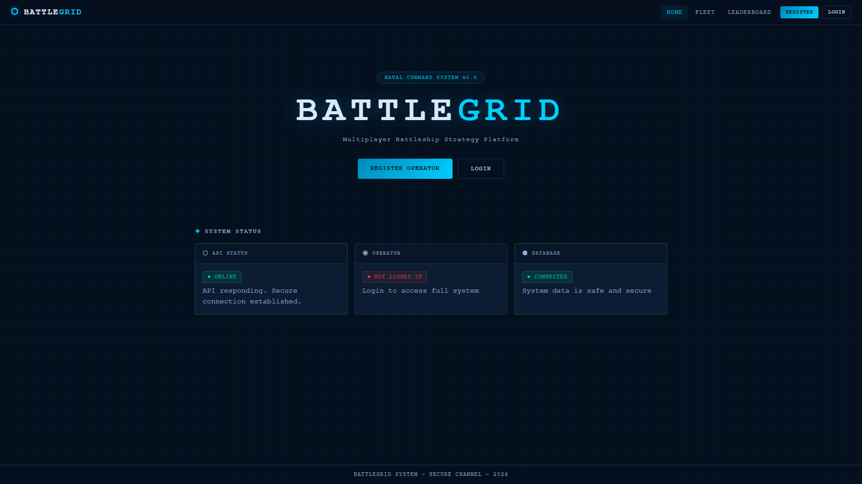
Home and System Status
Command center with API health, operator session, and database health checks

Slide 28
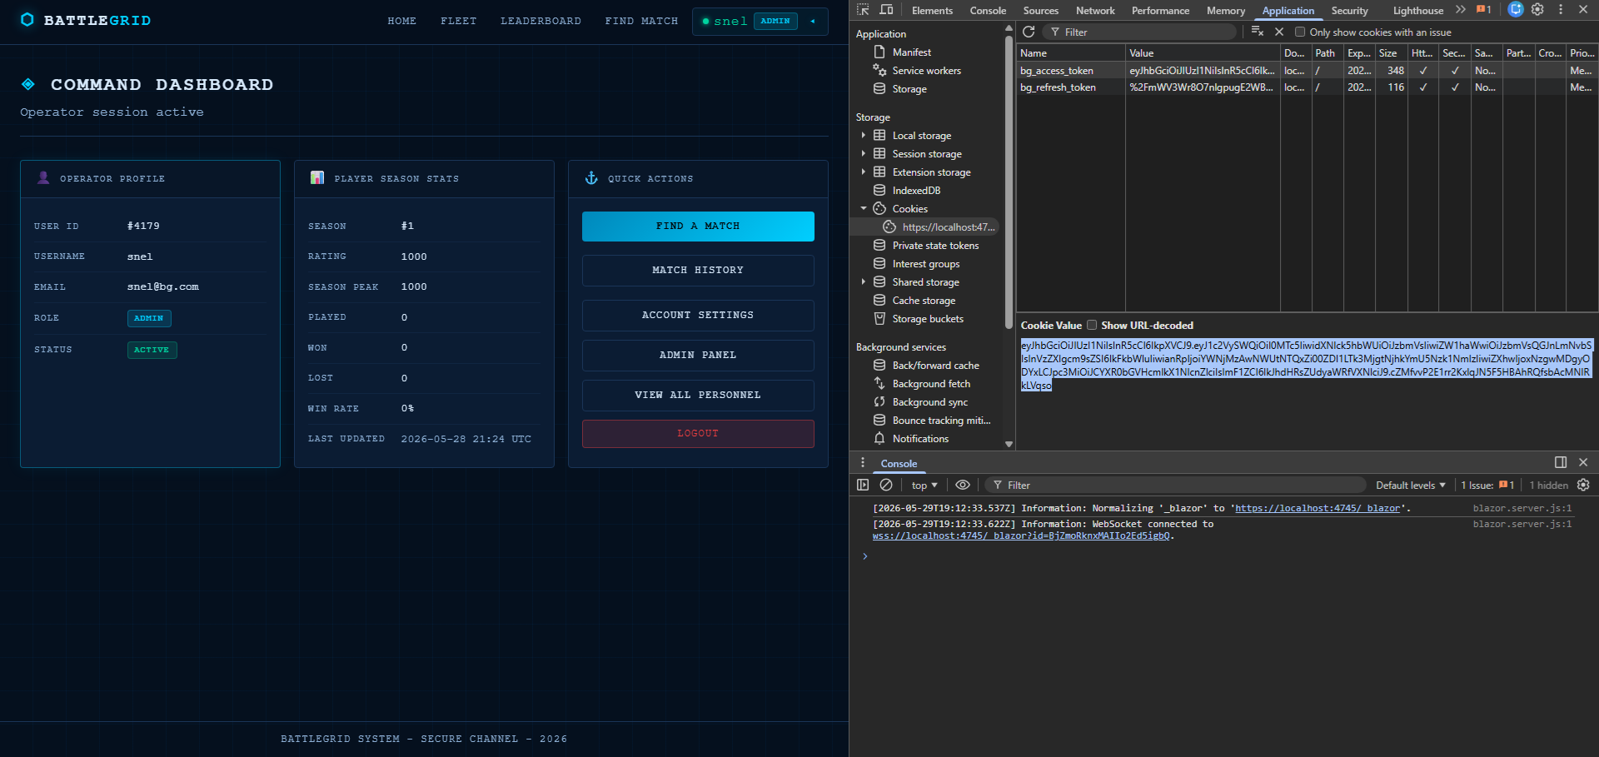
Authentication and Authorization
Register and login; JWT session via secure cookies

Slide 29
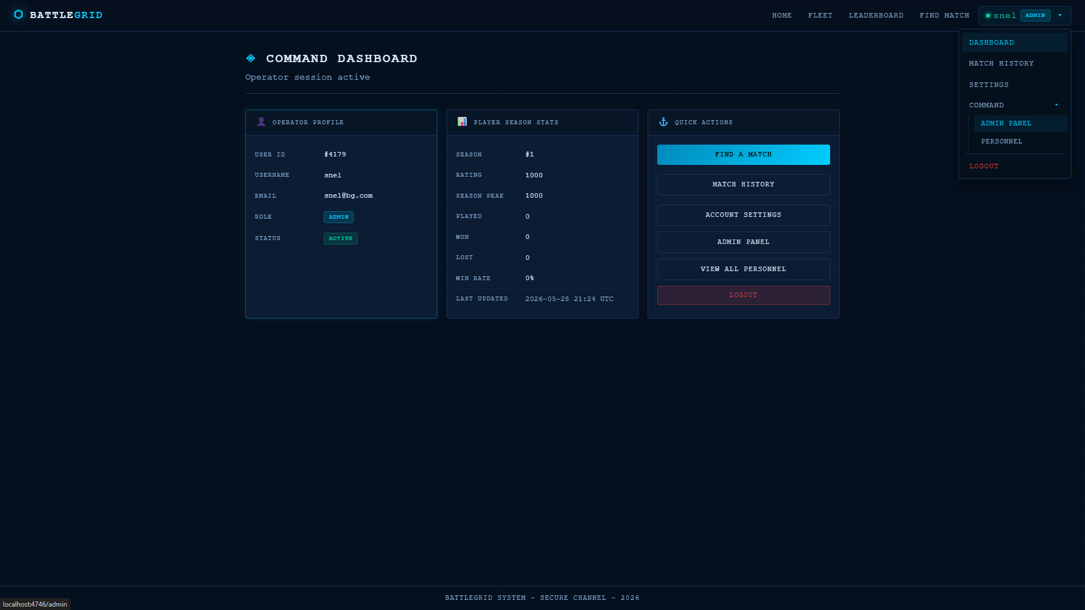
Dashboard
User information, player stats, quick actions

Slide 30
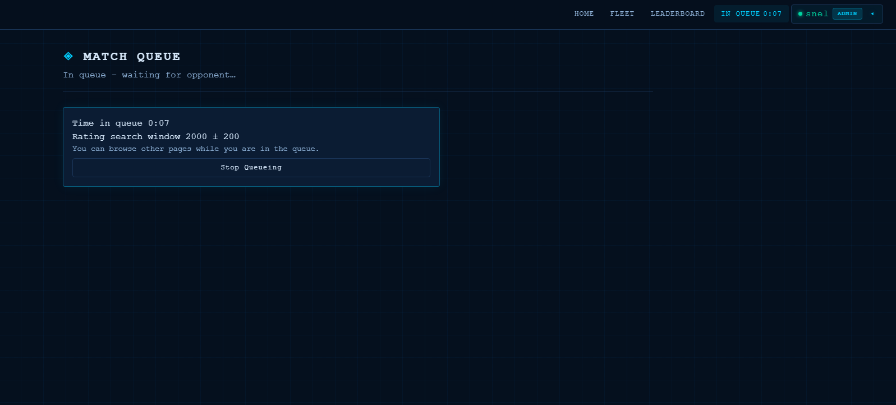
Queue and Timer
Real-time queue and ranking and elapsed time-based matchmaking

Slide 31
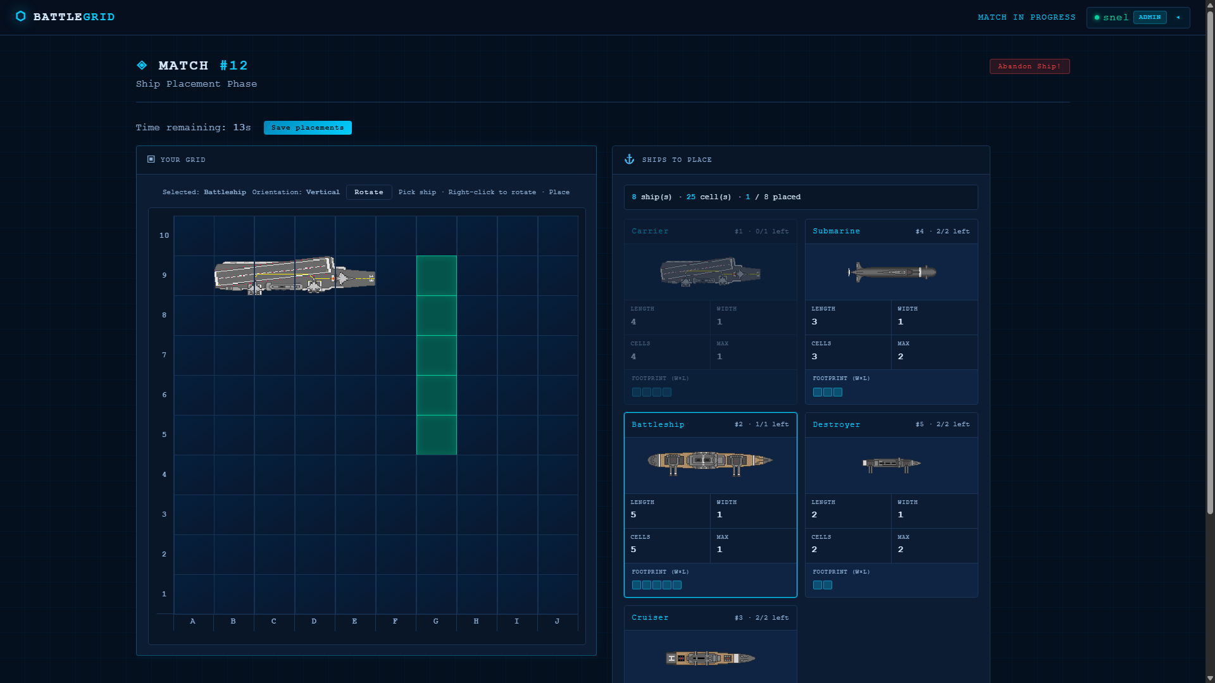
Gameplay – 1
Ship placement

Slide 32
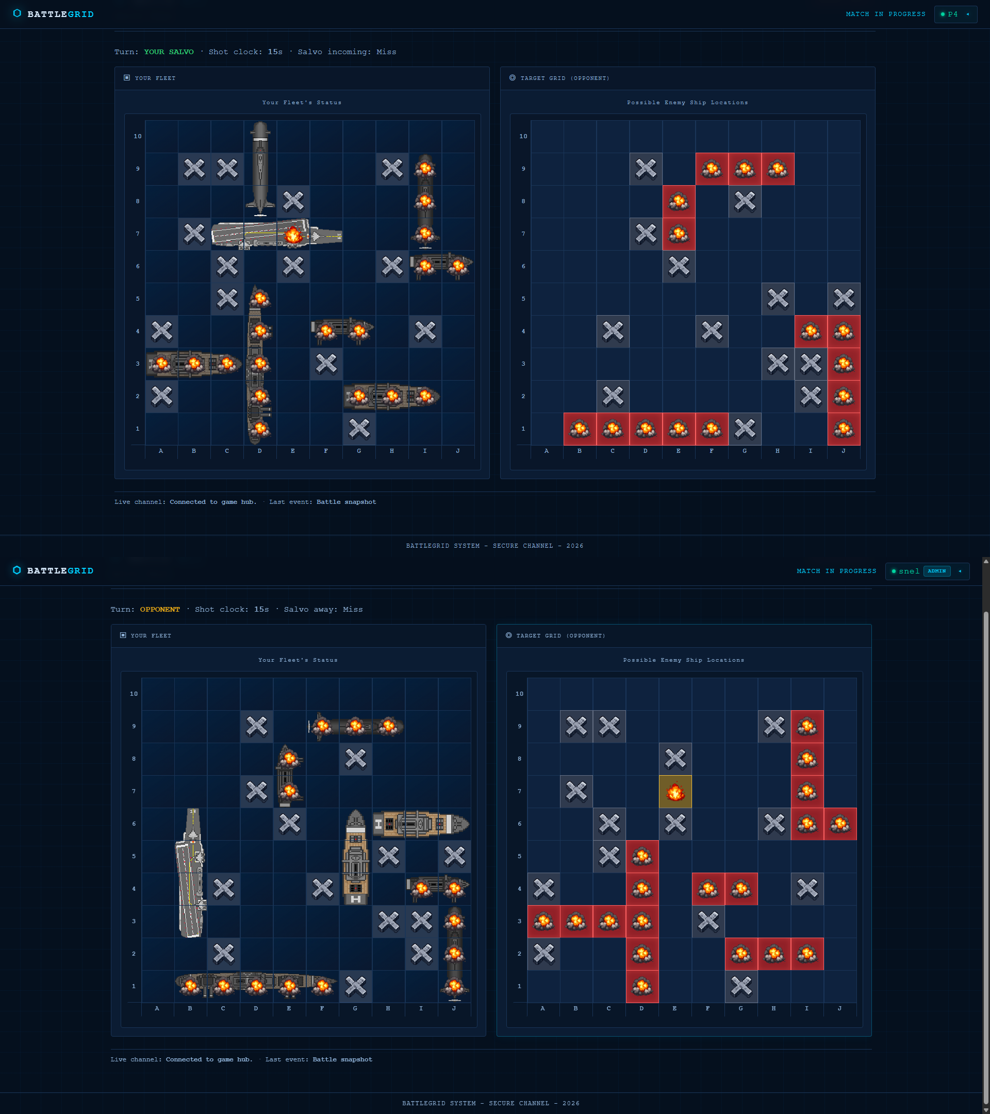
Gameplay – 2
Game phase

Slide 33
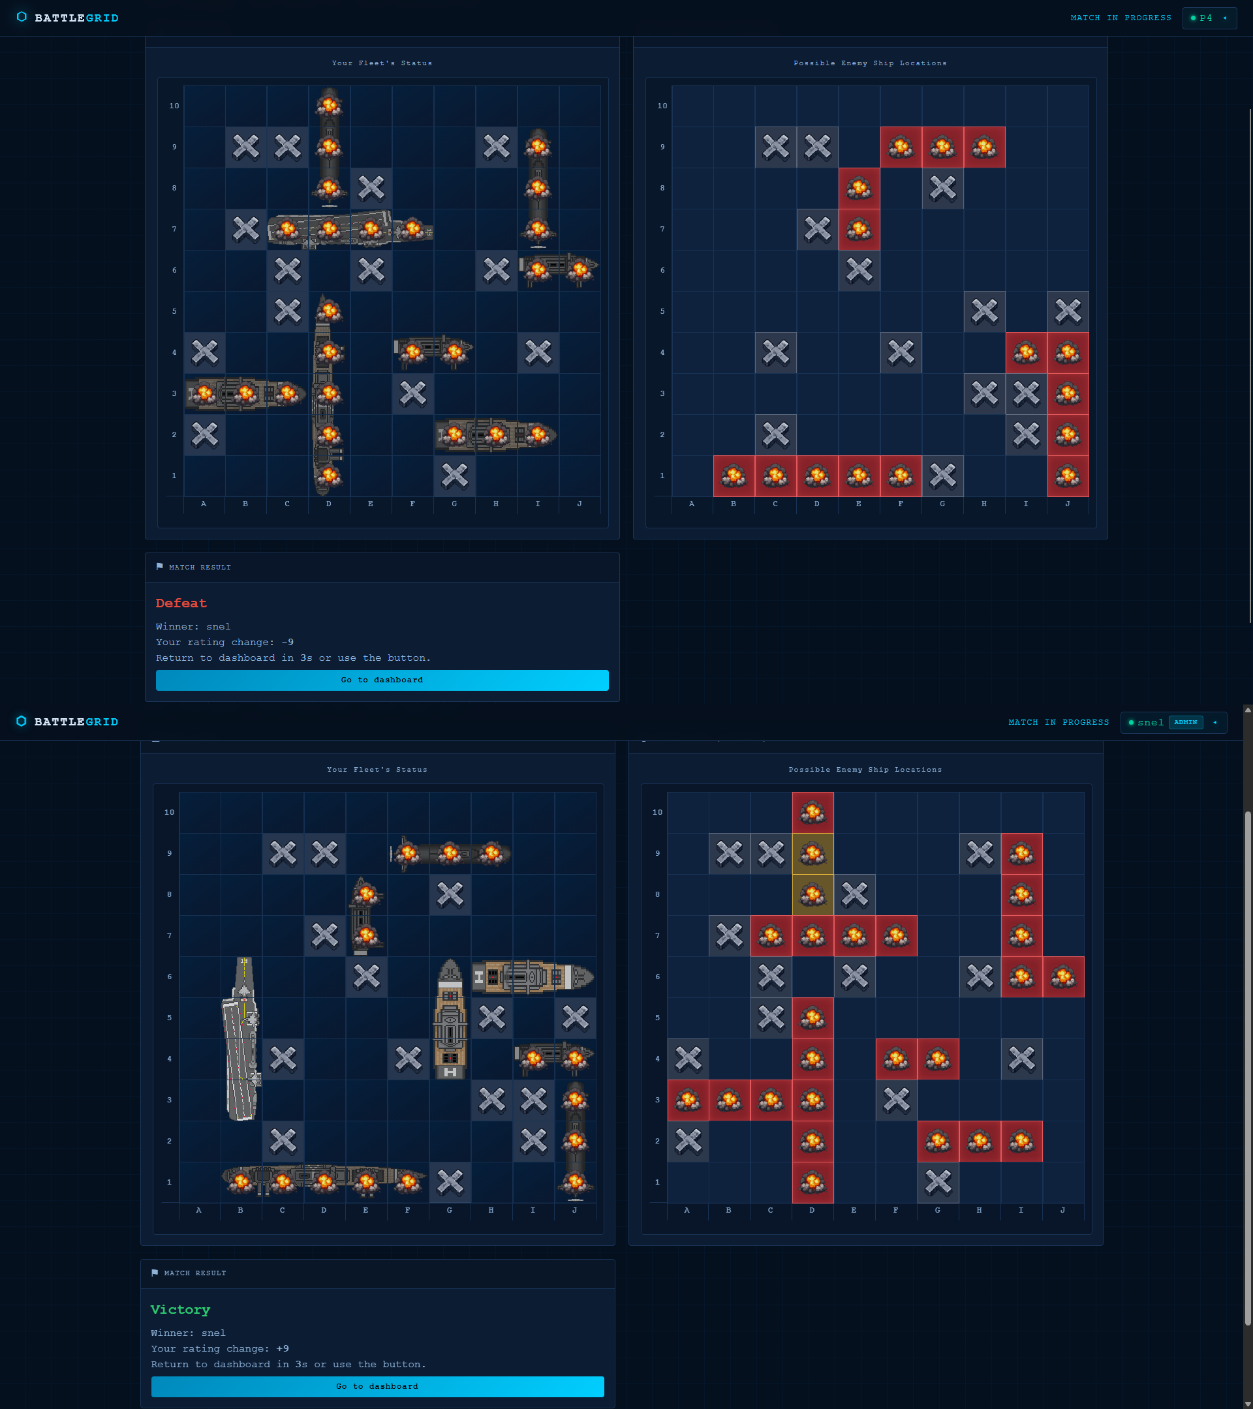
Gameplay – 3
Match end

Slide 34
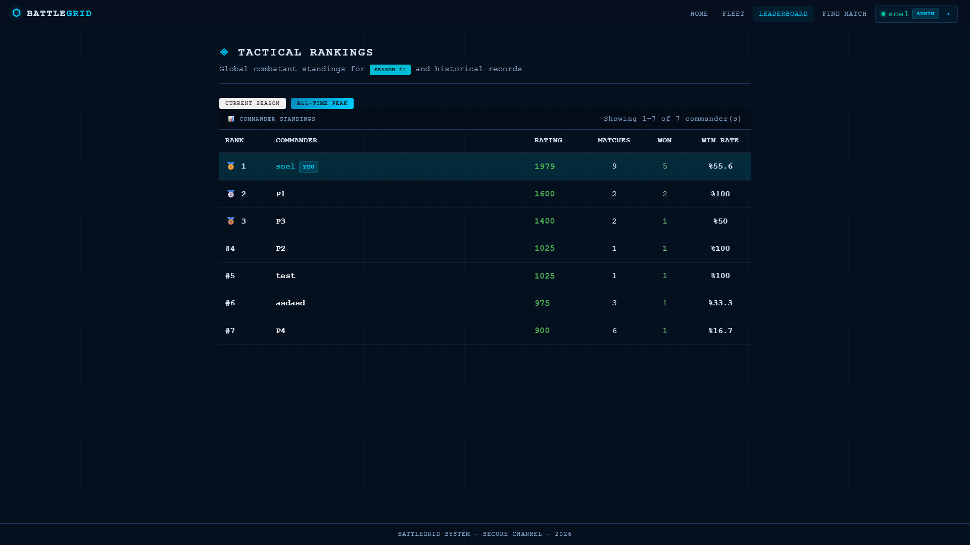
Leaderboard
Rankings

Slide 35
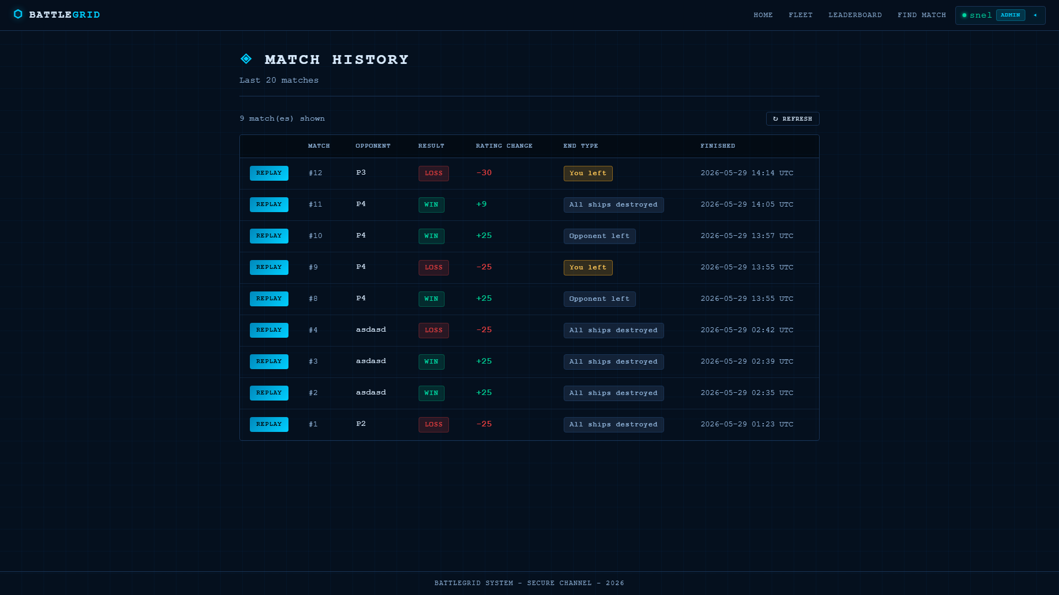
Match History
Past matches of a player

Slide 36
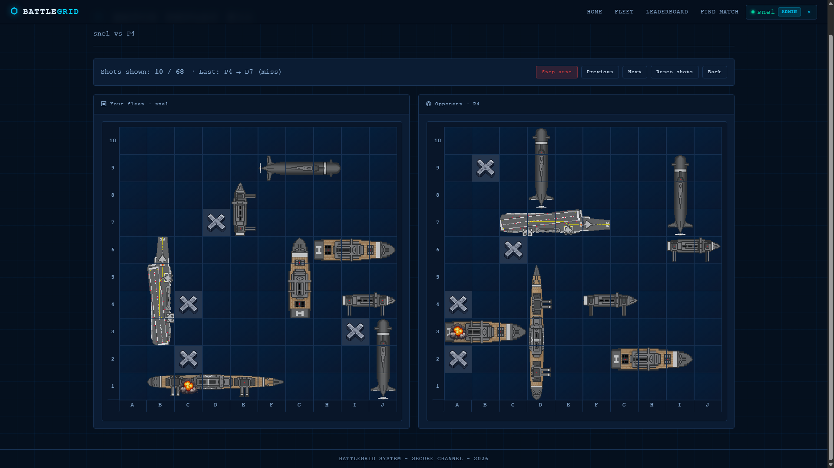
Match Replay
Players can replay their own matches. Admins can replay every match

Slide 37
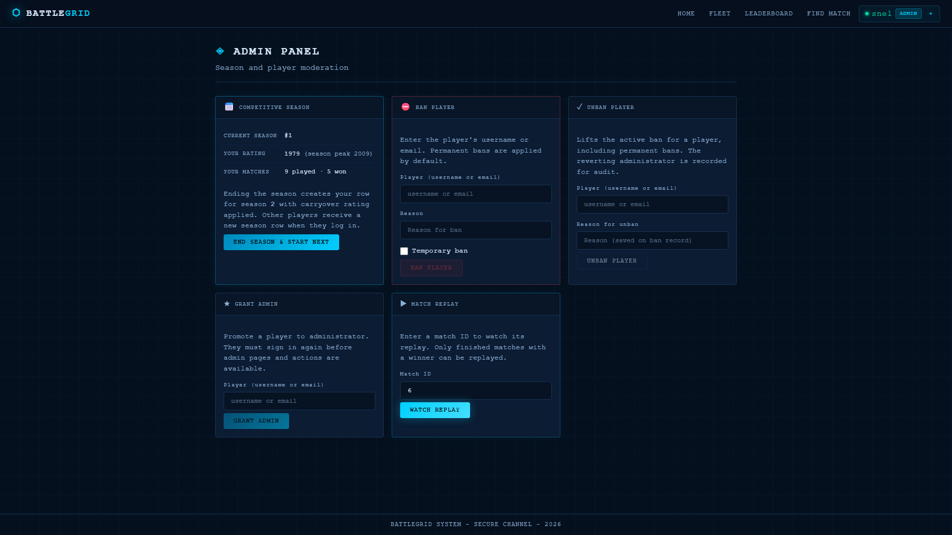
Admin – 1: Panel
Admin specific actions

Slide 38
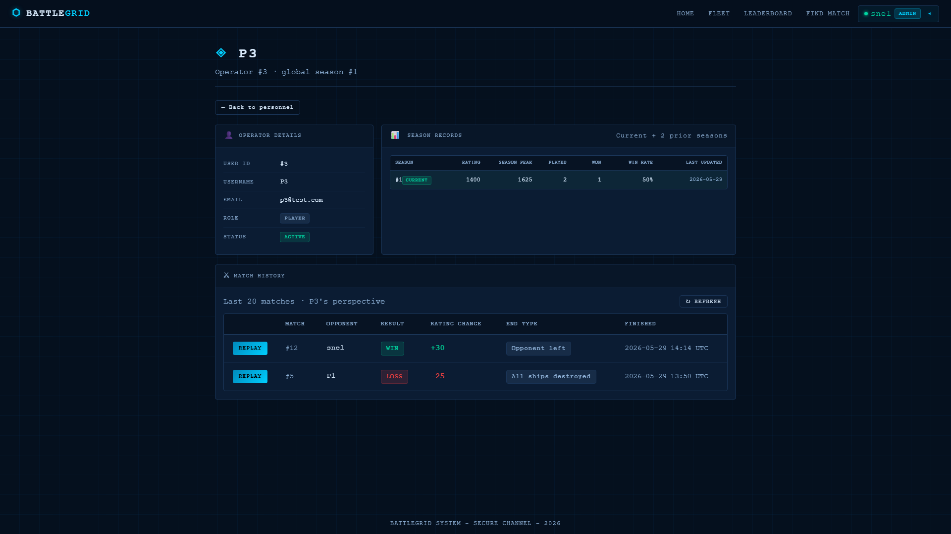
Admin – 2: User Profiles
Admins can see every player and their profiles registered to system

Slide 39
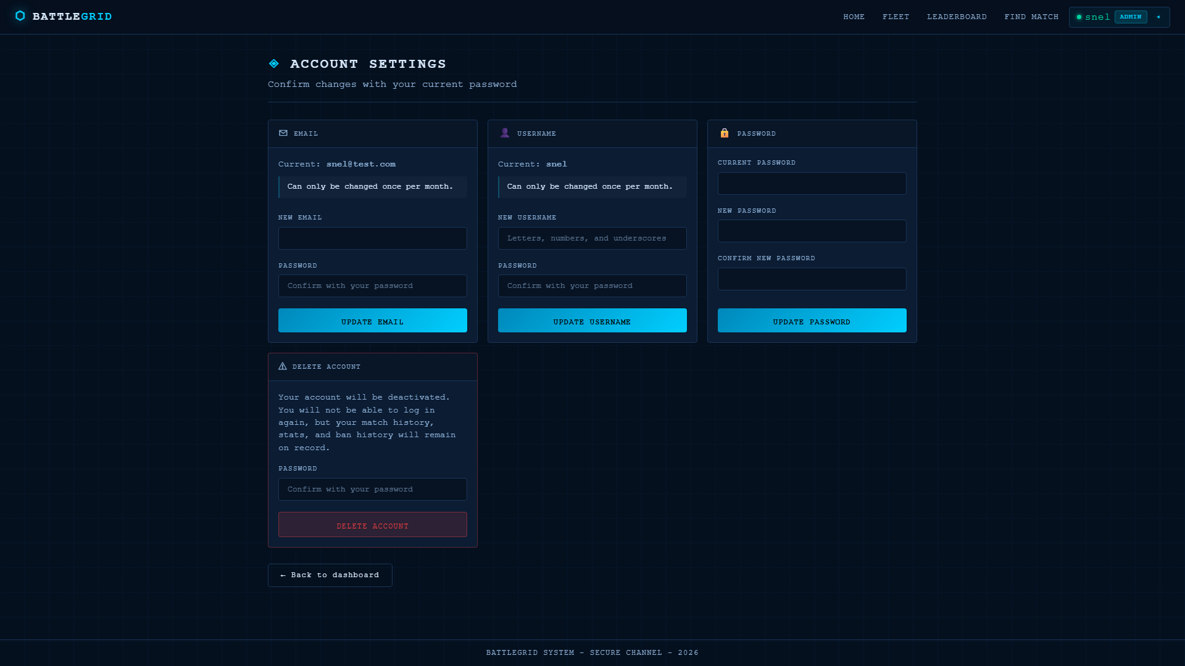
Settings
Allows users to change user name, email, and password as well as let them de-activate their account

Slide 40
Thank you
Questions? | BattleGrid on Render
https://battlegridweb.onrender.com

