Slide 1
Wire Frames
for vet application

Slide 2
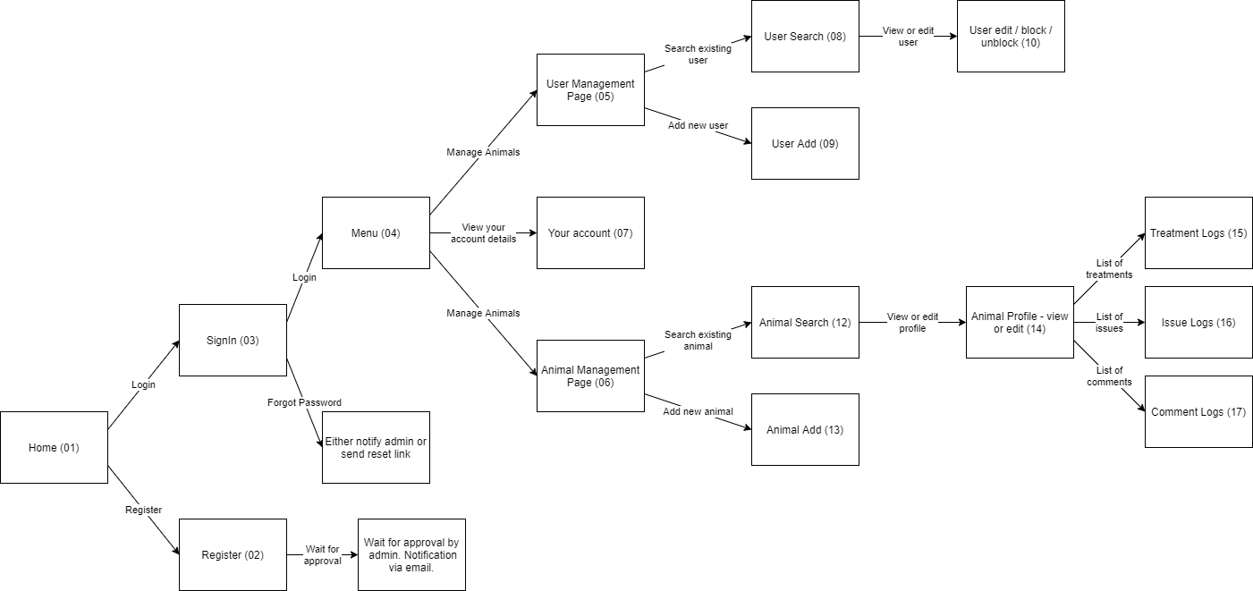
Flow

Slide 3
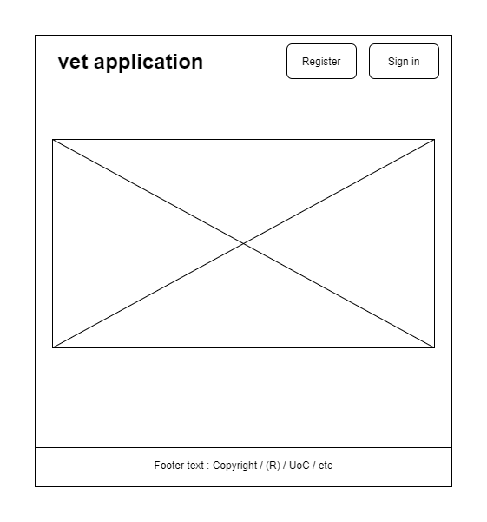
Home Page
Landing page

Slide 4
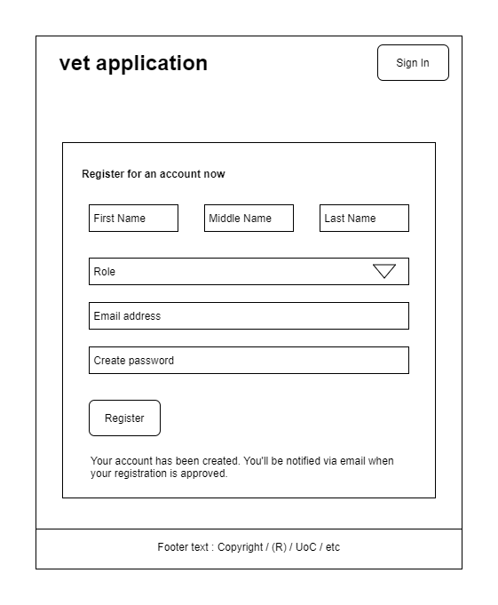
Register Page
Admin must unblock the account after its account creation.

Slide 5
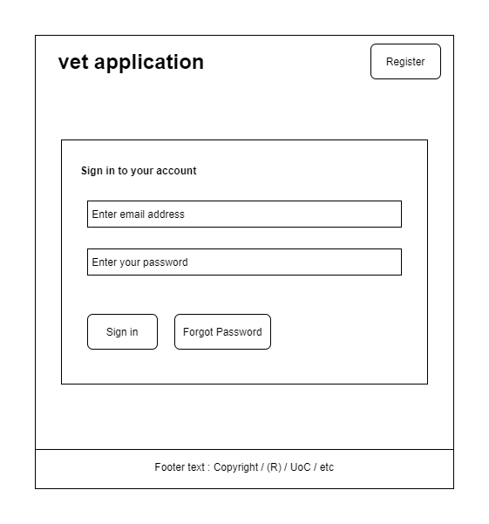
Sign-In Page

Slide 6
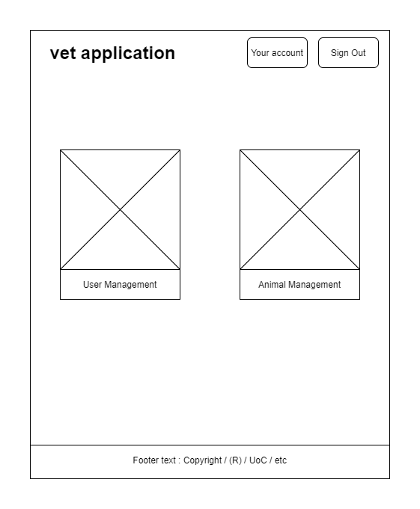
Main-Menu Page
Only admin would see the “User Management” option

Slide 7
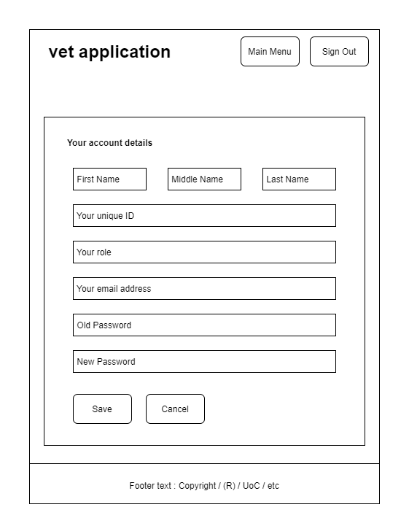
Your-Account Page
Only password can be changed by the user. Rest of the details are read-only.

Slide 8
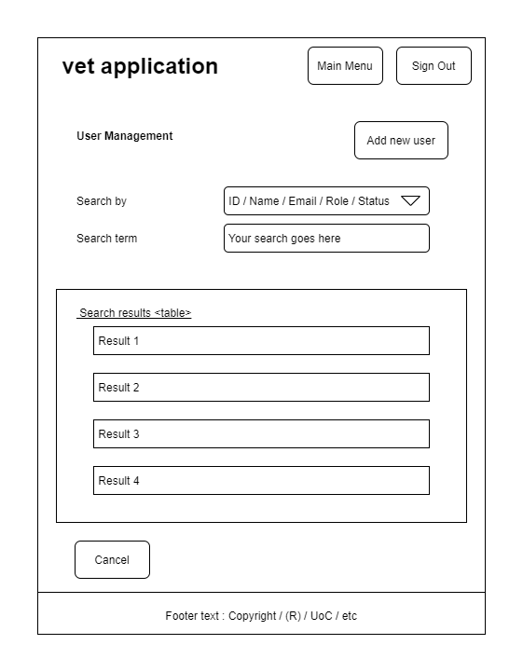
User Management
Click the search results to see user’s details

Slide 9
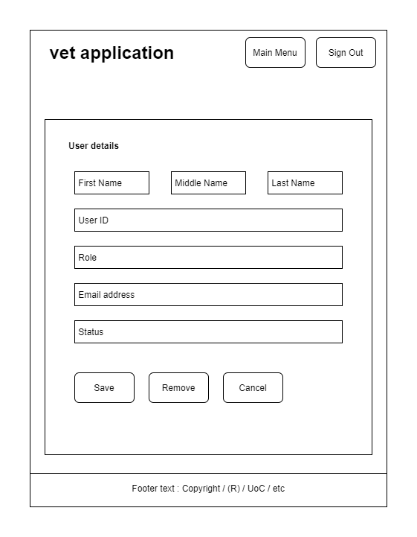
User Detail
Only admin may be able to modify details

Slide 10
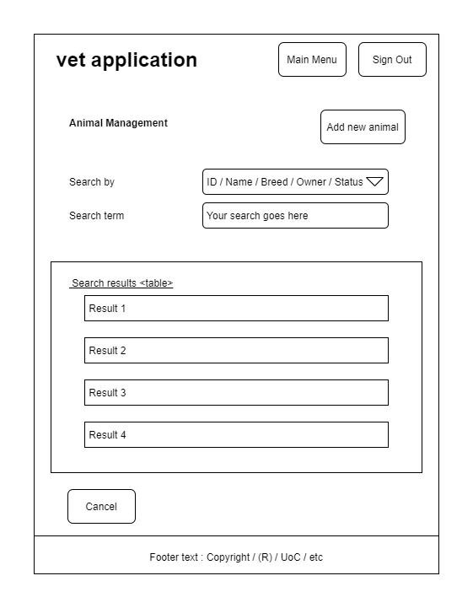
Animal Management
Click the search results to see animal’s profile

Slide 11
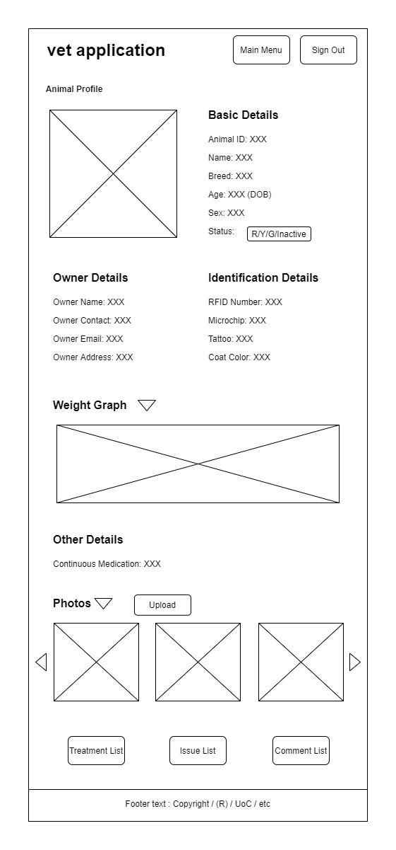
Animal Profile
Students don’t have access to modify any details

Slide 12
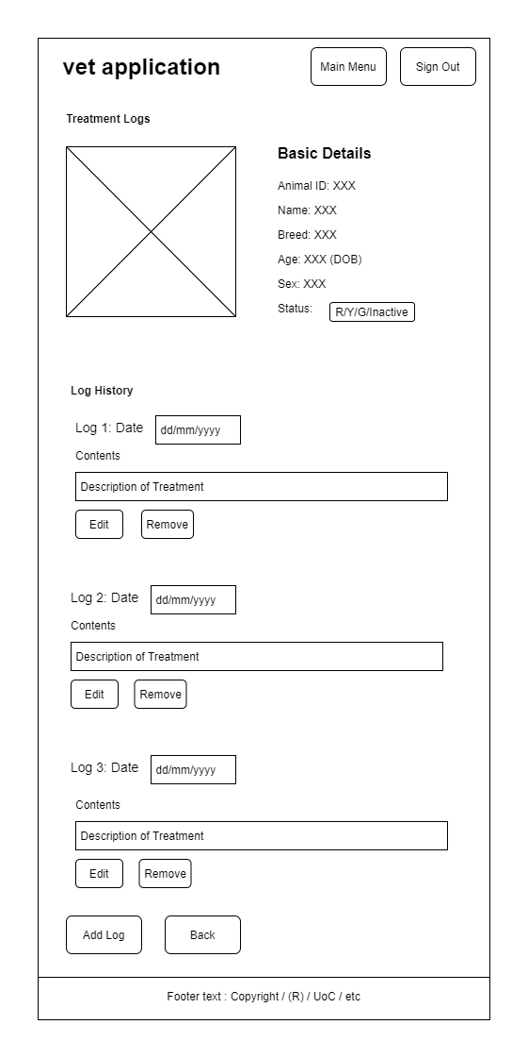
Animal Treatment Logs
Student: Have access to “Edit” but not “Remove” buttons at bottom of Log.
All other users: Have access to both buttons

Slide 13
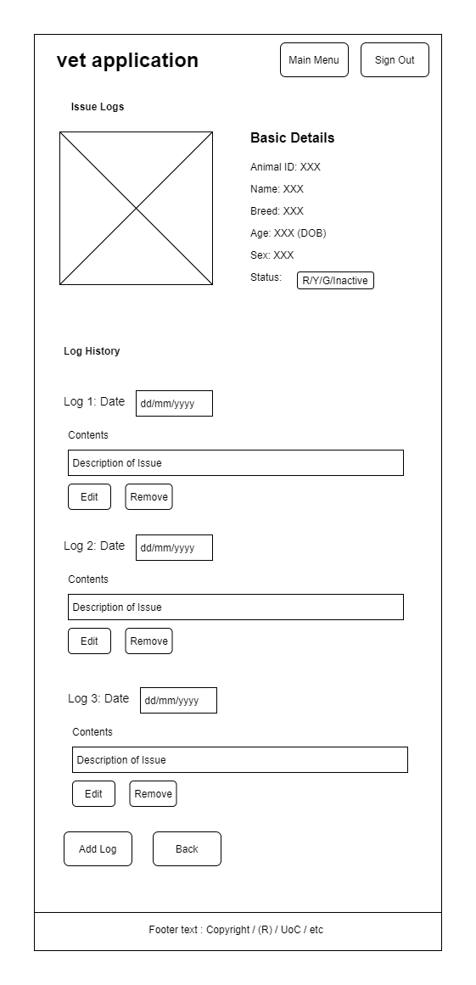
Animal Issue Logs
Student: Have access to “Edit” but not “Remove” buttons at bottom of Log.
All other users: Have access to both buttons

Slide 14

Animal Comment Logs
Student: Have access to “Edit” but not “Remove” buttons at bottom of Log.
All other users: Have access to both buttons

