Slide 1
CMSE-801 Final Project
Numerical analysis of natural vibration
Xiaocheng Sun

Slide 2
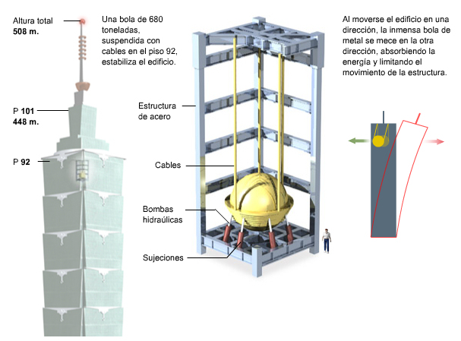
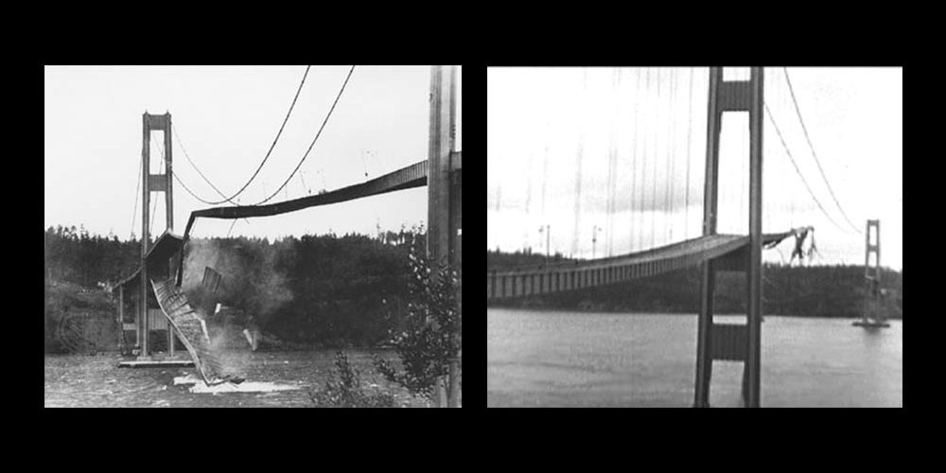
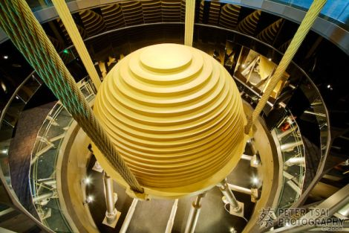
Earthquake damage

Slide 3
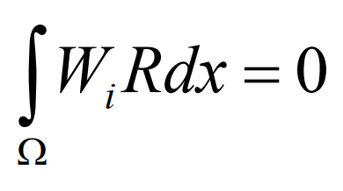
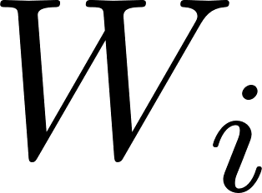
Numerical methods for integration
Forward Euler method
Runge-Kutta method
Monte Carlo method
Weight-residual method
is a set of linearly independent functions of x (weight functions)

Slide 4
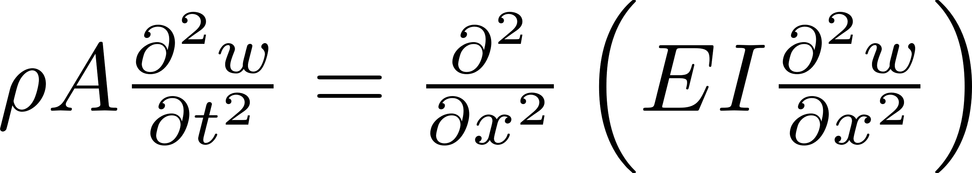
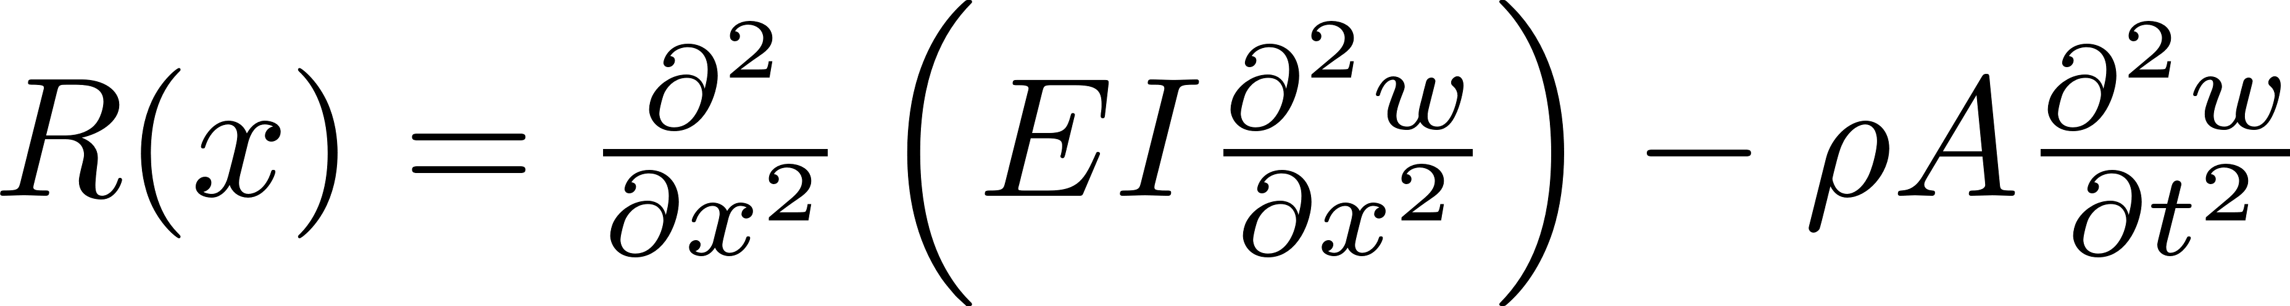
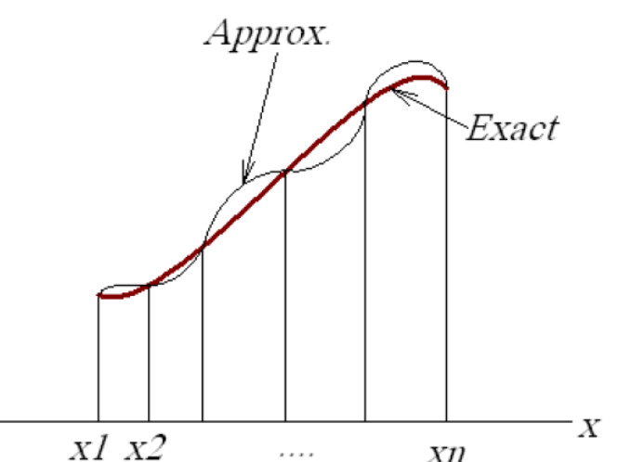
Euler-Bernoulli Beam Element
Governing equilibrium equations:
Residual formulation:
In order to perform the numerical approximation, an appropriate weighting function should be chosen:
Least-square method
Subdomain method
Collocation method
Galerkin method
Interpolation Functions:
Boundary condition for each domain:

Slide 5
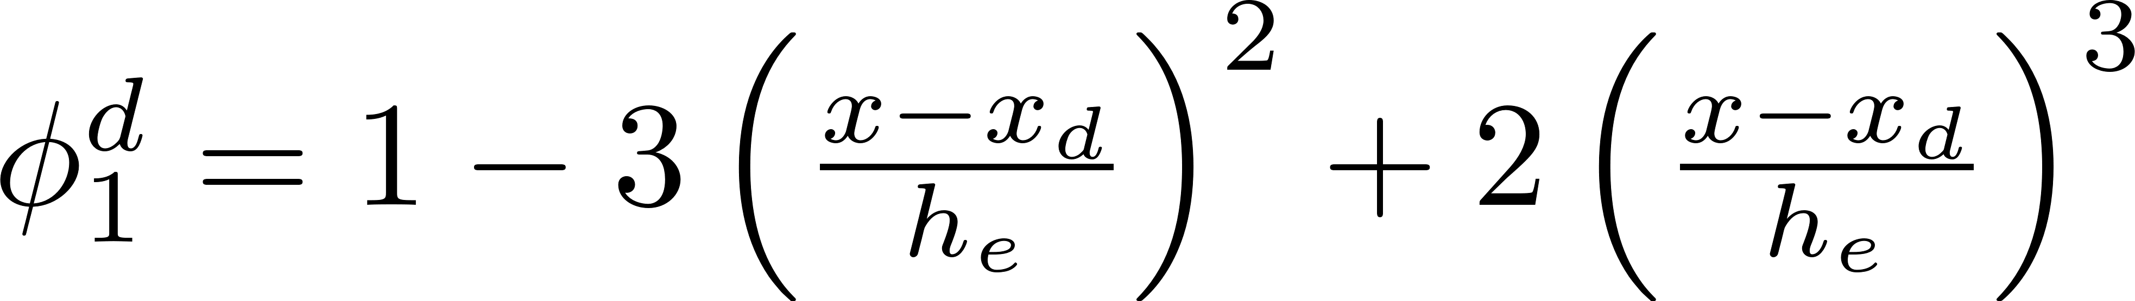
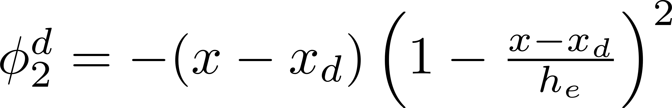
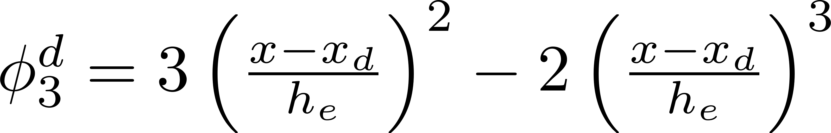
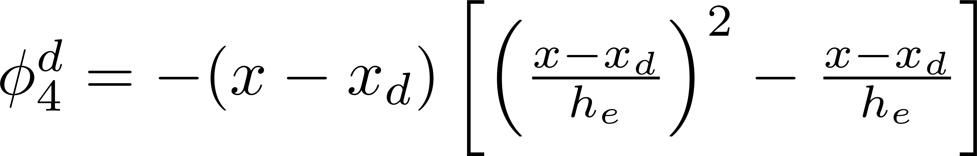
Hermite interpolation
Coefficient is a function of x in the interpolating function

Slide 6
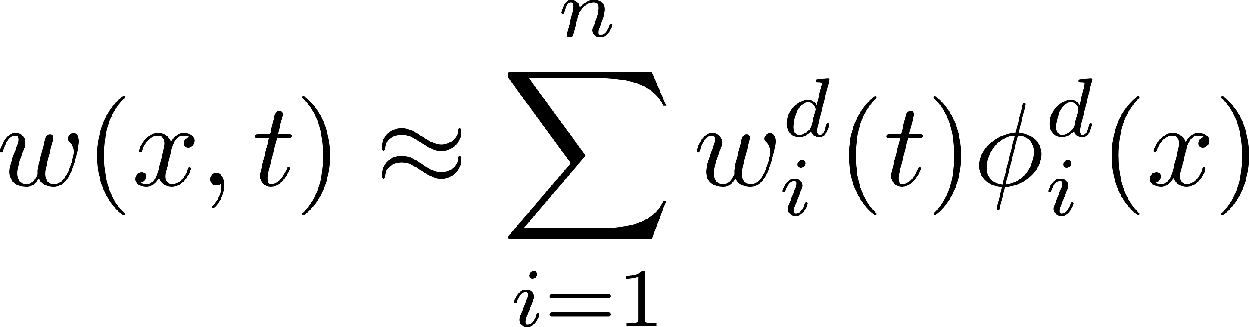
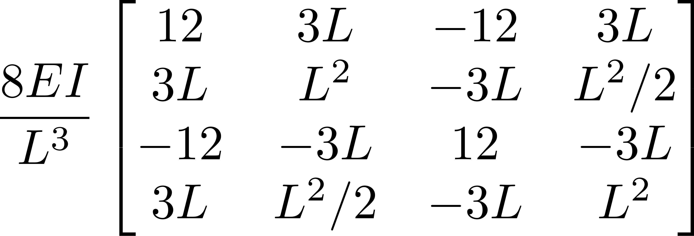
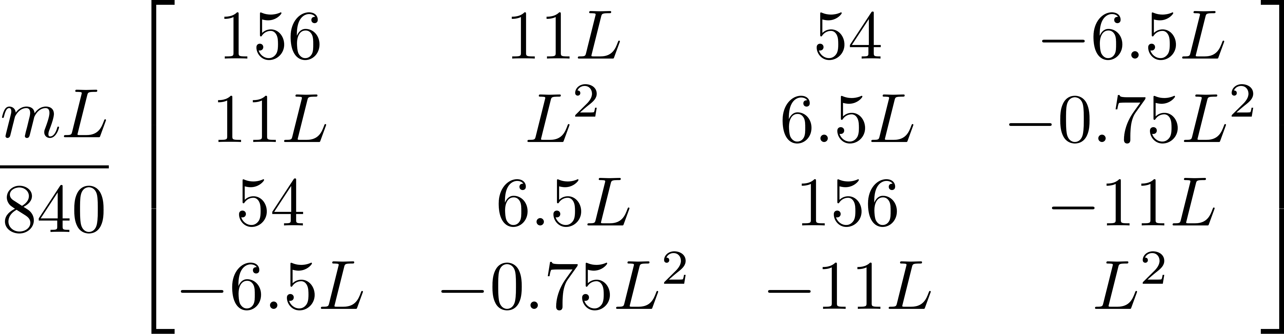
Semi-discretization over the time and special domain
Continuous solution:
Stiffness matrix: Mass matrix:

Slide 7
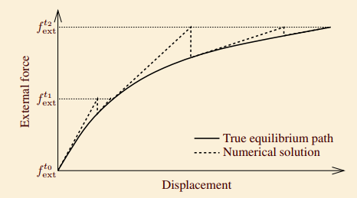
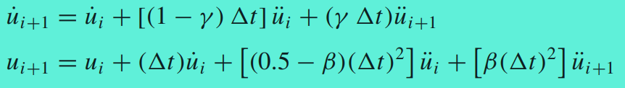
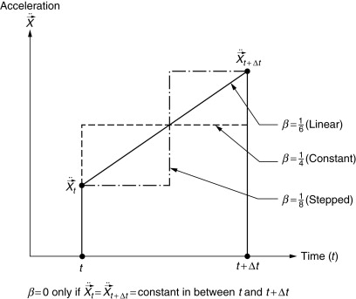
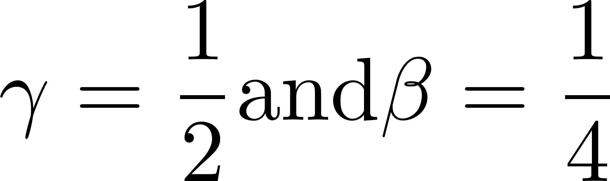
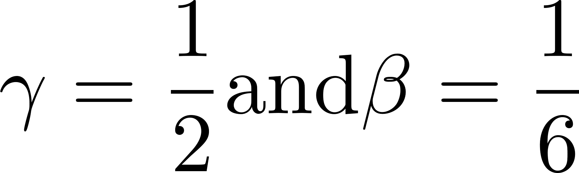
Newmark’s scheme
Numerical result getting closer to the exact number within each iteration
Constant average acceleration:
Linear variation acceleration:

Slide 8
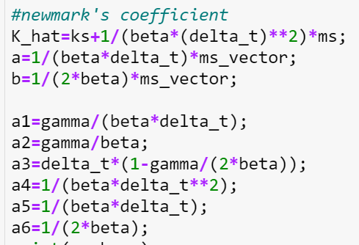
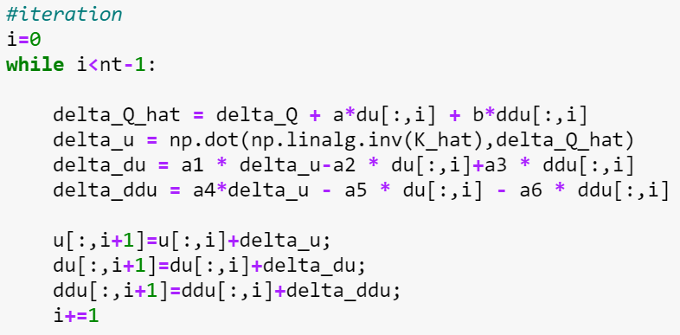

Newmark’s scheme
Assume Linear acceleration
Statable criteria:
$$∆t≤{∆t}_{crit}={\left[\frac{1}{2}ω_{max}^{2}\left(0.5−2β\right)\right]}^{−\frac{1}{2}}$$

Slide 9
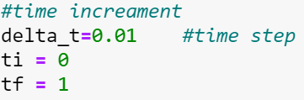
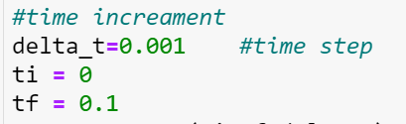
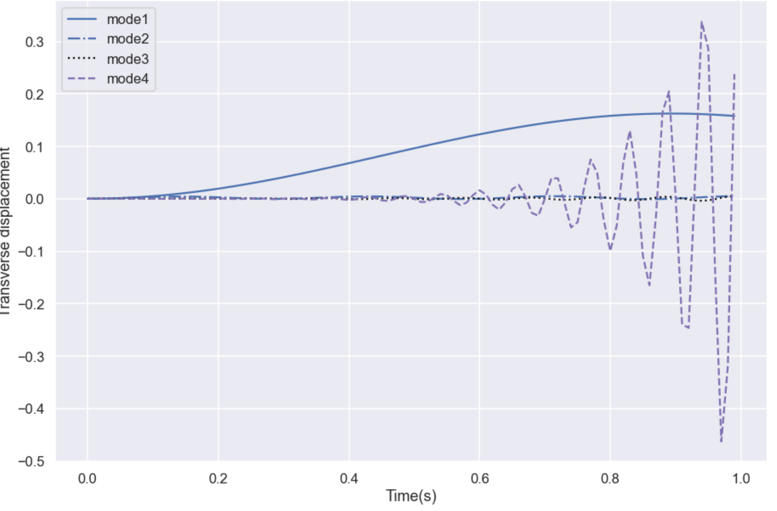
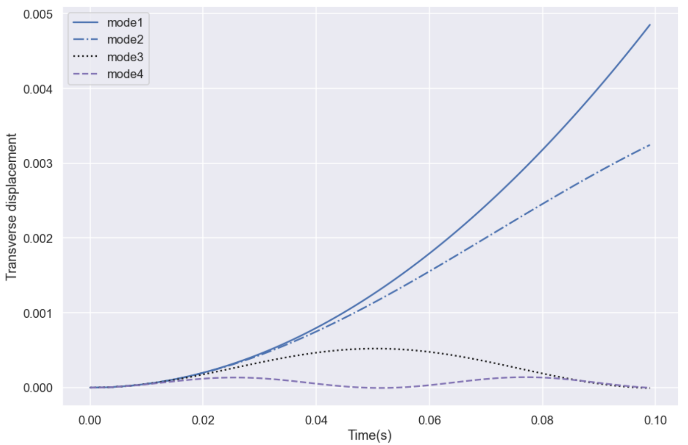
Result and discussion

Slide 10
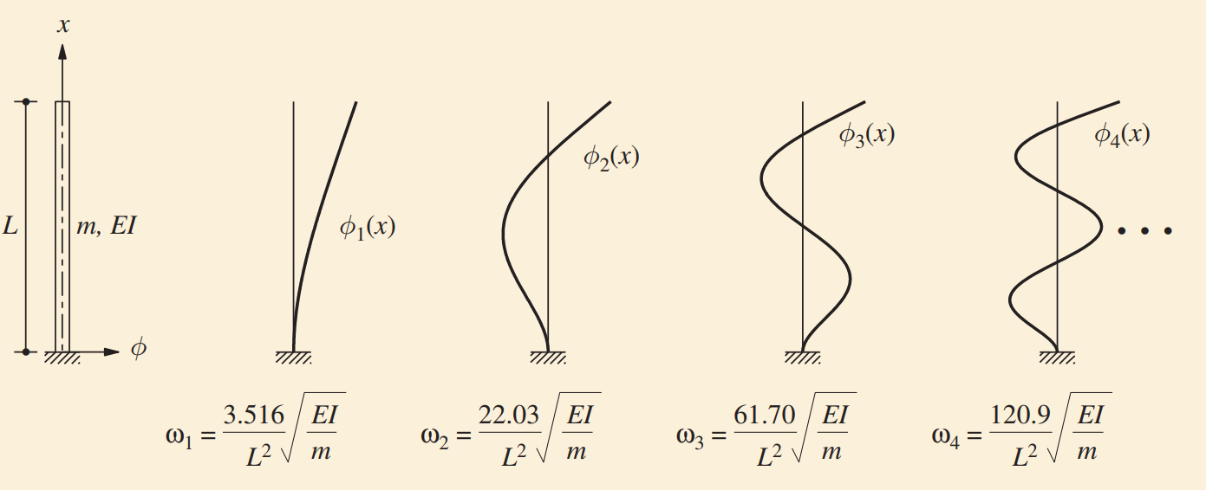
Verification
Compared with the exact solution, the numerical model shows a decent agreement
As the number of discretization increasing, the result getting closer

