Slide 1
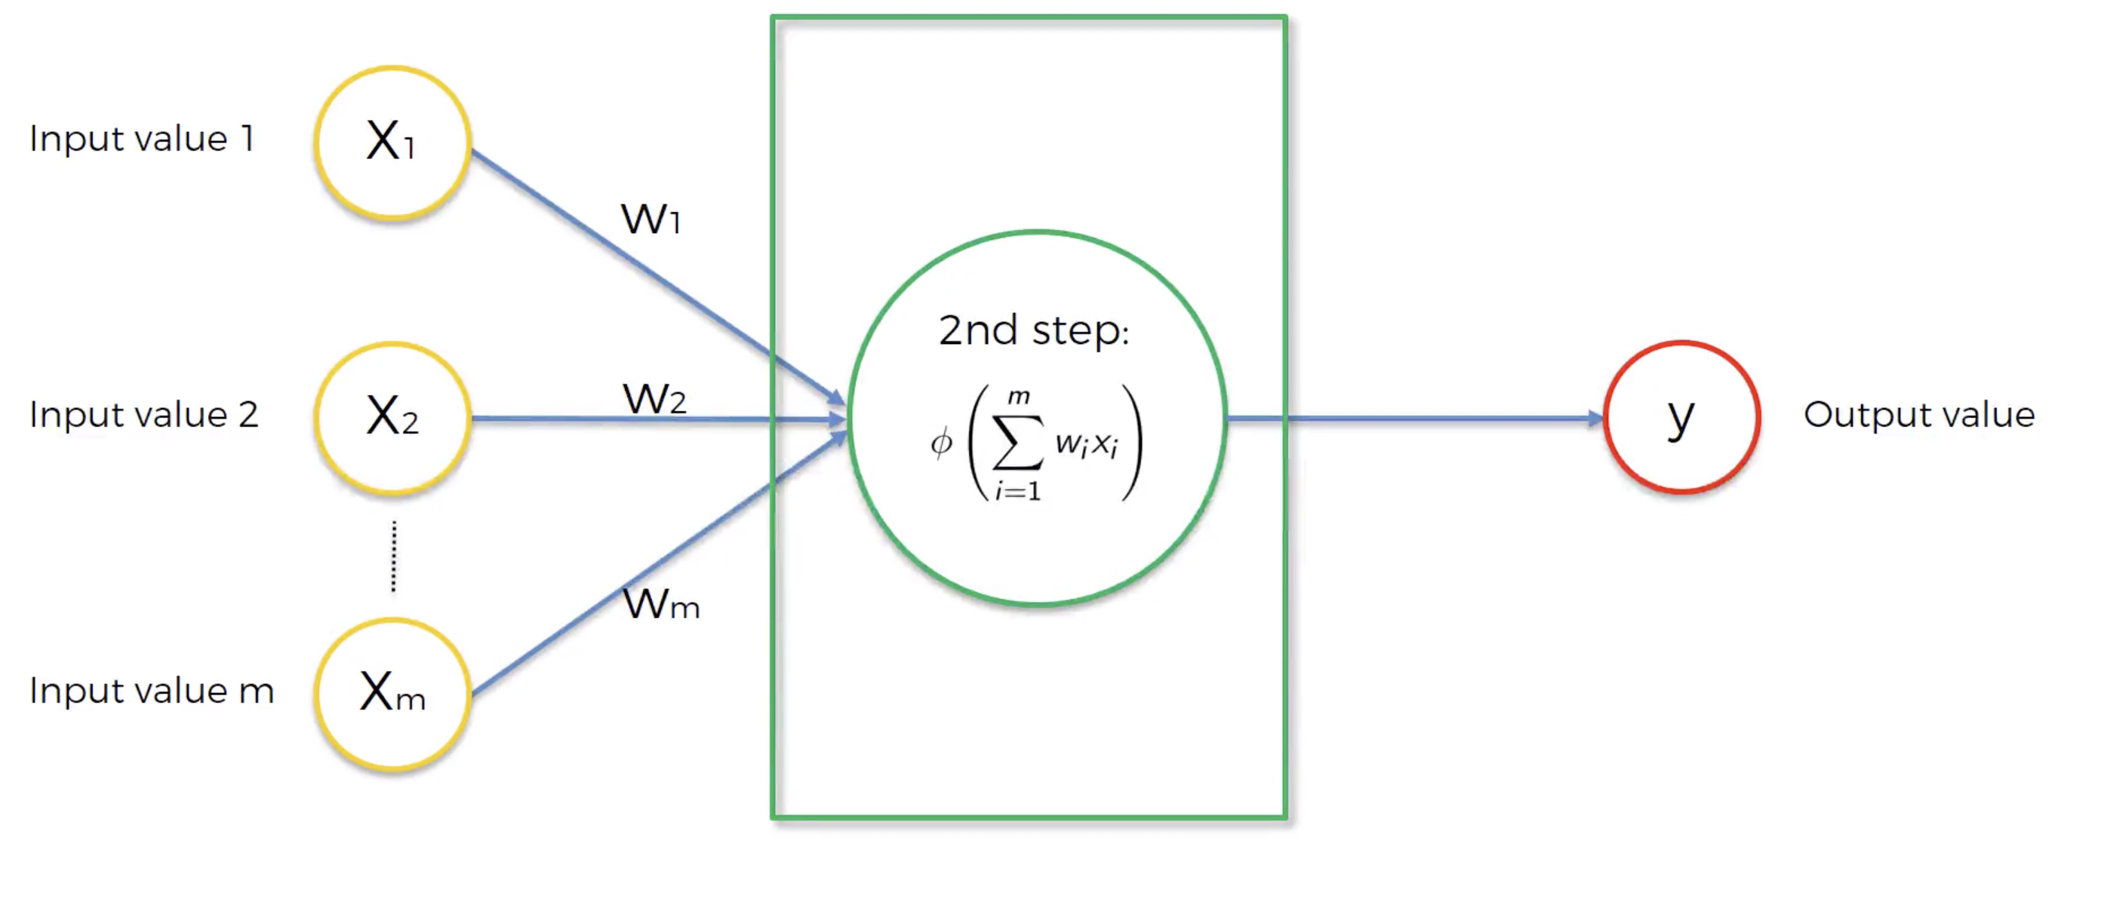
A Neuron
Prediction for a single observation
Φ: Activation Function -> Determines how strong is the signal that the neuron passes on.
m features of a single observation (must be standardized or normalized)

Slide 2
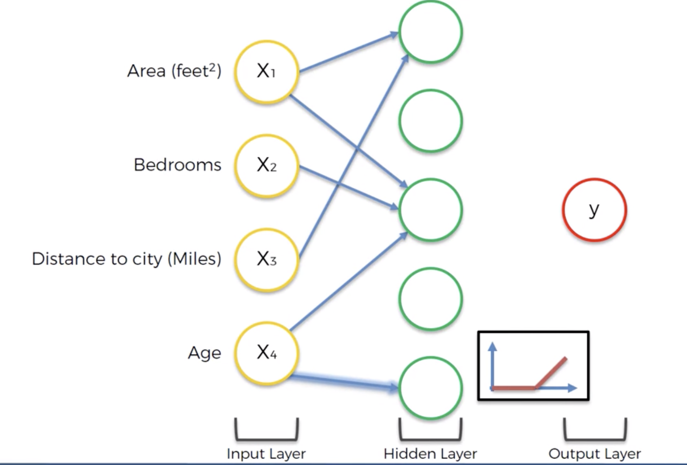
This neuron has learned that the combination of area and distance plays a role in price
PREDICTION OF PROPERTY PRICE
Through a rectifier function, this neuron has learned that after certain age, buildings become historic and that drives price
* No arrow means, weight = 0 for that input neuron

