Slide 1
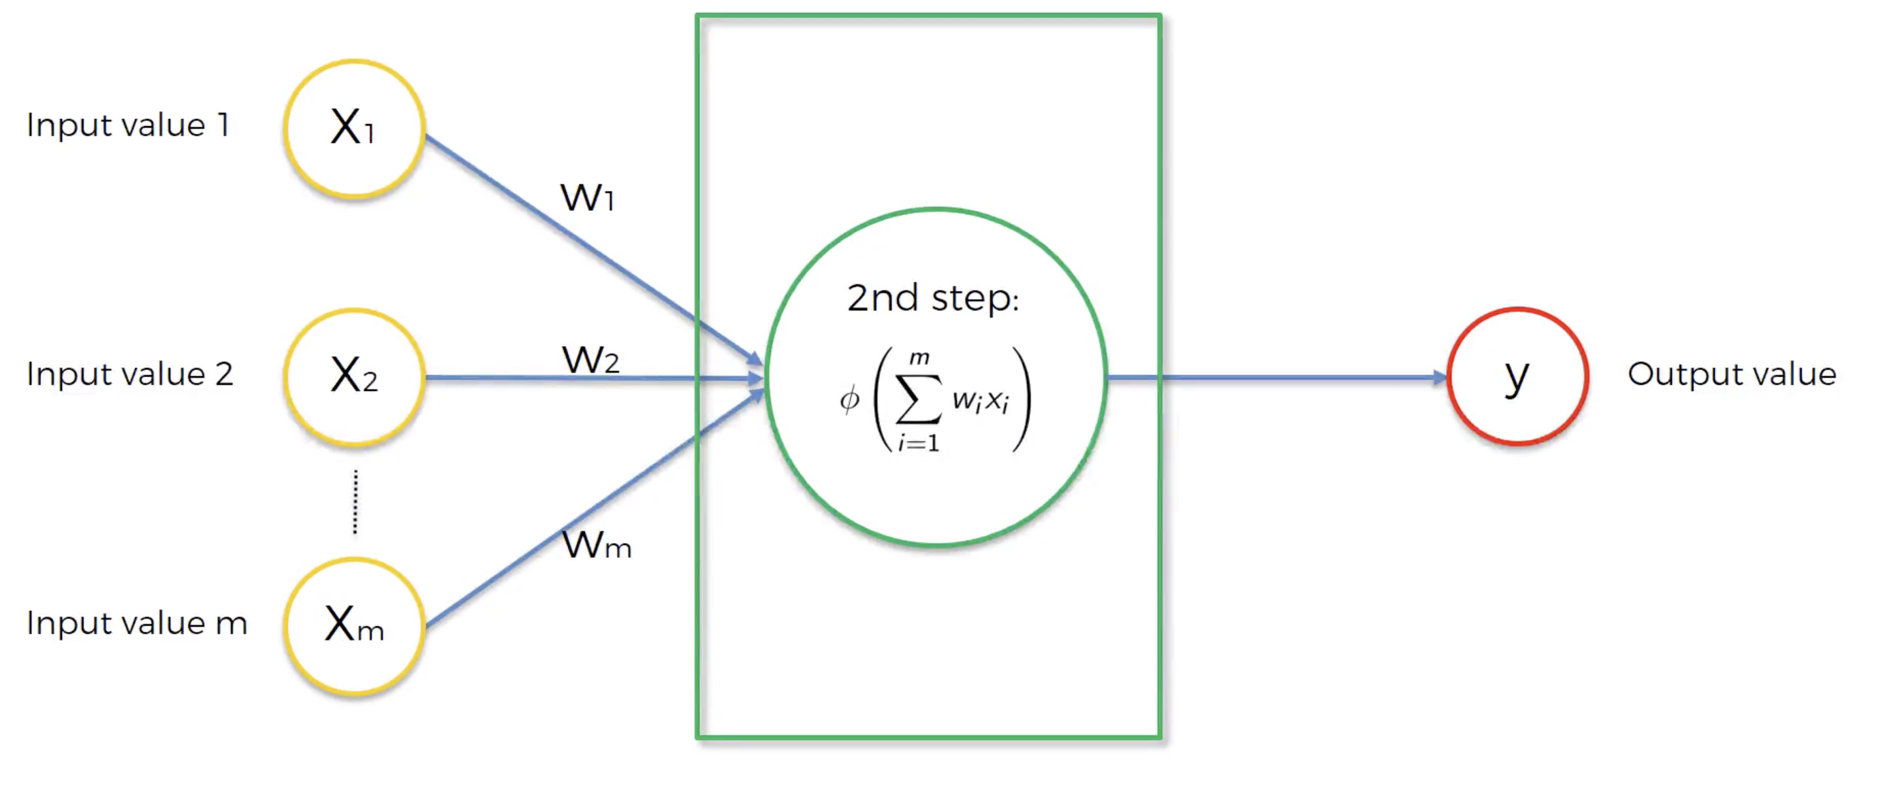
A Neuron
Prediction for a single observation
Φ: Activation Function -> Determines how strong is the signal that the neuron passes on.
m features of a single observation (must be standardized or normalized)

