Slide 1
Boosting

Slide 2
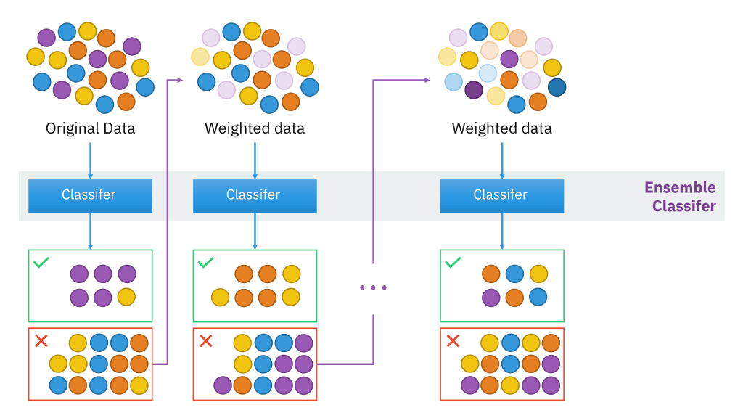
What is Boosting?
Reduces Bias and Variance: Boosting minimizes both bias and variance, improving model accuracy.
Sequential Learning: Models are trained sequentially, with each one correcting errors from the previous model.
Weak to Strong Learner Conversion: Combines multiple weak learners to create a powerful, accurate model.
Error Reduction: Focuses on difficult cases by adjusting weights to prioritize misclassified instances.
Improves Predictive Accuracy: Boosting enhances performance, even when initial models make mistakes due to limited training data diversity.
Source: Sirakorn [CC BY-SA]
Boosting (originally called hypothesis boosting) refers to any Ensemble method that can combine several weak learners into a strong learner.
The general idea of mostboosting methods is to train predictors sequentially, each trying to correct its predecessor.
https://aws.amazon.com/what-is/boosting/

Slide 3
Why is boosting important?
Boosting improves machine models' predictive accuracy and performance by converting multiple weak learners into a single strong learning model.
Weak learners
Weak learners have low prediction accuracy, similar to random guessing.
They are prone to overfitting—that is, they can't classify data that varies too much from their original dataset.
For example, if you train the model to identify cats as animals with pointed ears, it might fail to recognize a cat whose ears are curled.
Strong learners
Strong learners have higher prediction accuracy.
Boosting converts a system of weak learners into a single strong learning system.
For example, to identify the cat image, it combines a weak learner that guesses for pointy ears and another learner that guesses for cat-shaped eyes.
After analyzing the animal image for pointy ears, the system analyzes it once again for cat-shaped eyes.
This improves the system's overall accuracy.

Slide 4
How does boosting work?
To understand how boosting works, let's describe how machine learning models make decisions. Although there are many variations in implementation, data scientists often use boosting with decision-tree algorithms:
Decision trees
Decision trees are data structures in machine learning that work by dividing the dataset into smaller and smaller subsets based on their features. The idea is that decision trees split up the data repeatedly until there is only one class left. For example, the tree may ask a series of yes or no questions and divide the data into categories at every step.
Boosting ensemble method
Boosting creates an ensemble model by combining several weak decision trees sequentially. It assigns weights to the output of individual trees. Then it gives incorrect classifications from the first decision tree a higher weight and input to the next tree. After numerous cycles, the boosting method combines these weak rules into a single powerful prediction rule.
Boosting compared to bagging
Boosting and bagging are the two common ensemble methods that improve prediction accuracy. The main difference between these learning methods is the method of training. In bagging, data scientists improve the accuracy of weak learners by training several of them at once on multiple datasets. In contrast, boosting trains weak learners one after another.

Slide 5
Type of Boosting
AdaBoost (Adaptive boosting)
Gradient Boosting
Xgboost (extreme gradient boosting)

Slide 6
AdaBoost (Adaptive boosting)
What is AdaBoost?
AdaBoost, short for Adaptive Boosting, is one of the first Boosting algorithms developed to improve the performance of weak classifiers by converting them into a strong classifier.
Origin: Developed by Yoav Freund and Robert Schapire in 1995.
Objective: AdaBoost aims to create a strong model by iteratively adding weak models, focusing more on the samples that previous models misclassified.
Basic Concept of AdaBoost
Sequential Learning: AdaBoost works by adding weak learners sequentially, with each learner focusing on correcting errors of the previous learners.
Weak Learner: Typically a simple model, such as a decision stump (a one-level decision tree) that performs only slightly better than random guessing.
Error-Driven Weighting: AdaBoost assigns higher weights to misclassified samples, encouraging subsequent learners to focus on these harder cases
https://datamapu.com/posts/classical_ml/adaboost/

Slide 7
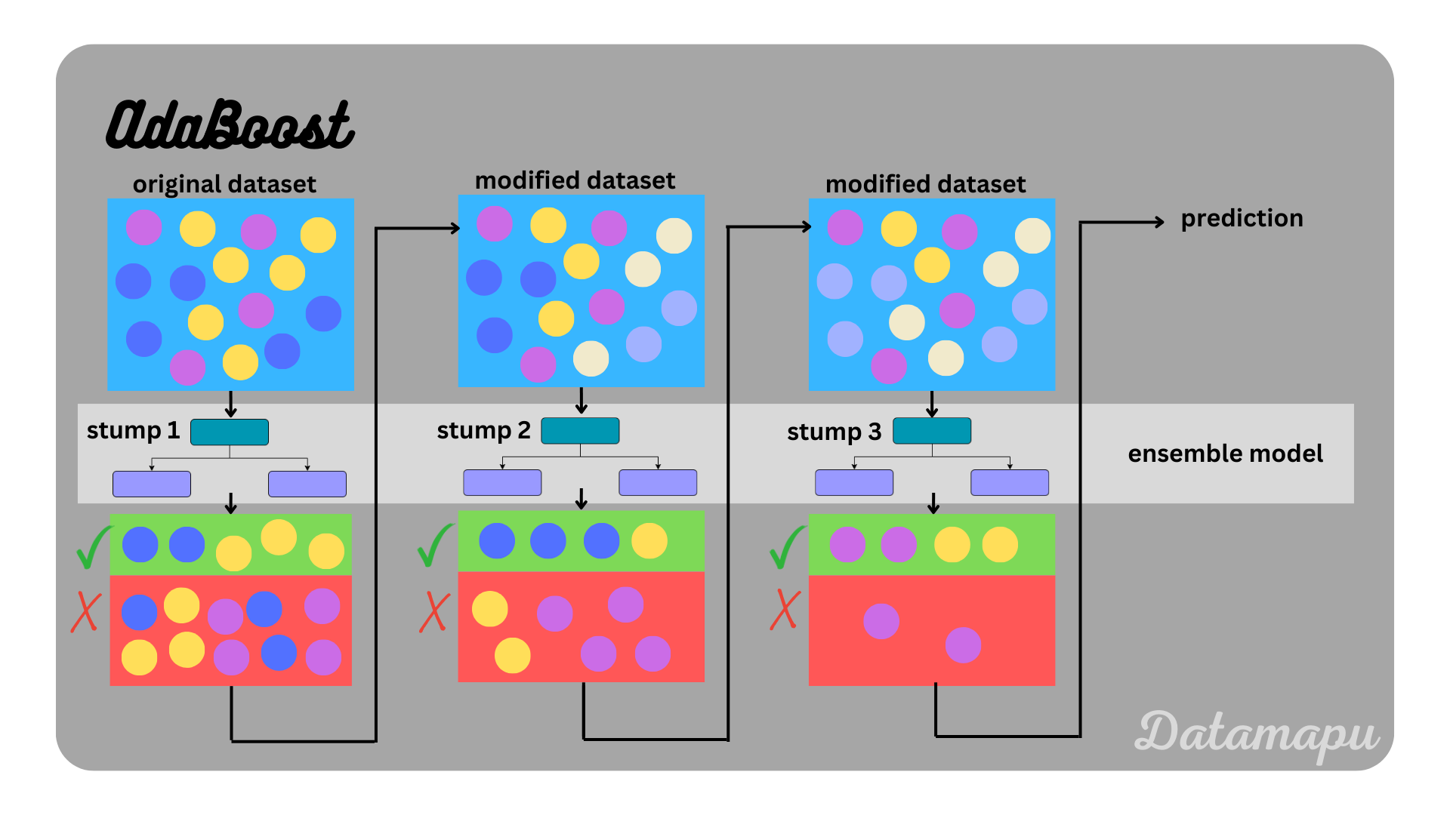
Steps
Initialize all sample weights equally: Begin with a uniform weight distribution.
Train a weak classifier: Create a classifier using a simple algorithm on weighted data.
Calculate Error Rate: Identify misclassified samples and calculate the error rate.
Compute Learner’s Weight: Calculate α\alphaα based on error to determine each weak learner’s contribution to the final model.
Adjust Weights: Increase the weights of misclassified samples, while correctly classified samples may have their weights reduced.
Repeat: Continue until the specified number of weak classifiers is reached or error rate achieves satisfactory level.
https://medium.com/@datasciencewizards/understanding-the-adaboost-algorithm-2e9344d83d9b

Slide 8
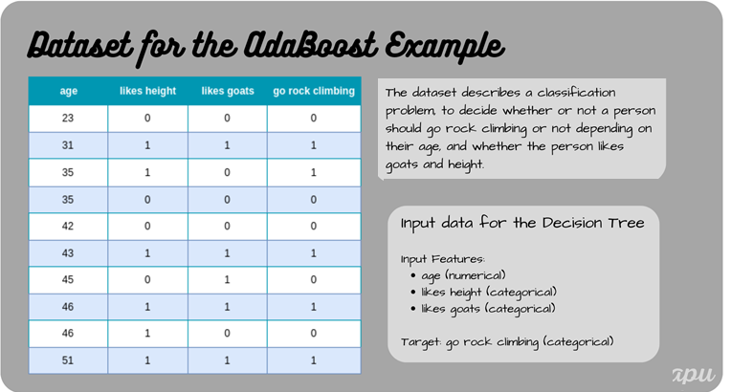
AdaBoost for Classification - Example
10 samples
https://datamapu.com/posts/classical_ml/adaboost_example_clf/

Slide 9
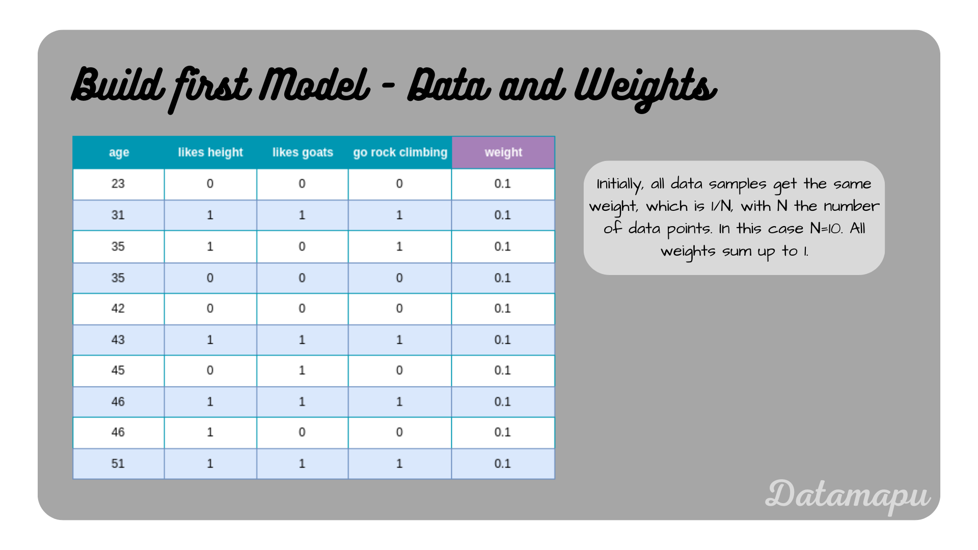
Build the Model
The first step in building an AdaBoost model is assigning weights to the individual data points. In the beginning, for the initial model, all data points get the same weight assigned, which is 1/N, with N the dataset size.

Slide 10
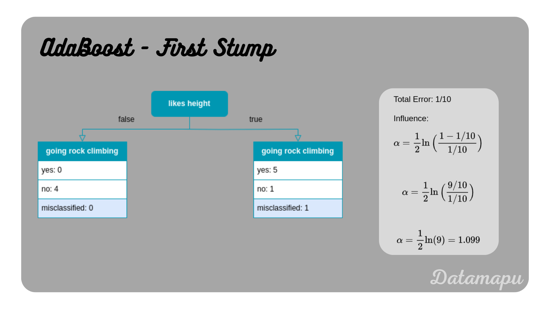
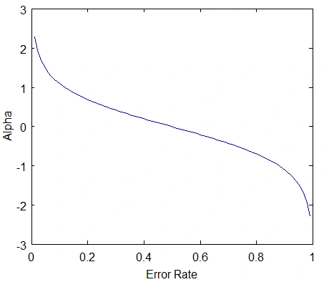
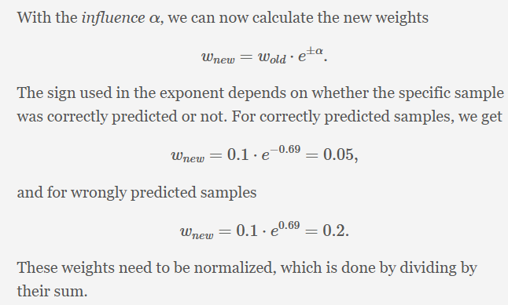
https://www.analyticsvidhya.com/blog/2021/09/adaboost-algorithm-a-complete-guide-for-beginners/

Slide 11
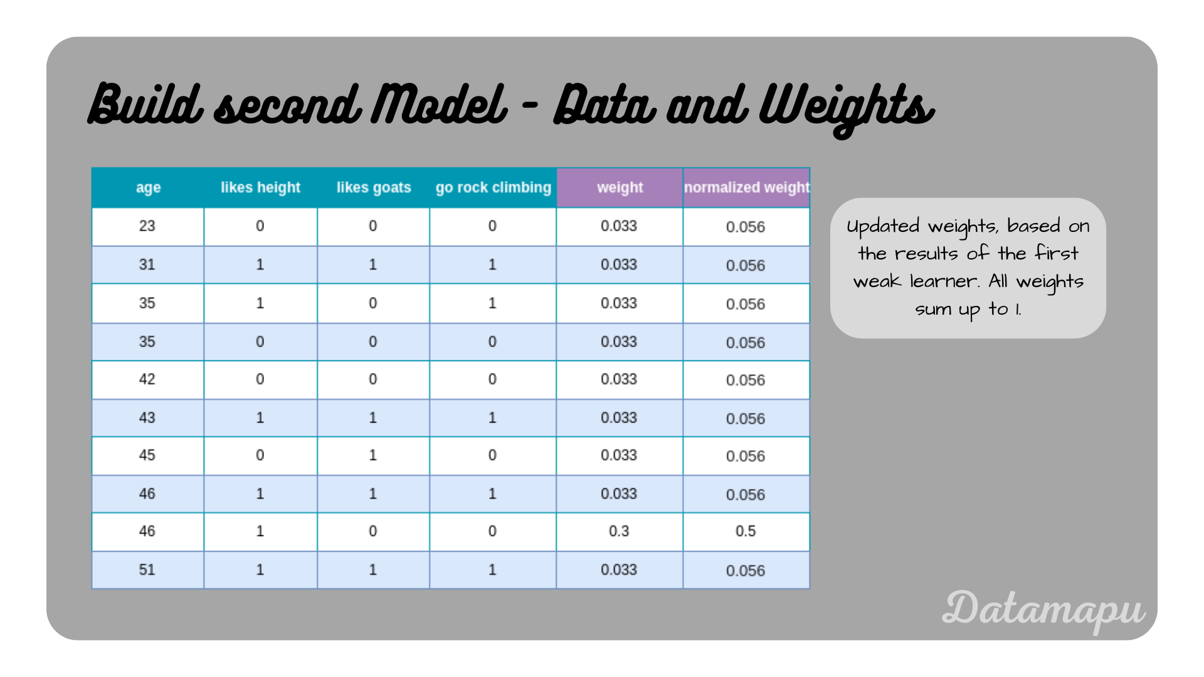

Slide 12
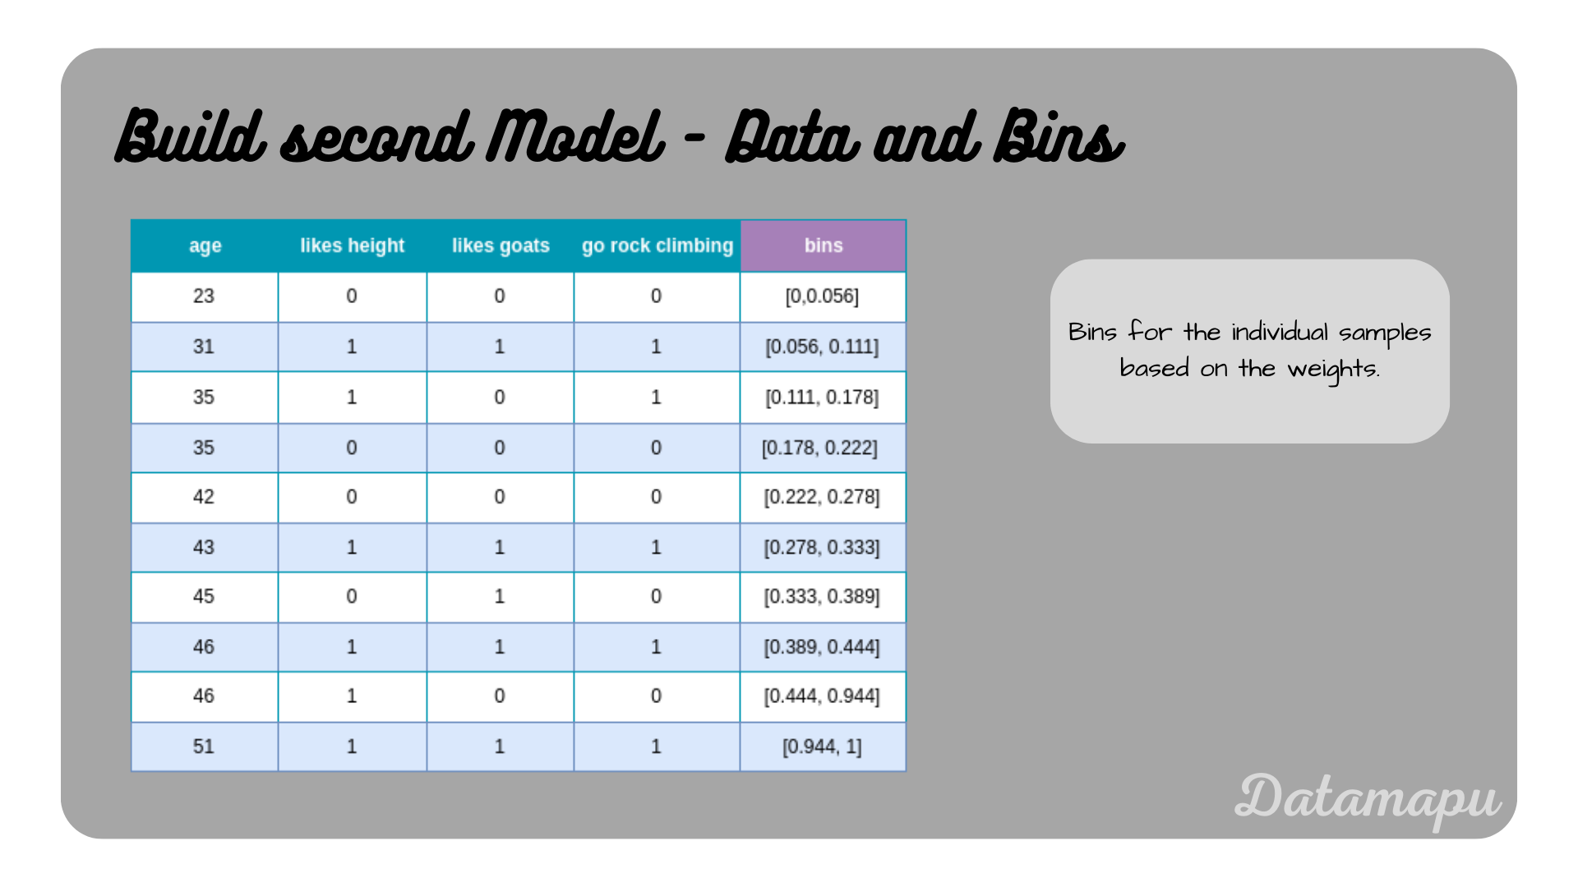
Random numbers between 0 and 1 are drawn, then we check in which bin the random number falls, and the according data sample is selected for the new modified dataset. We draw as many numbers as the length of our dataset is, that is in this example we draw 10 numbers. Due to the higher weight of the misclassified example, this example has a larger bin, and the probability of drawing it is higher. Let’s assume we draw the numbers [0.1,0.15,0.06,0.5,0.65,0.05,0.8,0.7,0.95,0.97], which leads to the selection of the samples [1,2,1,8,8,0,8,8,9,9].

Slide 13
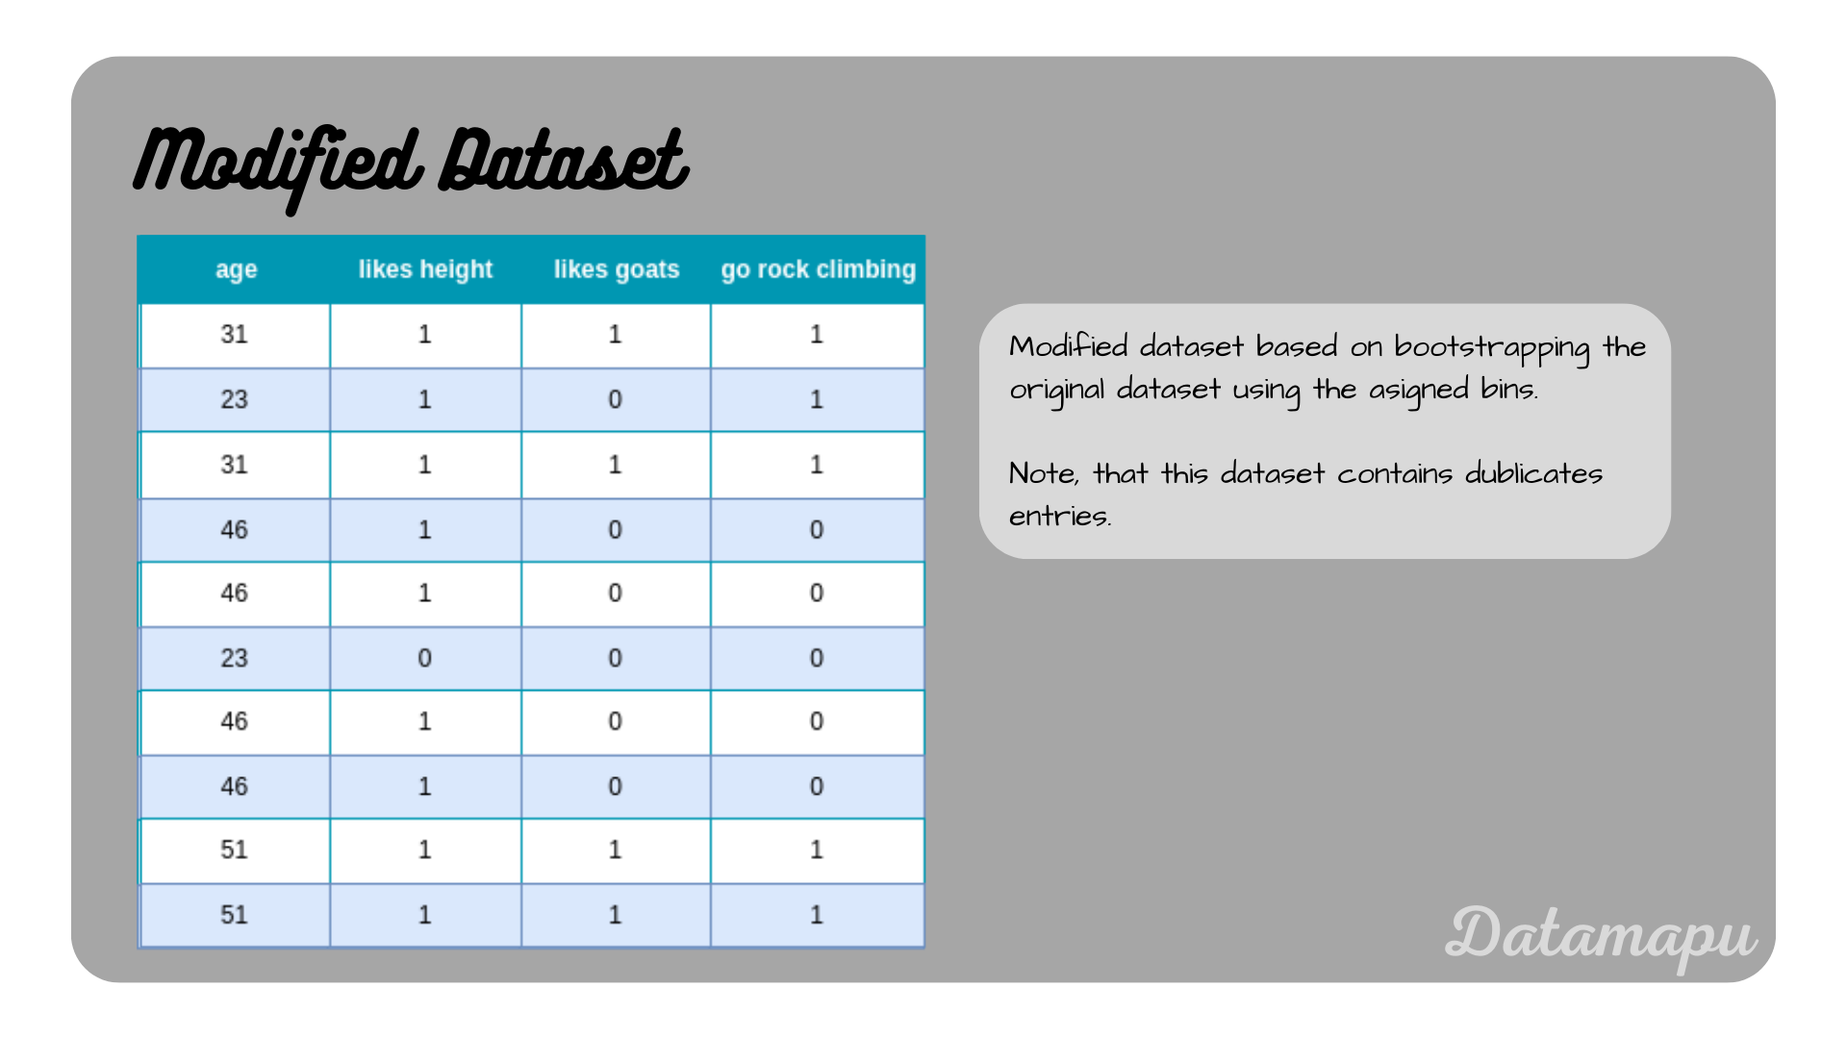
The modified dataset then has the following form.

Slide 14
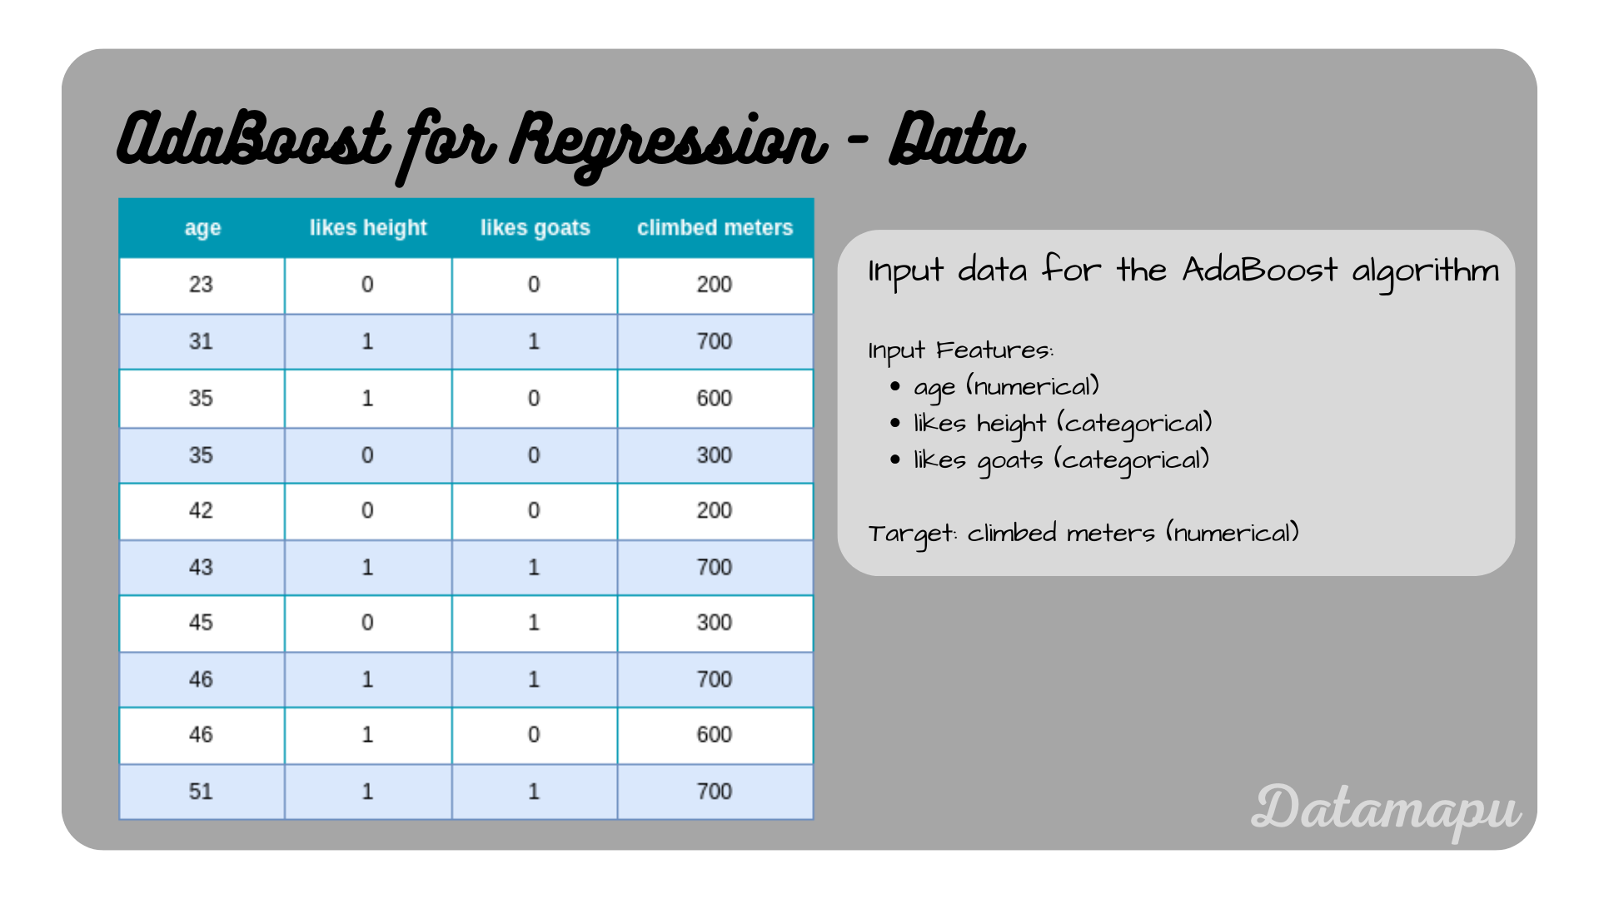
Adaboost for regression
https://datamapu.com/posts/classical_ml/adaboost_example_reg/

Slide 15
Advantages of AdaBoost
High Accuracy: By focusing on difficult cases, AdaBoost improves overall accuracy.
Versatility: Can be combined with various weak learners (e.g., decision stumps, logistic regression).
Resistant to Overfitting: Tends to generalize well, especially in structured datasets, due to its sequential error-reduction focus.
Handling Imbalanced Data: AdaBoost’s weighting mechanism naturally adapts to cases with imbalanced classes by emphasizing misclassified samples.
Limitations of AdaBoost
Sensitivity to Noisy Data: Tends to overemphasize noisy or mislabelled data, which can lead to overfitting.
Computational Complexity: The sequential nature of AdaBoost can lead to slower training times, especially for large datasets.
Poor Performance with Strong Learners: Designed for weak learners, AdaBoost may not work as effectively with stronger, complex models.

Slide 16
Hyperparameter Tuning in AdaBoost
n_estimators:
Number of weak learners (usually decision stumps) to be added sequentially.
A higher value may improve performance but also increase training time and risk of overfitting.
learning_rate:
Shrinks the contribution of each weak learner by this factor, controlling the weight adjustment for each learner.
Lower values require more n_estimators but can improve generalization.
base_estimator:
The weak learner model to boost, typically a decision stump (a tree with max depth 1).
Can be replaced with other models, but decision stumps are most common for AdaBoost.
algorithm:
Specifies the boosting algorithm type. Options are:
"SAMME": Multiclass boosting without probabilities, typically used for discrete outputs.
"SAMME.R": Uses real-valued boosting, which often results in better performance for probabilistic outputs.

Slide 17
Gradient Boosting
https://www.analytixlabs.co.in/blog/gradient-boosting-algorithm/

