Slide 1

WEB SCRAPING TO GAIN COMPANY INSIGHTS
27/01/2025

Slide 2
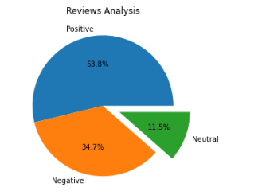
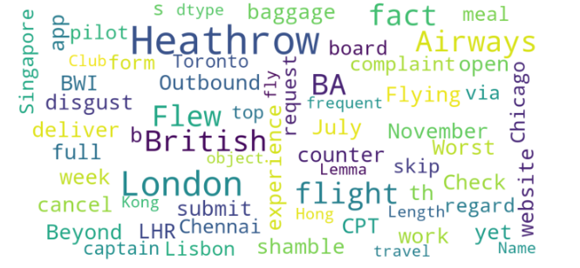
INSIGHTS FROM CUSTOMER REVIEWS
From cleaning 1000 reviews given by the customers, we obtained
Positive Reviews - 538
Negative Reviews - 347
Neutral Reviews – 115
Word cloud of keywords used in reviews

