Slide 1
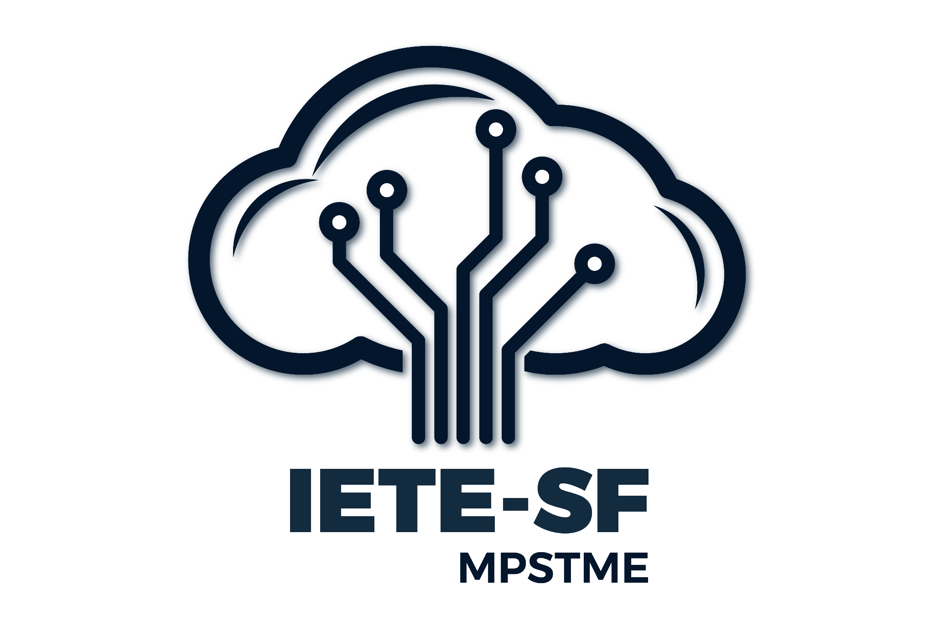

GenAI for Content Creation and Marketing
CodeBots
[G031]
Dhairya Khania, Shardul Gore, Gaurav Sahu, Athar Sayed, M.Tech AI

Slide 2
Road Map
Introduction
Problem Analysis
Detailed solution
Future scope/ Conclusion
References

Slide 3
Generative AI (GenAI) is transforming content creation and marketing by leveraging machine learning to produce high-quality, personalized content efficiently.
Key Benefits
Automated Content Generation:
Write blog posts, social media updates, and product descriptions automatically.
Assist in creative brainstorming.
Introduction

Slide 4
Personalization:
Tailor messages based on individual preferences.
Adapt content in real-time for user engagement.
Enhanced Customer Experience:
Create interactive and engaging content.
Maintain brand consistency.
Introduction

Slide 5
Problem Analysis
Problem:
Generic marketing content leads to low engagement, poor conversions, and customer dissatisfaction.
Manual personalization is time-consuming and resource-intensive.
Hypothesis:
Generative AI can automate personalized content creation, boosting engagement, conversions, and customer satisfaction.

Slide 6
Problem Analysis
Impact:
Low engagement & conversion rates due to irrelevant content.
Wasted marketing resources.
Competitive disadvantage for businesses not using AI-driven personalization.
Why It’s Not Solved Yet:
Complex personalization at scale.
Data privacy concerns.
Lack of expertise and resources.
Difficulty in real-time adaptation.

Slide 7
Detailed solution
Solution:
Use Generative AI to automatically create personalized content (emails, ads, social posts).
Real-time personalization based on customer data, behavior, and preferences.
Predictive analytics for product recommendations and dynamic content.
Target Audience:
E-commerce: Personalized product recommendations.
Digital Marketers: Scalable, automated content creation.
SMEs: Cost-effective personalized marketing.

Slide 8
Detailed solution
Impact:
Higher Engagement & Conversions: Tailored content increases relevance.
Customer Satisfaction: Relevant, dynamic experiences.
Efficiency: Automates content, reducing time and costs.
Approach:
Data Integration: Analyze customer behavior.
AI Model Selection: Use tools like Google Gemini.
Real-Time Adaptation: Update content based on interactions.

Slide 9
Future Potential and Conclusion
Enhanced Data Integration
Improvement: Use more granular customer data for better targeting.
Growth: Increased personalization accuracy, better retention.
AI Model Optimization
Improvement: Continuously fine-tune AI for better content relevance.
Growth: Higher conversions, more aligned content.
Real-Time Personalization Scaling
Improvement: Implement advanced real-time learning systems.
Growth: Faster adaptation to trends, better customer satisfaction.

Slide 10
Future Potential and Conclusion
Generative AI transforms personalized marketing by automating content creation and delivering real-time,tailored experiences.Continuous improvements in data integration, AI optimization, and ethical standards will enhance personalization accuracy and customer satisfaction.
The adoption of AI-driven marketing will lead to:
Higher engagement
Increased conversions
Stronger customer loyalty
Long-term growth and competitive advantage will be achieved through efficient, customer-centric marketing strategies.

Slide 11
References
https://www.gradio.app/
https://ai.google.dev/api/all-methods
https://aistudio.google.com/app/apikey
https://www.geeksforgeeks.org/
https://medium.com/latinxinai/simple-chatbot-gradio-google-gemini-api-4ce02fbaf09f

