Slide 1
There are three possible ways how to downsample the data and keep saving the max and min points, when the downsample ratio is not a huge number (in our case it’s between 2 and 10)
The semi-window method
The previous value difference method
The average value difference method

Slide 2
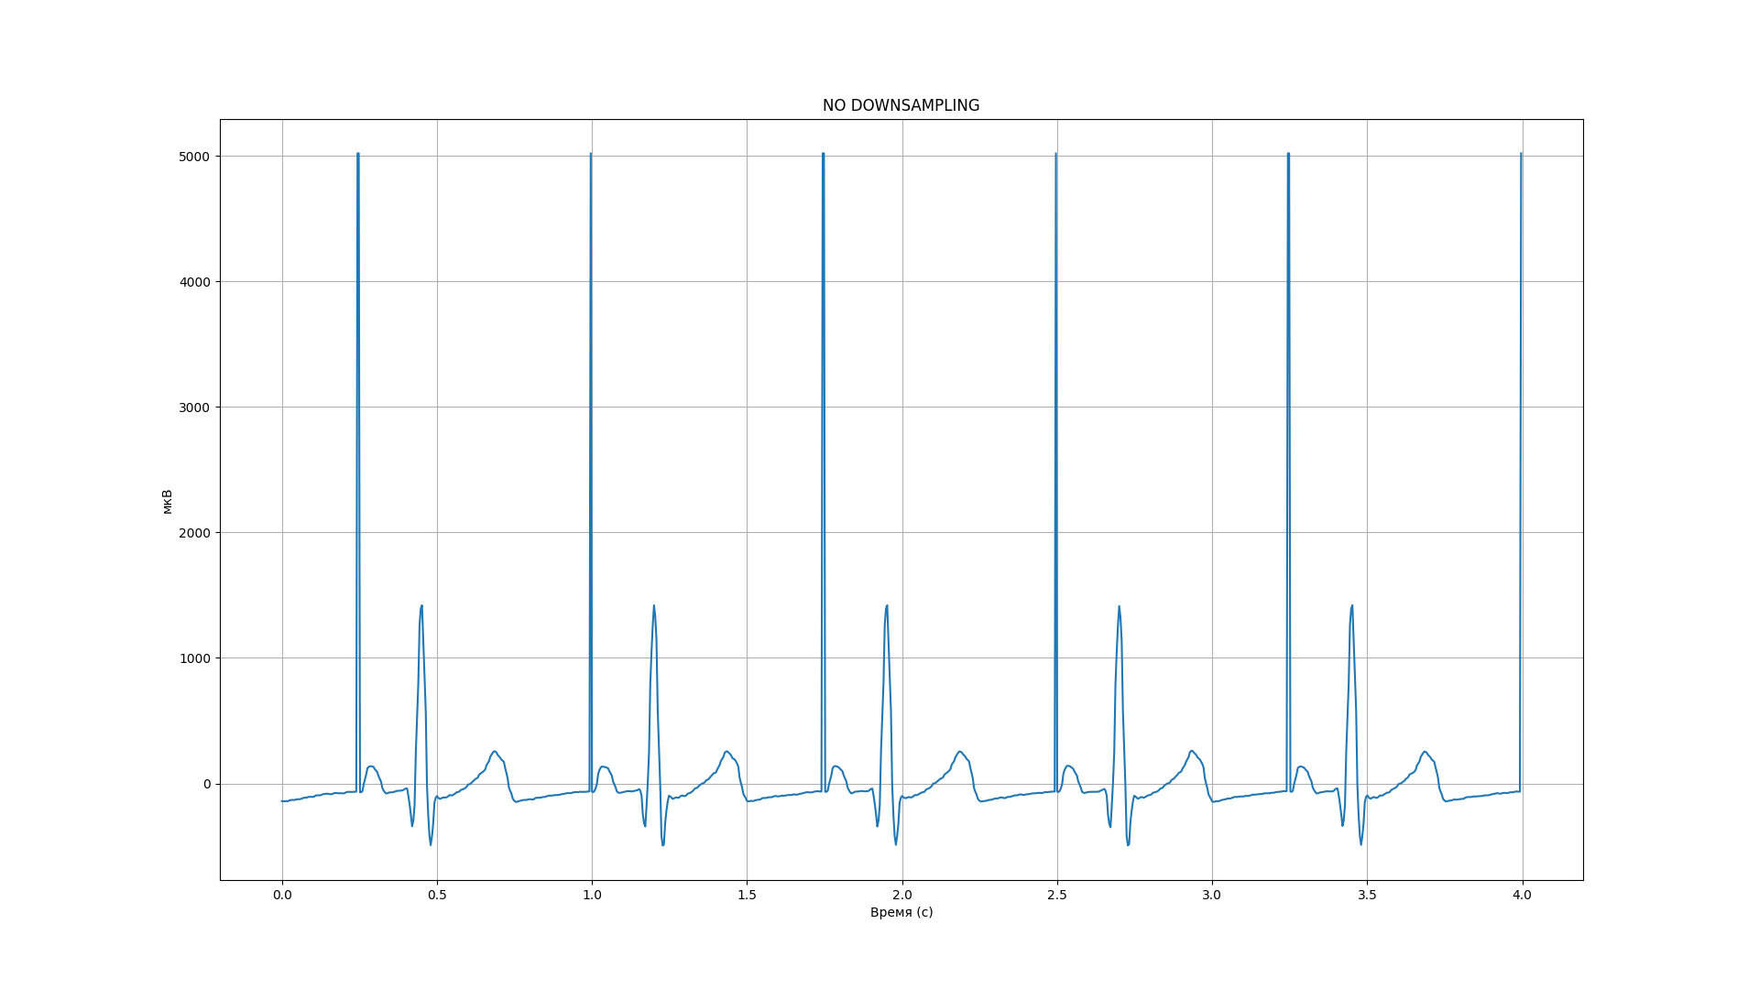
Default chart (no downsampling)

Slide 3
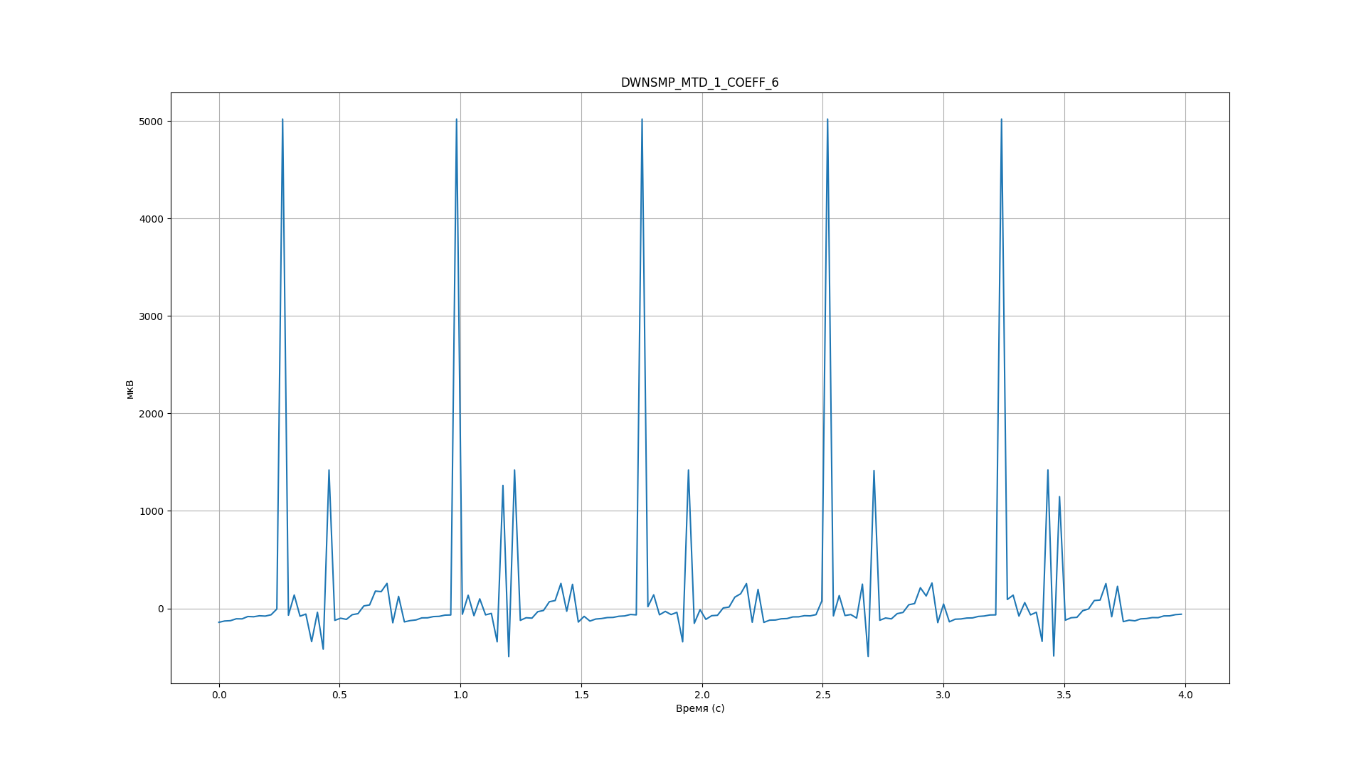
The semi-window method
We scan the data by comparing two joining arrays
The main idea is to keep receiving the max and min values
So we get max and min values from each semi-window and then just compare these values. In a result of one window we have one minimum and one maximum values
Advantages:
1) Reliable method to save the peaks on the chart
Disadvantages:
Unreliable with smaller maximum peaks and minimum peaks
I do not really why but It don’t want to keep the last peak (if you compare default and current charts, in the first one there will be 6 peaks, but here’s only 5)

Slide 4
Previous value difference
In this method we just comparing previous value and each element in new window and choose the one with biggest difference
Advantages:
1) Reliable method to save the peaks on the chart
Disadvantages:
The same problem: unreliable with smaller maximum peaks and minimum peaks

Slide 5
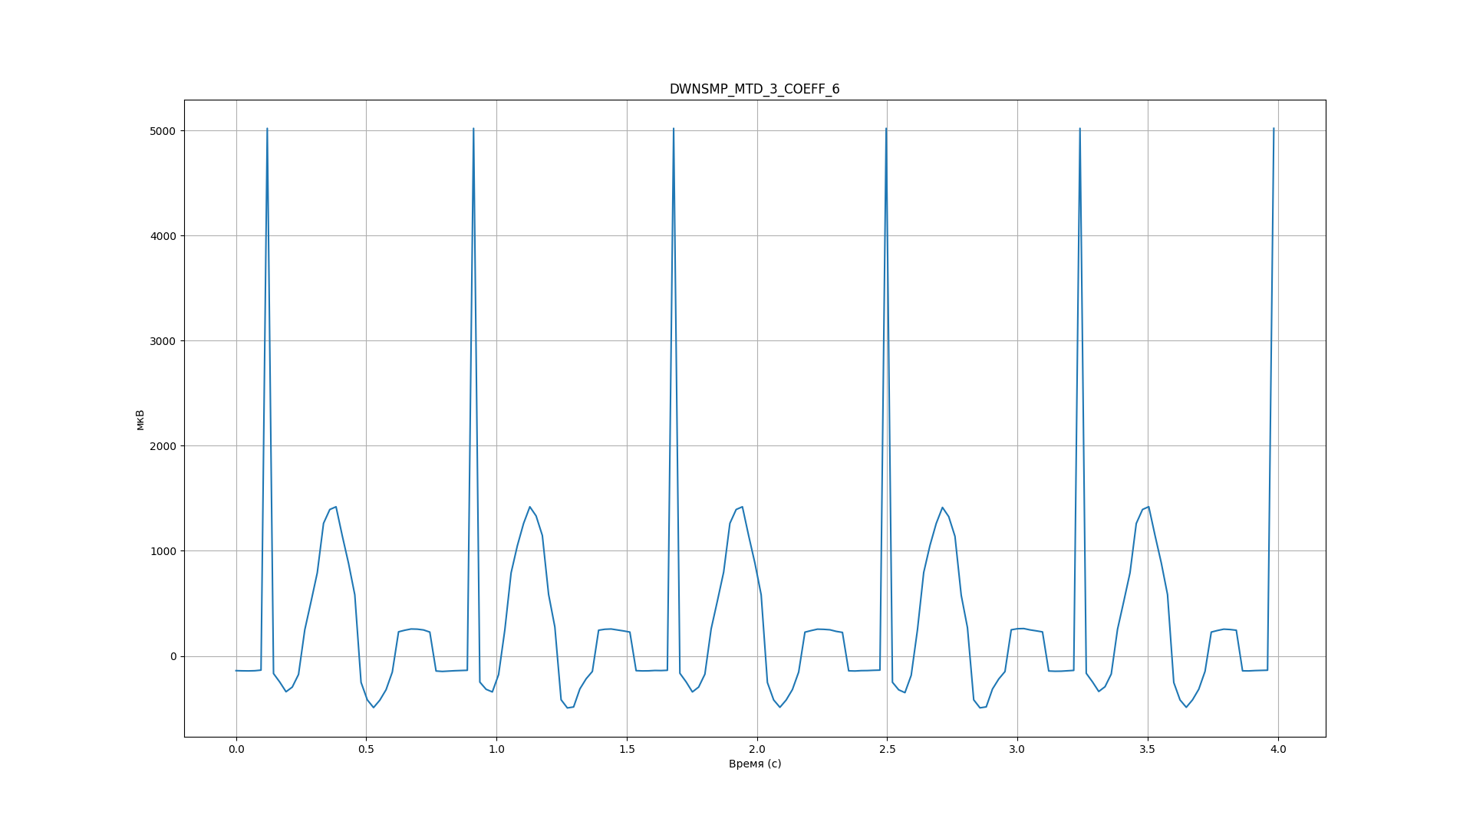
Average value difference
Find the average value of the whole dataset
Find elements with max difference of the average value (don’t forget to save their indices)
The result array should have the initial data array length divided into downsampling ratio (let just call it “amount”)
Get fist *amount* elements from the found max average diff values which do not differ more than DOWNSAMPLING_COEFF / FREQUENCY
Sort these items by indexes
Advantages:
1. The most accuracy method of all three ones
Disadvantages:
1. Do not think about it

