Slide 1
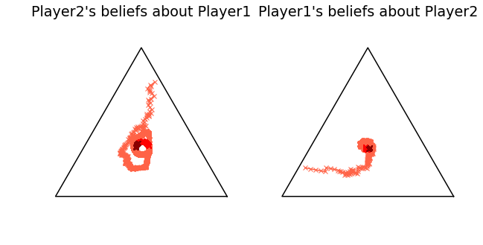
S
S
P
R
P
R

