Slide 1

Predicting milling machine failures before they happen
MACHINE LEARNING AND DATA MINING · UNIVERSITY OF BOLOGNA
A CRISP-DM project on the AI4I 2020 predictive maintenance dataset
Serra Özkasap
Prof. Matteo Francia

Slide 2



Problem statement
1 · BUSINESS UNDERSTANDING
Business goal
Project goal
Success criteria
Fewer unplanned stops: warn maintenance before a failure, so that a stop becomes a planned inspection.
Supervised binary classification: from one sensor record, predict machine failure (1) or no failure (0).
Catch most failures (recall) with few false alarms (precision); models are selected by F2.
Can sensor data tell us that a machine is about to fail?
AI4I 2020 (Matzka, 2020): 10,000 records, five sensors, 3.39% failures. Constraints: strong imbalance, synthetic data with published rules, unknown real costs.
AI4I predictive maintenance · Serra Özkasap
2
Notes:
Can sensor data tell us that a machine is about to fail? The business goal is fewer unplanned stops: if maintenance is warned in time, a stop becomes a planned inspection. I translate it into a data mining goal: supervised binary classification. From one sensor record the model predicts machine failure, one, or no failure, zero.
Success means catching most failures, that is high recall, without flooding the team with false alarms, so I also watch precision and I select models with F2. The constraints are the strong imbalance, 3.39 percent failures, the synthetic data, and the fact that I do not know the real costs of the plant.
POSSIBLE QUESTIONS
Q: Why supervised and not anomaly detection? A: The labels exist; and the outlier analysis showed that anomaly detection alone would miss about 85% of the failures.
Q: Why classification and not predicting the remaining time? A: The dataset has no time order per machine, only independent records with a failure label.

Slide 3
A missed failure costs more than a false alarm
1 · BUSINESS UNDERSTANDING
Predicted: no failure
Predicted: failure
Metric | Role
Recall | TP / (TP + FN): main metric
Precision | TP / (TP + FP): false alarms
F2 | Selection: recall counts twice
PR-AUC | Ranking, any threshold
Accuracy | Not used: 96.6% for “never”
Actual: no failure
TN · true negative
FP · false positive
Normal machine, left running
False alarm: one inspection
Actual: failure
FN · false negative
TP · true positive
Missed failure: unplanned stop
Failure caught in time
AI4I predictive maintenance · Serra Özkasap
3
Notes:
The business goal is to reduce unplanned stops. For me the positive class is ‘failure’. Every prediction falls in one of four boxes.
If the machine is normal and the model says normal, it is a true negative. If the model raises an alarm on a normal machine, it is a false positive, a false alarm: it costs one short inspection. If the machine fails and the model says normal, it is a false negative, a missed failure: an unplanned stop, scrap and maybe a broken tool. If the model catches the failure, it is a true positive.
So the expensive error is the false negative, and my main metric is recall: the share of real failures caught. But a model that alarms on every machine has recall one, so I also track precision, the share of alarms that are real failures, and I select models with F2, which treats recall as twice as important. I also report PR-AUC, which does not depend on the threshold. Accuracy is useless here: a model that never predicts a failure has 96.6 percent accuracy.

Slide 4
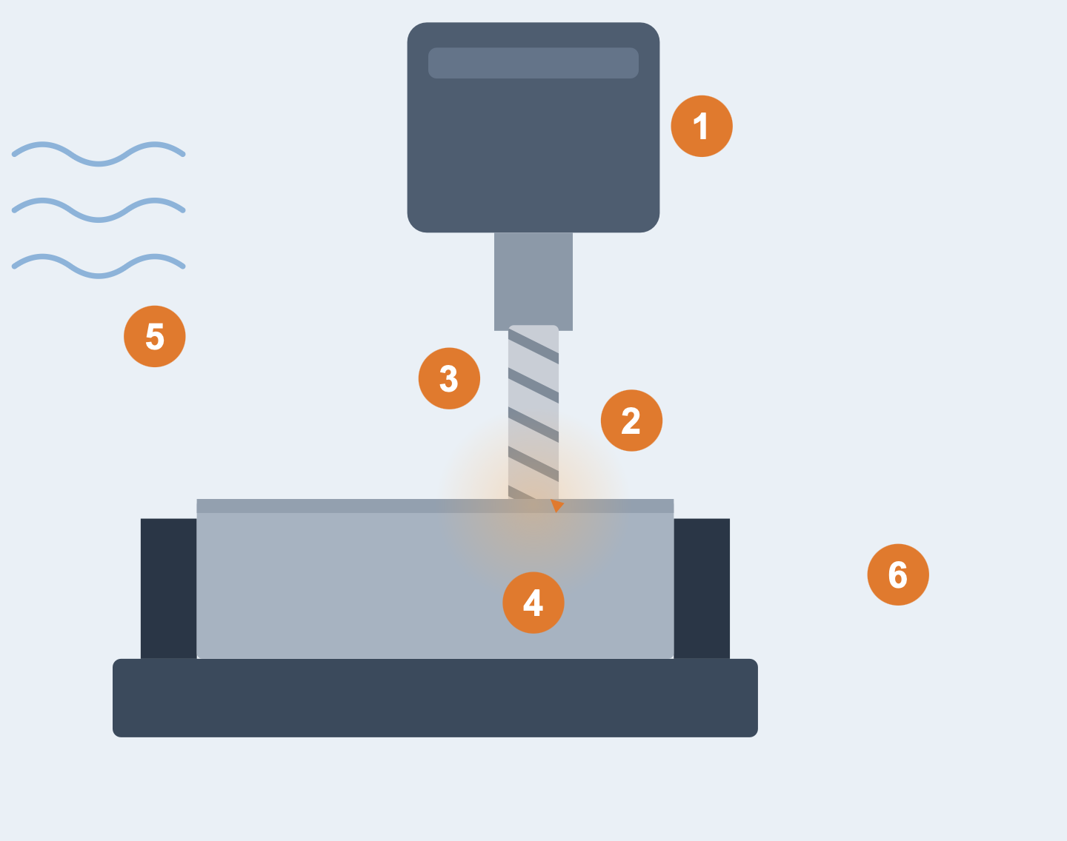
What each feature measures
1 · BUSINESS UNDERSTANDING
Feature | In the scene | In the data
① Rot. speed | How fast the spindle turns | From ~2,860 W power, plus noise
② Torque | Material resistance: “effort” | Normal, mean ~40 Nm
③ Tool wear | Minutes cut: “bluntness” | 0 to ~250 min, reset at tool change
④ Process temp. | Heat in the cutting zone | Air temperature + ~10 K
⑤ Air temp. | Workshop ambient air | Slow drift around 300 K
⑥ Type L/M/H | Quality class of the part | Higher quality wears the tool faster
AI4I predictive maintenance · Serra Özkasap
4
Notes:
Milling is a cutting process. A metal block is clamped in a vise on a moving table. Above it, a spindle turns a cutting tool very fast; as the tool is pressed into the block, it removes material and chips fly off. Every element of this scene is a feature of the dataset.
1- The spindle speed is the rotational speed.
2- The resistance the material opposes to the tool is the torque: how hard the machine has to work.
3- Every minute of cutting makes the tool blunter: that is tool wear. It grows until the tool is replaced, then goes back to zero.
4- The cutting zone heats up: process temperature.,
5- The workshop air around the machine: air temperature.
6- The part being produced has a quality class, low, medium or high.
HOW THE DATASET GENERATES THESE VALUES (from the dataset description)
Air temperature: random walk, standard deviation 2 K around 300 K.
Process temperature: air temperature + 10 K, small extra noise.
Rotational speed: computed from a power of about 2,860 W, plus normal noise. T
orque: normal around 40 Nm, standard deviation 10, never negative.
Tool wear: the quality variants H/M/L add 5/3/2 minutes of wear per process.
The dataset description says the type split is L 50%, M 30%, H 20%. The actual file I loaded has L 60.0%, M 30.0%, H 10.0% (my notebook output). In the presentation I always use the numbers measured in my data.

Slide 5
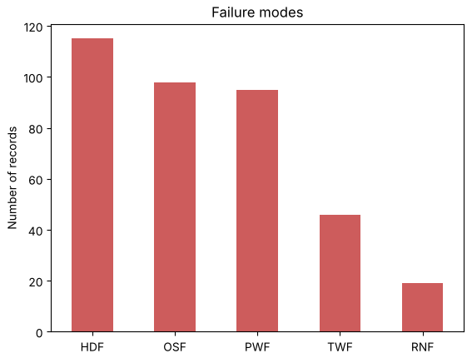
10,000 records, five sensors, five failure causes
2 · DATA UNDERSTANDING · THE MACHINE
Mode | Rule of the simulation | Records
HDF (heat dissipation) | ΔT < 8.6 K and speed < 1,380 rpm | 115
OSF (overstrain) | Tool wear × torque above a limit by type | 98
PWF (power) | Power < 3,500 W or > 9,000 W | 95
TWF (tool wear) | Random wear time, 200–240 min | 46
RNF (random) | 0.1% chance in any record | 19
Synthetic data with published rules: a limitation, but I can check whether the models learn the real mechanism.
AI4I predictive maintenance · Serra Özkasap
5
Notes:
AI4I is a synthetic dataset of 10,000 records that simulates a milling machine: a rotating tool removes material from a workpiece. Each row is one operating situation: the product quality type, low, medium or high, and five sensor values: air temperature, process temperature, rotational speed, torque and tool wear. The target is machine failure, and five more columns say which failure happened.
BAR CHART: counts the five causes. Heat dissipation, overstrain and power failures are the most frequent; tool wear failures are fewer, and random failures are only 19.
Because the data is synthetic, the rules are published: for example a power failure happens when the power is below 3,500 or above 9,000 watts.
This is a limitation, real data is noisier, but it lets me check whether my models learn the real mechanism.

Slide 6
The data was checked before any analysis
2 · DATA UNDERSTANDING · DATA QUALITY
Check | Code | Result
Missing values | df.isna().sum() | 0 in all 14 columns
Duplicates | df.duplicated().sum() | 0 rows
Types | df.info() | 10,000 rows, 2 text columns
Ranges | df.describe() | plausible, no negatives
Physics | process > air temperature | True in every row
Labels | failure vs the 5 mode flags | 27 inconsistent rows (0.27%)
# data quality checks (Section 2)
df.isna().sum() # 0 everywhere
df.duplicated().sum() # 0
(df["Process temperature [K]"]
> df["Air temperature [K]"]).all() # True
mode_count = df[modes].sum(axis=1)
((df["Machine failure"] == 1)
& (mode_count == 0)).sum() # 9
((df["Machine failure"] == 0)
& (mode_count > 0)).sum() # 18, all RNF
Decision: no imputation and no row removed. The 27 inconsistent labels (9 failures without a mode, 18 random failures without the failure flag) are kept and documented as label noise.
AI4I predictive maintenance · Serra Özkasap
6
Notes:
Before looking at any feature I checked the quality of the data. There are no missing values and no duplicate rows, so no imputation was needed. The types are correct: only Type and Product ID are text. With describe I checked that every value is physically plausible: temperatures between 295 and 314 kelvin, tool wear between 0 and 253 minutes, no negative values. A physical check: the process temperature is higher than the air temperature in every row.
The only issue is in the labels: 27 rows, 0.27 percent, are inconsistent. Nine failures have no failure mode, and eighteen records have a random failure flag but no machine failure. I kept them and documented them as label noise: they are too few to change the models, and removing them would mean guessing which column is wrong.
HOW TO READ
Left: each row is one check, the code I ran and what it returned. Right: the same checks as they appear in the notebook.
POSSIBLE QUESTIONS
Q: If there were missing values? A: Median imputation for skewed sensors or KNN imputation, learned on the training set only.
Q: Why keep the noisy labels? A: 0.27% of the data; the inconsistent RNF rows are random by definition and cannot be predicted anyway.

Slide 7
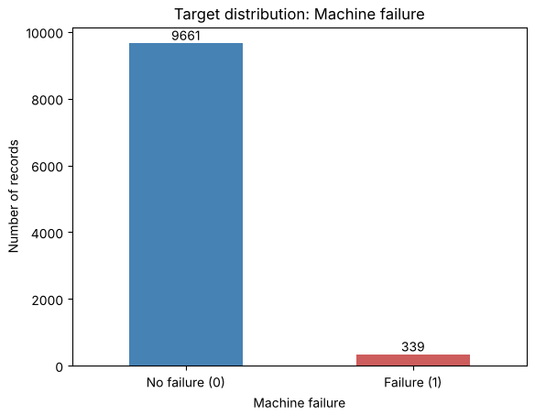
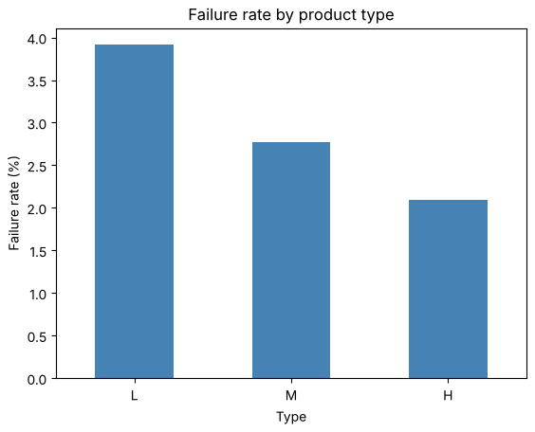
Only 3.39% of the records are failures
2 · DATA UNDERSTANDING · IMBALANCE
1 failure every ~28 normal records.
→ no accuracy
→ stratified split and folds
→ class weights, threshold
→ L 3.92%, M 2.77%, H 2.09%: ordinal type
I did not want to oversample synthetic records; class weights and the threshold tell the model that a missed failure is expensive.
AI4I predictive maintenance · Serra Özkasap
7
Notes:
The data quality is good: no missing values, no duplicates, every value physically plausible, and only 27 records, 0.27 percent, with inconsistent labels, which I kept as label noise. The property that drives most of my decisions is the imbalance: 9,661 normal records and only 339 failures, 3.39 percent.
I computed it myself with value_counts, and the mean of the 0/1 target in describe gives the same 0.0339.
Three consequences:
1- accuracy is useless;
2- every split and every cross-validation fold must be stratified so that it keeps 3.39 percent failures;
3- the models will ignore the minority class unless I use class weights or a lower threshold.

Slide 8
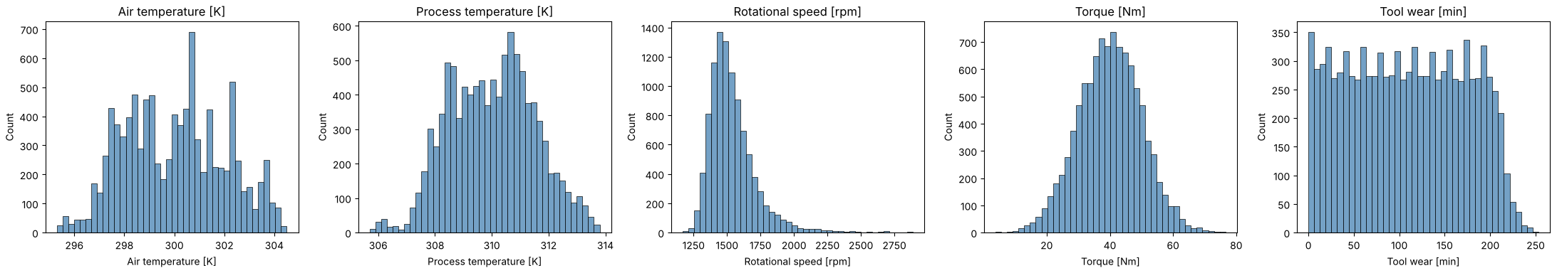
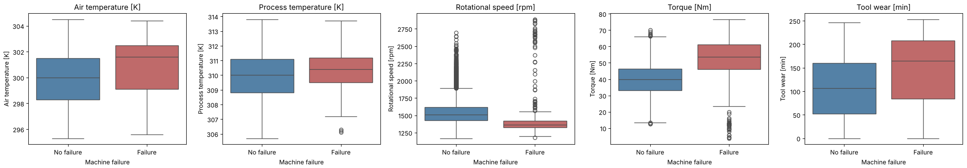
Failures sit at the extremes
2 · DATA UNDERSTANDING · SENSORS
Torque median 39.9 → 53.7 Nm · tool wear 107 → 165 min · speed: both ends
I compare medians because the distributions are skewed and have outliers: the median is robust.
AI4I predictive maintenance · Serra Özkasap
8
Notes:
The top row shows the shape of each sensor: the temperatures and torque are roughly bell-shaped, rotational speed is skewed to the right, tool wear is almost flat from 0 to about 250 minutes.
The bottom row compares each sensor between normal records, in blue, and failures, in red. If the two boxes are clearly different, the sensor helps. Torque is higher when machines fail, the median goes from 39.9 to 53.7 newton-metres, and tools are more worn, 107 against 165 minutes. Rotational speed is the interesting one: most failures happen at low speed, but some at very high speed, so failures sit at both ends. The relation is not linear, and that favours models that can cut a feature at several thresholds.
The extreme values are not errors. With the IQR rule, 69 records are torque outliers and about 90 percent of them are failures, so I kept them: they are exactly the conditions where machines fail.
HOW TO READ A BOX PLOT Box = from Q1 to Q3, the middle half of the records; line = median; whiskers = 1.5 × IQR; dots = extreme values.
Q: Isolation Forest? A: I used it only as a check: it flagged 300 records with a failure rate six times higher, but only 52 of the 339 failures, so anomaly detection alone is not enough.

Slide 9
Outliers are failure conditions, not errors
2 · DATA UNDERSTANDING · OUTLIERS
IQR rule (1.5 × IQR) | Bounds | Outliers | Failure rate
Air temperature | 293.5 – 306.3 K | 0 | –
Process temperature | 305.4 – 314.6 K | 0 | –
Rotational speed | 1,139.5 – 1,895.5 rpm | 418 | 8.4%
Torque | 12.8 – 67.2 Nm | 69 | 89.9%
Tool wear | −110.5 – 325.5 min | 0 | –
Isolation Forest
All five sensors at once, 3% contamination.
300 records flagged; failure rate 17.3% against 3.0% for the rest.
But they contain only 52 of 339 failures.
for col in num_cols: # IQR rule, one sensor at a time
q1, q3 = df[col].quantile([0.25, 0.75])
iqr = q3 - q1
is_out = (df[col] < q1 - 1.5*iqr) | (df[col] > q3 + 1.5*iqr)
rate = df.loc[is_out, "Machine failure"].mean()
iso = IsolationForest(n_estimators=100, contamination=0.03, random_state=42)
is_anomaly = iso.fit_predict(df[num_cols]) == -1
Decision: keep every outlier, no clipping: torque outliers are 90% failures. Anomaly detection alone misses ~85% of failures → supervised models.
AI4I predictive maintenance · Serra Özkasap
9
Notes:
The box plots showed many extreme values, so I asked whether they are measurement errors. I used the two methods of the course, only as a diagnostic. The IQR rule, the rule behind the box-plot whiskers, finds no outliers in the temperatures and tool wear, 418 in rotational speed and 69 in torque. If they were random errors, their failure rate would be close to 3.39 percent. Instead it is 8.4 percent for speed and 89.9 percent for torque: the extreme torques are almost always failures.
Isolation Forest looks at all five sensors together. It flags 300 unusual records, with a failure rate of 17.3 percent against 3 percent for the others, but these 300 records contain only 52 of the 339 failures. So the outliers are real failure conditions and I kept all of them, without clipping; and anomaly detection alone is not enough, which is why I use supervised models.
HOW TO READ THE TABLE
Bounds = Q1 − 1.5 × IQR and Q3 + 1.5 × IQR; Outliers = records outside the bounds; Failure rate = share of failures among those records (overall: 3.39%).
SCATTER-PLOT QUESTION (isolation tree)
“The split feature and the split value are chosen at random; an outlier is isolated after few cuts, so a short path means a high anomaly score.”
POSSIBLE QUESTIONS
Q: Why IQR and not 3 sigma? A: Quartiles are not affected by the extreme values themselves and work for skewed features like rotational speed.
Q: Why contamination 3%? A: Close to the 3.39% failure rate.

Slide 10
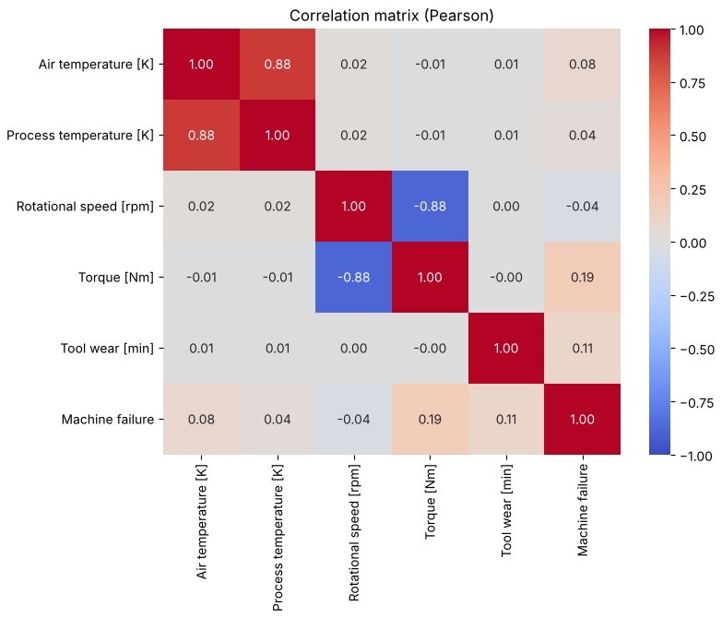
Two sensor pairs are linked by physics
2 · DATA UNDERSTANDING · RELATIONS
Speed ↔ torque, r = −0.88
The machine works at roughly constant power (P = τ · ω): a faster spindle means a lower torque.
Air ↔ process temperature, r = 0.88
The process heats up from the room; the useful information is the gap between them, ΔT.
Sensors ↔ failure: all |r| ≤ 0.19
Speed only −0.04, although failures sit at both ends of speed: Pearson sees only linear relations.
Each redundant pair hides one failure rule: these two relations become the derived features of data preparation.
AI4I predictive maintenance · Serra Özkasap
10
Notes:
Before preparing the data I looked at how the sensors move together, with the Pearson correlation matrix of the whole dataset. Two pairs are strongly correlated.
Rotational speed and torque: minus 0.88. The machine works at roughly constant power, and power is torque times angular speed, so if the spindle turns faster the torque must go down.
Air and process temperature: plus 0.88. The process heats up from the room, so the two move together; what matters is the gap between them, delta T, which tells how well the heat is removed.
last row is the correlation with failure: all values are small, and rotational speed is almost zero, minus 0.04. But the box plots showed failures at both low and high speed: the two ends cancel in a linear measure. This is why, after the split, I measure relevance with mutual information.
HOW TO READ
Each cell = Pearson r between two columns, from −1 (blue) to +1 (red). The two dark off-diagonal cells are the two pairs. Last row/column = correlation with Machine failure.
WHERE IT COMES FROM
Notebook Section 2, df[num_cols + ["Machine failure"]].corr(), whole dataset (nothing is learned from it, it is only a look at the data).
POSSIBLE QUESTIONS
Q: If speed and torque are so correlated, why keep both? A: They enter different failure rules (HDF uses speed, OSF uses torque, PWF their product); trees are not hurt by correlated inputs. Naive Bayes is, and I show it in the modeling slide.
Q: Why does tool wear × torque not appear here? A: It is a product, an interaction; a linear correlation cannot see it.

Slide 11
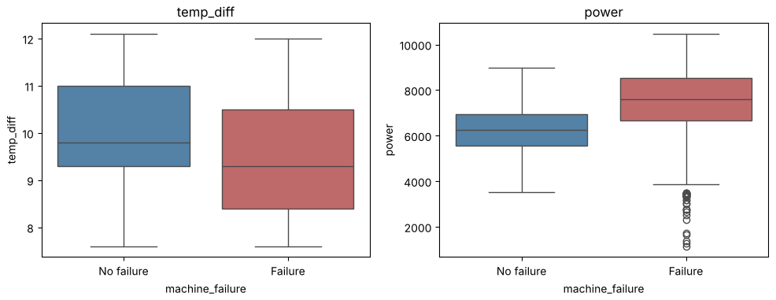
From raw table to model input
3 · DATA PREPARATION
Step | Decision and reason
Select | Drop UDI, Product ID: identifiers
Leakage | Drop the 5 mode columns: known only after
Encode | Type L = 0, M = 1, H = 2: ordered
Derive | ΔT = process − air; power = τ · ω
Split | 80/20 stratified, seed 42: 271 / 68 failures
Scale | StandardScaler fitted on train only
Failures: power outside ~3,500–9,000 W, lower ΔT.
data = data.drop(columns=["UDI", "Product ID"] + modes) # identifiers + leakage (failure modes)
data["type"] = data["type"].map({"L": 0, "M": 1, "H": 2}) # ordinal encoding
data["temp_diff"] = data["process_temp"] - data["air_temp"]
data["power"] = data["torque"] * data["rotational_speed"] * 2 * np.pi / 60 # watts
X_train, X_test, y_train, y_test = train_test_split(X, y, test_size=0.2, stratify=y, random_state=42)
X_train_scaled = scaler.fit_transform(X_train) # mean and std learned on the training set only
X_test_scaled = scaler.transform(X_test) # the same values applied to the test set
AI4I predictive maintenance · Serra Özkasap
11
Notes:
Data preparation turns these findings into code, in six steps, and with one rule: nothing is learned from the test set.
1- I removed the two identifiers, UDI and Product ID, which say nothing about the machine. Then the five failure-mode columns: they describe the failure and are known only after it, so keeping them would be data leakage, the model would see the answer.
I encoded Type as ordinal, L 0, M 1, H 2, because the categories are ordered and the failure rate follows the order.
Then domain knowledge: two failure causes depend on combinations of sensors, so I created the temperature difference, process minus air, and the mechanical power, torque times angular speed. The box plots check that they really separate the classes: normal machines stay inside a power band and failures fall outside it, and ΔT is lower for failures.
***Only then I split 80/20, stratified, with seed 42: 271 failures for training, 68 for the test. The derived features and the encoding work row by row, so it does not matter that they come before the split: they learn nothing from other records. The scaler instead learns a mean and a standard deviation, so it is fitted on the training set only and then applied to the test set. It is used only by KNN.
HOW TO READ
Table = the six steps in notebook order. Box plots: left ΔT, right power; blue = normal, red = failure. Code = the same steps as in the notebook (Sections 4–5).
POSSIBLE QUESTIONS
Q: Why 2π/60 in the power formula? A: rpm to rad/s, so newton-metres × rad/s gives watts.
Q: Why fit the scaler on training data only? A: Its mean and std are learned values; computed on all data, the test set would leak into training and the test score would be too optimistic.
Q: Is the scaler inside the cross-validation? A: It is fitted on the whole training set before the folds; the effect is tiny (one mean and one std per feature on 8,000 records) and the test set is untouched. A Pipeline inside GridSearchCV would be the strict version.
Q: Why not one-hot encoding? A: It would create three columns and lose the order L < M < H.

Slide 12
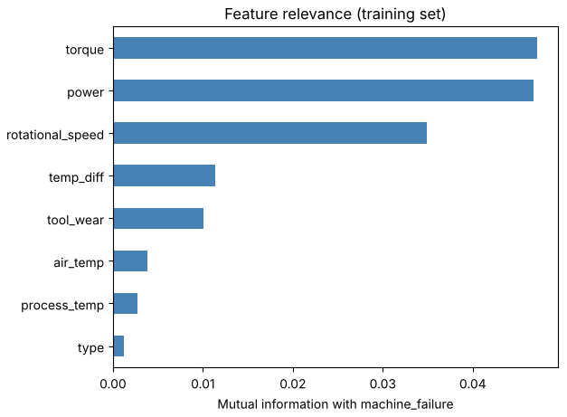
Mutual information keeps all eight features
3 · DATA PREPARATION · FEATURE SELECTION
Filter · mutual information
Training set only: torque (0.047), power (0.047) and speed (0.035) on top; no feature at zero.
Pearson vs mutual information
Speed: r = −0.04 but 3rd by MI. Failures at both ends of speed cancel in a linear measure.
Embedded and wrapper
Embedded: tree importance, shown after the models (slide 20). Wrapper: 2⁸ = 256 subsets, not used.
Result: all 8 features kept, no PCA: only eight features, and components would hide the meaning of power and ΔT.
AI4I predictive maintenance · Serra Özkasap
12
Notes:
Feature selection in the course has three strategies. The filter strategy scores each feature against the target without a model. I used mutual information, the information gain of the course, which measures any kind of dependence, not only linear ones. I computed it on the training set only, so the test set does not influence any decision.
Torque and power carry the most information, then rotational speed. Rotational speed is the proof that Pearson is not enough: its correlation with failure is only minus 0.04, but it is third by mutual information, because failures happen at both low and high speed. My two derived features, power and ΔT, are among the most informative.
No feature has zero information, so I kept all eight: mutual information ranks the features, it does not remove them. The embedded strategy, the importance inside the tree models, I show after the models, because it needs trained models. I did not use a wrapper: with only eight features it would train a model on up to 256 subsets for a small gain. I also did not use PCA: the components would hide the physical meaning of power and ΔT.
HOW TO READ
Bars = mutual information between each feature and machine_failure, training set; longer = more informative; 0 = independent.
CODE (notebook Section 4)
mi_scores = mutual_info_classif(X_train, y_train, discrete_features=[col == "type" for col in X_train.columns], random_state=42)
POSSIBLE QUESTIONS
Q: Filter vs wrapper vs embedded? A: Filter: statistics, no model, fast. Wrapper: trains the model on subsets, accurate but expensive. Embedded: selection happens inside training (tree importance, LASSO).
Q: Why random_state in mutual information? A: The estimator adds a little random noise to break ties between equal values.

Slide 13
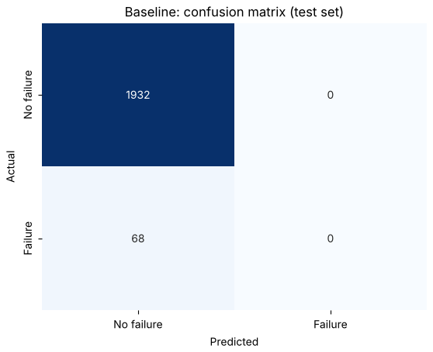
One protocol for every model
4 · MODELING · PROTOCOL AND BASELINE
Training set (8,000 records) → 5 stratified folds
Val.
Train
Train
Train
Train
Train
Val.
Train
Train
Train
… 5 rounds → mean F2 chooses depth, k, weights, threshold (GridSearchCV)
Test set (2,000, 68 failures): used once per model. One failure ≈ 1.5 points of recall.
Baseline (always “no failure”): accuracy 96.6%, recall 0, PR-AUC 0.034 = the failure rate.
AI4I predictive maintenance · Serra Özkasap
13
Notes:
Every model follows the same protocol. All choices are made with five-fold stratified cross-validation on the training set
the depth of a tree,
the number of neighbours,
class weights,
the threshold,
1- train on four folds,
2- validate on the fifth,
3- the setting with the best mean F2 wins.
The test set is used only once per model, because with only 68 failures one failure moves recall by 1.5 points
The baseline always predicts ‘no failure’. Its confusion matrix shows why accuracy is useless: all 1,932 normal machines are right, all 68 failures are missed, and the accuracy is still 96.6 percent
READ THE MATRIX Rows = actual, columns = predicted. Top-left TN, top-right FP, bottom-left FN, bottom-right TP. Here the whole right column is 0: the model never raises an alarm.
HOW THE THRESHOLD IS CHOSEN cross_val_predict gives every training record a probability from a model that did not see it; I pick the threshold with the best F2 on those predictions.
CODE (notebook Section 5)
cv = StratifiedKFold(n_splits=5, shuffle=True, random_state=42) # same folds for every model
f2_scorer = make_scorer(fbeta_score, beta=2)

Slide 14
Every setting chosen by grid search on F2
4 · MODELING · HYPERPARAMETER TUNING
Hyperparameters are settings fixed before training (depth, k, number of trees). GridSearchCV trains every combination with 5-fold CV on the training set and keeps the best mean F2; the test set is not used. Random search samples instead; my grids were small.
Model | Grid | Fits | Chosen (CV F2)
Decision tree | depth 3–10, None × leaf 1–20 × class_weight | 56 × 5 | depth 10 (0.773); balanced 0.753
KNN | k 1–31 × weights; then k 5–101 × threshold 0.05–0.5 | 18 × 5; 42 | k = 71, distance, thr. 0.10 (0.695)
Random forest | depth × leaf × max_features × class_weight | 36 × 5 | balanced_subsample, 4 feat., leaf 5 (0.807)
Gradient boosting | rounds 100–300 × rate 0.05–0.2 × depth 2–5 | 27 × 5 | 200 rounds, rate 0.2, depth 5 (0.800)
f2_scorer = make_scorer(fbeta_score, beta=2)
rf_grid = {"max_depth": [None, 10], "min_samples_leaf": [1, 3, 5],
"max_features": ["sqrt", 0.5, None], "class_weight": [None, "balanced_subsample"]}
rf_search = GridSearchCV(RandomForestClassifier(n_estimators=200, random_state=42, n_jobs=-1),
rf_grid, scoring=f2_scorer, cv=cv)
rf_search.fit(X_train, y_train) # 36 combinations x 5 folds -> best_params_, CV F2 0.807
AI4I predictive maintenance · Serra Özkasap
14
Notes:
Every model has settings that are fixed before training: the depth of a tree, the number of neighbours, the number of trees or boosting rounds. Choosing them is hyperparameter tuning. I used grid search, from the course: GridSearchCV trains every combination of a list with five-fold cross-validation on the training set, and keeps the one with the best mean F2. The test set is never used to choose.
The table shows the grids. For the tree, 56 combinations; for KNN, k and the voting rule, and then k together with the threshold, using cross-validated probabilities; for the forest, 36 combinations; for boosting, 27. The code shows the forest: the scorer is F2, so the search optimises my business metric, not accuracy.
HOW TO READ
Grid = values tried; Fits = combinations × folds; Chosen = the best combination and its mean cross-validated F2. Highlighted: the final model.
POSSIBLE QUESTIONS
Q: Grid search vs random search? A: Grid search tries every combination; random search samples combinations from the space, cheaper with many parameters. My grids were small, so grid search was affordable.
Q: Why F2 as the scoring? A: The default scoring is accuracy, which would choose models that ignore failures.
Q: Are hyperparameters and parameters the same? A: No: parameters (split thresholds, weights) are learned from the data; hyperparameters are chosen before training.

Slide 15
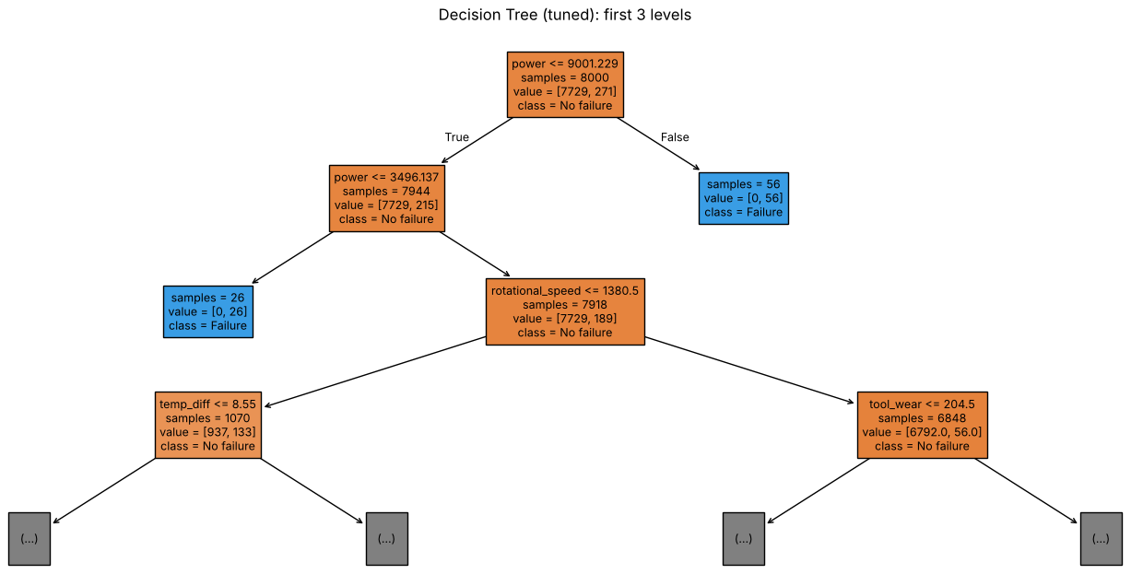
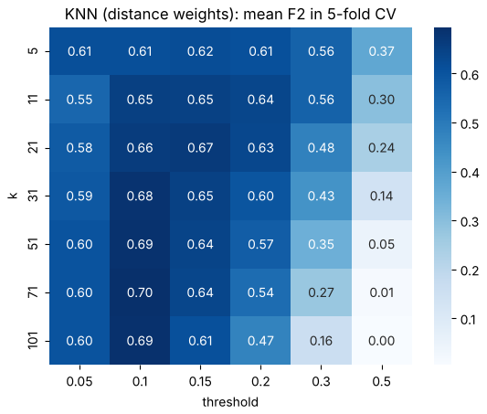
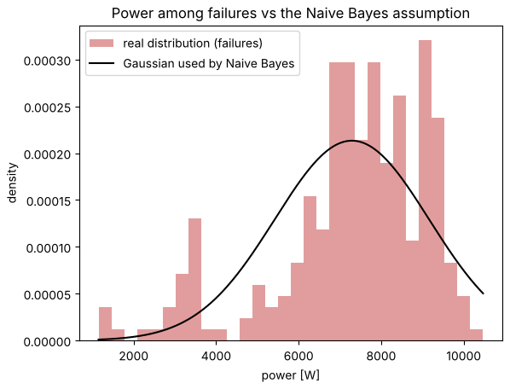
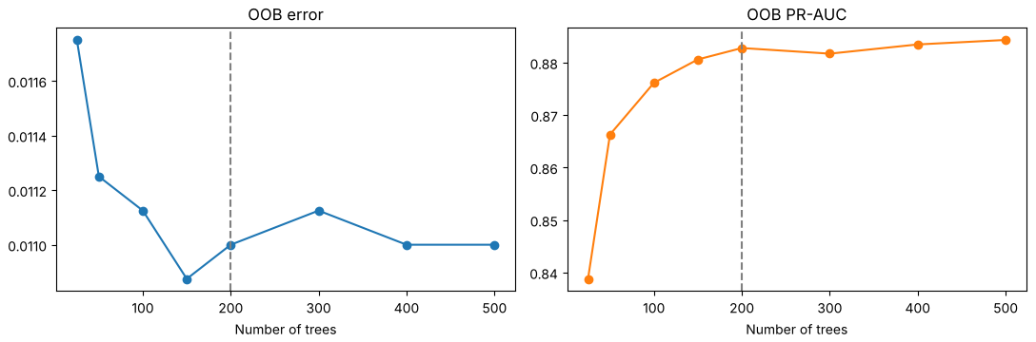
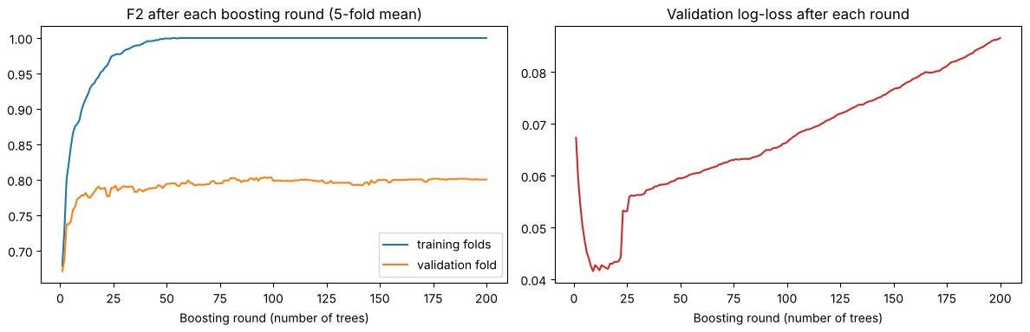
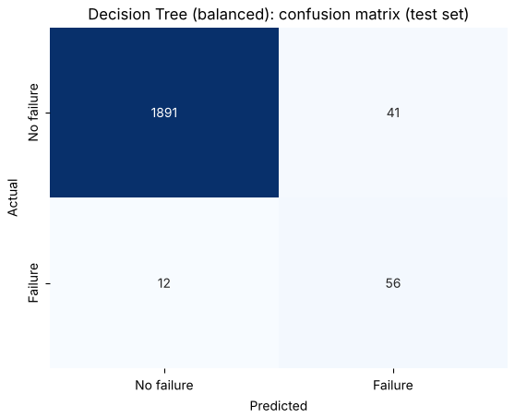

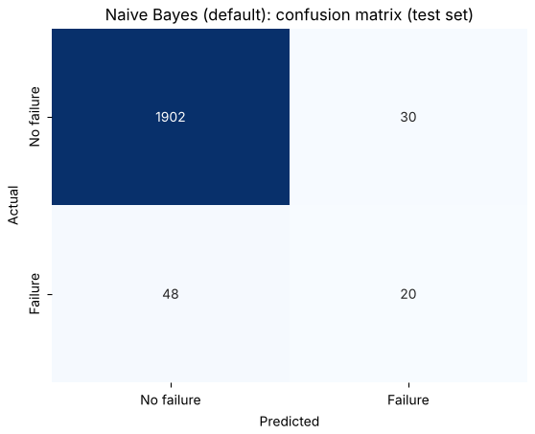


Five models
4 · MODELING
Decision tree
KNN
Naive Bayes
Random forest
Gradient boosting
Rediscovers the rules: power and ΔT splits. Unpruned it overfits; depth 10 by CV.
Threshold beats k: scaled data, k = 71, alarm at 10% failure neighbours.
Assumptions break: one bell curve for two groups; torque–power r = 0.98. Default model shown.
Bagging + random features: lower variance; 200 trees by OOB. Final model.
Trees on the errors: lower bias, but memorises after ~50 rounds.
56 caught · 41 false alarms
50 caught · 75 false alarms
20 caught · 30 false alarms
57 caught · 9 false alarms
56 caught · 7 false alarms
AI4I predictive maintenance · Serra Özkasap
15
Notes:
This is the comparison of the best version of each model on the same test set. The two tree ensembles are clearly the best: the random forest catches 57 of 68 failures with 9 false alarms, gradient boosting 56 with 7. The balanced tree catches as many but with 41 false alarms; KNN and Naive Bayes raise more false alarms than real failures they catch.
The bar chart shows the same thing in machines: green = failures caught, red = false alarms. An important check: the cross-validated F2, computed only on the training set, ranks the models exactly like the test set, so the choices made without looking at the test set hold on new data.
HOW TO READ THE BARS For each model: green bar = failures caught out of 68 (dashed line), red bar = false alarms.
POSSIBLE QUESTIONS Q: Why is precision of boosting higher but you prefer the forest? A: Recall is my main metric; and on one split the difference is one machine, so I compared them over repeated splits.

Slide 16
The two ensembles lead, on CV and on test
5 · EVALUATION · FINAL COMPARISON
Model | CV F2 | Recall | Precision | F2 | PR-AUC | Caught
Baseline | – | 0.000 | 0.000 | 0.000 | 0.034 | 0
Decision tree (balanced) | 0.753 | 0.824 | 0.577 | 0.759 | 0.776 | 56
KNN (k = 71, thr. 0.10) | 0.695 | 0.735 | 0.400 | 0.630 | 0.579 | 50
Naive Bayes (thr. 0.20) | 0.497 | 0.485 | 0.330 | 0.444 | 0.353 | 33
Random forest | 0.807 | 0.838 | 0.864 | 0.843 | 0.871 | 57
Gradient boosting | 0.800 | 0.824 | 0.889 | 0.836 | 0.832 | 56
CV F2, computed on the training set only, ranks the models like the test set: the choices made without the test set hold on new data.
AI4I predictive maintenance · Serra Özkasap
16
Notes:
This is the comparison of the best version of each model on the same test set. The two tree ensembles are clearly the best: the random forest catches 57 of 68 failures with 9 false alarms, gradient boosting 56 with 7. The balanced tree catches as many but with 41 false alarms; KNN and Naive Bayes raise more false alarms than real failures they catch.
An important check: the cross-validated F2, computed only on the training set, ranks the models exactly like the test set, so the choices made without looking at the test set hold on new data.
HOW TO READ Orange frame = recall, my main metric. CV F2 = training set only; the other columns = test set.
POSSIBLE QUESTIONS Q: Why is precision of boosting higher but you prefer the forest? A: Recall is my main metric; and on one split the difference is one machine, so I compared them over repeated splits.

Slide 17
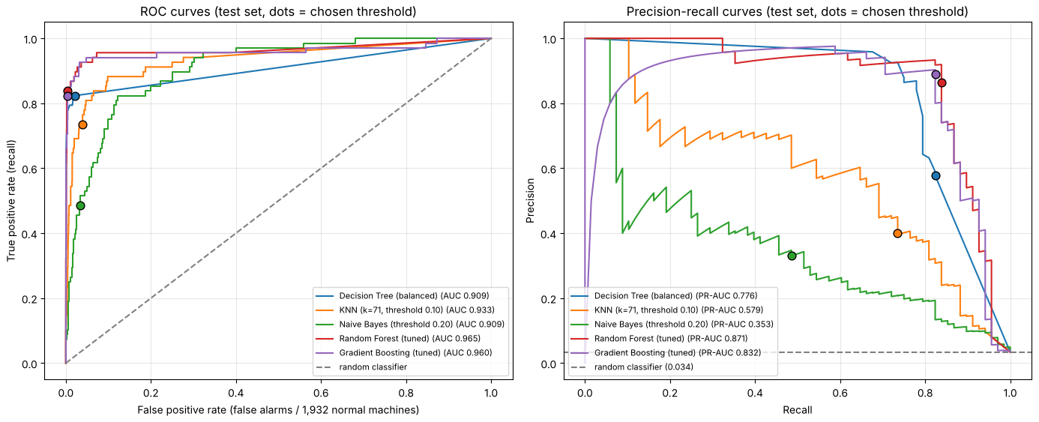
ROC looks optimistic, PR-AUC is honest
5 · EVALUATION · ROC AND PRECISION-RECALL CURVES
Test | ROC | PR
Forest | 0.965 | 0.871
Boost. | 0.960 | 0.832
Tree | 0.909 | 0.776
KNN | 0.933 | 0.579
NB | 0.909 | 0.353
Rand. | 0.500 | 0.034
ROC is the course tool to compare classifiers independently of the threshold; PR focuses on the failure class
Naive Bayes: 0.909 ROC vs 0.353 PR · its 67 false alarms are only 3.5% of 1,932 normal machines.
AI4I predictive maintenance · Serra Özkasap
17
Notes:
To compare the models independently of the threshold I used two curves.
1- The ROC curve, from the course: every threshold gives one point, the true positive rate, which is recall, against the false positive rate.
2- The precision-recall curve uses the same thresholds but plots precision against recall. The area under each curve summarises the model in one number.
The forest and boosting are on top in both: ROC-AUC 0.965 and 0.960, PR-AUC 0.871 and 0.832.
But look at Naive Bayes: its ROC-AUC is 0.909, the same as the balanced tree, although it catches only 33 failures.
The false positive rate divides its 67 false alarms by 1,932 normal machines, so they are only 3.5 percent: with 3.4 percent failures ROC looks optimistic, like accuracy.
The PR curve divides the false alarms by the alarms raised, so Naive Bayes falls to 0.353. That is why I reported PR-AUC for every model.
HOW TO READ ROC: x = false alarms / all normal machines, y = recall; top-left = perfect, diagonal = random (0.5). PR: x = recall, y = precision; top-right = perfect; random = flat line at the failure rate, 0.034. Dots = the threshold each model uses.
POSSIBLE QUESTIONS Q: Why show both? A: ROC is the course tool to compare classifiers independently of the threshold; PR focuses on the failure class, the one I care about.
Q: Is PR-AUC a threshold metric? A: No, it summarises all thresholds; the threshold comes afterwards, with F2 and the cost matrix.

Slide 18
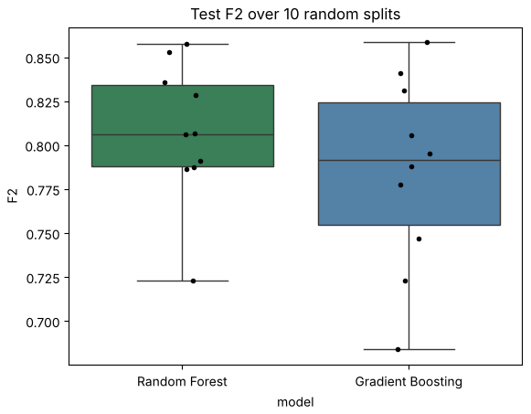
Ten splits choose the final model
5 · EVALUATION · ROBUSTNESS CHECK (RANDOM SUBSAMPLING)
10 splits | F2 | Recall
Random forest | 0.807 ± 0.040 | 0.801
Gradient boosting | 0.785 ± 0.054 | 0.762
The forest wins 7 of 10 splits, is more stable and has the higher recall.
Split-to-split variation (about ±0.05) is larger than the gap on the first test set: one split was not enough.
Final model: tuned random forest
AI4I predictive maintenance · Serra Özkasap
18
Notes:
On one test set the two ensembles differ by one machine. To decide, I used random subsampling, from the course:
the holdout method repeated with different random splits. I split the data ten times, 80/20 and stratified, retrained both models with their settings and evaluated each on its own test set.
The forest has a mean F2 of 0.807 with standard deviation 0.040, boosting 0.785 with 0.054. The forest wins seven of ten splits, it is more stable and it has the higher recall, my main metric. So the final model is the tuned random forest. The box plot also shows that from one split to another the F2 moves by about five points, more than the gap on the first test set.
HOW TO READ Each dot = test F2 of one split; box = middle half of the ten values; line = median.
POSSIBLE QUESTIONS Q: Random subsampling vs cross-validation? A: CV splits the data into k folds and tests every record exactly once; I used it to tune. Random subsampling repeats the holdout with random splits; I used it to compare the two final models. Q: Is it optimistic? A: The settings were tuned on the first split, so slightly, but equally for both models.
IF ASKED “WHAT IS A ROBUSTNESS CHECK?”
Checking that a result does not depend on one lucky split. Here the ten random splits (random subsampling) are my robustness check; the learning curve on the last slide is a second one (more data, same conclusion).

Slide 19
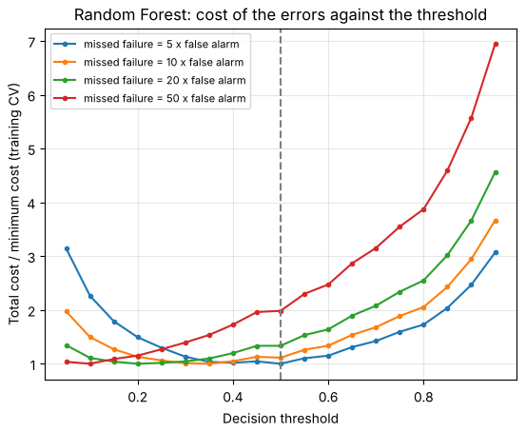
The threshold is a business decision
5 · EVALUATION · COST MATRIX AND THRESHOLD
Missed failure costs | Best thr. | Caught | False al.
5 × an inspection | 0.50 | 57 | 9
10 × | 0.35 | 59 | 34
20 × | 0.20 | 63 | 95
50 × | 0.10 | 65 | 157
Total cost = C × missed failures + 1 × false alarms. Thresholds chosen on cross-validated training predictions; the test set only reports.
Default: 0.5 (best F2). If a stop costs ≥ 20 inspections: about 0.2.
AI4I predictive maintenance · Serra Özkasap
19
Notes:
threshold is the probability above which the model raises an alarm. Until now I weighed the two errors only through F2.
The cost matrix of the course gives each error a cost directly: a false alarm costs one inspection, a missed failure costs C inspections. I do not know the real C of a plant, so I tried 5, 10, 20 and 50, and for each one I chose the threshold with the lowest total cost on the cross-validated predictions of the training set.
The more expensive a missed failure, the lower the threshold. At five times, 0.5 is already the best. At 20 times the best threshold is 0.2: on the test set the forest then catches 63 of 68 failures, but with 95 false alarms. So the threshold is not a technical detail but a business decision for the maintenance team. As a default I keep 0.5.
HOW TO READ Each curve = one cost ratio; y = total cost divided by its minimum (1.0 = best); the lowest point of each curve = its best threshold; dashed line = 0.5.
POSSIBLE QUESTIONS Q: Why not choose it on the test set? A: The threshold is a setting like the others; choosing it on the test set would make the result optimistic.
Q: How would a plant estimate C? A: Cost of an unplanned stop divided by the cost of one planned inspection.

Slide 20
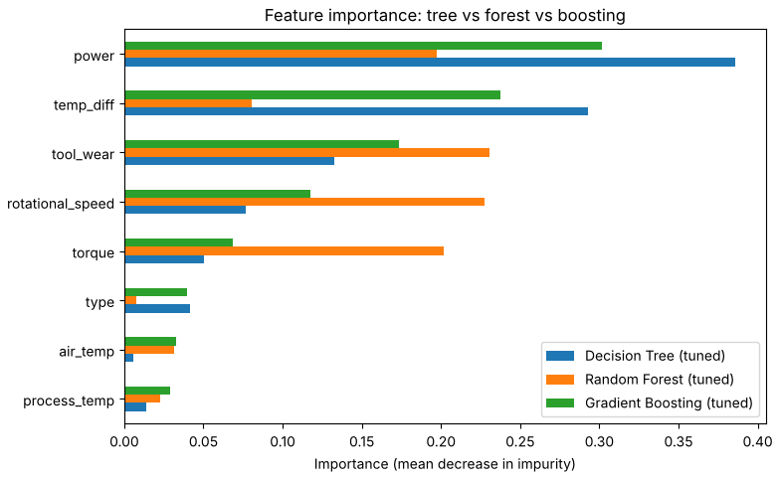
What the trees learned and what they miss
5 · EVALUATION · ERROR ANALYSIS
Failure mode (test) | In test | Caught
Heat dissipation | 29 | 29
Power | 13 | 13
Overstrain | 16 | 16
Tool wear (random) | 10 | 1
No recorded mode | 2 | 0
Learned: power and ΔT on top = the rules of heat dissipation and power failures; every physical failure is caught.
Missed: 9 of 11 misses are tool wear failures. 790 records have wear 200–240 min, only 43 fail: no sensor can tell which.
AI4I predictive maintenance · Serra Özkasap
20
Notes:
Now that the models exist, two questions: what did they learn, and where do they fail?
On the left, the embedded feature importance of the three tree models, the mean decrease in Gini impurity. The single tree and boosting put most of the importance on power and ΔT, my two derived features: these are exactly the rules of power failure and heat dissipation failure. The forest spreads the importance over tool wear, speed, torque and power, because each split sees only some features and correlated features replace each other.
On the right, the errors of the final forest by failure mode. I used the failure-mode columns only here, after training, like a maintenance engineer reading the failure report. Every heat dissipation, power and overstrain failure is caught: these are threshold rules on the sensors, and the trees learned them. Nine of the eleven misses are tool wear failures: the tool fails at a random time between 200 and 240 minutes; 790 records are in that window and only 43 fail, so no sensor can tell which one. These errors are irreducible with these features.
HOW TO READ
Left: bars = importance per feature, normalised to 1 per model (blue tree, orange forest, green boosting). Right: test failures per mode and how many the forest caught; a failure can have two modes, so the column is larger than 68.
CODE (notebook Section 5, error analysis)
failure_modes = df.loc[test_failures, modes]
caught = test_pred[test_failures] == 1
per_mode = pd.DataFrame({"failures in test": failure_modes.sum(), "caught": failure_modes[caught].sum()})
POSSIBLE QUESTIONS
Q: Is using the mode columns here leakage? A: No, the model never saw them; I read them only after training.
Q: Is impurity importance reliable? A: It is computed on training data and shared among correlated features, so I read it together with mutual information.

Slide 21
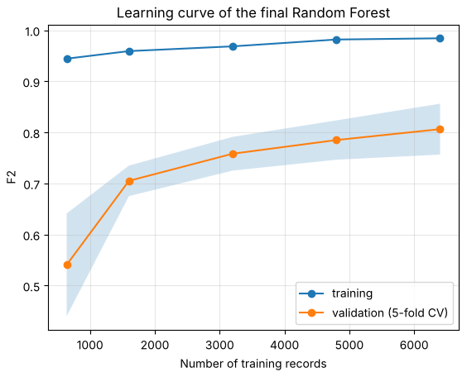
57 of 68 failures caught, 9 false alarms
6 · CONCLUSION
Can sensor data tell us that a machine is about to fail?
Yes, for the failures that follow physical rules: the forest caught every heat dissipation (29/29), power (13/13) and overstrain (16/16) failure in the test set. Tool-wear failures happen at a random time and cannot be predicted from one record.
0.838
Recall · test set
0.864
Precision · test set
0.843
F2 · test set
0.871
PR-AUC · test set
Thresholds win: trees beat distances and bell curves.
Limits: synthetic data, unknown real costs.
AI4I predictive maintenance · Serra Özkasap
21
Notes:
To conclude, back to the question of the second slide: can sensor data tell us that a machine is about to fail? Yes, for the failures that follow physical rules. The final random forest catches 57 of the 68 test failures with only 9 false alarms: recall 0.84, precision 0.86, F2 0.84, PR-AUC 0.87. Every heat dissipation, power and overstrain failure is caught; the misses are the random tool wear failures.
The learning curve shows the validation F2 rising from 0.54 to 0.81 and still rising: more data, above all more failures, would still help.
1- models that learn thresholds clearly beat distance-based and probabilistic ones on this problem.
2- the next steps are real plant data, a real cost estimate from maintenance, and a planned tool change before 200 minutes for the failures no model can predict.
3- the limits: the data is synthetic, so these results are an upper bound, and the real costs are unknown.
HOW TO READ
Learning curve: x = number of training records; blue = F2 on training data; orange = mean F2 in 5-fold CV, band = ± one standard deviation. Tiles = test-set metrics of the final forest at threshold 0.5.
POSSIBLE QUESTIONS
Q: Why is the training F2 almost 1? A: Each tree is grown deep on its bootstrap sample; the gap to validation is the variance that averaging reduces, and it shrinks as data grows.
Q: What would you change first in a real plant? A: Get the cost of a stop to fix the threshold (slide 19), and collect time series per machine.

