Slide 1
Hierarchical vs. Flat CNNs for Object Detection
Serra Yılmaz

Slide 2
Motivation & Description
Biological inspiration: Human visual cortex processes edges → corners → contours → full objects
Curriculum learning: Prior work shows that staged tasks can speed convergence and improve feature quality (Bengio et al. 09)
Gap: Most CNNs learn end-to-end; we ask: Does explicitly layering low- to high-level representations help recognition?

Slide 3
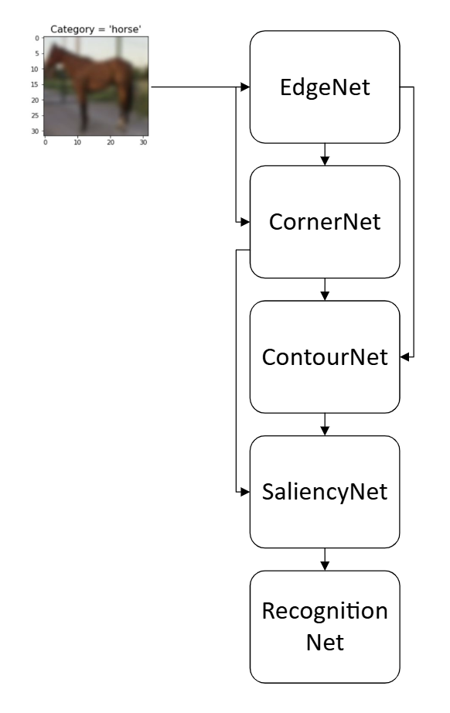
Model Architectures & Training
Hierarchical Pipeline (Total ~0.25 M params)
EdgeNet (0.06 M) Accuracy: 96.00 % (pixel)
Input: RGB → Sobel-style edge maps
CornerNet (0.05 M) Accuracy in : 87.08 % (pixel)
Input: RGB + EdgeMap → corner detections
ContourNet (0.04 M) Accuracy: 65.06 % (pixel)
Input: EdgeMap + CornerMap → contour detections
SaliencyNet (0.06 M) Accuracy : 0.000554 (MSE)
Input: CornerMap + ContourMap → saliency scores
RecognitionNet (0.04 M)
Input: concat(AllMaps) + RGB → 10-way softmax
Flat CNN (0.09 M params)
Standard 3-layer conv ⇒ pooling ⇒ FC
Training Details:
Dataset: CIFAR-10
Optimizer: Adam, lr=1e-3, batch size=64
https://i.sstatic.net/HVVoF.jpg

Slide 4
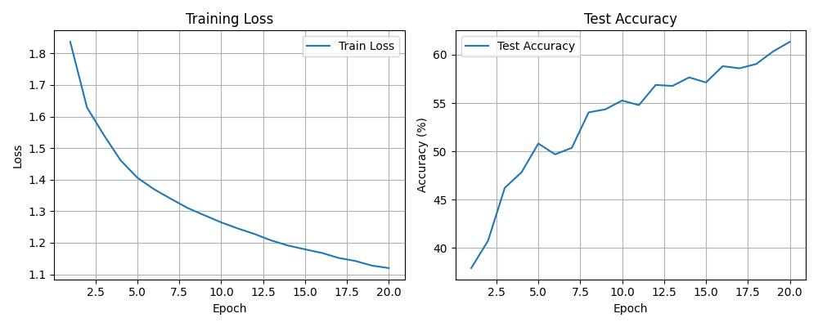
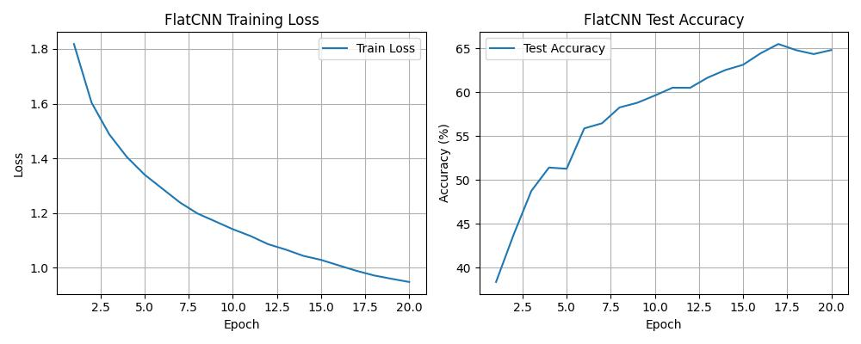
Experimental Results
1) Full-Data (CIFAR-10)
Model | Params | 10 ep Time | Test Accuracy
Flat CNN | 0.09 M | 58 s | 63.78 %
Hierarchical | 0.25 M | 178 s | 61.25 %

Slide 5
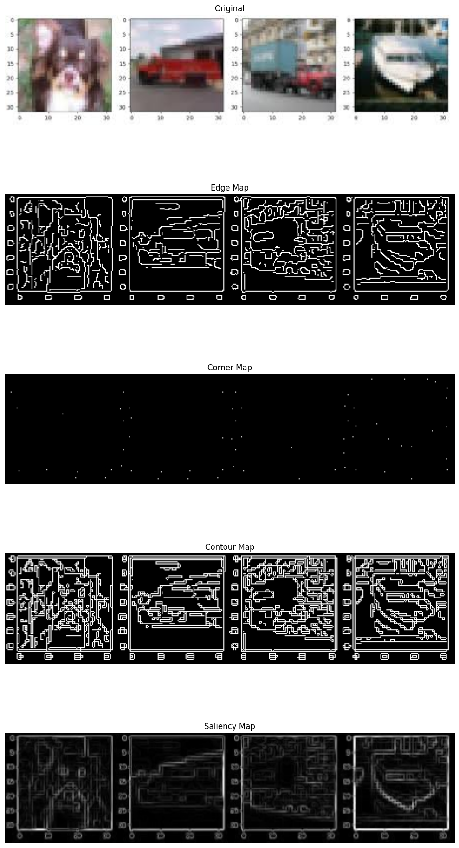
2) Ablation (RGB + Single Map, 20 ep)
RGB only: 57.88 % (3-channel)
RGB+Edge: 57.59 % (4-channel)
RGB+Corner: 59.00 % (4-channel)
RGB+Contour: 56.85 % (4-channel)
RGB+Saliency: 59.88 % (4-channel)
RGB+All: 59.47% (7-channel)
https://encrypted-tbn0.gstatic.com/images?q=tbn:ANd9GcStPsx2YaCxL9OPfjFTd4aQdNv6a5-xPWEWJQ&s

Slide 6
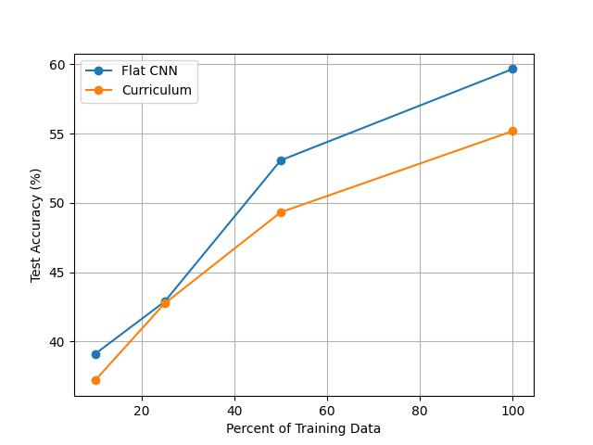
Data-Efficiency Sweep
At 10 %, 25 %, 50 % of data: FlatCNN leads, but gap shrinks (trained for 10 epochs)

Slide 7
Discussion, Limitations & Future Work
Key Takeaways:
Accuracy: Flat CNN still best with full data
Interpretability: Hierarchical maps clearly detect intended features
Efficiency: Hierarchy narrows gap in low-data regimes
Limitations:
More parameters & training time
Tested only on clean dataset (CIFAR-10)
Future Directions:
End-to-end fine-tuning: allow backprop across all modules
Robustness tests: add noise / domain shift (e.g., TinyImageNet, real-world photos)
Larger datasets: scale to CIFAR-100 or ImageNet-lite
Further investigations on saliency maps

Slide 8
References
[1] Yoshua Bengio, Jerome Louradour, Ronan Collobert, and Jason Weston. Curriculum learning. In Proceedings of the 26th annual international conference on machine learning, pages 41–48. ACM, 2009.

