Slide 1
Simple Client Server Chat Application-Socket Programming
Khagendra Adhikari (02)
Dinank Bista (07)
Sabin Ghimire (13)
Rajan Mali (25)
Bibhusan Jha (64)

Slide 2
INTRODUCTION
Socket is a fundamental technology of computer network programming.
Allow network software applications to communicate.
Socket programming is a way of connecting two nodes on a network to communicate with each other.
One socket(Server) listens on a particular port at an IP, while other socket(Client) reaches out to the other to form a connection.

Slide 3
OBJECTIVES
Learning about sockets.
Creating a simple socket program.
Making a simple client server model for data communication.
Learning to configure IP address and ports assigned to the program.
Using winshock2

Slide 4
TECHNICAL SPECIFICATIONS
Programming Language: C++
IDE used : Codeblocks
OS Version: Windows 10
Important Library: Winshock Library

Slide 5
SOCKETS
Sockets allow network software applications to communicate.
Sockets are bidirectional connection i.e. Both parties can send and receive data.
It implement standard Application Programming Interfaces (APIs)
The Berkeley Socket Library is still widely in use on UNIX systems.
Windows Sockets (WinSock) library for Microsoft operating systems.
WinSock has been in use since 1993
Berkeley sockets since 1982.
TYPES: Stream sockets and Datagram sockets

Slide 6
IP ADDRESS
To communicate over the Internet, socket libraries use the IP address to identify specific computers.
IP stands for Internet Protocol and refers to the Internet Layer of the overall network architecture.
An IP address is a 32-bit quantity interpreted as four 8-bit numbers or octets.
Examples:
127.0.0.1 localhost
66.249.89.104 www.google.com
192.168.135.1 Hotspot Network

Slide 7
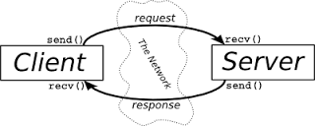
CLIENT AND SERVER
The client-server model is one of the most used communication paradigms in networked systems.
Client makes a request for information.
After getting the response, terminate or other processing.
Server takes a request from the clients
Perform the required processing and send information to the requestor client.

Slide 8
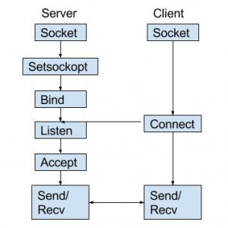

Slide 9
IMPORTANT FUNCTIONS
Build environment links to the Winsock Library file WS2_32.lib
Initialize Winsock
WSADATA wsaData;
int iResult = WSAStartup( MAKEWORD(2,2), &wsaData )
Create a socket.
m_socket = socket( AF_INET, SOCK_STREAM, IPPROTO_TCP )
Address Family : AF_INET (this is IP version 4)
Type : SOCK_STREAM (this means connection oriented TCP protocol)
Protocol : IPPROTO_TCP or IPPROTO_UDP ]

Slide 10
Binding a Socket Server
Create a sockaddr_in object and set its values.
service.sin_family = AF_INET;
service.sin_addr.s_addr = inet_addr( "127.0.0.1" ); //(192.168.137.1)
service.sin_port = htons( 27015 );
Listening On Server
Listen( m_socket, 1 )

Slide 11
Accept Connection
SOCKET AcceptSocket
AcceptSocket = accept( m_socket, NULL, NULL )
Connecting To Server.
Create a sockaddr_in object clientService and set its values.
Sending And Reciveing Data
bytesSent, bytesRecv, sendbuf, recvbuf
std::fill(&sendbuf[0], &sendbuf[100], 0);

