Slide 1
Final Presentation
TOPICS IN ARTIFICAL INTELLIGENCE
COMPLEX EVENT PROCESSING
By
Sertan Kaya

Slide 2
OUTLINE
Information regarding taxi data
1st Approach: Event detection for CEP with IPython (backend Apache Spark) with only 125 txt files
2nd Approach: Event detection for CEP with Scala (backend Apache Spark) with entire data set (9.4 Gigabyte)
Graph chart for 2nd approach via Tableau

Slide 3
INFORMATION REGARDING TAXI DATA
It consists of 13,798 txt files and its size is 9.4 Gigabyte
Data format:
Name (License plate name)
Time
jd (Longitude)
wd (Latitude)
status (0=no passenger, 1=has passenger)
V (velocity)
Angle (Directions: 0=E, 1=SE, 2=S, 3=SW, 4=W, 5=NW, 6=N, 7=NE )
Record date: from 2011/04/18 to 2011/04/26 (00:00 to 12:00)

Slide 4
1st Approach: Event detection for CEP with Python (backend Apache Spark) with only 125 txt files
125 txt files are used for detecting complex event processing
1,442,410 row exist in 125 txt files
1st Event: Taxi takes passenger (Status=1) Taxi leaves passenger (Status=0)
Detected Number of Events : 352,968

Slide 5
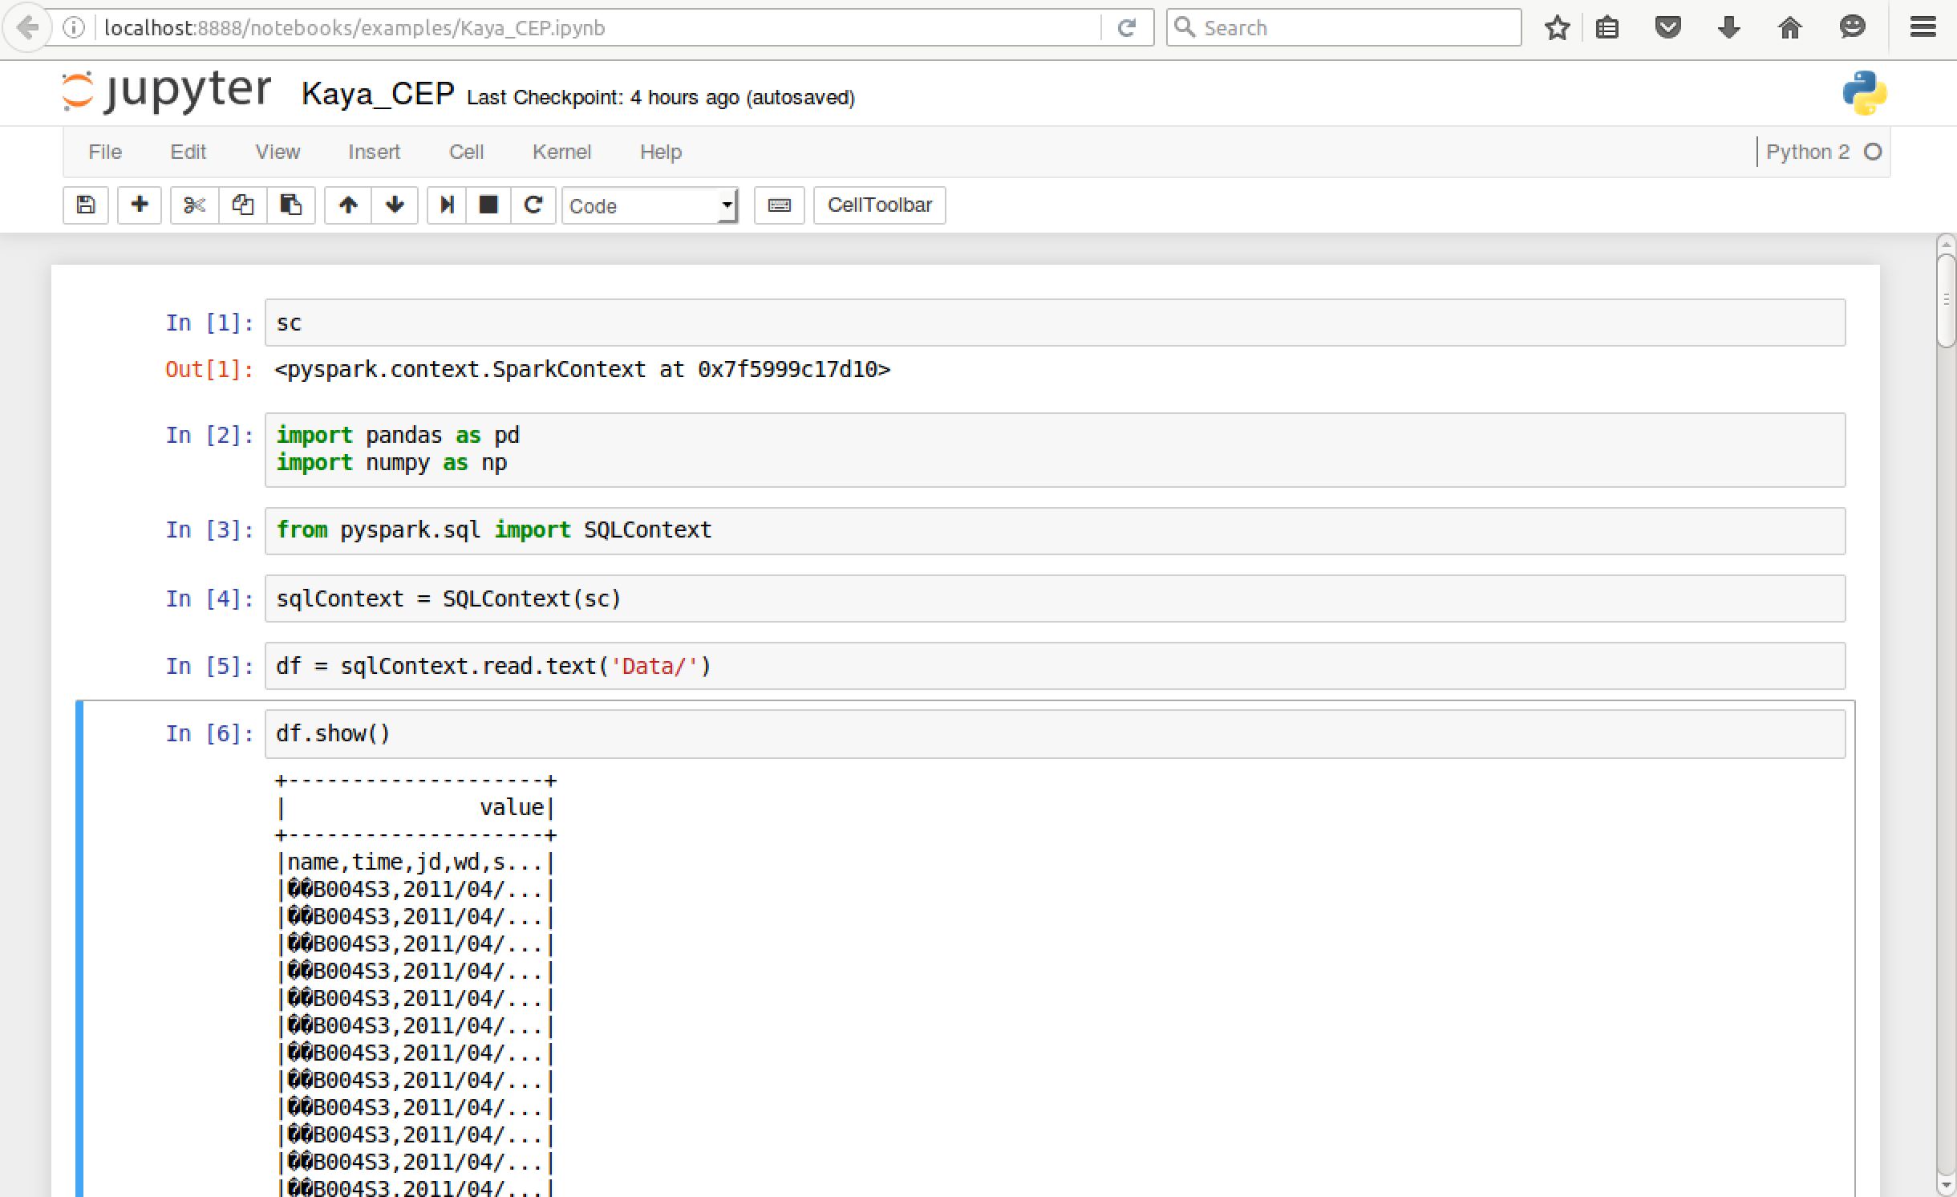
Importing libraries and defining SQL context

Slide 6
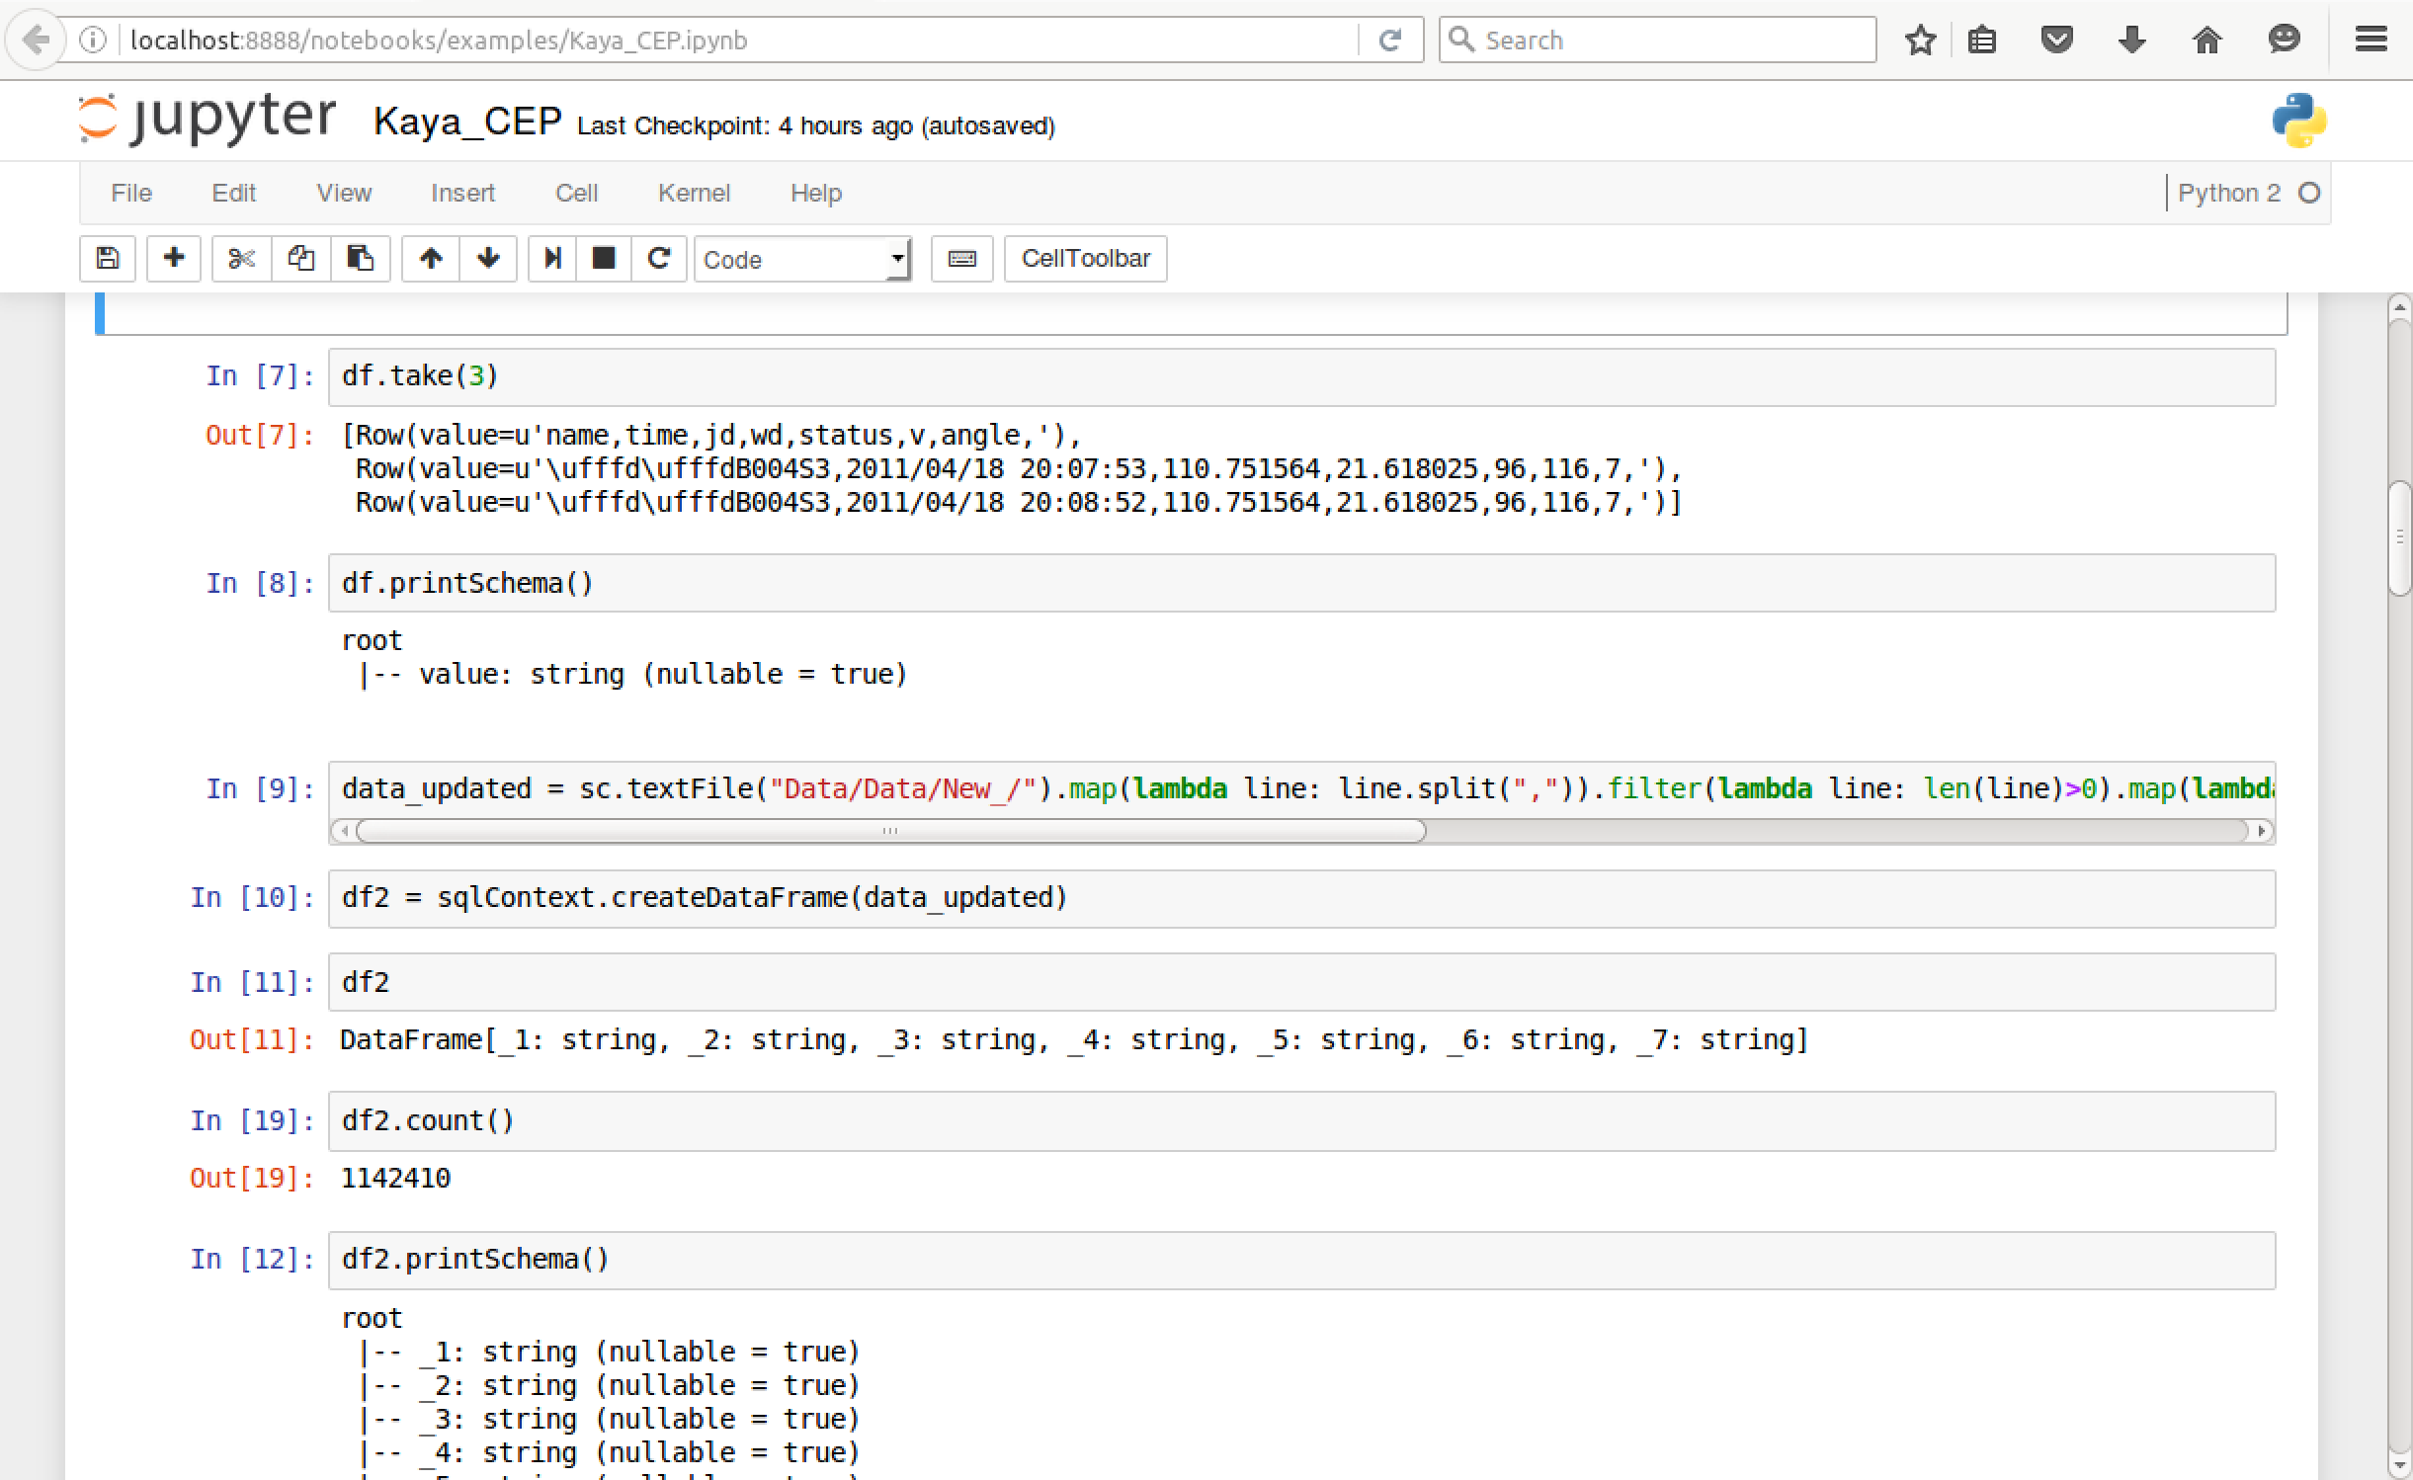
Filtering data and creating data frame
_1 :Name (License plate name)
_2:Time
_3: jd (Longitude)
_4: wd (Latitude)
_5: status (0=no passgr, 1=passenger)
_6: V (velocity)
_7: Angle

Slide 7
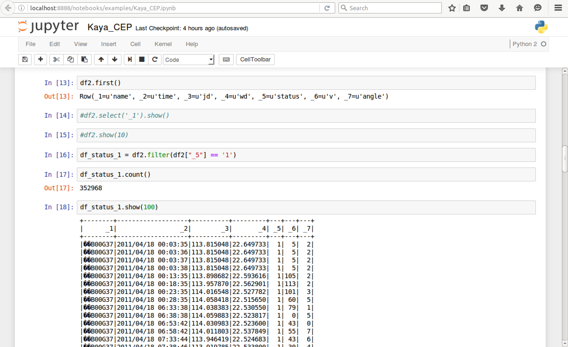
Detection of 1st Event where Status=1

Slide 8
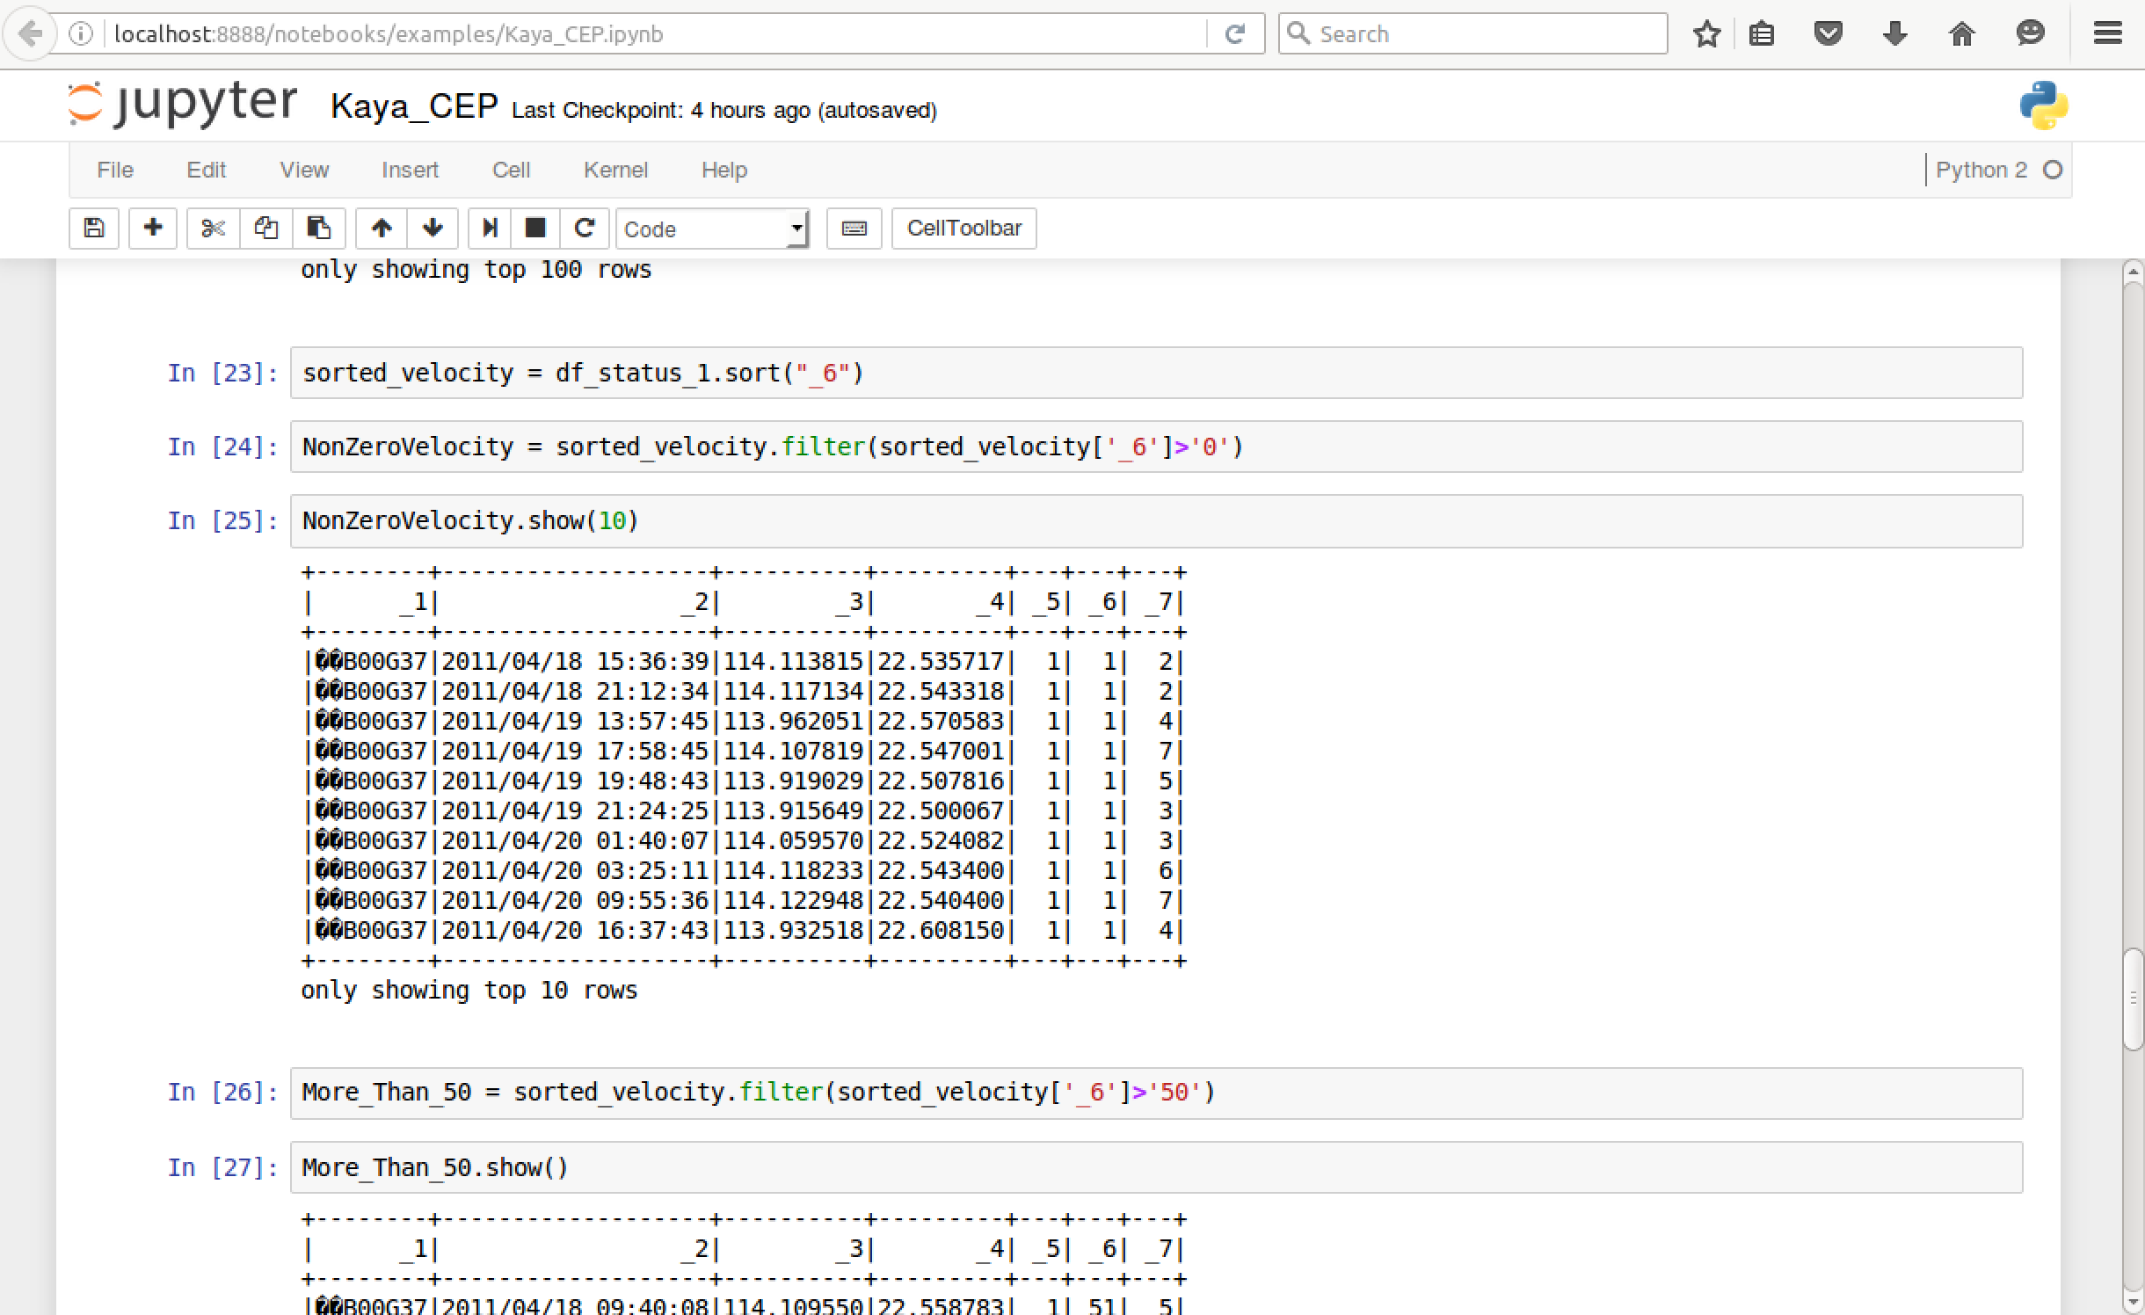
The taxis’ velocity > 0 and status=1

Slide 9
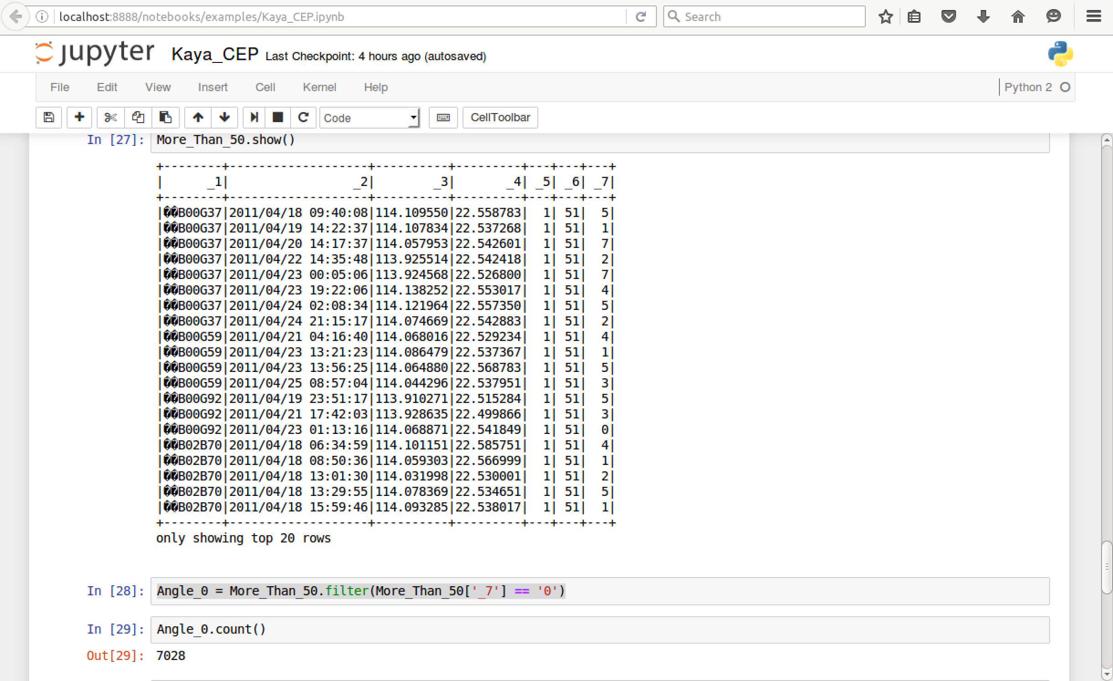
The taxis’ velocity > 50 and status=1

Slide 10
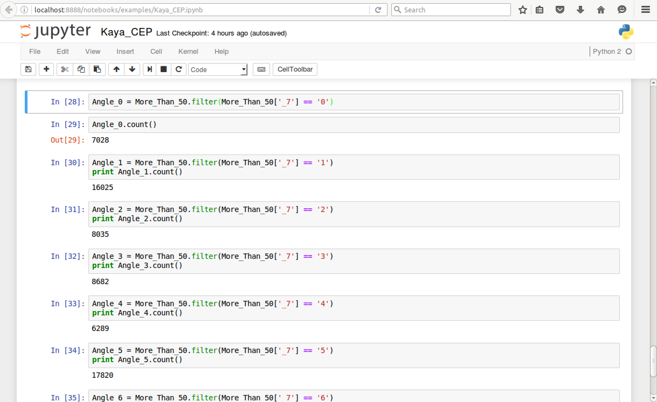
Count taxis heading each direction while status=1

Slide 11
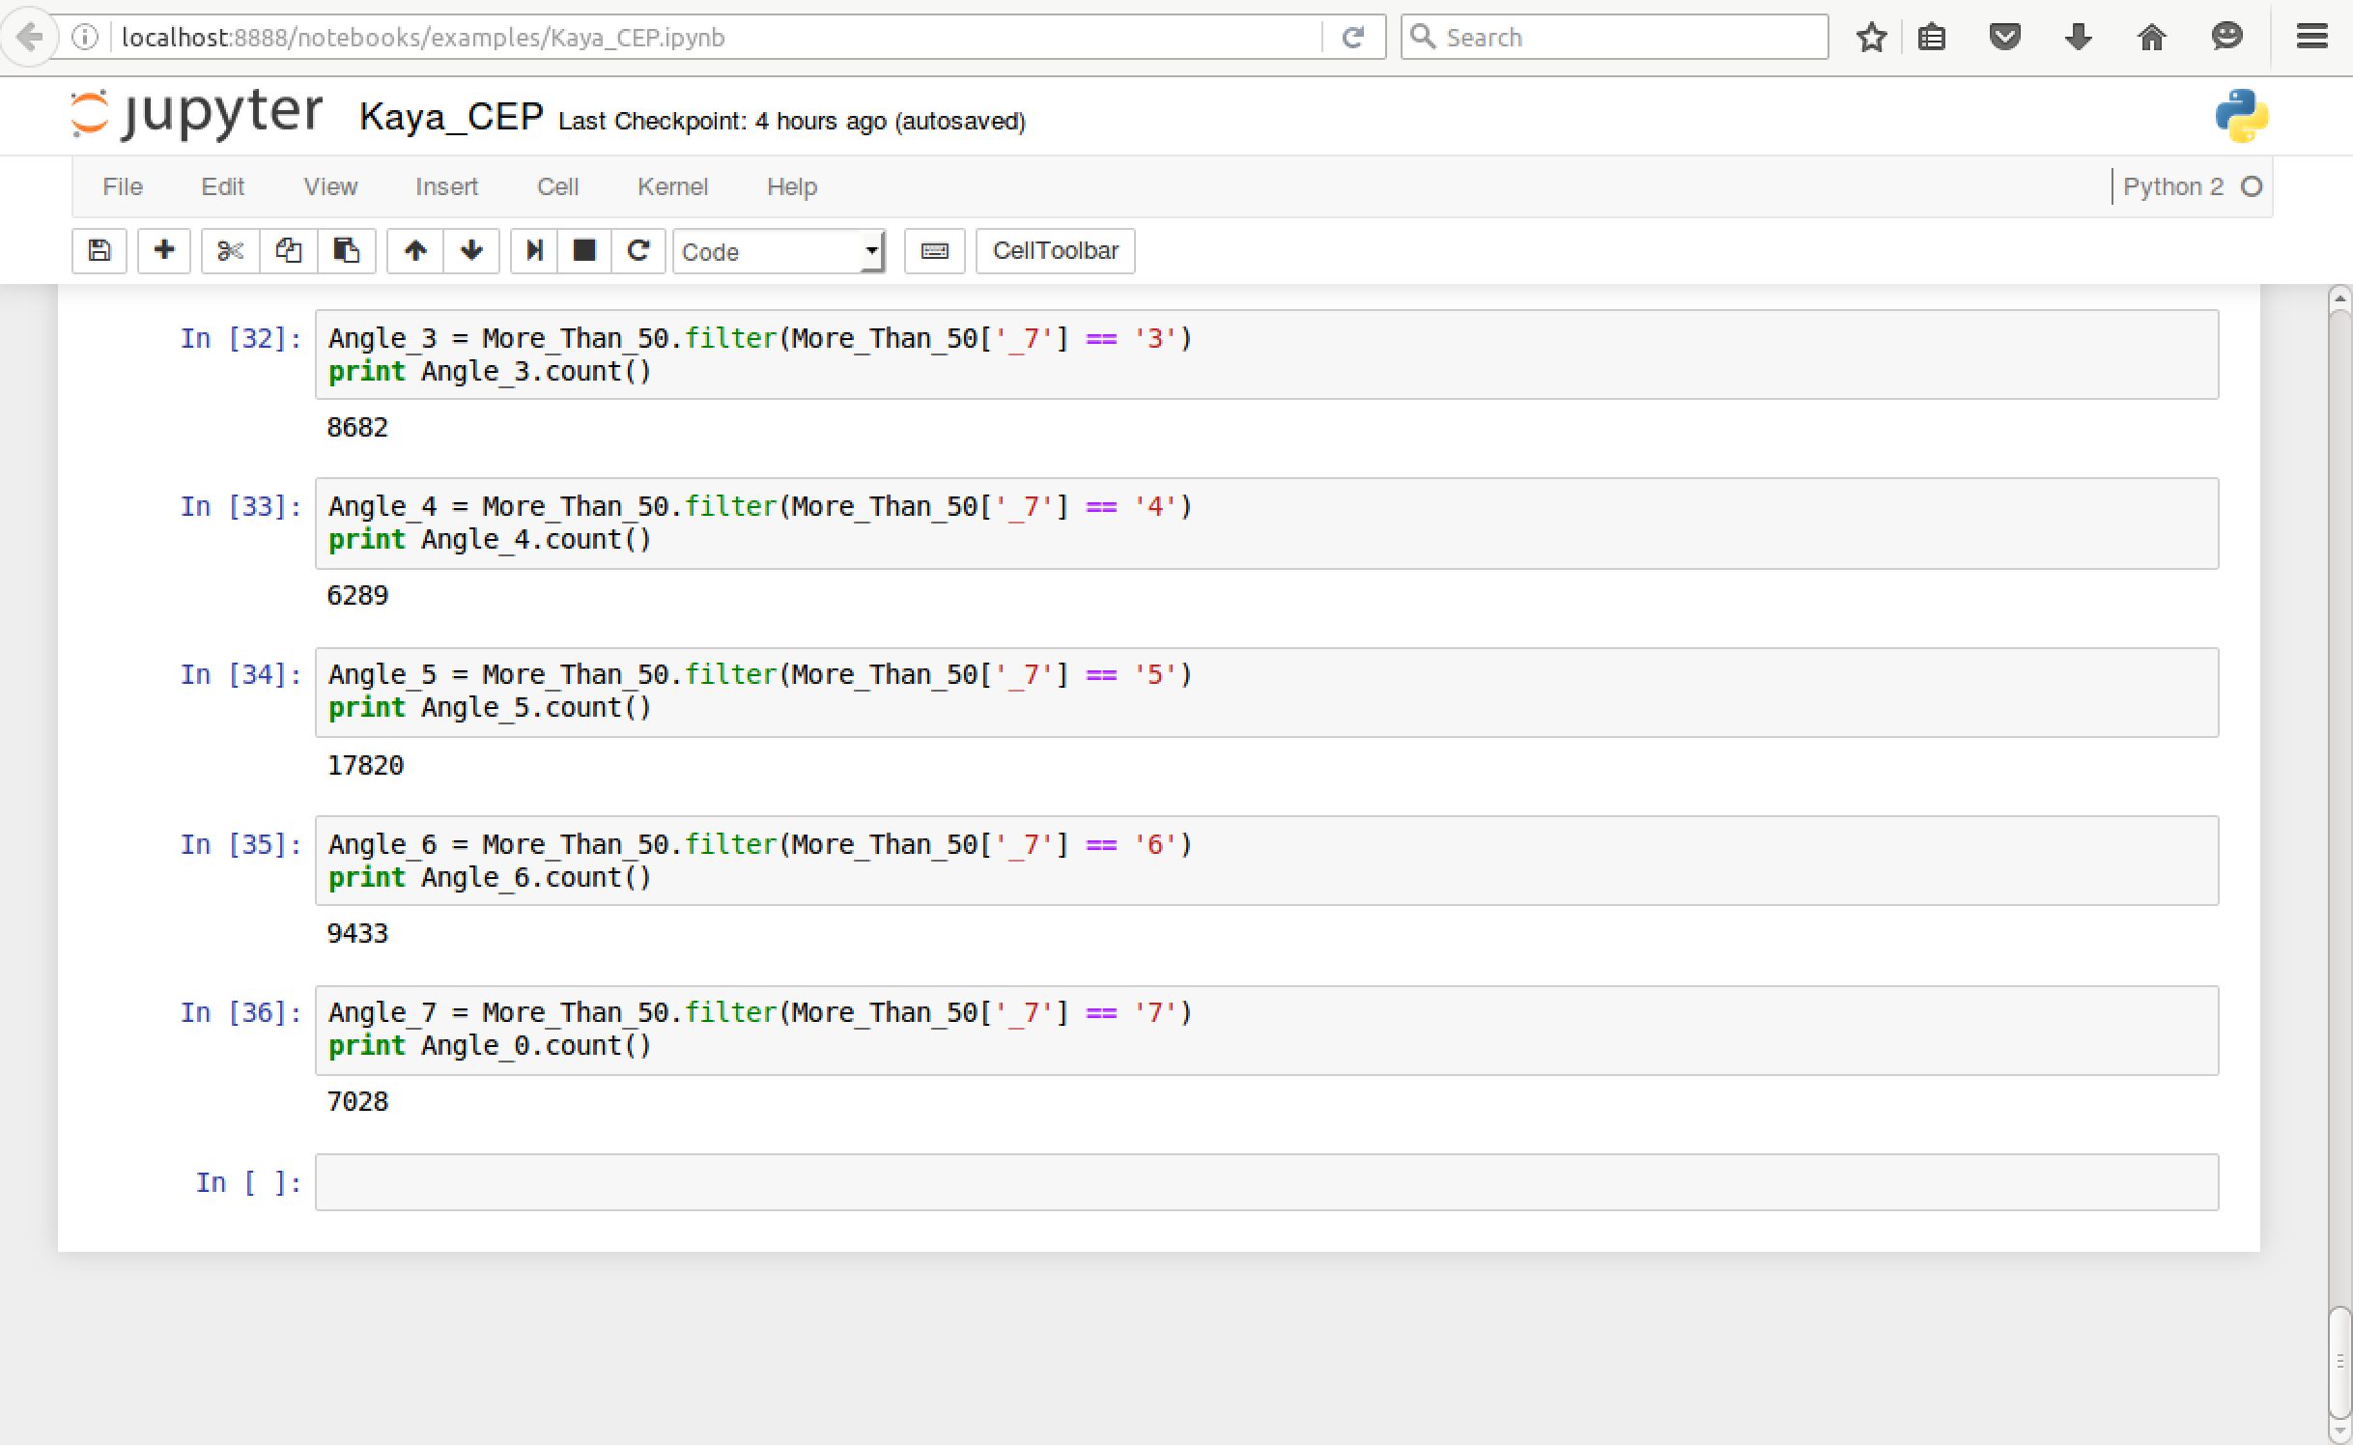
Count taxis heading each direction while status=1 (continued)

Slide 12
2nd Approach: Event detection for CEP with Scala with entire data set (9.4 Gigabyte)
13,798 single txt file is combined into a single taxiData.cvs file
taxiData.cvs file’s size is 9.4 Gigabyte
1st Event: Taxi takes passenger (Status=1) Taxi leaves passenger (Status=0)

Slide 13
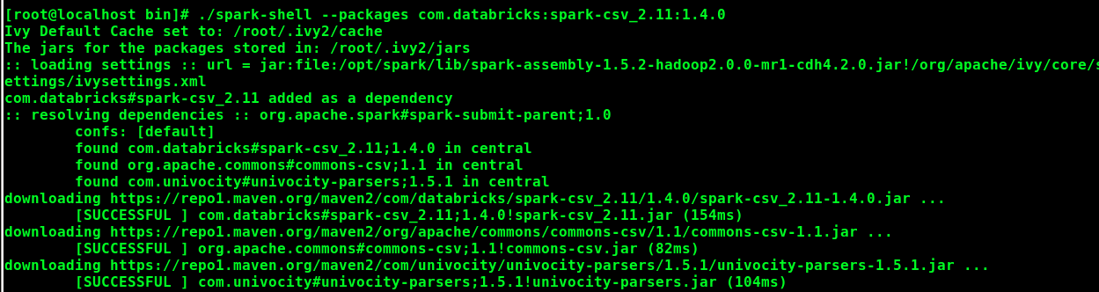
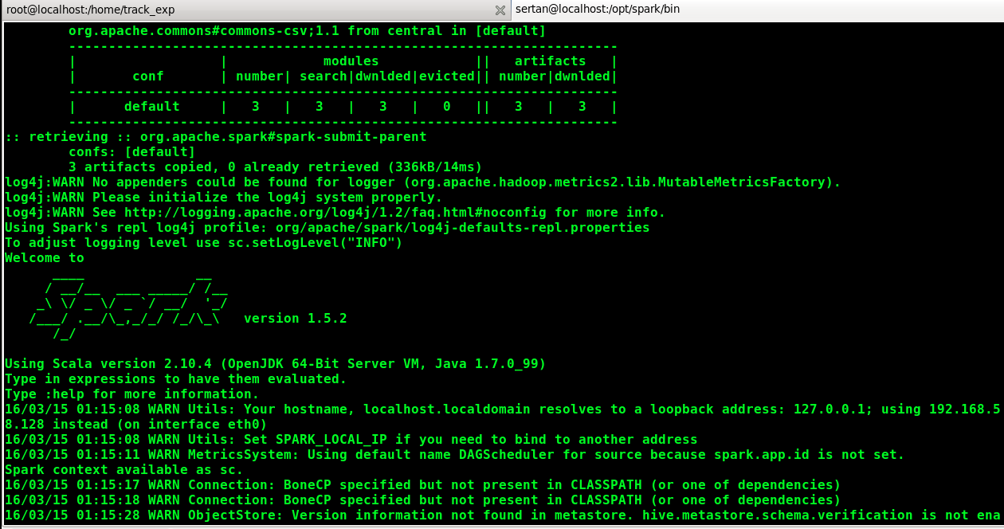
Scala backend Apache Spark Server Starting

Slide 14
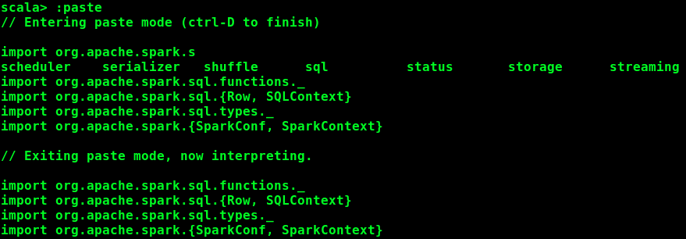
Import and SQL context at Apache Spark

Slide 15
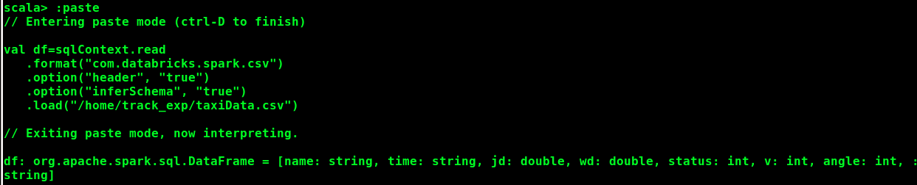
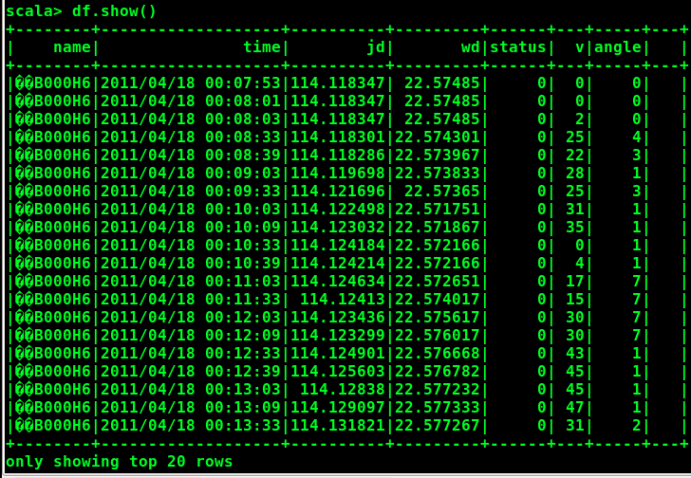
Read and Show in Scala Programming Lang.

Slide 16
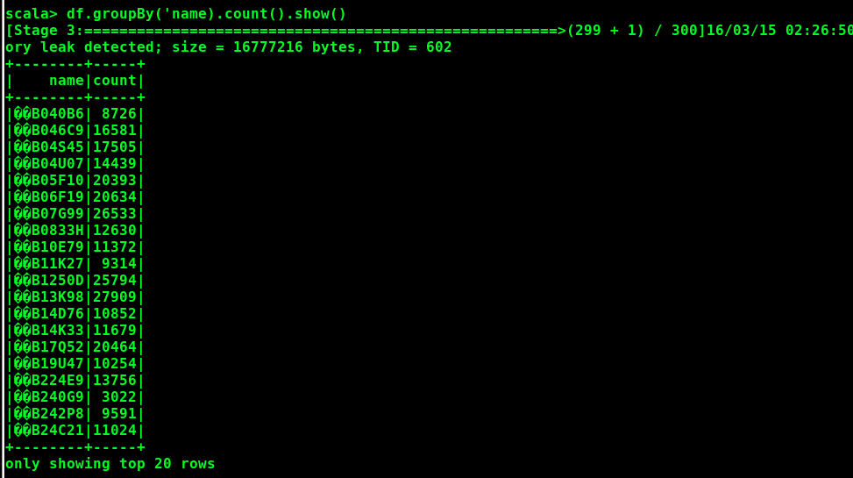
Group by name and count each

Slide 17
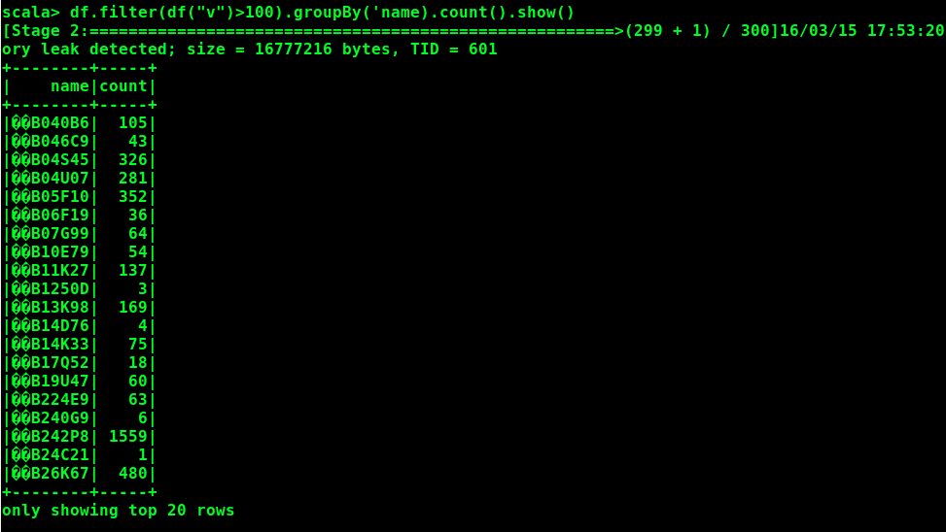
Velocity > 100 and count this cases

Slide 18
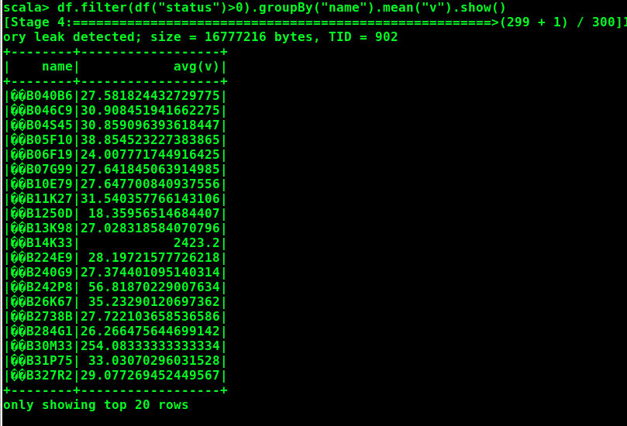
Average velocity of taxies which carry passenger

Slide 19
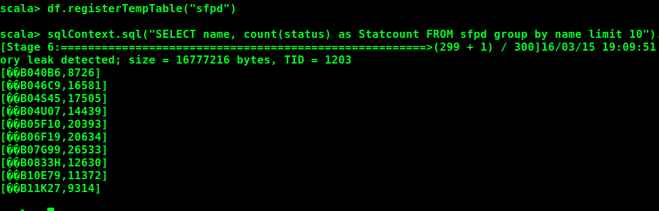
Count Status (having passenger) – 10 taxis

Slide 20
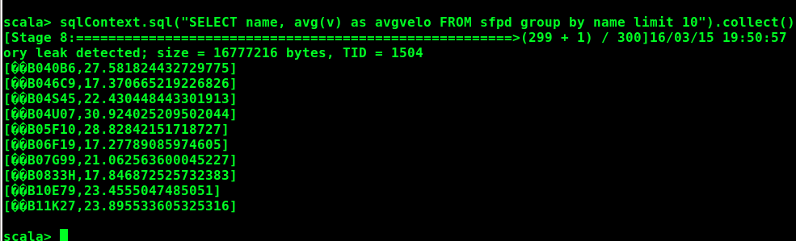
Average Speed of showing 10 of taxis

Slide 21
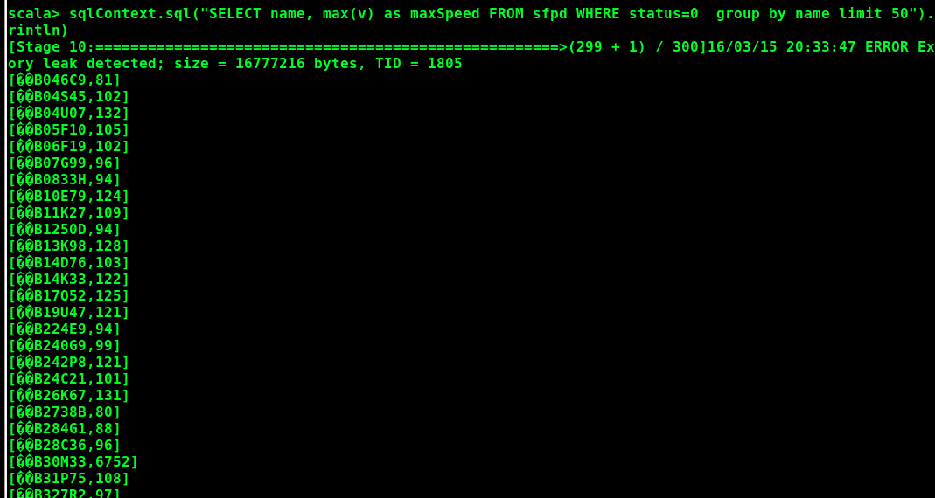
Max Velocity while not carrying passenger

Slide 22
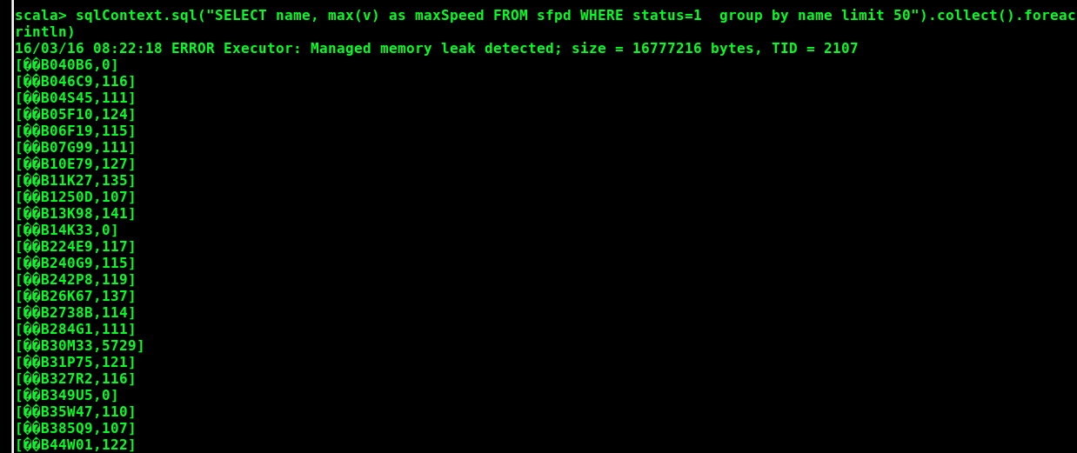
Max Velocity while carrying passenger

Slide 23
Graph chart for 2nd approach via Tableau

