Slide 1
CMPE 487: Sp. Tp. Applied Computer Networks
Fall 2020 - Final Project
ONLINE CONNECT 4 GAME

Slide 2
Agenda
Introduction
Who we are?
What have we promised?
1
The Process
Overview of completed tasks
Faced challenges
2
3
Demo

Slide 3
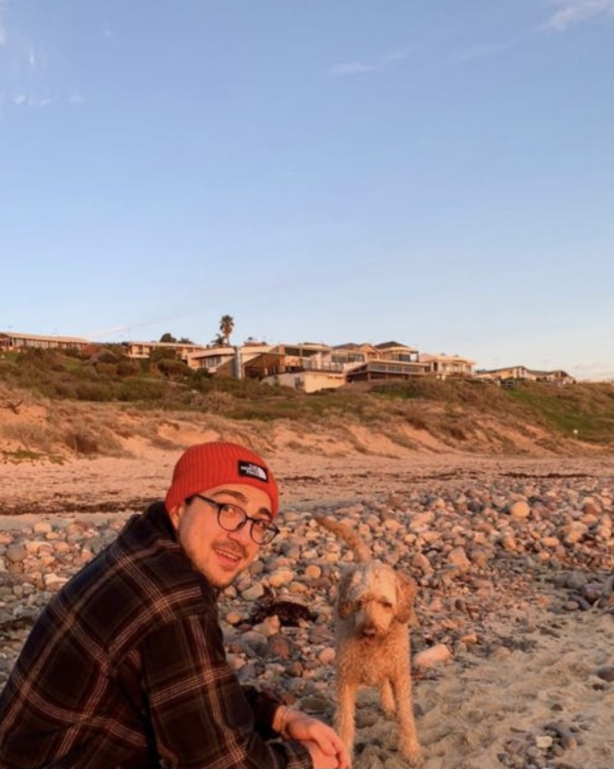
We are a group of two
Sertay Akpınar
Ahmet Şentürk

Slide 4


We were tasked with developing an online Connect Four game
Our aim was to build a basic GUI, backed up with a fast and reliable server-client model
Waiting room where players can choose their opponents
Chat feature for the players while they are playing the game
1.

Slide 5
Up until today, what we have done?
Research
Back-End
Front-End
Which GUI libraries serve better for our objectives (game, chat, waiting room) Tkinter and PySimpleGUI
Implementing the server-client model using python’s socket library
Parallel structure to play the game and chat simultaneously
Handling the possible errors such as connection lost
Implementing game functionalities, shapes and conditions with Pygame library
Display pop-up windows for notifications and erros using PySimpleGUI lib.
Combine Front-End feat. with Back-End

Slide 6
References: some resources we benefit from
https://www.pygame.org/docs/ref/pygame.html
http://pythonic.zoomquiet.top/data/20180919091955/index.html
https://github.com/PySimpleGUI/PySimpleGUI/issues/520
https://pysimplegui.readthedocs.io/en/latest/cookbook/

Slide 7
References: external libraries we have used
Pygame, https://www.pygame.org/news
PySimpleGUI, https://pysimplegui.readthedocs.io/en/latest/
Numpy, https://numpy.org/

