Slide 1

Moving Average-Arima
Ata Eren Arslan
1906102036

Slide 2

Moving Average
Moving Averages are indicators calculated by taking the average of the prices of a financial instrument over a specific period. When conducting technical analysis on the price of a financial product, moving averages are often utilized. This is because moving averages can provide insights into the direction of price movements and can be used to identify support and resistance points on a chart.

Slide 3

Moving Average
As the days progress, the chart matures, and closing prices form the trend line of the moving average. If prices break the trend line either downward or upward, it generates signals that investors should pay attention to. A downward break is interpreted as a bearish signal, indicating a potential decrease in prices, while an upward break is interpreted as a bullish signal, suggesting a potential increase in prices.

Slide 4
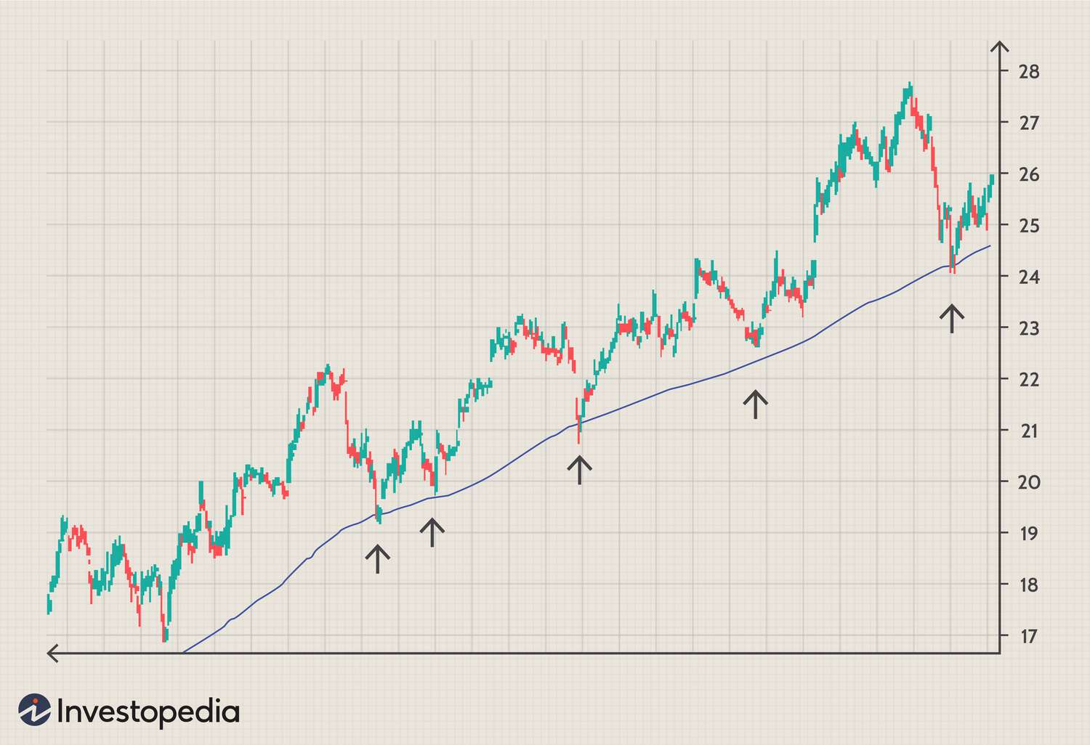
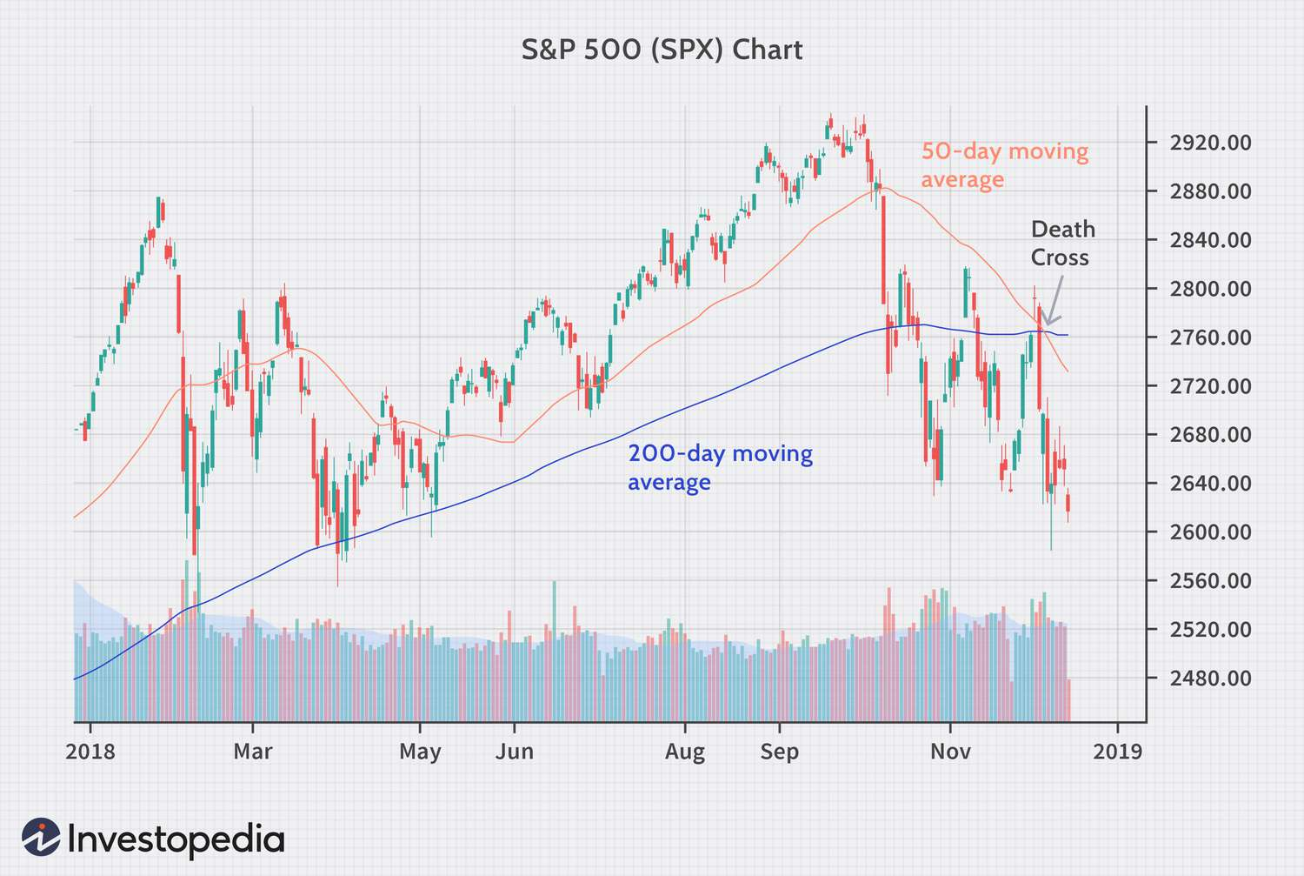
Moving Average
Exp. Of a Bullish MA
Exp of a Bearish MA

Slide 5

Moving Average
In technical analysis, the most commonly used moving averages are as follows:
Simple Moving Average (SMA),
Exponential Moving Average (EMA),
Weighted Moving Average (WMA).

Slide 6

ARIMA
ARIMA (AutoRegressive Integrated Moving Average) model, which is one of the Box-Jenkins methods, is a statistical analysis method used in time series analysis. It can be successful in short-term predictions when there is a sufficient sample size.

Slide 7
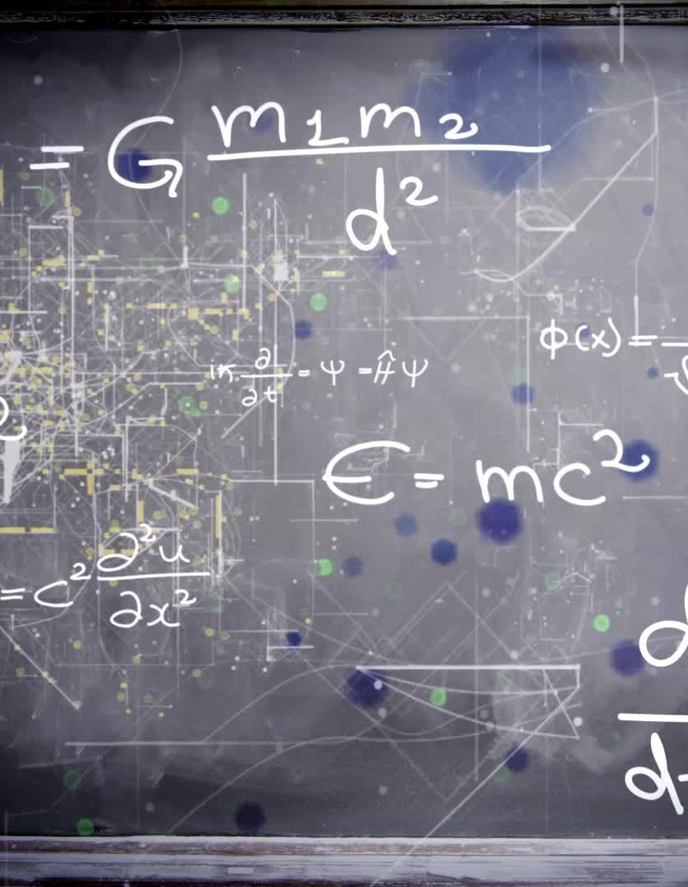
ARIMA
ARIMA can be divided into three components:
AR(p): Autoregressive - indicates the lags of the variables in the forecasting equation.
I(d): Integrated - indicates the order of differencing needed to achieve stationarity.
MA(q): Moving Average - indicates the lags of the forecast errors.
Here,
p: the number of included lags in the model,
d: the order of differencing,
q: the number of terms in the moving average window.
The notation is as follows: ARIMA(p, d, q).

Slide 8
ARIMA
After making the time series stationary by taking the difference (d=1), there is no universally accepted method for determining the p and q parameters. However, one common approach involves examining the autocorrelation function (ACF) and partial autocorrelation function (PACF) plots to determine the numbers of AR and MA terms.

Slide 9
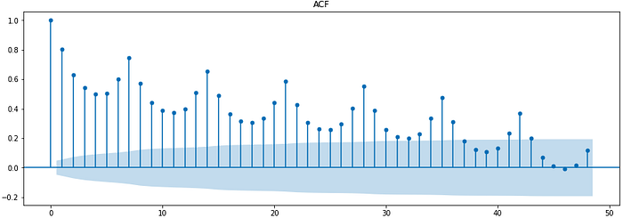
ARIMA

Slide 10
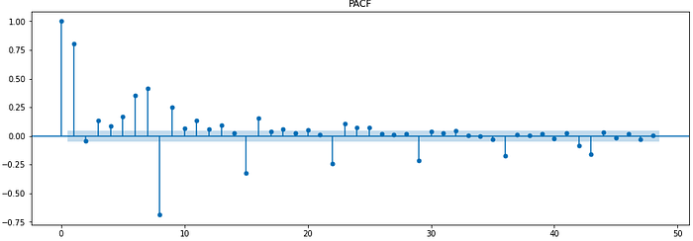
ARIMA

Slide 11
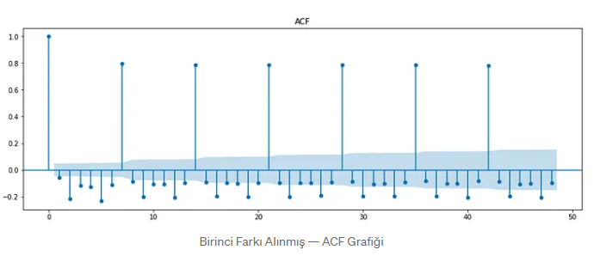
ARIMA

Slide 12
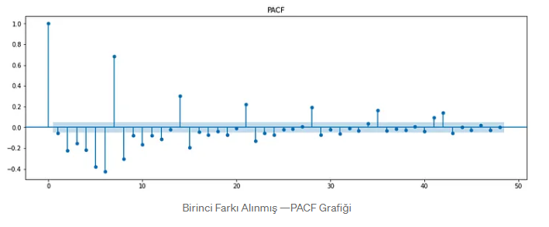
ARIMA

Slide 13
ARIMA-AIC
Akaike Information Criterion or AIC is a statistical method used for model selection. It helps you compare candidate models and select the best among them.
AIC aims to select the model which best explains the variance in the dependent variable with the fewest number of independent variables (parameters). So it helps select a simpler model (fewer parameters) over a complex model (more parameters).

Slide 14

ARIMA-AIC
But why select a simpler model over a complex one?
To reduce overfitting
Reduce the number of parameters (reduce in the number of dimensions)
AIC measures the information lost, so the model with a lower AIC score indicates a better fit.

Slide 15
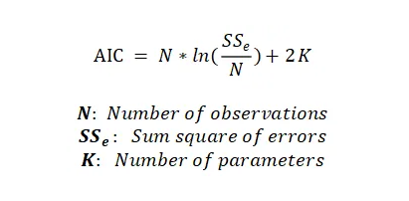
Formula of AIC

Slide 16

REFERENCES
https://www.unlumenkul.com/blog/hareketli-ortalama-moving-average-nedir/
https://medium.com/machine-learning-t%C3%BCrkiye/zaman-serileri-analizi-2-e4f6a750cd5d
https://www.investopedia.com/thmb/ewl2YIJDqDVlrtGxGM810q4nm_M=/1500x0/filters:no_upscale():max_bytes(150000):strip_icc()/dotdash_INV-final-Death-Cross-Definition-June-2021-01-7a934ae7f94f4678acc75f8c63475131.jpg
https://www.investopedia.com/thmb/xURakL4heDXO2N7Q0QcQFGc5Tgc=/1500x0/filters:no_upscale():max_bytes(150000):strip_icc()/dotdash_Final_How_to_Use_a_Moving_Average_to_Buy_Stocks_Jun_2020-01-3b3c3e00d01442789e78a34b31e81d36.jpg
https://medium.com/geekculture/akaike-information-criterion-model-selection-c47df96ee9a8

