Slide 1
Network ıntrusıon detectıon
BLG 440E Computer Project 2

Slide 2
hello!
040110078
Nurefşan Sertbaş
040090508
Betül Kantepe
Project #1 - Group 16

Slide 3
Purpose of the Project
Goal is to learn a classifier to define TCP/IP connections as intrusion/okay
TERMINOLOGY
Feature: Good data representatıon ın specıfıc domaın
Data: Collection of features describing TCP connection
Class / label: Non-attack or type of attack

Slide 4
About Extracted features
These features can be divided into three categories as
Basic features of TCP connection derived from packet headers
→ protocol, duratıon, service
Content features within a connection suggested by domain knowledge
→is_guest_login, num_failed_logins
Traffic features computed using a two-second time window
→srv_rerror_rate, srv_diff_host_rate

Slide 5
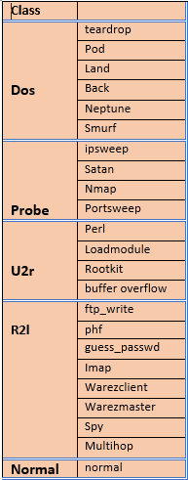
Dos: denial-of-service,
e.g. syn flood;
probing: Attacker gather some information about target system in order to initiate an attack.
e.g., port scanning.
u2r: unauthorized access to local super user to gaın (root) privileges
e.g., various ``buffer overflow'' attacks;
R2l: unauthorized access from a remote machine, e.g. guessing password;

Slide 6
CLASSIFICATION and Parameters
MaxDepth:
Increasing maxDepth
accuracy rate
test error.
complexity of the training process
MaxBins:
It is the parameter that can be used in making continuous signals discrete. Increasing MaxBins parameters may result better split. But it increases complexity.
Test set includes several attack types not found in training set

Slide 7
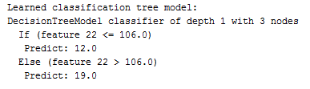
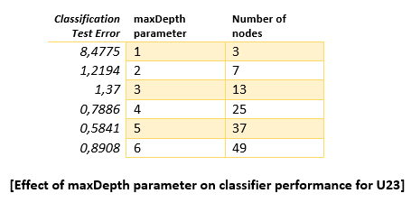
Parameter Selectıon
Class 12 Class 19
Traın: 87551 Traın: 25271
Test: 9727 Test: 2808
Total U23 data
Traın: 123258
Test: 49401
[It means that just covering these two classes it covers most of the data in the set so that result can be seen as meanıngful]
decide maxDepth parameter as 2
because its test error is acceptably small
MaxBins parameter is set to 32

Slide 8
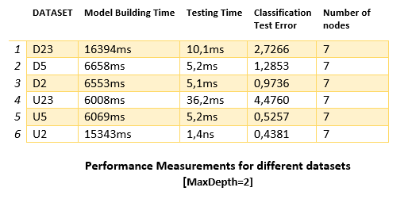
Performance comparıson

Slide 9
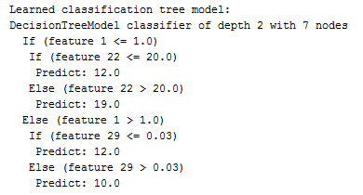
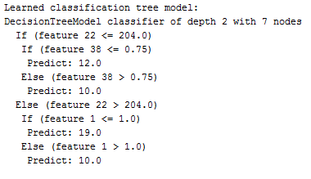
D23 –U23 dataset
[ Class 10 (Neptune) 96481 samples,
Class 12(normal) with 87551 samples
Class 19(smurf) with 252711 samples
are used in building model phase because total number of these samples are 436743 /444620. Because of this reason classifier learns these classes successfully. ]
[ Class 10 (neptune) with 9649 samples
Class 12(normal) with 87551 samples
Class 19(smurf) with 25271 samples
are used in building model phase because total number of these samples are 122471/123258. Because of this reason classifier learns these classes successfully. ]

Slide 10
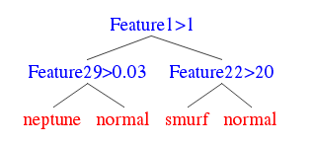
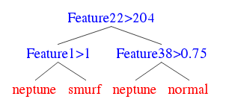
When we compare D23 and U23 dataset classification results unexpectedly test error is increased from 2.72 in D23 to 4,5 in U23.
It is easy to understand from their confusion matrixes.

Slide 11
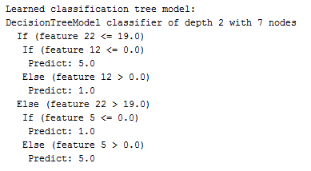
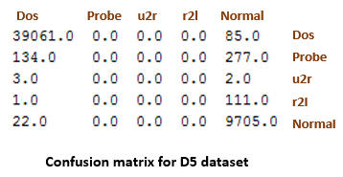
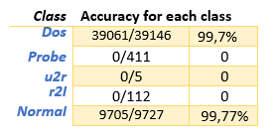
D5 dataset
There are huge number of dos and normal class samples in training set so that classifier can learn these two class sufficiently good.
Probe, u2r and r2l classes cannot classified properly.
Due to classifier has learned dos and normal classes, it thought probe, u2r and r2l as dos or probe.

Slide 12
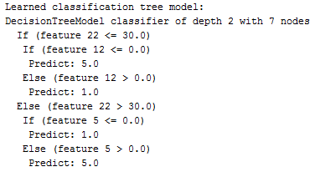
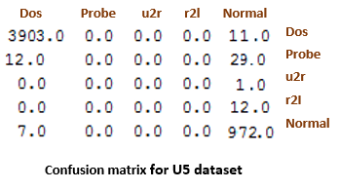
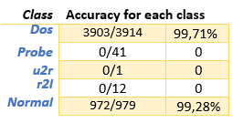
U5 dataset

Slide 13
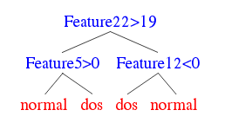
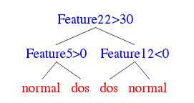
Decision trees for D5 and U5

Slide 14
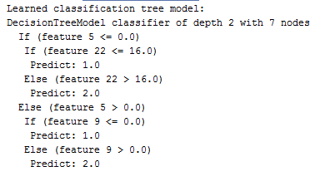
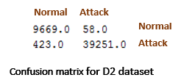

D2 dataset
There are huge number of dos and normal class samples in training set so that classifier can learn these two class sufficiently good.
Probe, u2r and r2l classes cannot classified properly.
Due to classifier has learned dos and normal classes, it thought probe, u2r and r2l as dos or probe.

Slide 15
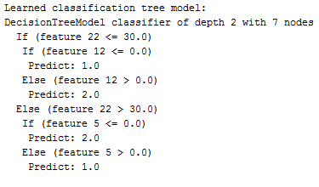


U2
dataset
In D2 there are 58 mistakes in normal class however in this case number of mistakes only 7. Same performance increment occurs for attack class from 423 mistakes to only 53 mistakes.

Slide 16
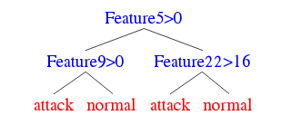
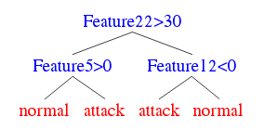
Decision trees for D2 and U2

Slide 17
Thanks!
No question

