Slide 1
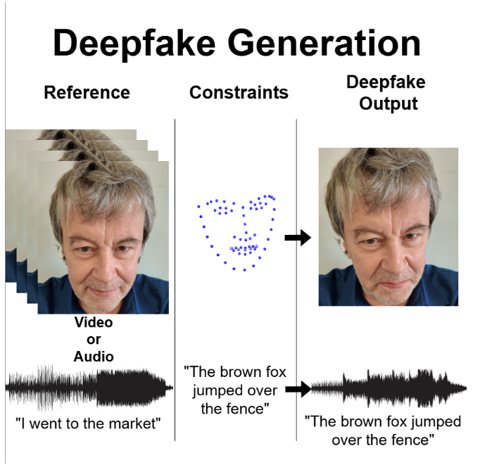
ImageCLEF 2026
Deepfake Detection & Generation
Competition overview, evaluation logic, and a realistic high-performance system plan.
1st edition
Audio + Images
2 subtasks
Deepfakes are AI-generated media that portray real individuals and are often created to manipulate, mislead, or misinform the public.
Why it matters: the challenge explicitly targets realistic deepfakes and detector generalization to unseen generation methods.
Fig.1. Overview of generation task.
1
Notes:
Open with the challenge scope: first edition, multimodal, and designed around both creating and detecting deepfakes. Emphasize that the deck also proposes a practical system plan rather than just restating the webpage. [Sources] - https://www.imageclef.org/2026/deepfake-detection-and-generation [/Sources]

Slide 2
Task Description
Image CLEF page: https://www.imageclef.org/2026/deepfake-detection-and-generation
Images
Audio
Key structural
The competition runs generation first and detection second.
Results from one subtask are used in evaluating the other.
Image generation
Audio generation
Few-shot identity-conditioned deepfake creation
One reference video per identity
Must preserve facial landmarks + realism
Few-shot voice deepfake creation
One reference audio per identity
Must speak a required text prompt
Generation
Practical implication
It rewards realism, constraint satisfaction, and cross-method robustness.
A strong team should think adversarially: generator and detector can improve each other.
Image detection
Audio detection
Binary (real vs deepfake) classification
Needs robustness to organizer, internet, and participant fakes
Binary (real vs deepfake) classification
Must generalize beyond seen generators and conditions
Detection
Constraints: quality check, identity similarity requirements, preservation of key features (facial landmarks in images), a text prompt that must be spoken in the audio sequence
2
Notes:
Explain the 2x2 structure clearly. The important insight for classmates is that this is not four isolated tasks - the organizers intentionally connect them. [Sources] - https://www.imageclef.org/2026/deepfake-detection-and-generation [/Sources]

Slide 3
Competition critical issues
The challenge is engineered around generalization
1. No organizer training set
2. Unseen generators matter
3. Few-shot generation
4. Multimodal
Teams must rely on public data and their own curation pipeline.
Data selection becomes part of the method, not a side task.
Detection is evaluated on organizer, internet, and participant-produced deepfakes.
Generation gets only one reference sample per identity.
Identity preservation and constraint control are central.
Image and audio need different pipelines and validation.
One team can enter one or both modalities.
Strategic View
Consideration Points
The safest high-performance plan is to optimize for cross-dataset robustness, calibration, and failure detection - not just leaderboard chasing on a narrow validation split.
The benchmark is difficult because deepfakes evolve quickly.
The organizers deliberately avoid giving a training set.
So, the real challenge is learning transferable artifacts and identity cues.
3
Notes:
Frame this as the core narrative of the presentation: the competition is fundamentally about generalization. That is why no training set is provided and why public datasets become essential. [Sources] - https://www.imageclef.org/2026/deepfake-detection-and-generation [/Sources]

Slide 4
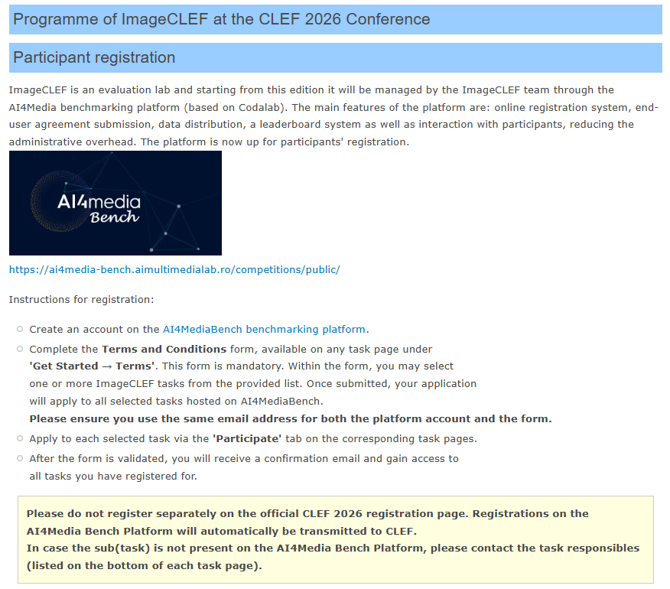
Schedule, registration, and deliverables
Time flow to be considered
26 Jan
03 Mar
03 Apr
07 Apr
07 May
28 May
Registration opens
Generation starts
Generation ends
Detection starts
Detection ends
Paper due
Registration essentials
Use AI4MediaBench (not a separate CLEF registration page).
Create the platform account, complete the Terms form, then click Participate for each task.
Use the same email address for the platform account and the form.
Fig.2. Participant registration.
https://ai4media-bench.aimultimedialab.ro/competitions/public/
4
Notes:
This slide is useful because classmates often ask about logistics. Mention the non-overlapping schedule and the AI4MediaBench registration flow. [Sources] - https://www.imageclef.org/2026/deepfake-detection-and-generation - https://www.imageclef.org/2026 [/Sources]

Slide 5
Data, constraints, and evaluation
Model design
Generation track
Detection track
Critical rule
Input is few-shot: one reference video or one reference audio file per identity.
Image generation must preserve facial landmark constraints.
Audio generation must speak the required text prompt.
For the Images subtask, a dataset composed of over 300 video clips of length between 8 and 30 seconds, depicting a single person speaking.
For the Audio subtask, a dataset of hundreds of mono audio files of different people saying different phrases, along with a text transcription of those phrases.
Binary classification: real vs deepfake.
Test data includes organizer deepfakes, internet deepfakes, and participant-generated deepfakes.
Evaluation uses accuracy, recall, precision, and F1.
Because generators vary widely, robust validation matters more than a single dev score.
Neither subtask provides a training dataset. Teams are explicitly expected to use public state-of-the-art datasets.
Recommended public data from the organizers
Image detection: FaceForensics++, CelebDF, DeeperForensics, DFDC
Image generation: AVSpeech, DH-FaceVid-1K, TalkVid
Audio detection: ASVspoof, WaveFake, AUDETER
Audio generation: LibriSpeech / MLS / People's Speech / Common Voice
5
Notes:
Spend extra time on this slide because it connects rules to design decisions. The audience should understand why external data curation is a competitive advantage. [Sources] - https://www.imageclef.org/2026/deepfake-detection-and-generation [/Sources]

Slide 6
Recommended high-probability strategy
My recommendation
Primary goal: build a strong detection submission first. This can be more realistic route especially when time is limited.
Secondary goal: add a controlled generation baseline after the detector is stable.
Use the generation branch as an adversarial data engine to create hard negatives that improve the detector.
Public
datasets
Detector
training
Hard-negative
mining
Submission
ensemble
Optional generator creates new attack styles
Use generator outputs as hard negatives, not just as a second track.
6
Notes:
This is the first strongly opinionated slide. Make clear that this is your proposed strategy, not an organizer rule. The reasoning is that detection is more feasible to finish and benefits from adversarially generated hard negatives. [Sources] - https://www.imageclef.org/2026/deepfake-detection-and-generation [/Sources]

Slide 7
Training stack and validation plan
How to turn public datasets into a competition-ready system
Data strategy
Validation strategy
Ablation strategy
Mix datasets by source and generator family instead of concatenating blindly.
Balance quality levels, codecs, accents, speakers, and demographics as much as possible.
For detection, reserve an internal “unknown generator” validation split.
Use leave-one-dataset-out or leave-one-generator-family-out testing.
Track not only F1 but also confidence calibration and worst-group performance.
Inspect false positives on real samples carefully - they often reduce model performance.
Test each stream separately: RGB only, frequency only, SSL audio only, ensemble only.
Measure the benefit of hard negatives, TTA, and calibration.
Keep the final ensemble small enough to reproduce reliably under deadline pressure.
9
Notes:
This slide is not from the organizer site; it is your engineering plan. It explains how public datasets should be converted into reliable experiments. [Sources] - https://www.imageclef.org/2026/deepfake-detection-and-generation [/Sources]

Slide 8
Execution roadmap and final takeaways
Stage 1
Read rules, choose track, build data list, set up baselines
Consideration Points
Stage 2-3
Train unimodal detection baselines on public datasets
This benchmark is about generalization under realistic attack diversity.
A competitive team should prioritize a robust detector before chasing a complex generator.
The best practical edge comes from disciplined validation, hard negatives, and calibrated ensembling.
Stage 4
Add robustness: augmentations, calibration, unknown-generator validation
Stage 5
Build small ensemble and failure-analysis dashboard
Stage 6+
Optional: add generation branch for hard negatives and dual submission
10
Notes:
End with the narrative, not the webpage details. The audience should remember that robustness to unseen deepfakes is the central idea. [Sources] - https://www.imageclef.org/2026/deepfake-detection-and-generation - https://www.imageclef.org/2026 [/Sources]

