Slide 1
Will Serverless End the Dominance of Linux in the Cloud?
Ricardo Koller and Dan Williams, IBM Research
Wosc2 2017

Slide 2

The beginning of the end of Linux
“[T]hroughout the history of computer science there has been a fairly constant opinion that current operating systems are inadequate”
      Engler and Kaashoek 1995
Linux
Why now?

Slide 3
The beginning of the end of Linux
“[T]hroughout the history of computer science there has been a fairly constant opinion that current operating systems are inadequate”
      Engler and Kaashoek 1995
Linux
Why now?
  Cloud unit of execution shrinking: serverless
  Complexity of kernel continues to grow

Slide 4

Options and Roadmap
Linux
Linux
bypass
Native Serverless OS
Fix Linux
Bypass Linux
Replace Linux
Overview
Serverless and its demands
How Linux containers fail to meet these demands
Rethinking the kernel

Slide 5
Serverless and its demands
Isolation for multi-tenancy (excludes native processes)
Performance

Slide 6
Serverless and its demands
Isolation for multi-tenancy (excludes native processes)
Performance

Slide 7
Serverless and its demands
Isolation for multi-tenancy (excludes native processes)
Performance
Latency
User: should launch immediately
Provider: should not require caching complexities
Target: 100 ms
Throughput
Provider: should at least cover hourly cost of server
Provider: should at least cover hourly cost of server
Target: 125 actions/sec

Slide 8
What about caching of warmed containers?
Cache hit ratio
100%
0%
100
1000
Number of
Standby warm
containers

Slide 9
What about caching of warmed containers?
Cache hit ratio
100%
100 users running python 2.7 with x,y,z packages
0%
100
1000
Number of
Standby warm
containers

Slide 10
What about caching of warmed containers?
Cache hit ratio
100%
0%
100
1000
Number of
Standby warm
containers

Slide 11
Options Revisited
Linux
Linux
bypass
Native Serverless OS
Fix Linux
Bypass Linux
Replace Linux

Slide 12
Options Revisited
Linux
Linux
bypass
Native Serverless OS
Containers, e.g., runc
libOS approch e.g., ukvm unikernels
Replace Linux

Slide 13
Experimental setup
...
Linux
core1
core2
core3
core16
runc container
ukvm unikernel
regular host process

Slide 14
Latency

Slide 15
Throughput

Slide 16
A tradeoff
Impediments due to lack of familiar/useful abstractions
A
A
A
A
Linux
Linux
A
A
bypass
Native Serverless OS
Impediments due to complexity

Slide 17
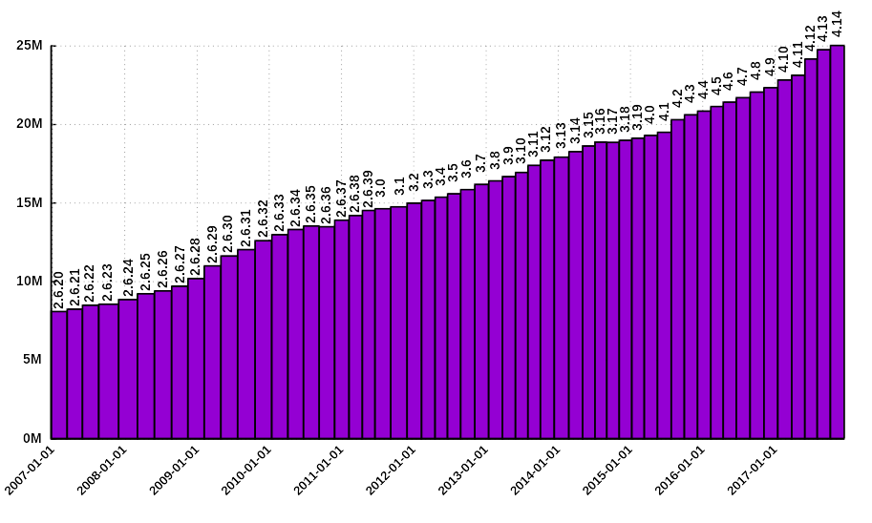
Can we fix containers?
Cost = C x Lines^{1.3}
[1] https://upload.wikimedia.org/wikipedia/commons/1/11/Lines_of_Code_Linux_Kernel.svg
[2] The Linux kernel as a case study in software evolution. Journal of Systems and Software 83, 3 (2010)

Slide 18
If we choose to bypass Linux…
Linux is just used for setup
  “the OS is the control plane”
We would prefer that the kernel stop trying to adapt to cloud workloads
We should choose to design for bypass
Linux
bypass
Bypass Linux

Slide 19
If we choose to replace Linux…
  No preemptible scheduling
    actions are short and run-to-completion
  No process synchronization
  No IPC (inter-process communication)
  Limited set of I/O calls: literally input and output
    files are unnecessary abstractions

Slide 20
Conclusions?
Native abstractions in Linux (containers) are not suitable for serverless at this time
Can they be fixed?
Should we bypass Linux?
  Then we should design for bypass
Is it time to replace Linux? Can that even happen?

Slide 22
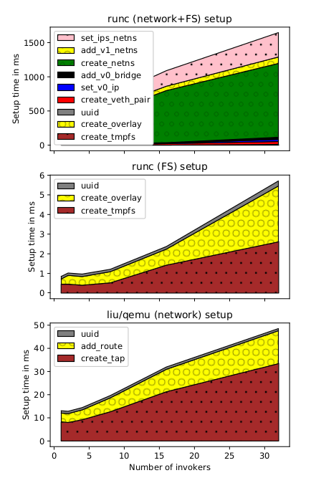

Slide 23
Cold starts

