Slide 1
Charges based on: MONTH
One-time fee: 50 €
Subscription period
Jan.
Feb.
March
April
May
June
July
Aug.
Billing period
X + 50.00 €
X’
X’’
X’’’

Slide 2
Charges based on: DAY
Subscription price: 100 € per DAY
12 p.m.
12 p.m.
Subscription period
MO
TU
WE
TH
FR
SA
SU
MO
Pro rata calculation: 0.5 + 1.0 + 1.0 + 0.5 = 3 * 100.00 € = 300.00 €
Per time unit calculation: 1.0 + 1.0 + 1.0 + 1.0 = 4 * 100.00 € = 400.00 €

Slide 3
Charges based on: DAY
Subscription price per DAY: 10 €
12 p.m.
12 a.m.
User A
User B
User C
MO
TU
WE
TH
FR
SA
SU
MO
Pro rata calculation: (2*0.5) + (3*1.0) + (3*1.0) + (1.0 + 0.5) = 8.5 * 10.00 € = 85.00 €
Per time unit calculation: (2*1.0) + (3*1.0) + (3*1.0) + (2*1.0) = 10 * 10.00 € = 100.00 €

Slide 4
Pro rata calculation
Usage time:
2 users * 0.5 + 3 users * 1 = 4
Recurring charge for users:
Charge 20 € * 4
80.00 €
One-time fee:
30.00 €
30.00 €
Recurring charge per subscription:
10.00 €
10.00 €
TOTAL for first month:
120.00 €

Slide 5
Per time unit calculation
Time units:
5 users * 1 = 5
Recurring charge for users:
Charge 20 € * 5
100.00 €
One-time fee:
30.00 €
30.00 €
Recurring charge per subscription:
10.00 €
10.00 €
TOTAL for first month:
140.00 €

Slide 6
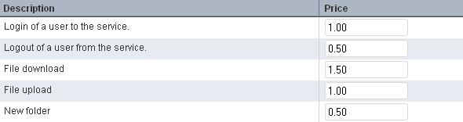
A
B
C
D
E
Subscription period
MO
TU
WE
TH
FR
SA
SU
MO
A
B
A
D
C
C
E

Slide 7
Event A:
2 * 1.00 €
2.00 €
Event B:
1 * 0.50 €
0.50 €
2 * 1.50 €
Event C:
3.00 €
1 * 1.00 €
Event D:
1.00 €
1 * 0.50 €
Event E:
0.50 €
TOTAL for subscription period:
7.00 €

Slide 8
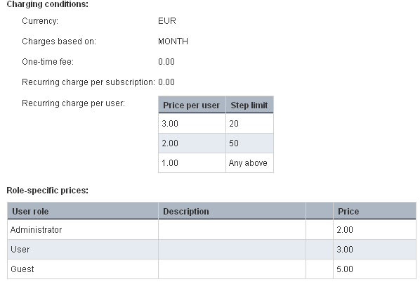

Slide 9
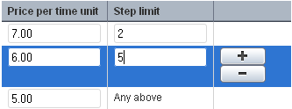
Definition of stepped prices for users:

Slide 10
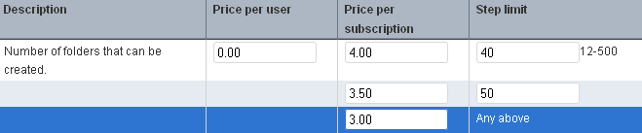
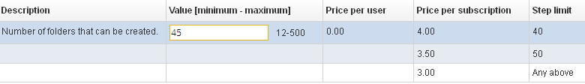
Definition of stepped prices for a parameter:
Customer choice when subscribing to the service:

Slide 11
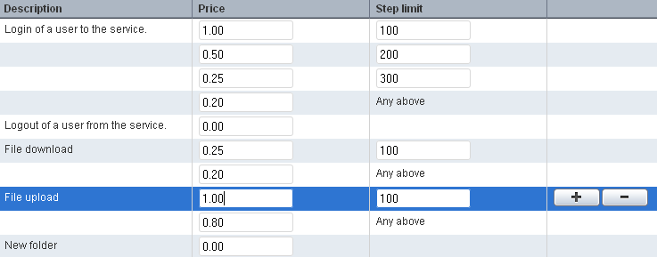

Slide 12


Slide 14

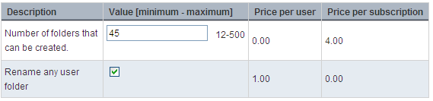
Definition of parameter prices in the price model:
Customer choices when subscribing to the service:
Two users are assigned to the subscription.

Slide 15
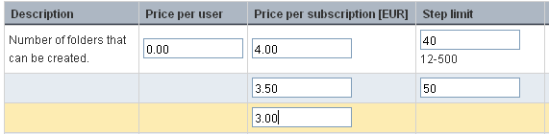
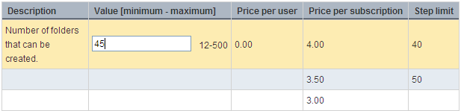
Definition of parameter prices in the price model:

Slide 16
Usage time: | 15 users * 1 = 15
Recurring charge per user: | 1 * 20.00 € | 20,00 €
 | 9 * 15.00 € | 135,00 €
 | 5 * 10.00 € | 50,00 €
TOTAL for one month: |  | 205,00 €

Slide 17
Usage time: | ( 7 users * 0.5 ) + ( 8 users * 1) = 11.5
Recurring charge per user: | 1 * 20.00 € | 20,00 €
 | 9 * 15.00 € | 135,00 €
 | 1.5 * 10.00 € | 15,50 €
TOTAL for one month: |  | 170,50 €

Slide 18
Usage time: | 15 users * 1 = 15
Recurring charge per user: | 1 * 20.00 € | 20,00 €
 | 9 * 15.00 € | 135,00 €
 | 5 * 10.00 € | 50,00 €
TOTAL for one month: |  | 205,00 €

Slide 19
Number of folders that can be created: | 45
 | 40 * 4.00 € | 160,00 €
 | 5 * 3.5 € | 17,50 €
TOTAL: |  | 177,50 €

Slide 20
Calculation: 4.00 € * 40 + 3.5 € * 5 = 177.50 €

Slide 21
Usage time: | 15 users * 1 = 15
Recurring charge per user: | 1 * 20.00 € | 20,00 €
 | 9 * 15.00 € | 135,00 €
 | 5 * 10.00 € | 50,00 €
ADMIN role | 3 * 1.00 € | 3,00 €
USER role | 5 * 10.00 € | 50,00 €
GUEST role | 2 * 5.00 € | 10,00 €
TOTAL for one month: |  | 268,00 €

Slide 22
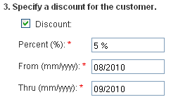

Slide 23
Charges based on: MONTH
One-time fee: 50 €
Subscription period
Jan.
Feb.
March
April
May
June
July
Aug.
Billing start day = 1 (default)
Billing period
X + 50.00 €
X’
X’’
X’’’
Billing start day = 15
Billing period
X + 50.00 €
X’
X’’
X’’’

Slide 24
Charges based on: DAY, calculation per time unit
Subscription price: 100 € per DAY
12 p.m.
12 a.m.
Subscription period
Customer A: Subscription 1
MO
TU
WE
TH
FR
SA
SU
22 p.m.
2 a.m.
Customer B: Subscription 2
Subscription period
MO
TU
WE
TH
FR
SA
SU
1.0 + 1.0 + 1.0 + 1.0 = 4 * 100.00 € = 400.00 €

Slide 25
Charges based on: WEEK, calculation per time unit
Subscription price per WEEK: 20 €
User A
Week
1
2
3
4
5
6
User B
Billing period 1
Billing period 2
User A: 1* 20 €
User A: 3* 20 € = 60 €
User B: 4* 20 € = 80 €

