Slide 1
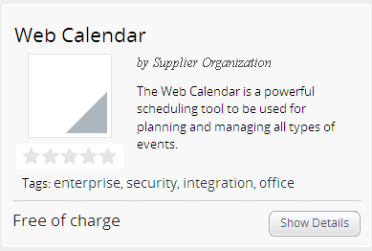

Service image
Service name for customers
Name of the supplier
Short description

