Slide 1
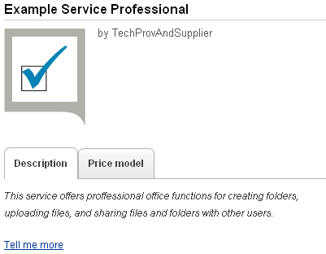
Service name
Technology provider who registered
the underlying technical service
Service image
Tab showing the service description
Tab showing the price model description
Hyperlink for additional information

Slide 2
Technology provider
Prepare
technical service
Register
technical service
Supplier
Define
marketable service
Define price model
Publish service
Customer
Subscribe to service
Use service

Slide 3
Technology provider
Prepare
application
Register as
technical service
Manage customers
Supplier
Define
marketable service
Define
price model
Publish service
Prepare
billing and payment
Customize BSS
Customer
Subscribe
to service
Use service

Slide 4
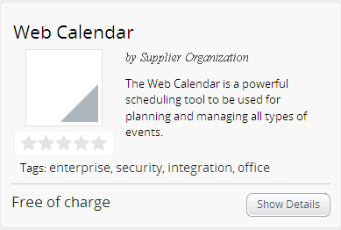

Service image
Service name for customers
Name of the supplier
Short description

Slide 5
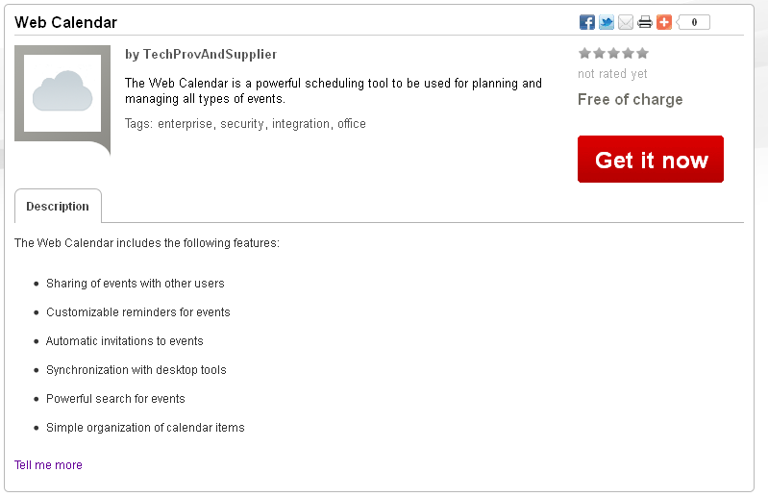
Service description
Hyperlink for
additional information

Slide 6


Slide 7
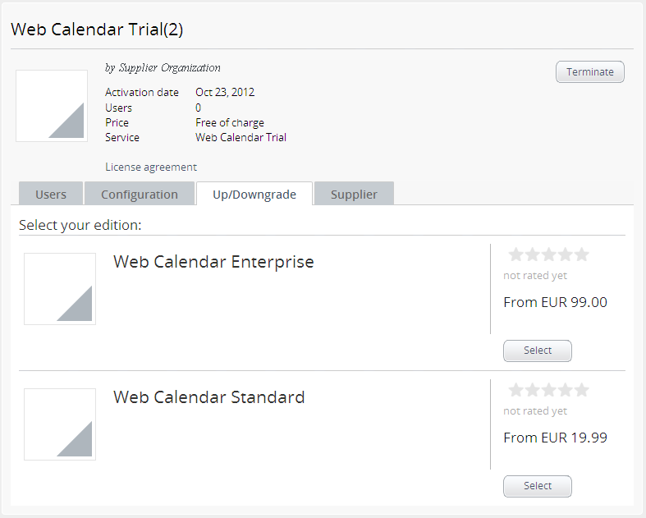

Slide 8
