Slide 1
User
Interface
A
p
p
l
i
c
a
t
i
o
n
A
p
p
l
i
c
a
t
i
o
n
A
p
p
l
i
c
a
t
i
o
n
Account
Management
Subscription
Management
Identity
Management
Bill
Presentment
Reporting
Payment
Collection
Event
Management
Billing
Service
Provisioning
Tenant
Provisioning
Business Enablement Services

Slide 2
Browser
HTML
JavaScript
Web Service
Client
User Interface
A
p
p
l
i
c
a
t
i
o
n
Public Web Service
Interface
Presentation in Web Container
Business Logic: EJBs in EJB Container
Persistence
RDB

Slide 3
Remote
Interface
User
Interface
A
p
p
l
i
c
a
t
i
o
n
Identity
Management
Web
Service
Event
Management
Tenant
Provisioning
Business Enablement Services

Slide 4
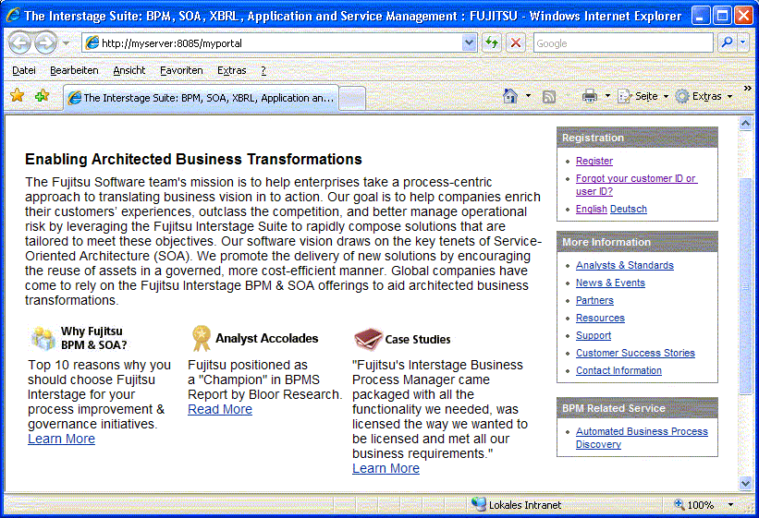

Slide 5
The following slides are not used

Slide 6
Customer
Customer
Application
Portal
Web Interface
Web Service
Account
Management
A
p
p
l
i
c
a
t
i
o
n
S
e
r
v
i
c
e
Subscription
Management
Identity
Management
Billing
Reporting
Payment
Collection
Service Level
Management
Bill
Presentment
Service
Provisioning
Tenant
Provisioning
Event
Management
Business Enabling Services

Slide 7
Business Enabling Services
BES
User
Interface
Account
Management
Identity
Management
Reporting
Billing
Customer
Web Interface
Payment
Collection
Application
Web Interface
Bill
Presentment
Application
Customer
Application
Web Service
Service
Provisioning
Service
Subscription
Management
Event
Management
Service Level
Management
Tenant
Provisioning

