Slide 1

Navigating AiTM and
Device Code Phishing
Attacks in Entra ID
HOOK,
LINE,
& SESSION
JOHN LAFFERTY
Systems Engineer – Vandalia Health
NATHAN HESS
Information Security Specialist – Vandalia Health
Notes:
LEAD: John opens, Nathan takes the thesis. ~45s.
JOHN: I'm John Lafferty. I build and run the identity stack. Nathan watches the same stack from the security side. Hook is the phish. Line is the real Microsoft login. Session is what the attacker leaves with after MFA succeeds. We are not here to tell you to turn on MFA. We are here for the two paths that still work after the green check.
NATHAN: MFA can succeed and you can still lose the account. Everything after this is how that happens, how we hunt it, or what John turns on so it stops.

Slide 2
THE CREW
Who is walking you through the session.
ENGINEER
SECURITY
JOHN
NATHAN
LAFFERTY
HESS
Builds and manages the identity stack.
Secures and monitors the same stack.
20+
12
YEARS
YEARS
B.S. Computer Science
Azure Administrator
M.S. Cybersecurity
ISC2 SSCP
AWS Cloud Admin
Active Directory
CySA+ · ISC-360
AZ-900
Automation Scripting
SC-300
Notes:
LEAD: Split. Each person reads only their own card. Do not read the cert list. ~1 min.
JOHN: Systems side. I own AD, Entra, the CA policy set, authentication methods, and break-glass. If a later control sounds expensive to roll out, that is my problem to sequence, not a reason to skip it.
NATHAN: Security side. I own the detections, the sign-in hunts, and whether the alert actually fired. A policy John deploys that I cannot see in the logs is not a control yet.

Slide 3
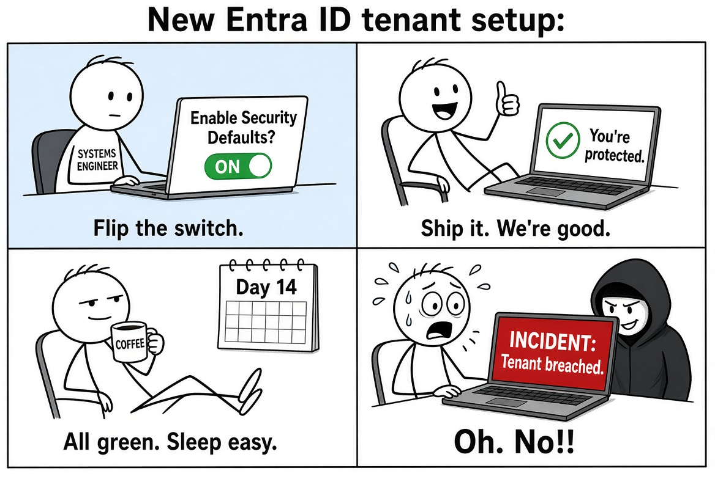
The Default Posture of Entra ID
ENABLED
≠ PROTECTED
GREEN CHECK ≠ GREEN LIGHT
Security Defaults is a starting lock.
It is not a hardening program.
Notes:
LEAD: John. Nathan punchline. ~1:15.
JOHN: Security Defaults is one switch. Free, real, not a program. It registers an authenticator, challenges privileged roles, kills legacy auth, and puts MFA on the Azure portals. It does not decide who may open the gate from where, on what device, for how long, or with what method. If Defaults is still on, you do not have a CA plane. Those two cannot run together.
NATHAN: The green check auditors like is 'MFA registered.' The attacker we are about to show never needed that box to be empty.

Slide 4
SECURITY DEFAULTS ≠ SECURE BY DEFAULT
One free on/off switch. Useful baseline. Not a control plane.
INCLUDED · FREE
STILL MISSING · NEEDS CA
Security Defaults
Not in the switch
✓
MFA registration
✕
Session & token control
Every user has to enroll an authenticator.
No sign-in frequency or persistent-session policy.
✓
Admin MFA every sign-in
✕
Location, device, app
Privileged roles get challenged every time.
No named locations, compliant device, or app targeting.
✓
Legacy auth blocked
✕
Risk & exceptions
IMAP / POP / SMTP AUTH and old clients die.
No ID Protection policies, guests, or break-glass paths.
✓
Azure portal MFA
✕
Auth strength & guests
Resource Manager and admin portals require MFA.
No phishing-resistant MFA requirement or guest rules.
Defaults and Conditional Access cannot run together. If you have Entra ID P1/P2, disable Defaults and replace the baseline with CA — then add location, device, session, and risk.
Notes:
LEAD: John. Nathan on the right column. ~2:30.
JOHN: Left column is the switch: MFA registration, admin MFA every sign-in, legacy auth blocked, Azure portal MFA. Right column is the talk: no sign-in frequency, no persistent session, no named locations, no compliant device, no app targeting, no risk, no guest rules, no break-glass path, no authentication strength.
Operational rule: if you have P1, do not turn Defaults off on a Monday. Build the replacement in report-only first — all-users MFA, block legacy auth, block device code, admin sign-in frequency. Watch a week. Then disable Defaults and flip those four On. No overlap period.
NATHAN: Every item on the right is a place I have watched a successful MFA sign-in turn into a mailbox rule. Defaults never bind the cookie to the device that minted it.

Slide 5


TWO IDENTITY-DRIVEN ATTACKS DEFAULTS DO NOT STOP
MFA can succeed. The attacker can still leave with the session.
Adversary-in-the-Middle
Device Code Phishing
A phishing proxy relays the real sign-in and steals the password plus the session cookie. Defaults have no token protection.
The user types an attacker-generated code on a real Microsoft page. The token is issued to the attacker’s device. Defaults are not a CA policy you can tune.
Security Defaults register a method and challenge some sign-ins. They do not bind the cookie or stop these two paths.
Notes:
LEAD: Nathan. John one liner. ~1:45.
NATHAN: Two paths. Both end with a token. Neither cares that MFA completed.
AiTM: reverse proxy relays the real Microsoft login. Password in, MFA out, user approves, cookie issued to the proxy. Login worked. Session also lives on infrastructure we do not own.
Device code: attacker starts the device-code grant, user types the code at the real microsoft.com/devicelogin page. Token issued to the attacker's device. Defaults cannot see that flow as a thing you can block.
JOHN: No Security Defaults knob for either. Device code becomes blockable only after CA exists, under Conditions > Authentication flows. Token binding is a session control with device prerequisites. We build both later.

Slide 6
IDENTITY-DRIVEN
INITIAL ACCESS
Identity policy & insider risk – 11%
65%
Credential misuse & brute force – 21%
Identity based Phishing and SE – 33%
Source: Palo Alto Unit42
Notes:
LEAD: Nathan only. ~1 min.
NATHAN: Unit 42 split, as cited. About two-thirds of those initial-access stories are identity-shaped: phish and social engineering 33, credential misuse 21, identity-policy or insider risk 11. Not a claim about every incident on earth. The front door that still matters, after MFA, is the session and the grant. The 33% bar is this talk. The 11% bar is policy that exists but does not cover the flow the attacker used. Do not invent a year for the figure.

Slide 7
AiTM DID NOT STAY RARE
From first disclosure to a three-day industrial wave.
APRIL 2026
2021 – 2022
2024
10,000+
10,000+
35,000
orgs targeted
attacks / month
First large Microsoft AiTM campaign disclosed
Reported run-rate against Microsoft users
users targeted in 3 days
13,000 organizations · 26 countries
Healthcare the largest vertical at 19%
Jul 23 – Jun 24
H2 25 – Q1 26
+146%
+139%
year over year
in six months
Code-of-conduct lures. Real Microsoft sign-in proxied. Session cookie stolen. MFA completed and still lost.
Microsoft Digital Defense Report 2024
KnowBe4: reverse-proxy / AiTM kits
Sources: Microsoft 2022 AiTM disclosure; Digital Defense Report 2024; Apr 2026 campaign (14–16 Apr); KnowBe4 Phishing Threat Trends Vol. 7 via PhishEye 2026.
Notes:
LEAD: Nathan only. ~1:30.
NATHAN: Read the dates. 2021-22: Microsoft discloses the first large AiTM campaign, 10,000+ orgs. 2024: 10,000+ attacks a month reported. Digital Defense Report Jul 23–Jun 24: +146% YoY. KnowBe4 reverse-proxy kits: +139% H2 25 to Q1 26.
April 14-16 2026: 35,000 users, 13,000 orgs, 26 countries, healthcare largest vertical at 19%. Code-of-conduct lure. Real Microsoft sign-in proxied. MFA completes. Cookie still gone. If you are from a hospital, you were the preferred target, not an edge case.
JOHN: If asked whether we saw it, do not claim an uncleared incident. 'The vertical mix is why the second half is controls a health system can turn on.'

Slide 8
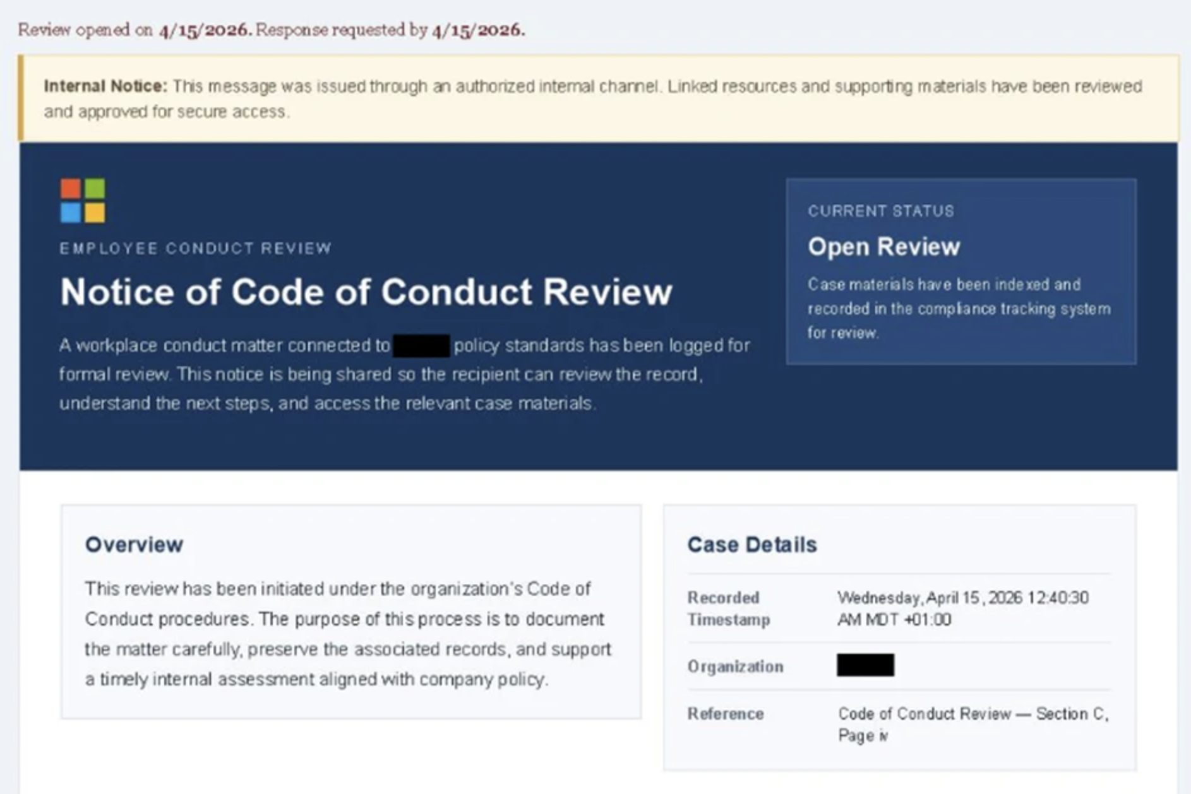
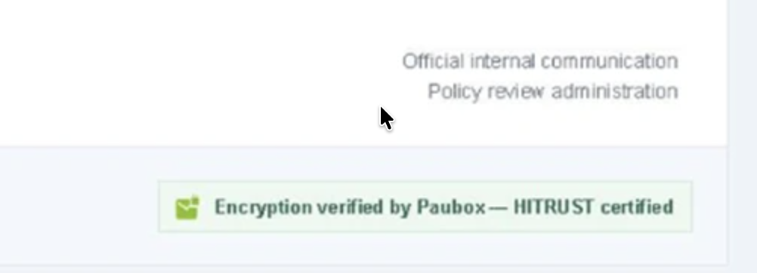
2026 Code of Conduct Campaign
Source: Microsoft
Notes:
LEAD: Nathan. ~1:15. Microsoft visual from the May 4 2026 'Breaking the code' write-up.
NATHAN: Lure is a conduct accusation with a deadline. Urgency does the work a spelling error used to do. User is walked to a scheduling step, then Sign in with Microsoft. That button is the hook into the proxy. From there it is a normal-looking Entra login, including the MFA prompt.
Hunt after the click is not a failed password. It is a successful sign-in, then an inbox rule, a forward, or a second sign-in on that same session from somewhere else. Microsoft flags anomalous token, unfamiliar sign-in properties, impossible travel, inbox-rule alerts. Those names come back on the risk slide. Point at the image. Do not read the article.

Slide 9
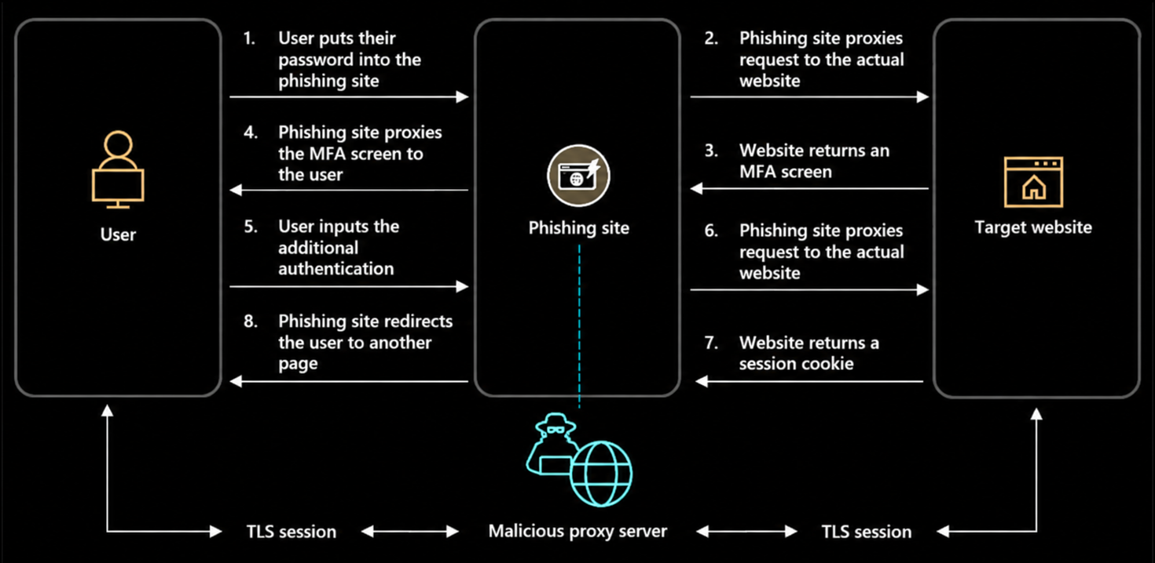
Adversary-in-the-Middle
Source: Microsoft
Notes:
LEAD: Nathan. John one sentence. ~1:30.
NATHAN: Walk left to right. Proxy and lure. User submits credentials to the proxy. Proxy submits them to Entra. Entra issues a real MFA challenge. User satisfies it. Entra sets the session cookie. Proxy keeps a copy and replays it. Mailbox or inbox rule follows. MFA is in the path. It is not the boundary. The boundary is who holds the cookie after success.
JOHN: The control that breaks this diagram is not a second MFA prompt. A second phishable prompt still completes through the proxy. The control is a method the proxy cannot relay — passkey or FIDO2 bound to the real Microsoft origin — or token protection that will not redeem the session off-device. Both are CA plus an authentication-methods change.

Slide 10
Placeholder for Video
Exceeded file size limits for GitHub
Notes:
LEAD: Nathan. Skip if the video is still a placeholder. ~2 min or one sentence.
IF VIDEO PLAYS: Narrate only the beat they might miss. 'That approve tap is the user doing the right thing. The session is already forked.'
IF NOT: 'The clip is the same diagram in motion. User completes a real MFA prompt and the attacker is in the mailbox before the tab closes. We are not debugging video live. The hunt slides are the receipt.'
JOHN if asked what would have blocked it: Phishing-resistant authentication strength. The proxy origin cannot satisfy a passkey assertion.

Slide 11
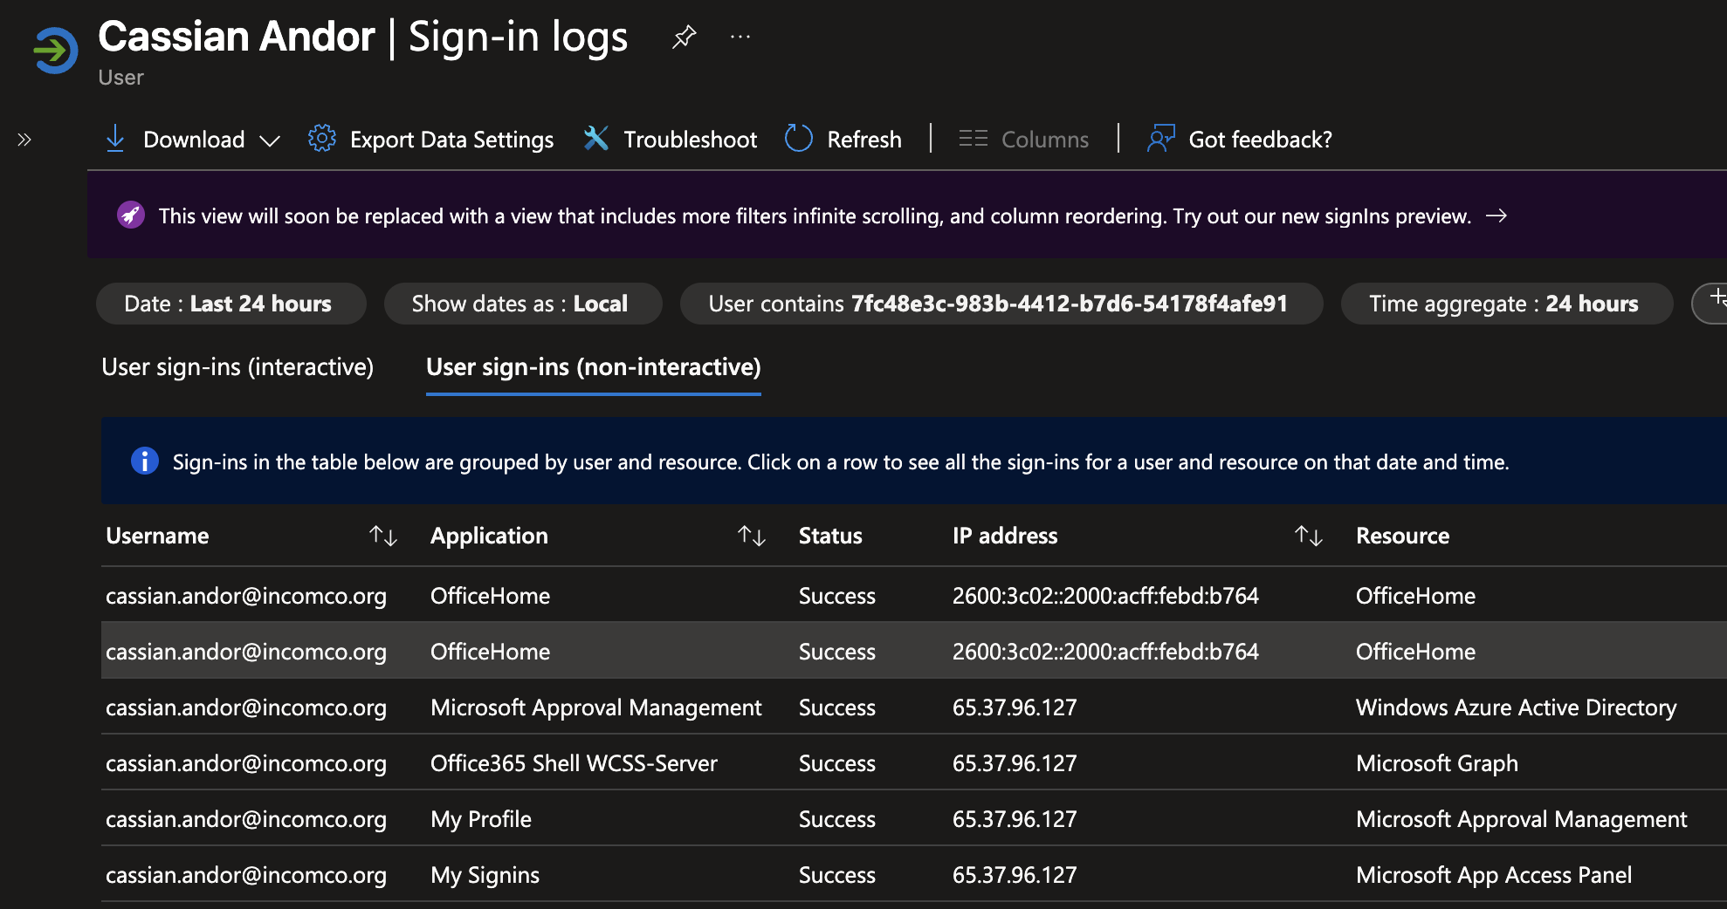
Hunting for AiTM Activity
Notes:
LEAD: Nathan. John on the log pipeline. ~2 min. Talk to the screenshot.
NATHAN: AiTM rarely looks like a failure. Filter success first. Hunt the session, not the user.
1. Same SessionId, more than one IP, short window. First IP is often the proxy. Second is the cookie redemption. Pair with a new country, ASN, or user agent.
2. ID Protection: Anomalous token, Unfamiliar sign-in properties, Unfamiliar sign-in properties for session cookies. Anomalous token is the one written for this.
3. Confirm impact: inbox rule, forward, or mail delete in the same hour. Unified Audit Log or Defender for Cloud Apps.
JOHN: Portal sign-in logs are 30 days on P1. Stream SignInLogs and NonInteractiveUserSignInLogs to Log Analytics or Sentinel or you cannot join SessionId next quarter. Cookie replay often shows as non-interactive. Interactive-only retention under-counts this.
Query shape if asked: SigninLogs, 1d, ResultType == 0, summarize dcount(IPAddress) by SessionId, UPN, keep distinct IPs > 1. A lead, not a conviction.

Slide 12
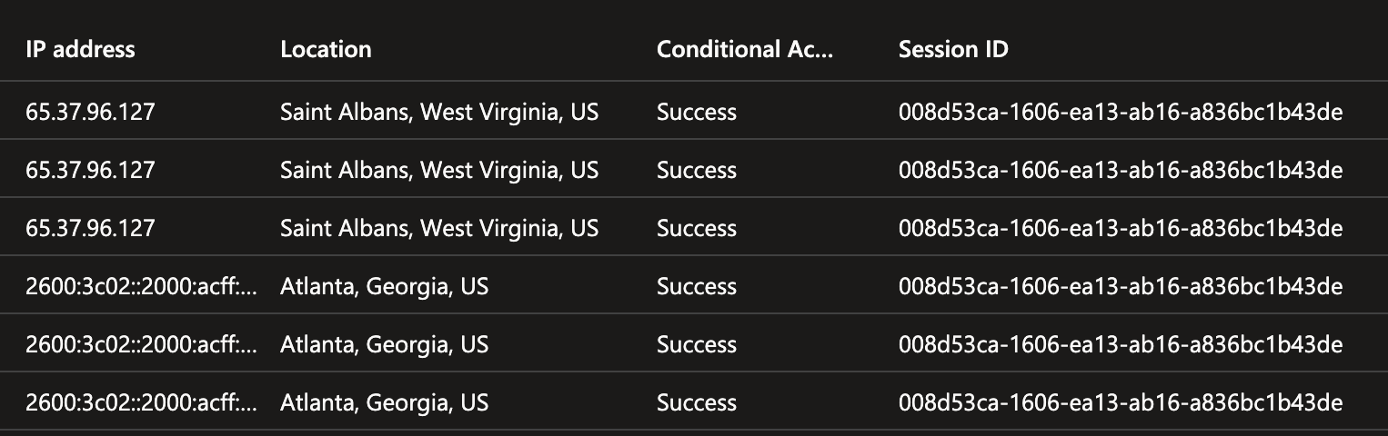
Hunting for AiTM Activity
Notes:
LEAD: Nathan. John only if the visual is a portal blade. ~1:30.
NATHAN: On the sign-in detail open Authentication details and Location. Three mismatches in one row: auth requirement already satisfied by a claim in the token, a network the user has never used, and an app that is Office Home or Exchange Online Web. Office Home is a common first app because that is where the session is minted before the pivot to mail.
Timing beats geography. Impossible travel is the late signal. Two IPs five minutes apart in the same SessionId is the early one.
JOHN: 2 a.m. bookmarks: Sign-in logs with Authentication protocol column and Session ID filter. ID Protection risk detections filtered to Anomalous token. Unified Audit Log for Set-InboxRule. No custom workbook required for the first hour.

Slide 13
SYSTEMS · THE LOG THAT OUTLIVES THE PORTAL
DEFAULT LOG ANALYTICS
One diagnostic setting. Entra sign-ins land in a workspace you own. Portal history stops at 30 days.
TURN IT ON
RUN IT
Diagnostic setting, not a workbook
Two systems queries
01
Workspace
Sign-ins per application · 7 days
One Log Analytics workspace. Destination table: resource-specific, so the table is SigninLogs.
SigninLogs
| where TimeGenerated > ago(7d)
| summarize SignIns = count() by AppDisplayName
| top 15 by SignIns desc
02
Blade
Entra ID → Monitoring & health → Diagnostic settings → Add.
03
Categories
Device-code inventory · the exception list
SigninLogs, NonInteractiveUserSignInLogs, ServicePrincipalSignInLogs, AuditLogs.
SigninLogs
| where TimeGenerated > ago(30d)
| where AuthenticationProtocol == "deviceCode"
| summarize SignIns = count(),
Users = dcount(UserPrincipalName)
by AppDisplayName
| top 15 by SignIns desc
04
Destination
Send to Log Analytics. Name the setting entra-default-log-analytics.
Security Administrator to save. Reports Reader to query. First rows in about 15 minutes. Non-interactive is the replay table — do not skip it.
Notes:
LEAD: John. Nathan one line on why the second table matters. Insert after the hunting slides. ~1:45.
JOHN: Portal sign-in logs are 30 days. The SessionId join from the last two slides does not exist next quarter unless this setting does. Path: create or pick one Log Analytics workspace. Entra ID, Monitoring and health, Diagnostic settings, Add. Name it entra-default-log-analytics. Check four categories: SigninLogs, NonInteractiveUserSignInLogs, ServicePrincipalSignInLogs, AuditLogs. Destination: Send to Log Analytics. Destination table: resource-specific, or the queries on this slide have the wrong table name. AzureDiagnostics mode buries them.
Role: Security Administrator to create the setting. Reports Reader to run the queries. Rows show up in about 15 minutes, sometimes closer to an hour on a cold workspace.
Left query is the baseline: who is signing in to what. Right query is the device-code exception list from the demo. Anything in that top 15 that is not a room account or a documented CLI is a finding, not an exclusion.
Skip ManagedIdentitySignInLogs and MicrosoftGraphActivityLogs on day one. They dominate the bill and they are not the hunt.
NATHAN: Non-interactive is the table I need for cookie replay. Interactive-only retention is how an AiTM incident disappears before I open the ticket.

Slide 14
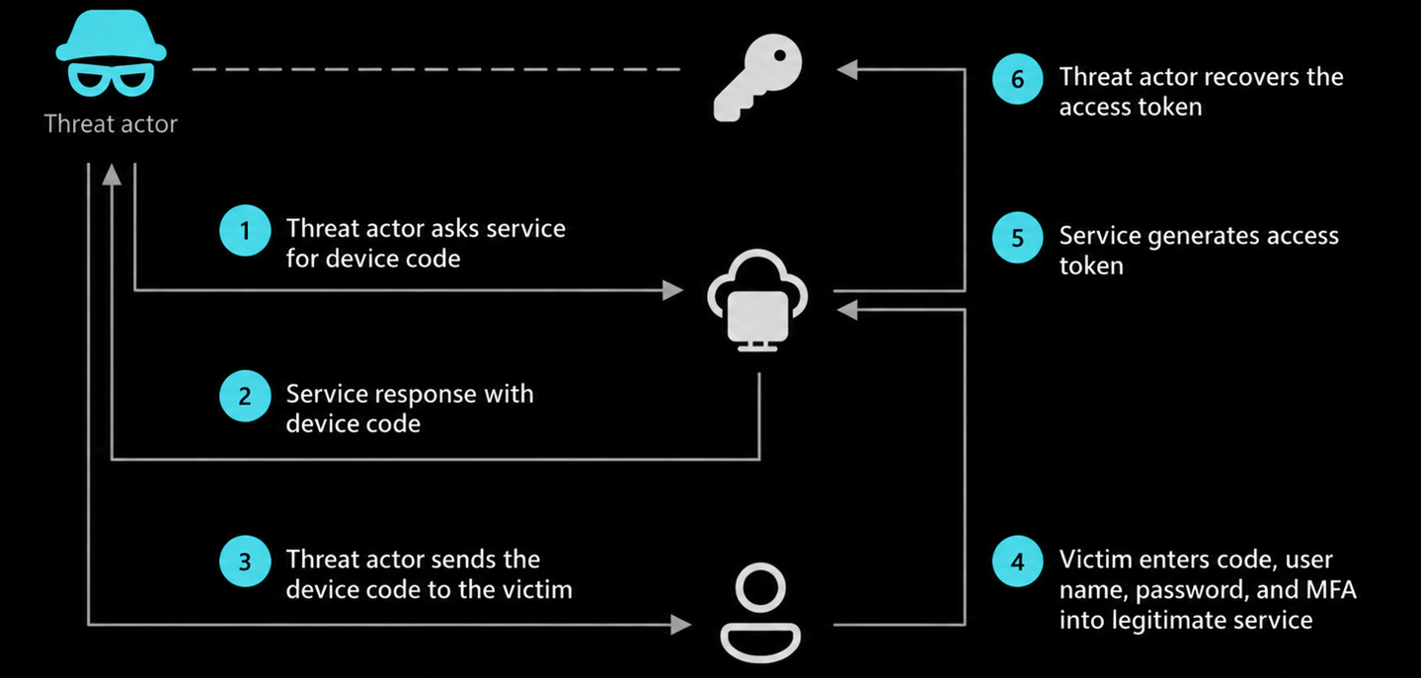
Device Code Flow Phishing
Notes:
LEAD: Nathan. John on legitimate use. ~1:45.
NATHAN: Device-code flow was built for devices with no keyboard. Device prints a code, user types it at a Microsoft page, token is delivered to the device that asked, not the browser where it was typed.
Phish: attacker requests a code with a trusted-looking client, sends 'paste this at microsoft.com/devicelogin.' Real Microsoft domain. No proxy to detect. MFA can fire. Token still lands on the attacker's machine.
Log tell: Authentication protocol = device code. Client app usually mobile and desktop. IP on token redemption is the attacker. IP on code entry is the user.
JOHN: Do not block device code Tuesday without a list. Legitimate hospital callers: Teams rooms, Teams phones, signage, Azure CLI on a jump host, Connect-MgGraph -DeviceCode. Inventory is sign-in logs, authentication protocol = device code, 30 days, grouped by user and app. That list is the exception group. Everyone else is the block.

Slide 15
Device
Code Flow
DEMO
Notes:
LEAD: Nathan narrates the attack. John drives the portal. ~4 min. Agree who presses Enter.
NATHAN: I start the device-code grant from a machine the user has never seen. I send the code and the real Microsoft URL. User types the code, satisfies MFA, consents. My window now has a token. I did not proxy anything. Entra handed it to me because the flow is designed that way.
JOHN click-path: Entra admin center > Conditional Access > new policy. Users: all, exclude break-glass and the room-account group. Resources: all. If Teams devices register themselves, also exclude Device Registration Service. Conditions > Authentication flows > Configure yes > Device code flow. Grant: block. State: report-only. Leave it until hits are attackers and room accounts, not a clinic. Then On.
Also look at authentication transfer in the same condition. A device-code session stays protocol-tracked and can get blocked later in Exchange even if a later policy looks narrower.
If demo breaks: narrate the path. Failure mode is a Teams room that cannot sign in, not a missed phish.

Slide 16
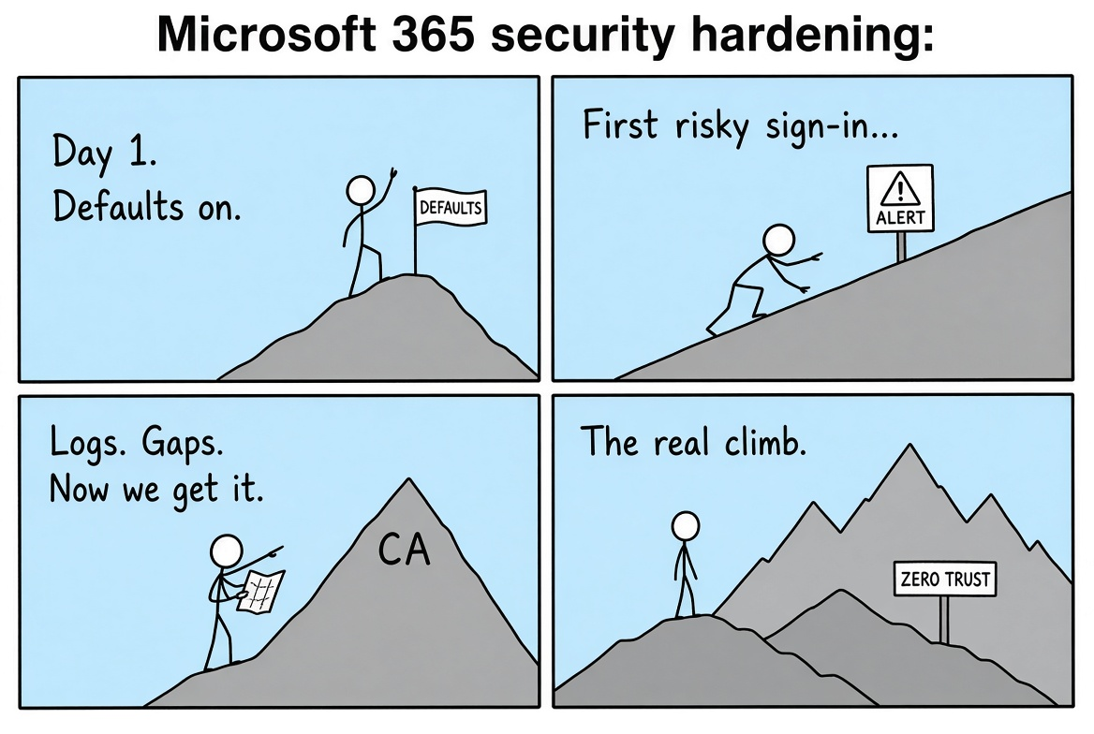
The Default Posture of Entra ID
BASE CAMP
≠ THE SUMMIT
Defaults get you on the mountain.
Alerts, logs, and CA are the climb.
01 Enable the baseline
02 Get alerted
03 Read the gaps
04 Build the posture
Notes:
LEAD: John. Nathan names step 2. ~1:15.
JOHN: Step 1 baseline: replace Defaults with CA, MFA for all, legacy auth blocked, device code in report-only. Step 2 alerts that page a human: any break-glass sign-in, anomalous token, device-code success outside the room group. Step 3 gap review: who is still on SMS, which apps succeed in report-only, which guests have no MFA. Step 4 posture: authentication strength, sign-in frequency, token protection where devices can support it. If the project plan ends at Security Defaults on, you finished step zero.
NATHAN: Step 2 is mine. A report-only policy nobody reviews is a diary. Anomalous token and the device-code success alert belong in the same queue as phish clicks.

Slide 17

Hardening 365 Against Identity-Driven Attacks
Microsoft Entra’s policy engine for access decisions
WHAT IS
CONDITIONAL
ACCESS?
Evaluates signals such as the user, application, device, location, and sign-in risk
Applies controls in real time: allow, block, or require additional authentication
Enables organizations to enforce consistent access rules across cloud resources
Notes:
LEAD: John. Nathan one sentence. ~1:15.
JOHN: CA is the policy engine Defaults is not. At sign-in it evaluates user, app, device, location, client app, authentication flow, and with P2 sign-in risk. Then grant, block, or demand a stronger method, and stamp session controls: sign-in frequency, persistent browser, token protection. It is not a firewall and it is not retroactive against a session that already left. It decides the next token request.
NATHAN: I treat every CA policy as a detection until it is On. Report-only writes what would have happened. That line is how I prove the policy is aimed at the attack and not the night shift.

Slide 18
Hardening 365 Against Identity-Driven Attacks
A FEW THINGS THAT CONDITIONAL ACCESS
ALLOWS YOU TO DO
Require MFA for all users AND apply session lifetime policies
Require additional authentication if the sign-in is deemed risky
Block all sign-ins from accounts with an active risk detections
Block legacy authentication methods
Block device code flow authentication entirely
Notes:
LEAD: John. Nathan maps each line to an attack. ~2 min.
JOHN, in build order:
1. MFA for all users plus session lifetime. Admin sign-in frequency every time or 1 hour. Persistent browser never for privileged roles.
2. Extra auth when sign-in is risky. Needs P2. Do not promise it on P1.
3. Block when user risk is high. Also P2.
4. Block legacy auth. Replaces the Defaults behavior you lose when Defaults goes off. Skip it and SMTP AUTH comes back.
5. Block device code. Authentication flows condition. P1 is enough.
NATHAN: One and five are the talk. Session lifetime cuts the AiTM replay window, it does not stop the replay. Device-code block stops the second attack if the exception list is tight. Risk policies page me. They do not prevent the first click.

Slide 19
Hardening 365 Against Identity-Driven Attacks
WHAT IS RISK-BASED
CONDITIONAL ACCESS?
Evaluates sign-in risk signals and applies controls when risk has been detected on an account
Anonymous IP address
Impossible travel
Anomalous Token
Malicious IP address
Atypical travel
Unfamiliar sign-in properties
These detections are great for raising flags on
AiTM and Device Code Phishing Attacks
Notes:
LEAD: Nathan. John on license and the policy pair. ~1:45.
NATHAN: Anomalous token is the AiTM specialty. Unfamiliar sign-in properties fires when the cookie shows up with a new IP, agent, or location. Impossible and atypical travel are the late geographic version. Anonymous IP and malicious IP catch the cheap proxy and miss the residential proxy bought this morning.
Good at raising a flag. Inconsistent as the front door. The flag often lands after the token is issued. Use them to scope the incident and force step-up on the next request. Do not brief leadership that risk-based CA prevents AiTM.
JOHN: Sign-in risk and user risk in CA require P2. P1 can do device-code block, MFA grant, legacy-auth block, and authentication strength. If you have P2, two policies: sign-in risk medium+ require phishing-resistant MFA or compliant device; user risk high block. Exclude break-glass. Watch VPN egress and clinician travel before On.

Slide 20
Hardening 365 Against Identity-Driven Attacks
CONDITIONAL ACCESS
LIMITATIONS
Risk-based Conditional Access requires Entra ID P2 licenses
Conditional access is like checking a user’s badge at the front door. It doesn’t check to see if the people already inside are swapping badges
MAKE SURE YOU HAVE BREAK GLASS ACCOUNTS
Notes:
LEAD: Nathan metaphor, then John on break-glass. ~1:45.
NATHAN: Even with P2, CA is a door check. It evaluates the request in front of it. It does not walk the building asking who already swapped badges. A cookie replayed against an app that is not asking for a new token yet is inside. CAE closes some of that for Exchange, SharePoint, and Teams. It is not a time machine.
JOHN: Two cloud-only accounts. Not synced. Not a daily admin. Long passwords in a safe, FIDO2 key in a second safe. Excluded from every CA policy that can lock you out. Alert on any sign-in, interactive or not. If the alert does not page, you do not have break-glass, you have a backdoor. Do not sign into them to test MFA. Test the alert.

Slide 21
Hardening 365gainst Identity-Driven Attacks
CONDITIONAL ACCESS -
TECHNICAL LIMITATIONS
Risk Detection Bypasses during AiTM and Device Code Phishing
IPv6 + Obfuscated Location and Device Properties
Signal and indicator reliability (IP Geolocation)
Timing
Notes:
LEAD: Nathan. John on controls that survive bad signals. ~1:30. Do not read the title — it says 365gainst.
NATHAN: Three misses. IPv6 and obfuscated device properties — geolocation is worse, kits walk past atypical travel. Residential proxy in the user's own metro does not look like travel. Timing — ID Protection is not synchronous with token mint. Sign-in succeeds, cookie is replayed, detection lands after the inbox rule.
JOHN: When signals lie, use controls that do not consult IP. Authentication strength, device-code block, sign-in frequency. Those three still work on a Tuesday when ID Protection is quiet. Build them even if you have P2.

Slide 22
Hardening 365 Against Identity-Driven Attacks
CONDITIONAL ACCESS -
TECHNICAL LIMITATIONS
IPv6 + Obfuscated Location and Device Properties
ADD EVENT LOG SCREENSHOTS
Notes:
LEAD: Nathan. Placeholder — do not project as-is. Drop a redacted sign-in or skip. ~1 min.
WITH SCREENSHOT: Successful result. Auth details show a claim already satisfied. Location is a network the user does not have in 30 days. Risk column empty or late. The incident is the row, not the risk badge. If the playbook says only page on high risk, this sign-in never pages.
IF STILL PLACEHOLDER: Skip. The row we meant to put here is a success, thin device properties, no risk detection at that timestamp, and a Set-InboxRule in the same hour.
JOHN: Export is sign-in log download, or Log Analytics. First column to add is Authentication protocol so device code and browser replay are not in the same bucket.

Slide 23
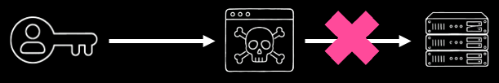
Hardening 365 Against Identity-Driven Attacks
FIDO2 /
PASSKEYS
Conditional Access Policies can also be used to enforce phishing-resistant authentication methods such as passkeys
Passkeys require physical proximity,
which breaks AiTM attacks.
Notes:
LEAD: John on the policy, Nathan on why the attack dies. ~2 min.
JOHN: Authentication strength is a grant control. Built-in Phishing-resistant MFA means FIDO2, Windows Hello, or certificate-based auth. Passkeys in Authenticator sit in that set. Turn methods on under Authentication methods. CA only demands the strength. If the method is disabled, the demand is an outage.
Order: privileged roles, report-only, then On. Then ePHI and finance apps. Then everyone, after registration has actually run. Do not start with all users and a hard fail.
NATHAN: A push or SMS can be relayed. A passkey cannot. WebAuthn binds the assertion to the relying-party origin. The proxy hostname is not login.microsoftonline.com, so the browser will not release the assertion. The slide says physical proximity — true for a USB key. For a synced passkey the deeper point is origin binding. Say origin binding if you only have one phrase. Number matching does not stop a real-time proxy.

Slide 24
Hardening 365 Against Identity-Driven Attacks
FIDO2 /
PASSKEYS
VS. AITM
[DEMO]
Notes:
LEAD: Nathan narrates, John drives. ~3:30.
NATHAN: Same kit. Lure, proxy, real Entra page. This user is in the authentication-strength policy. Password still relays. Next step is a passkey challenge tied to Microsoft's origin. The browser will not answer it for the proxy origin. No push to approve. The attack stops in front of the user. First time in the deck the user can do the right thing and have it matter.
JOHN: What changed. Authentication methods: passkey and FIDO2 on, enforce attestation if you issue your own keys. CA scoped to the privileged-role group, grant require authentication strength, phishing-resistant. Report-only until registration shows in the campaign report, then On.
Failure mode: user with no passkey and policy On cannot sign in. TAP exists for that — one time, short lifetime, verified out of band. TAP over unverified email is phishable.

Slide 25
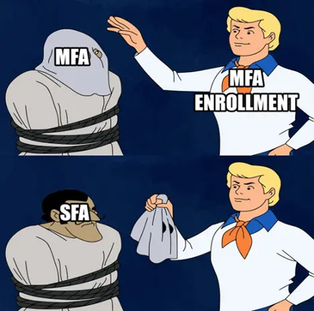
Hardening 365 Against Identity-Driven Attacks
FIDO2 /
PASSKEYS
Always require an additional authentication method (MFA, TAP, location, domain joined device) for self service portals such as Microsoft’s Security Info page.
Notes:
LEAD: John. Nathan on the attacker outcome. ~1:30.
JOHN: This undoes the last two slides if you skip it. The Security info page is where a user adds a passkey, and where an attacker with a stolen session or a social-engineered TAP adds their own method.
CA user action: Register security information. Require phishing-resistant MFA, or a compliant device, or a named admin workstation. Combined registration should not be satisfiable by the SMS method you are retiring.
Help desk: TAP, single use, one hour, not a persistent bypass. Monitor issuance. Unaudited TAP is a new device-code flow with better branding.
NATHAN: Quiet pattern. No new phish. A new FIDO key or Authenticator on an account that was already inside. Hunt Audit logs for Add authentication method, unexpected. Same queue as anomalous token.

Slide 26
THE GOOD NEWS
Microsoft built a policy to block device code flow sign-ins
All you have to do is enable it!
In September, Microsoft moved towards making Passkeys the default sign-in method for all Entra tenants
By February 1st, SMS and Voice methods for MFA will be minimally supported in Entra. Work towards moving these users to a more secure authentication method.
Notes:
LEAD: John. Nathan one line. ~1:45. SAY THE YEARS. Slide omits them.
JOHN: Device-code block is a documented CA pattern, available now, no P2. Report-only, then On. Room accounts and break-glass only.
September 1, 2026: passkeys became the default experience. SMS/voice users auto-enabled and nudged at next MFA. That date is behind us.
February 1, 2027: Microsoft-provided SMS and voice retires for general users. Global Admins and external users follow July 1, 2027. After Feb 1 a general user whose only method is SMS or voice gets a blocking passkey prompt. Telephony can continue only via a telecom provider you configure.
Order: inventory SMS/voice users, turn on passkeys, run registration campaign, protect the registration page, then retire telephony methods so they cannot be re-added.
NATHAN: SMS and voice are relayable. That is why they are in this talk. A tenant still on them in January 2027 is choosing to keep the AiTM path open.

Slide 27
[PASS]KEY
TAKEAWAYS
Identity-driven attacks like AiTM and Device Code Flow phishing are rising year after year
Conditional Access can help detect and respond to risky sign-ins (with limitations)
Passkeys can help prevent these attacks
Notes:
LEAD: Split. ~1:15.
NATHAN: Identity-driven initial access is still climbing, and MFA completion is not the end of the story. CA risk policies help us detect and respond. License gate, timing gap, geolocation gap. Use them. Do not brief them as prevention.
JOHN: Passkeys demanded by authentication strength are the prevention control for the proxy. The device-code block is the prevention control for the real Microsoft page. Neither is in Security Defaults. Both are buildable this month on P1: inventory, report-only, exclusions, then On. One thing after this session: put device code flow in report-only before you leave, and look at the hits tomorrow.

Slide 28
Q&A
Notes:
LEAD: Both. John moderates, Nathan takes attack questions.
Route: click-path, license, exclusions, what breaks -> John. Logs, detections, how the kit works -> Nathan. Passkeys -> Nathan on the attack, John on rollout. P1 only -> John: device-code block, MFA, legacy auth, auth strength still exist; risk policies do not. No CA yet -> do not disable Defaults until the four baseline policies are in report-only. Teams rooms -> exception group from the device-code inventory; exclude Device Registration Service only if registration needs it. Block the phishing domain -> Nathan: the sign-in page is Microsoft's. Domain blocking catches the lure, not the grant.
CLOSE, JOHN: If you copy two policies, copy the report-only device-code block and the privileged-role authentication-strength policy. Thank you.

