Slide 1

Prose
2023/09/08
https://gitlab.com/romualdrousseau/prose

Slide 2
Motivation
A developer tool to bring the power of LLM to the CI/CD by reinforcing documentation and unit tests for an entire project.
After using several tools and editor assistant, I could not find a tool to integrate into my development workflow and even less in a CI/CD automated flow.

Slide 3

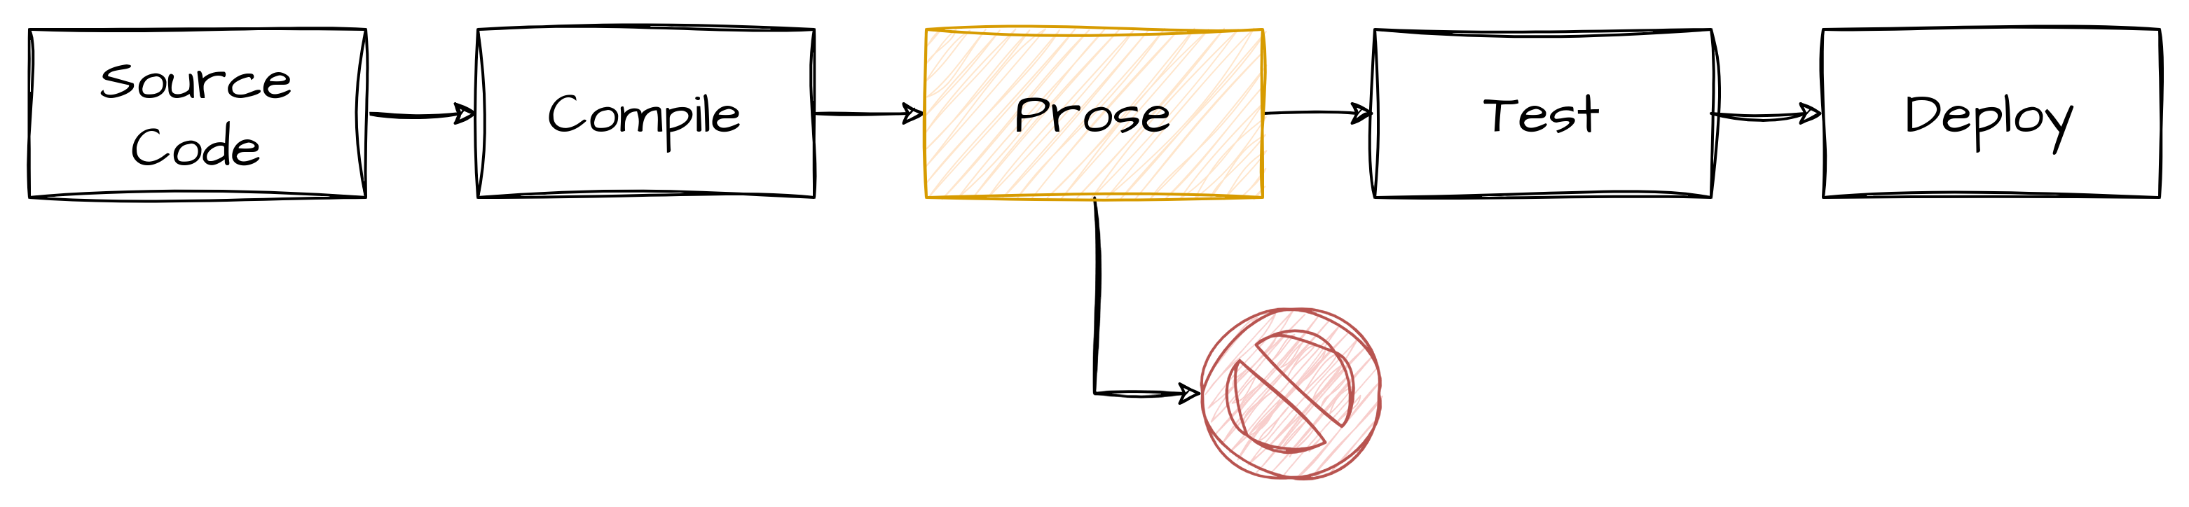
What is Prose?
Prose is a CLI tool to document and generate tests for Java and Python projects using LLM.
It allows for easy addition of new languages and LLM systems, such as Azure OpenAI.
Prose parses source code and generates comments and tests incrementally.
Prose can also be integrated into a CI/CD pipeline and failed if there are classes or methods without documentation or tests.
Additionally, Prose collects all information and adds a summary to the README file.

Slide 4
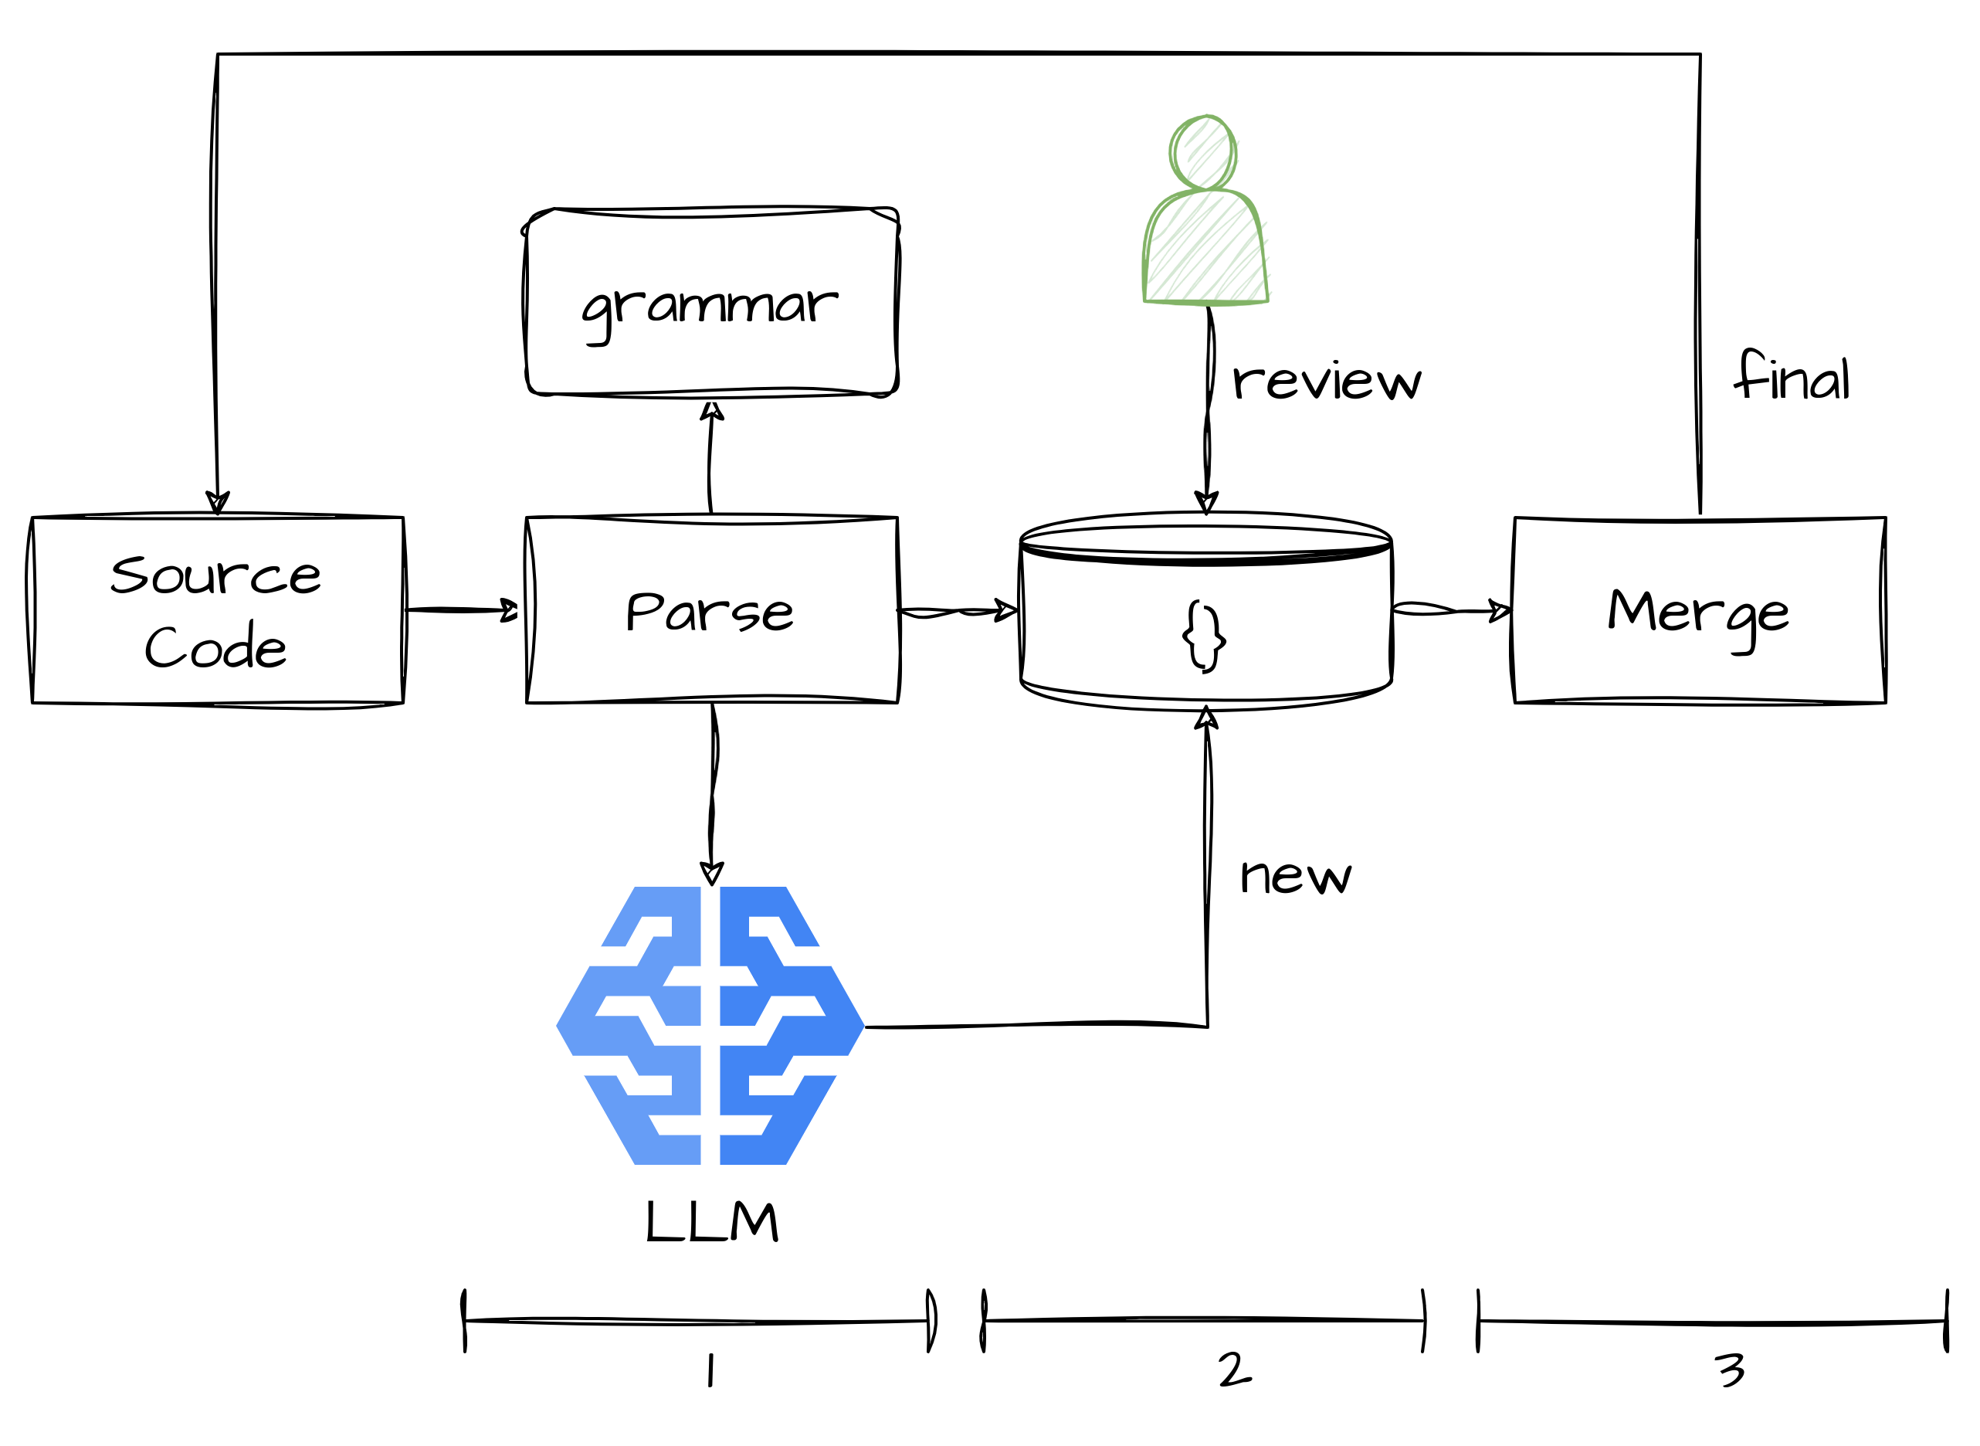
How does it work?
Prose works in 3 steps:
Step 1
Prose parses a tree source, collects non documented classes and methods and proposes comments and tests using LLM.
The sources are not modified. The comments and tests are saved in a prose.json file with a status "new".
If any "new" are found, Prose warns the developer and terminates in error, otherwise, terminates without error silently.
Step 2
the developer checks the prose.json for status "new", check and corrects the proposed comments and tests and then change the status as "review".
Step 3
Prose reruns in merge mode all comments and tests marked "final".

Slide 5
Features
LLM
Azure OpenAI
LR Parser
Tree Sitter
LLM
Documentation: OK
Test generation: OK
Java
Documentation: OK (JAVADOC)
Test generation: In progress (JUNIT)
Python
Documentation: TBD
Test generation: TBD
Behave Plugin
Test generation: TBD
Poetry Plugin
Documentation: TBD
Maven Plugin
Documentation: TBD
vscode Plugin
TBD

Slide 6
CLI
# prose
New comments and tests found, abort!
# prose –merge --inplace

Slide 7
Thank you

