Slide 1


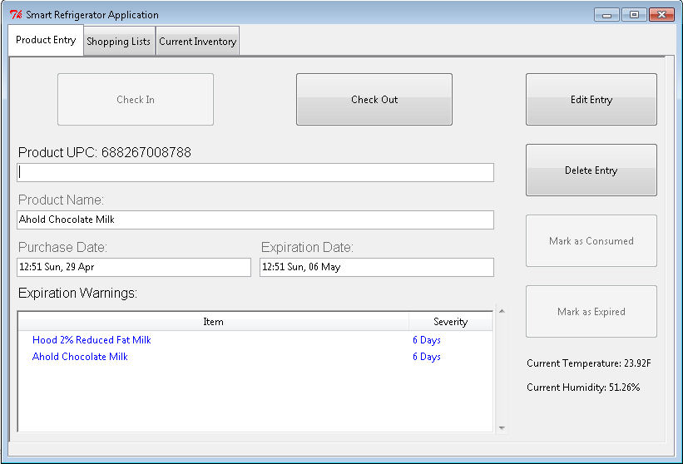
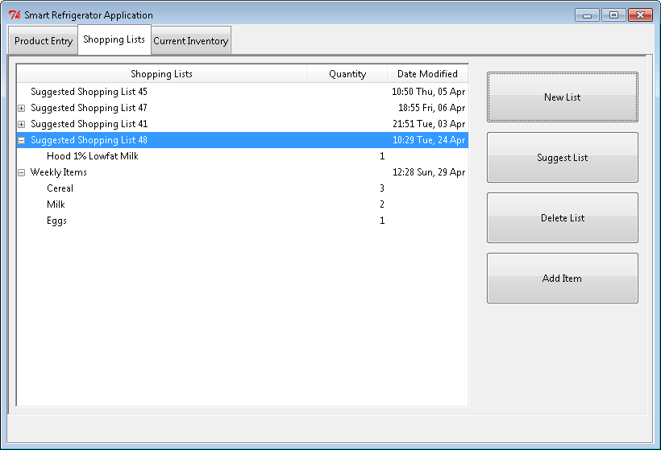
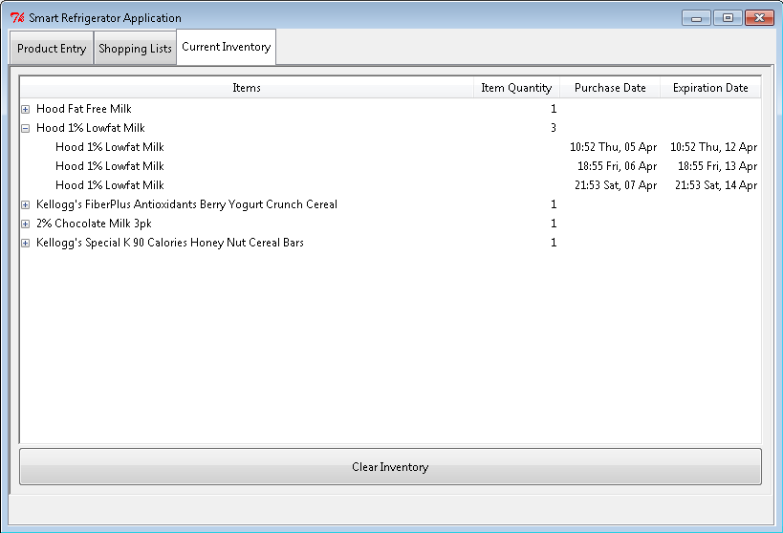

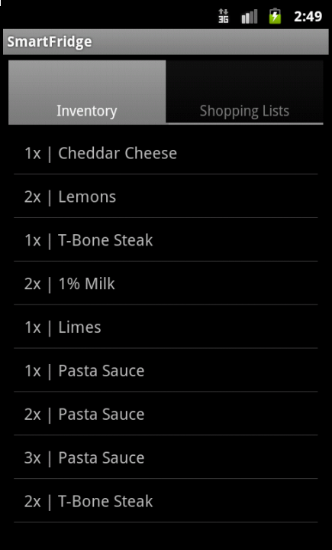
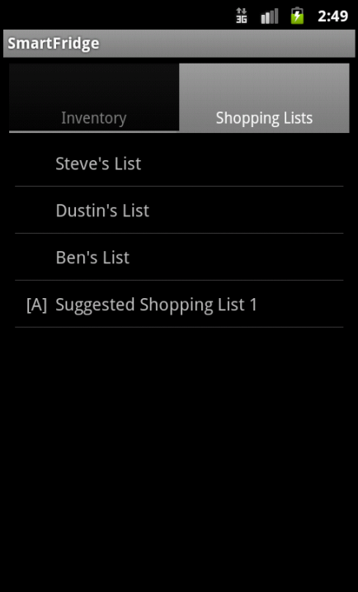
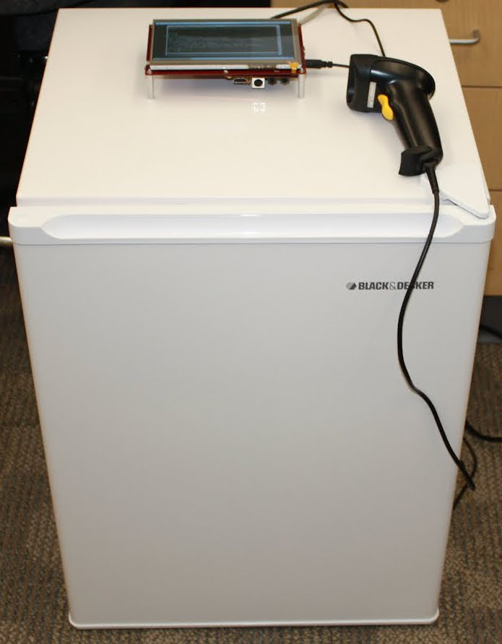
Smart Refrigerator
Steven Strapp, Dustin Stroup, Ben Reeves
RIT Computer Engineering Senior Design Project
Environment
About the Project
Technologies Used
The benefit of our system versus existing systems is its size and portability. Our Smart Refrigerator requires no modification to existing appliances. This also means that the system can be used in other places besides the refrigerator; cupboards, freezers, pantries, any place that there is food to be kept track of.
The goal of this project is to develop and prototype a Smart Refrigerator system, which will monitor grocery items purchased by the user to reduce food waste and facilitate efficient shopping habits. Items are scanned in to the system using a bar code scanner, which automatically looks up UPC codes online or in an internal database. Items are stored with a purchase date and expected expiration date, and the user is warned when an item is nearing expiration. The system tracks buying habits and item purchase frequency, and suggests shopping lists based on this information. Users may also create their own shopping lists. All lists may be edited through the base station interface. A mobile application is also available, through which users can view current inventory and shopping lists. An included sensor monitors refrigerator temperature and displays that information on the base station application.
Beagleboard Xm Rev C
ULCD-7 Touch Screen
Digilent PmodTMP2 Temperature Sensor
Sparkfun Level Converter
Angstrom Linux – Custom Image - Kernel 3.0.2.8
Python 2.7
NumPy 1.4.1
Java 1.7
Android SDK (API 10)
Base Station Interface
Budget
Part | Retail Cost | Our Cost
BeagleBoard-xM | $149 | $0
BeagleBoard Power Adapter | $26.33 | $26.33
Dorm Room Fridge | $100 | $0
Android Smart Phone | $100 | $0
ULCD7 Lite Display | $151.50 | $151.50
UPC Barcode Scanner | $40.67 | $40.67
USB Keyboard / Keypad | $10 | $0
Diligent Pmod TMP2 Temperature Sensor | $42.55 | $0
Total Cost | $620.05 | $271.05
This is the main screen of the base station interface. From here, a user can check items in and out, as well as edit the item’s information. The tabs at the top allow access to the Shopping Lists and Current Inventory screens. From there, users can view, edit, and create shopping lists, and view all current inventory, respectively.
Mobile Application
Team SmartFridge
BeagleBoard xM
The images to the right are of the Mobile application. It provides an easy way of viewing the current inventory and shopping lists, as well as the contents of each list.
Dustin, Steve, and Ben
The image below is of the BeagleBoard xM. It is the main hardware and computing platform for the system. It houses the database, web server, and base station application It also computes all purchase statistics, creates the suggested shopping lists, and handles connection from the mobile device and web interface.

