Slide 1


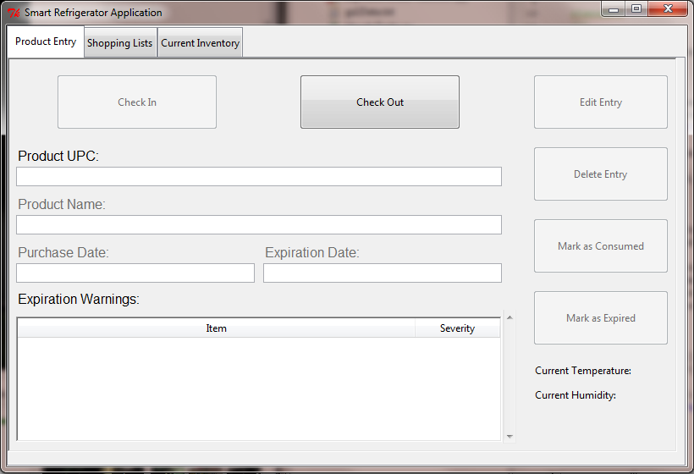
Smart Refrigerator
Steven Strapp, Dustin Stroup, Ben Reeves
RIT Computer Engineering Senior Design Project
Some big-picture background stuff here, such as operating environment, constraints, etc.
Basic description of project and its operation here.
The goal of this project is to develop and prototype a Smart Refrigerator system, which will monitor grocery items purchased by the user to reduce food waste and facilitate efficient shopping habits. Items are scanned in to the system using a bar code scanner, which automatically looks up UPC codes online or in an internal database. Items are stored with a purchase date and expected expiration date, and the user is warned when an item is nearing expiration. The system tracks buying habits and item purchase frequency, and suggests shopping lists based on this information. Users may also create their own shopping lists. All lists may be edited through the base station interface. A mobile application is also available, through which users can view current inventory and shopping lists. An included sensor monitors refrigerator temperature and displays that information on the base station application.
Below are some text templates that might be helpful.
Technologies Used
Heading
Beagleboard Xm Rev C
ULCD-7 Touch Screen
Digilent PmodTMP2 Temperature Sensor
Sparkfun Level Converter
Angstrom Linux – Custom Image - Kernel 3.0.2.8
Python 2.7
NumPy 1.4.1
Java 1.7
Android SDK (API 10)
This sentence is the first of a paragraph. This sentence is the second of a paragraph. This sentence is the third of a paragraph. This sentence is the fourth of a paragraph. This sentence is the fifth of a paragraph. This sentence is the sixth of a paragraph. This sentence is the seventh of a paragraph.
This sentence is the first of a paragraph. This sentence is the second of a paragraph. This sentence is the third of a paragraph. This sentence is the fourth of a paragraph. This sentence is the fifth of a paragraph. This sentence is the sixth of a paragraph. This sentence is the seventh of a paragraph.
This sentence is the first of a paragraph. This sentence is the second of a paragraph. This sentence is the third of a paragraph. This sentence is the fourth of a paragraph. This sentence is the fifth of a paragraph. This sentence is the sixth of a paragraph. This sentence is the seventh of a paragraph.
A list of bullet points follows.
Some project pictures here—(each picture, diagram, and table should be clearly labeled)
This is the main screen of the base station interface. From here, a user can check items in and out, as well as edit the item’s information. The tabs at the top allow access to the Shopping Lists and Current Inventory screens. From there, users can view, edit, and create shopping lists, and view all current inventory, respectively.
Point1
Point 2
Point 3
Brief summary

