Slide 1

Fairness‑Based Rewiring in the Prisoner’s Dilemma
Game‑theoretic discovery
September 24, 2025

Slide 2
Introduction
The Prisoner’s Dilemma captures the conflict between self‑interest and mutual cooperation.
Behavioural experiments show that fairness and contributions strongly influence cooperation【71034340793045†L204-L223】.
Adaptive networks allow players to switch partners, enabling cooperators to cluster and avoid exploitation【758520193555499†L218-L239】.
[1] [2]

Slide 3
Hypotheses
Agents sever unfair links to foster cooperation
Strict fairness (θ=0) yields rapid clustering but may fragment the network
Moderate thresholds (θ≈0.5–1.0) maximise stable cooperation
Lenient thresholds or no rewiring fail to deter exploiters
[2] [1]

Slide 4
Methods
Compute payoffs
Sum PD payoffs across neighbours
Fairness rewiring
Sever links when |ΔΠ| > θ and rewire
Strategy update
Imitate neighbour via Fermi rule
Simulation parameters
80 agents, Erdős–Rényi network (avg deg 4)
PD payoffs: R=1, S=0, T=1+u (u=0.5), P=u
Thresholds θ ∈ {0,0.5,1,2,5,∞}, α=5, 60 steps
[3] [2]

Slide 5
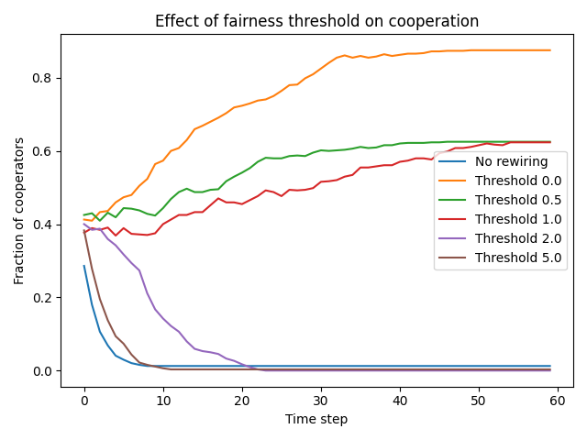
Results
Key findings
Strict fairness (θ=0) → ≈0.85 cooperation
Moderate (0.5–1.0) → ≈0.6 cooperation
Lenient (≥2) or no rewiring → collapse of cooperation
θ | ̅ρ_C
0 | 0.85
0.5 | 0.60
1.0 | 0.55
2.0 | 0.05
5.0 | 0.01
∞ | 0.01
[3] [2] [1]

Slide 6
Discussion & Conclusion
Fairness‑based rewiring fosters cooperation
Inequality aversion lets cooperators cluster and avoid exploiters
Moderate thresholds balance tolerance and punishment; extremes perform worse
Builds on adaptive network models and fairness preferences
Limitations: simple network and strategies; thresholds exogenous
Future work: heterogeneous norms and real social networks
[1] [2] [3]

