Slide 1
ThermoSolar
Netwrok Architecture
Notes:
Schneier Electrics - GTCI - Anup Lewis - 09/03/2008

Slide 2
Geographical and Network Architecture Using M340 Controller
Complete Solar field divided into many sector (e.g. Gemasolar 3 sector)
Sector division mostly based on electrical cabling to power –up the device connected to the network not the network bandwidth
Each sector have 8 to 10 network Ring called secondary ring which is again connected by L3 router to network called Primary ring
Each ring Identified by network ID ( e.g. ID= 192.168.x.0, Subnet 255.255.255.0)
Each ring consist of 128 max heliostats ( Limitation on NOE who can not serve more than 128 Dynamic IP)
In Gemasolar there are 2650 heliostats divided in to 3 sector
  Sector-1 = 900 heliostats
  Sector-2 = 900 heliostats
  Sector-3 = 850 holiostats
Each heliostat “monitored and controlled by” individual M340 Controller

Slide 3
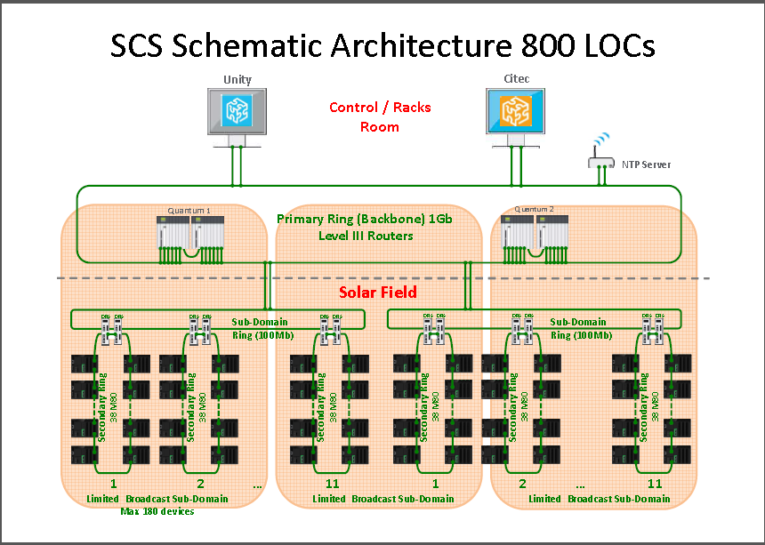
Network Architecture Using Mx80 Controller

Slide 4
Network Architecture Using MX80 Controller
Complete Solar field divided into many sector
Each sector have many subnet
Each Subnet have many RSTP ring ( 1to 11)
Each ring can have max 38 Mx80 device. Ring size limitation is based on RSTP performance ( more then 40 device in a ring Mx80 does not meet the requiered performance)

Slide 5
Subnet information for Gemasolar Plant
Ring | Network | Subnet mask | GATEWAY | SWITCHES | Heliostats
N01 | 192.168.11.0 | 255.255.255.0 | 192.168.11.254 | 24 | 109
N02 | 192.168.12.0 | 255.255.255.0 | 192.168.12.254 | 26 | 119
N03 | 192.168.13.0 | 255.255.255.0 | 192.168.13.254 | 24 | 105
N04 | 192.168.14.0 | 255.255.255.0 | 192.168.14.254 | 30 | 105
N05 | 192.168.15.0 | 255.255.255.0 | 192.168.15.254 | 29 | 124
N06 | 192.168.16.0 | 255.255.255.0 | 192.168.16.254 | 24 | 106
N07 | 192.168.17.0 | 255.255.255.0 | 192.168.17.254 | 24 | 113
N08 | 192.168.18.0 | 255.255.255.0 | 192.168.18.254 | 15 | 69
E01 | 192.168.19.0 | 255.255.255.0 | 192.168.19.254 | 23 | 105
E02 | 192.168.20.0 | 255.255.255.0 | 192.168.20.254 | 25 | 119
E03 | 192.168.21.0 | 255.255.255.0 | 192.168.21.254 | 24 | 106
E04 | 192.168.22.0 | 255.255.255.0 | 192.168.22.254 | 24 | 106
E05 | 192.168.23.0 | 255.255.255.0 | 192.168.23.254 | 24 | 106
E06 | 192.168.24.0 | 255.255.255.0 | 192.168.24.254 | 33 | 106
E07 | 192.168.25.0 | 255.255.255.0 | 192.168.25.254 | 19 | 73
E08 | 192.168.26.0 | 255.255.255.0 | 192.168.26.254 | 15 | 71
E09 | 192.168.27.0 | 255.255.255.0 | 192.168.27.254 | 23 | 108
O01 | 192.168.28.0 | 255.255.255.0 | 192.168.28.254 | 23 | 105
O02 | 192.168.29.0 | 255.255.255.0 | 192.168.29.254 | 25 | 119
O03 | 192.168.30.0 | 255.255.255.0 | 192.168.30.254 | 24 | 106
O04 | 192.168.31.0 | 255.255.255.0 | 192.168.31.254 | 24 | 106
O05 | 192.168.32.0 | 255.255.255.0 | 192.168.32.254 | 24 | 106
O06 | 192.168.33.0 | 255.255.255.0 | 192.168.33.254 | 33 | 106
O07 | 192.168.34.0 | 255.255.255.0 | 192.168.34.254 | 19 | 73
O08 | 192.168.35.0 | 255.255.255.0 | 192.168.35.254 | 15 | 71
O09 | 192.168.36.0 | 255.255.255.0 | 192.168.36.254 | 23 | 108

Slide 6
SGBackup download
Considure one ring @ a time
Single device @ a time
Takes Aprox 30 min to complete single ring
Have simultanieous download ( Supported 50 device) but 1 ring @ a time. Limitation is based on PC resources not Network bandwidth.
With 50 device simmultenious consume only Aprx-13% of network bandwidth
Download time increases proposnataly as number of device added more to simmulteniously
With 1 device at a time takes Aprox 30 Min to complete one ring of 128 device where as with 50 device at a time takes Aprx 50 Min to complete same ring

Slide 7
SGBackup download Cont...
UMAS and Modbus command to read the application version for Backup solution

Slide 8
Questions ?
How Broadcast and multicast traffic managed between the network
  Broadcast ristricted by dividing subnet of entry network. In this case router block the broadcast packet coming out from the subnet
Does Multicast filtering enabled
  Not used in existing solution- no device uses multicast IP to communicate within the network
  Router have capabilities of IGMP V3 to filter the multicast packets
  Switch as well have capabilites of IGMP snooping
  Mx80 does not have multicast filtering capabilities

