Slide 1
MSU Integration with 1 FW Tool
March 2014
Pawan Modi

Slide 2
Services
Architecture Layers, shows where and how MSU fits in FW Tool
Services
High Level Services
Mapping
Protocol
Mapping
Protocol
Mapping
Protocol
Mapping
Protocol
Mapping
LAYERS
Low Level Services
EtherNet / IP
FTP (S)
Modbus TCP
MSU
TCP / IP
USB
UDP/IP
UART, USB , CAN...
Transport

Slide 3
Layer view for MSU server (tool) and MSU Client (device) implementation
Tool
Device
API
High level Services
FW Installer
Platform specific
Mapping
To MSU
Packet Processor
MSU
Protocol Stack
MSU-UDP/IP
Protocol Stack
MSU -UDP
Transport Protocol: UDP

Slide 4
Common/Overlap feature
Scan netwrok – Both case need to scan complet N/W
Device selection – in this case multiple device
File selection – Both case the single file

Slide 5
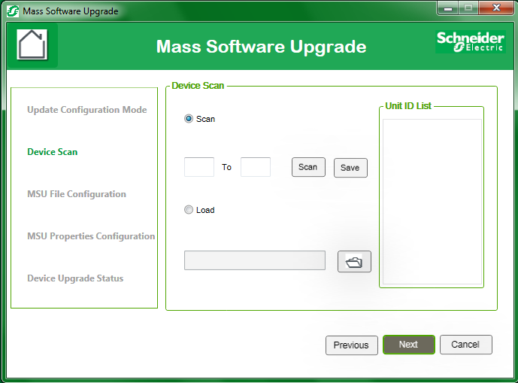
MSU Server Tool

Slide 6
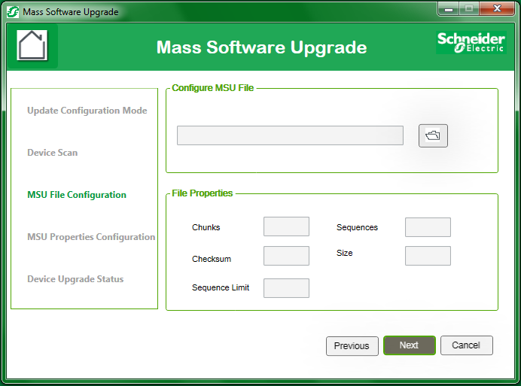
MSU Server Tool

