Slide 1


Processing real time AIS messages and integrating with third party geo data using Sesam
Tom Bech
Sesam product developer
tom.bech@sesam.io

Slide 2
Background & motivation
Read interesting Norwegian Digi article about Gov’t opening up “AIS” real time ship traffic data to the general public
Disappointed to learn data not really open, article turn out to be about a web map applicaton
Public data only available as socket with binary “raw” data (full access to “proper data” still subject to application & approval)

Slide 3
AIS 101
AIS = Automatic Identification System
UN standard (IEC 62320-1)
Used world-wide for maritime traffic

Slide 4
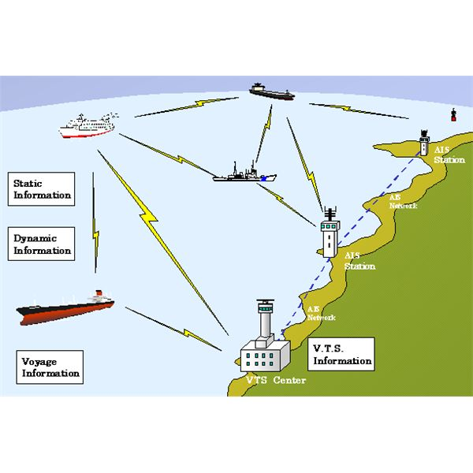
Real time messages from ships
  ID, name and callsigns
  Position updates, speed, bearing, status
  Emergencies
  Cargo information & destination
  Metadata; type, size

Slide 5
AIS con’t
Messages broadcast, rebroadcast
Over-the-horizon media: VHF/UHF, satellites
  Radar limited to visible range
Picked up by transponders
  Stations on land - i.e. basestations
  Satelittes
All larger vessels in world have AIS equipment
Many leisure boats as well

Slide 6
AIS in Norway
“Kystverket” owns and operates
  50 base stations along the coast
  Two satellites in polar orbit
Infrastructure to process and analyze AIS data
  Rebroadcasts AIS messages on the internet
  ~30-100 messages/sec

Slide 7
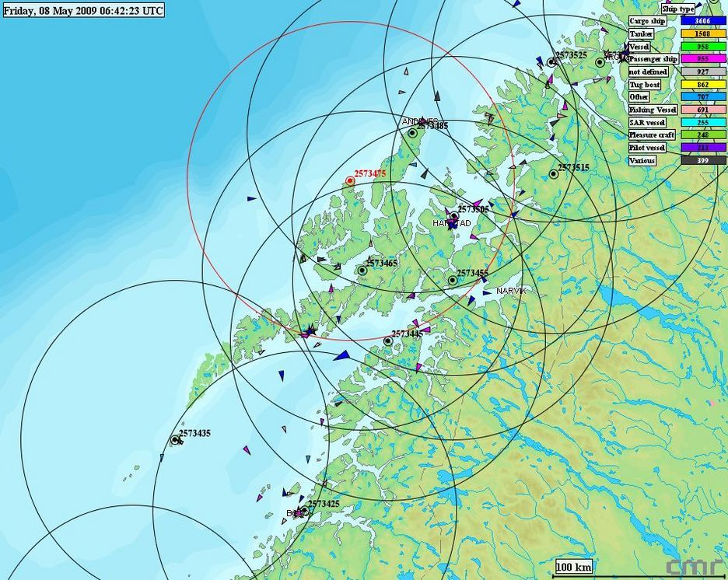

Slide 9
The Challenge!
Want to use AIS data + a search engine to do geo-queries like:
  Which ships are near “Bergen”?
  How many cargo ships are in Norwegian waters today?
  Which ships are nearest vs another ship?
  How many fishing boats are active near Lofoten at the moment?
Additional challenge: from scratch - and in one day!

Slide 10
Programmer: Ooh. Very cool task, but pretty ambitious! Can I use Sesam as the integration platform?
Boss: Sure, use whatever tools you think is best for the job
Challenge accepted!

Slide 11
What is Sesam?
Sesam is an integration platform
Employs a Data Oriented Architecture (DOA) to make integration more manageable, scalable, powerful, expressive and agile
Everything is data and everything is explicit
  Including configuration, logging etc
A datahub as a central component
  Schema-less data store that consumes or is fed the data from the systems that are to be integrated
  Solves the “cache-invalidation” problem in integration context
  Push&pull source/transformation/sink + microservices = Pipe
  Pipe+Pipe=Flow
  Extensive REST API + command line client + GUI

Slide 12

So..
Learn/research about AIS
Consume AIS data into Sesam somehow - write microservice?
Integrate AIS data with third party data (geolocated places) and compute nearest - another microservice?
Learn/research Elasticsearch
Insert result and changes into Elasticsearch
Figure how to do the queries
Profit!
..

Slide 13

Starting point
http://www.kystverket.no/Nyheter/2016/september/apner-ais-for-publikum
A subpage mentions a AIS socket (IP+port)
Tested it in Firefox. Got:
!BSVDM,1,1,,B,H3m<Od4N>F34u5K<=ojjn00H8220,0*73
!BSVDM,1,1,,A,35UeSP5000Puj;>V<B`;02mV0000,0*0F
!BSVDM,1,1,,A,13mM0u00001FlEdWnhUuL:OT0@NW,0*17
!BSVDM,2,1,1,A,53mN1J400000hluB2218E<=DF0T@5:1Di=@DTr0k0p?154rdR2fLMevMeN88,0*73
!BSVDM,2,2,1,A,88888888880,2*3C
..

Slide 14





The familiar first two hours

Slide 15
First round results
An understanding of what AIS is in more detail
Found docs for AIS spec in codemonkey-grokkable form:
  http://catb.org/gpsd/AIVDM.html
Found python lib for decoding AIS messages:
  https://github.com/schwehr/libais
Norwegian places with geo coords:
  http://www.erikbolstad.no/geo/noreg/postnummer
Nearest point search and geo calculus:
  https://en.wikipedia.org/wiki/K-d_tree
  https://en.wikipedia.org/wiki/Haversine_formula
  https://en.wikipedia.org/wiki/Vincenty%27s_formulae

Slide 16


Third and fourth hour
Forked Sesam Python Microservice template on Github + wrote Python code to read and decode AIS stream using “libais”
The usual loop; make stupid error. Fix it. Rinse & repeat.
Configured JSON endpoint in Sesam & posted first AIS data to Sesam

Slide 17
AIS MicroService Code
# Open socket to AIS service
s = socket.socket(socket.AF_INET, socket.SOCK_STREAM)
s.connect((options.ais_server, int(options.ais_port)))
f = s.makefile()
with requests.session() as session:
# This loop will not end as long as the socket is open
for msg in ais.stream.decode(f):
message = ais.compatibility.gpsd.mangle(msg)
message["_id"] = "%s_%s" % (message["type"], message["mmsi"])
json_data = json.dumps(message)
resp = session.post(url, params={}, headers={"content-type": "application/json"},
data=json_data, verify=False, timeout=3600)
resp.raise_for_status()
resp.close()

Slide 18
Sesam receiver conf
This pipe will set up a JSON receiver so we can use HTTP POST operations at
http://sesamservice:port/api/receivers/ais_data/entitites
{
"_id": "ais_data",
"type": "pipe",
"source": {
"type": "http_endpoint"
}
}

Slide 19
AIS messages
{
"maneuver": 0,
"received_stations": 29,
"slot_timeout": 3,
"status": 0,
"second": 31,
"class": "AIS",
"scaled": True,
"course": 0,
"raim": True,
"type": 1,
"lat": 62.6781005859375,
"spare": 0,
"sync_state": 0,
"device": "stdin",
"repeat": 0,
"lon": 6.669294834136963,
"speed": 0,
"accuracy": True,
"status_text": "Under way using engine",
"turn": NaN,
"heading": 511,
"mmsi": 257389600
}
{
"type": 24,
"device": "stdin",
"repeat": 0,
"shipname": "AAS KYSTSERVICE",
"mmsi": 257389600,
"class": "AIS",
"scaled": true,
"part_num": 0
}
Message type
Unique ship ID

Slide 20
Message deduplication
AIS feed contain LOTS of duplicates (10:1)
  Rebroadcasts + captured by multiple transponders
  Static non-changing/repeating messages
  Noise in data
Sesam deduplicates automatically using hashing if given a unique entity ID
  ID for message = MMSI + type
Sesam keeps history of changes
  Track ship positions over time!

Slide 21
Hours 4 and 5
Splitting on message type
Split static and dynamic messages on type
Positional updates
  AIS types 1-3 & 18-19
Static metadata
  Type 5 & 24
  These may be multipart messages!

Slide 22
Pipes and DTL
Deduplicated AIS data from initial dataset piped to various new datasets based on type
  Positional messages
  Static data -> part A and B
  Ship metadata from multipart messages (A U B)
  Positional data enriched with nearest city info
  Ship info with last known location
  Final flow is outbound, i.e. Elasticsearch sink

Slide 23
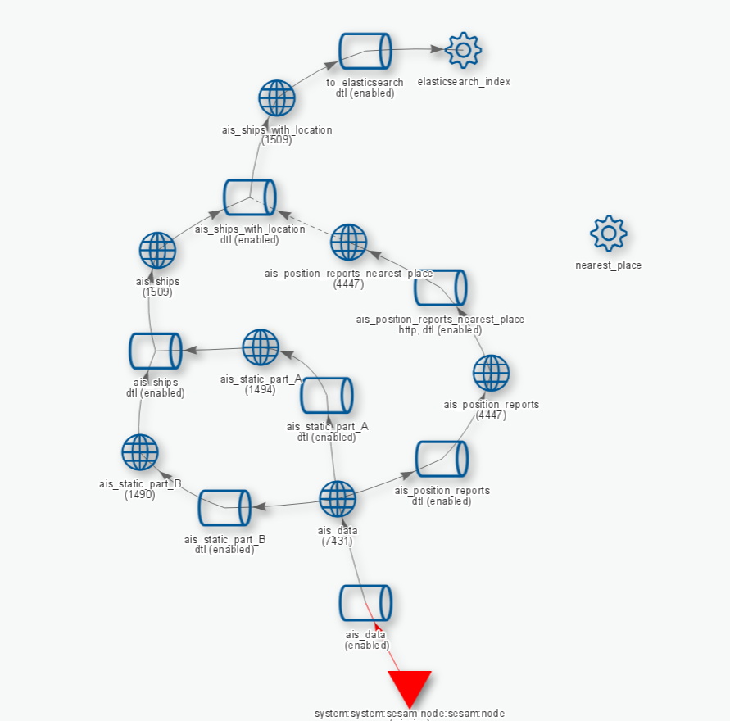
Flow diagram

Slide 24
DTL transform for filtering on type
{
"_id": "ais_position_reports",
"type": "pipe",
"source": {
"type": "dataset",
"dataset": "ais_data"
},
"transform": [
{
"type": "dtl",
"name": "Filter out all but position reports (type 1-3 and 18-19)",
"dataset": "ais_data",
"transforms": {
"default": [
["filter", ["or",
["eq", "_S.type", 1],
["eq", "_S.type", 2],
["eq", "_S.type", 3],
["eq", "_S.type", 18],
["eq", "_S.type", 19]]
],
["copy", "*"]
]
}
}]
}

Slide 25
Hours 6 and 7
Nearest city microservice
Sesam Python HTTP transform microservice template from github
Inserts places into a KD-tree (BSP) on startup

Slide 26
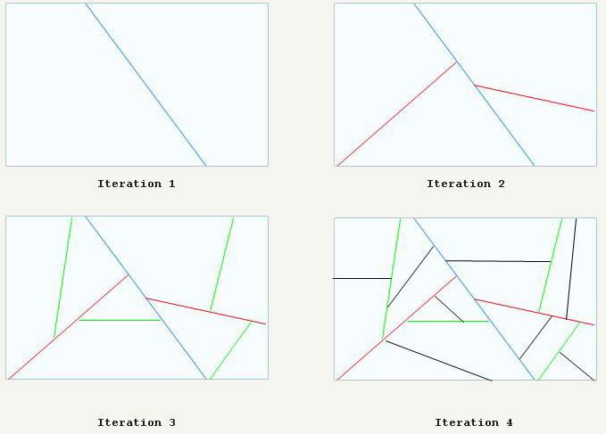

Slide 27
Nearest city microservice
Given a set of entities, searches KD-tree for nearest city and inserts into entity
Computes bearing and distance to city using Haversine- and Vincenty formula
The enriched entity is returned to Sesam in response (JSON)

Slide 28
$ curl -s -XPOST 'http://localhost:5001/transform' -H "Content-type: application/json" -d '[{ "_id": "jane", "name": "Jane Doe", "lat": 58.995903, "lon": 10.082722}]' | jq -S .
[
{
"_id": "jane",
"lat": 58.995903,
"lon": 10.082722,
"name": "Jane Doe",
"nearest_place": {
"bearing": 170.2446453605429,
"direction": "SSE",
"distance": 3963.305464313277,
"lat": 59.030966,
"lon": 10.071019,
"name": "Larvik",
"postal_code": "3260"
}
}
]
Original entity
Added data

Slide 29
8 hour: Elasticsearch
Googled how to run Elasticsearch:
docker pull elasticsearch
docker run --name elasticsearch -p 9200:9200 -p 9300:9300 -d elasticsearch
Googled how to configure a Elasticsearch index and wrote a schema for my entities

Slide 30
{
"mappings": {
"ship": {
"properties": {
"mmsi": {"type": "integer"},
"callsign": {"type": "string"},
"shipname": {"type": "string"},
"length": {"type": "integer"},
"width": {"type": "integer"},
"position": {"type": "string"},
"when": {"type": "date"},
"vendor_id": {"type": "string"},
"url": {"type": "string"},
"location": {"type": "geo_point"}
}
}
}
} => ships.json
curl -XPUT http://<elasticsearch-ipaddress-here>:9200/ships @ships.json

Slide 31
Sesam Elasticsearch pipe
{
"_id": "elasticsearch_index",
"type": "system:elasticsearch",
"hosts": ["172.17.0.2:9200"]
},
{
"_id": "to_elasticsearch",
"type": "pipe",
"source": {
"type": "dataset",
"dataset": "ais_ships_with_location"
},
"sink": {
"type": "elasticsearch",
"system": "elasticsearch_index",
"default_index": "ships",
"default_type": "ship"
}
}

Slide 32

A sprinkle of DTL
I also added a bit of DTL to massage the data slightly on the way out

Slide 33
"transform": [
{
"type": "dtl",
"name": "Transform to elasticsearch document",
"dataset": "ais_ships_with_location",
"transforms": {
"default": [
["copy", "_id"],
["copy", "mmsi"],
["add", "length", ["+", "_S.to_stern", "_S.to_bow"]],
["add", "width", ["+", "_S.to_port", "_S.to_starboard"]],
["copy", "vendor_id"],
["copy", "callsign"],
["copy", "shipname"],
["copy", "url"],
["rename", "status_text", "status"],
["rename", "shiptype_text", "shiptype"],
["merge", ["apply", "apply-last-seen", "_S.last-seen-at"]]
],
"apply-last-seen": [
["copy", "*"],
["add", "location", ["dict", ["list",
["list", "lat", "_S.lat"],
["list", "lon", "_S.lon"]]
]],
["remove", "lat"],
["remove", "lon"]
]
}
}]

Slide 34
Moment of truth – queries!
Ships near Bergen?
  curl -XGET 'http://172.17.0.2:9200/ships/ship/_search?q=position:bergen*&pretty=true
Fishingboats near Leknes (in Lofoten islands, northern Norway):
  curl -XGET 'http://172.17.0.2:9200/ships/ship/_search?q=position:leknes*%20AND%20shiptype:fishing*&pretty=true
All ships named something with "viking":
  curl -XGET 'http://172.17.0.2:9200/ships/ship/_search?q=shipname:viking*&pretty=true

Slide 35
Ships near a specific position
{
"sort" : [
{
"_geo_distance" : {
"location" : {
"lat" : 59.902006,
"lon" : 10.718077
},
"order" : "asc",
"unit" : "km"
}
}
],
"query": {
"filtered" : {
"query" : {
"match_all" : {}
},
"filter" : {
"geo_distance" : {
"distance" : "5km",
"location" : {
"lat" : 59.902006,
"lon" : 10.718077
}
}
}
}
}
}

Slide 36

Success!
Using Sesam, I was able to create a working (PoC) AIS solution
- in a single day! :)
(Well, technically over one afternoon and subsequent morning – but in sum 8 hours. honest!)

Slide 37
Show me the code!
All code and full blog article
https://github.com/sesam-io/ais-integration
Sign up for & download the Sesam appliance: https://beta.sesam.in/

