Slide 1



Cloud Development of QuickCheck™
Sesario Imanputra | B.S. Computer Science and Engineering | Autumn 2020 | Faculty: Dr. William Erdly, School of STEM
Notes:
Title card

Slide 2
Educating Young Eyes (EYE) is an organization that develops QuickCheck™,
a mobile application, which screens, evaluates, and intervenes vision dysfunctions in an affordable manner.
QuickCheck™
Notes:
Title card

Slide 3
Purpose
To ensure that backend services support alpha version of QuickCheck™
Problem
Server-side systems are not connecting to client systems
Backend services can be slow or disruptive
Lack of comprehensive documentations
Overview
Goal
To ensure that server-side systems can connect to client systems or other relevant systems
To guarantee fast response times between messages sent from client to server-side systems
To create quality documentations that describe the software architecture of backend services and their interaction with client systems
Notes:
Overview
Educating Young Eyes (EYE) is an organization that develops ubiquitous software as a service to screen, evaluate, and intervene vision dysfunctions in an affordable manner.
Purpose
To ensure that backend services support alpha version of EYE software
Problem
Server-side systems are not connecting to client systems
Backend services can be slow or disruptive.
Lack of comprehensive documentations
Goal
To ensure that server-side systems can connect to client systems or other relevant systems
To guarantee fast response times between messages sent from client to server-side systems
To create quality documentations that describe the software architecture of backend services and their interaction with client systems

Slide 4

Infrastructure as a Service
Software Development Lifecycle
Maintenance
Requirement Gathering
Analysis
Design
Implement
Testing
IaaS
Used to create development and testing environments.
Applied to meet new server-side requirements
Methods
REST API Design
Software Architecture Document
Employed to design API calls that uses sorting, filtering, searching, and pagination.
Used to illustrate backend infrastructure for various stakeholders.

Slide 5






Tools
Notes:
Tools
Mysql
PhpMyAdmin
NodeJS
AWS
Github
Postman
jmeter

Slide 6
Relevant Courses
CSS480 Database Systems (Autumn 2019)
CSS490 Distributed Systems (Summer 2020)
CSS310 Cyber Security (Autumn 2020)
CSS436 Cloud Computing (Autumn 2020)
Notes:
Helpful Courses
CSS310 Cyber Security
CSS436 Cloud Computing
CSS480 Database
CSS490 Distributed Systems

Slide 7
Tasks and Challenges
C1
\
Developing with Existing AWS Resources
Exporting and Importing EC2
Updating EC2 and RDS Certification
C2
C3
\
\
Designing API’s For Client-side
Debugging NodeJS Services
Extremely slow client-side autocorrect feature
Debugging Existing and Complex APIs
Creating Logs for APIs
Notes:
Challenges
Working with EC2 and RDS and their existing resources
Jumping from one to another
Updating certs
Developing/ Debugging services in NodeJS
Logging
Existing APIs
Designing API’s client and server side.
Negative aspect to API

Slide 8
Developing with Existing AWS Resources
Debugging NodeJS Services
Exporting/Importing EC2
Exporting
And Importing EC2
Updating EC2 Certification
Updating EC2 Certification
Solutions
S1-C1/C2/C3
S2-C2
\
Communicating with Team Members
Understanding CloudWatch
Provided insight on the history of API behavior from a Client–Side perspective
Examined Resource Bottlenecks
Disk Bottlenecks
Network Bottlenecks
Provided a comprehensive guide on how current resources are used
Memory Bottlenecks
S3-C1/C3
S4-C3
Trial and Error
Load and Stress Testing
Deployed NodeJS services for testing
Tested the limits of the current backend infrastructure
Reading implemented NodeJS code
Disk Bottlenecks
Reading Development Process of NodeJS services
Notes:
Solution
S1-C1-C2-C3.Communicating with team members
S2-C1.Understanding AWS logs
I/O bottlenecks
Network bottlenecks
S3-C3.trial and error, Reading the code, documentation, and deploying locally for testing
S4-C3.Lots of load and stress testing to understand response time behaviors

Slide 9
Results
Figure 1: AWS Infrastructure
Notes:
Show relationship with quickcheck
Sequence diagram
Explain final api results and how you got there
graphs
Current infrastructure
Aws diagram

Slide 10
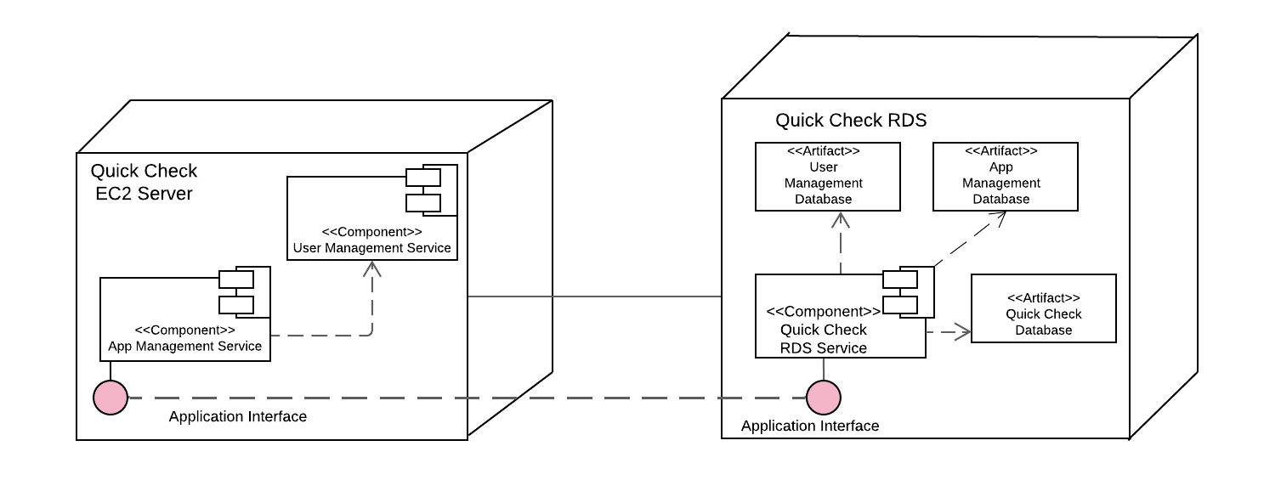
Results
Figure 2: Component View
Notes:
Show relationship with quickcheck
Sequence diagram
Explain final api results and how you got there
graphs
Current infrastructure
Aws diagram

Slide 11
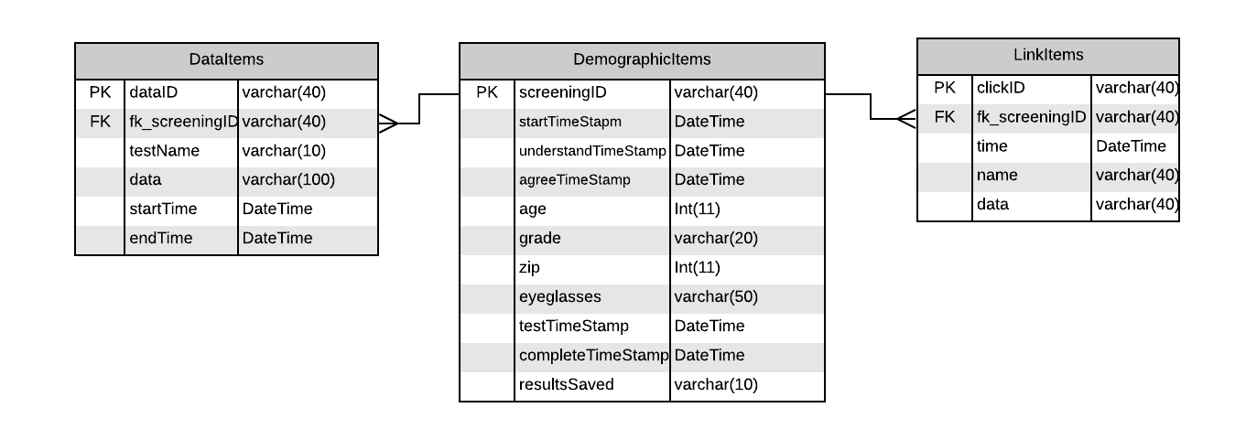
Results
Figure 3: Entity Relationships Diagram
Notes:
Show relationship with quickcheck
Sequence diagram
Explain final api results and how you got there
graphs
Current infrastructure
Aws diagram

Slide 12
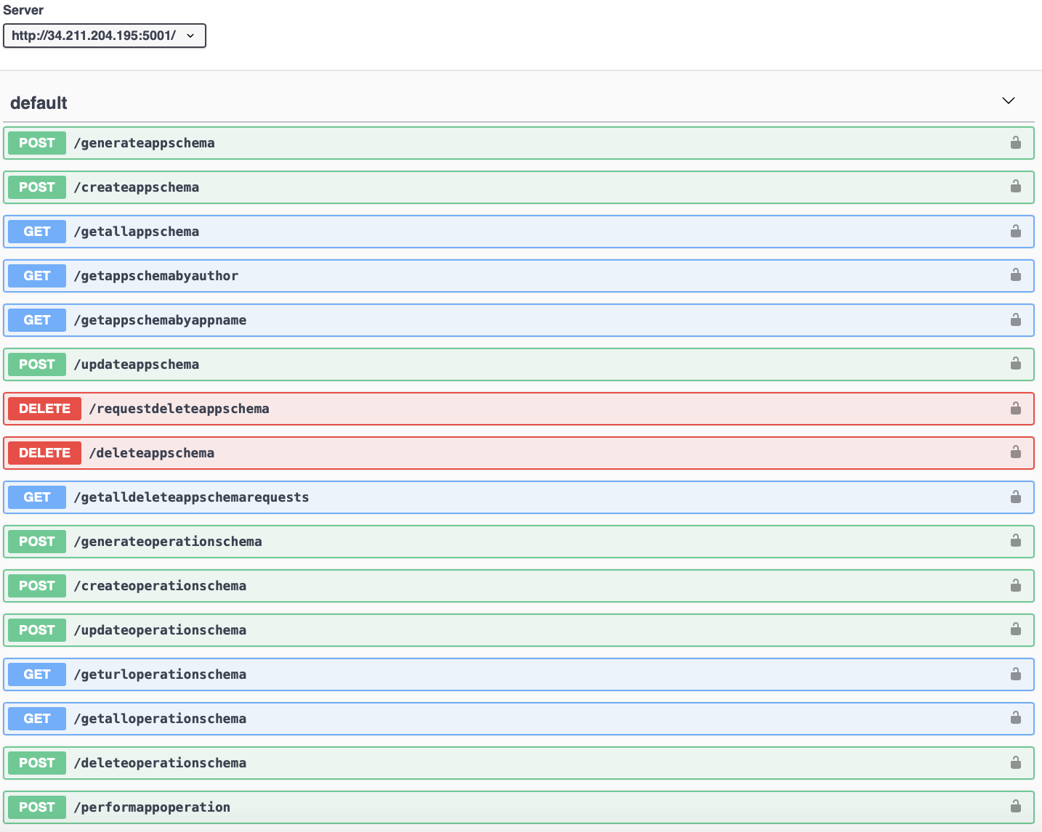
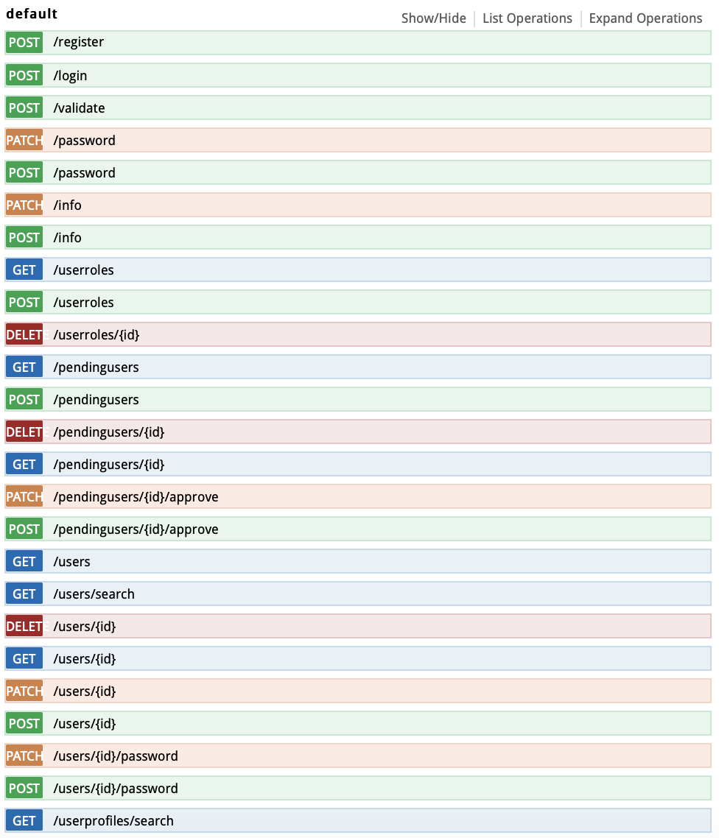
Results
Figure 4: User Management Service
Figure 5: App Management Service
Notes:
Show relationship with quickcheck
Sequence diagram
Explain final api results and how you got there
graphs
Current infrastructure
Aws diagram

Slide 13
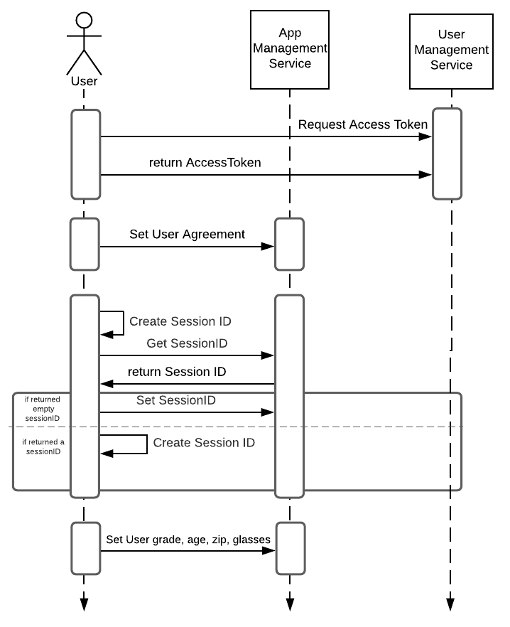
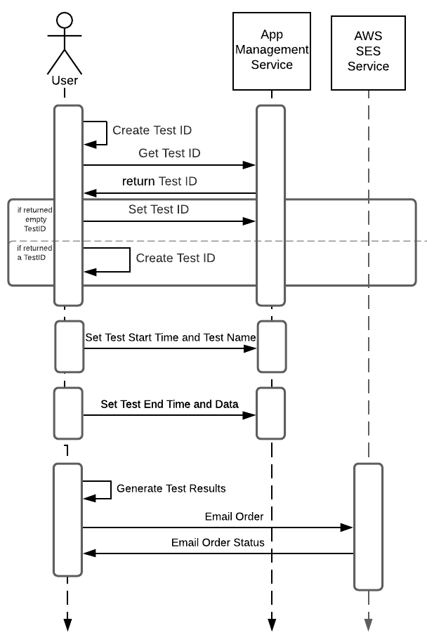
Results
Figure 6: Backend Interaction with QuickCheck (Sample from Documentation)
Notes:
Show relationship with quickcheck
Sequence diagram
Explain final api results and how you got there
graphs
Current infrastructure
Aws diagram

Slide 14
Results
Figure 7: QuickCheck API Catalogue and Performance
Notes:
Asynchronous implementation
Walk down through the code
Add notes on the hci guy

Slide 15



Achieved alpha phase and are ready for internal testing
Certifying HIPAA compliance and scaling becomes the next obstacle of backend progress
Conclusion
New team members will learn, adapt, and iterate the backend efficiently with the quality of documentations created.
Notes:
Overview
Educating Young Eyes (EYE) is an organization that develops ubiquitous software as a service to screen, evaluate, and intervene vision dysfunctions in an affordable manner.
Purpose
To ensure that backend services support alpha version of EYE software
Problem
Server-side systems are not connecting to client systems
Backend services can be slow or disruptive.
Lack of comprehensive documentations
Goal
To ensure that server-side systems can connect to client systems or other relevant systems
To guarantee fast response times between messages sent from client to server-side systems
To create quality documentations that describe the software architecture of backend services and their interaction with client systems

Slide 16




Business Aspect of Development
Server-Side Development
Accommodating AWS billing to business needs
Learned to develop and deploy backend services with new languages and concepts
Reflection
Interpersonal Flexibility
First-Hand Learning
Adapting communication styles to gain credibility with others
Experienced First-Hand Learning on:
Networking, Cloud Computing (AWS), and Cyber-Security

Slide 17
Acknowledgements
Dr. Erdly for granting me the opportunity to work on this innovative project.
Dr. Pearson for sharing his vision of applying new technology to advance modern optometric practices.
Past and current iterations of the EYE team for working with me throughout the year.

Slide 18
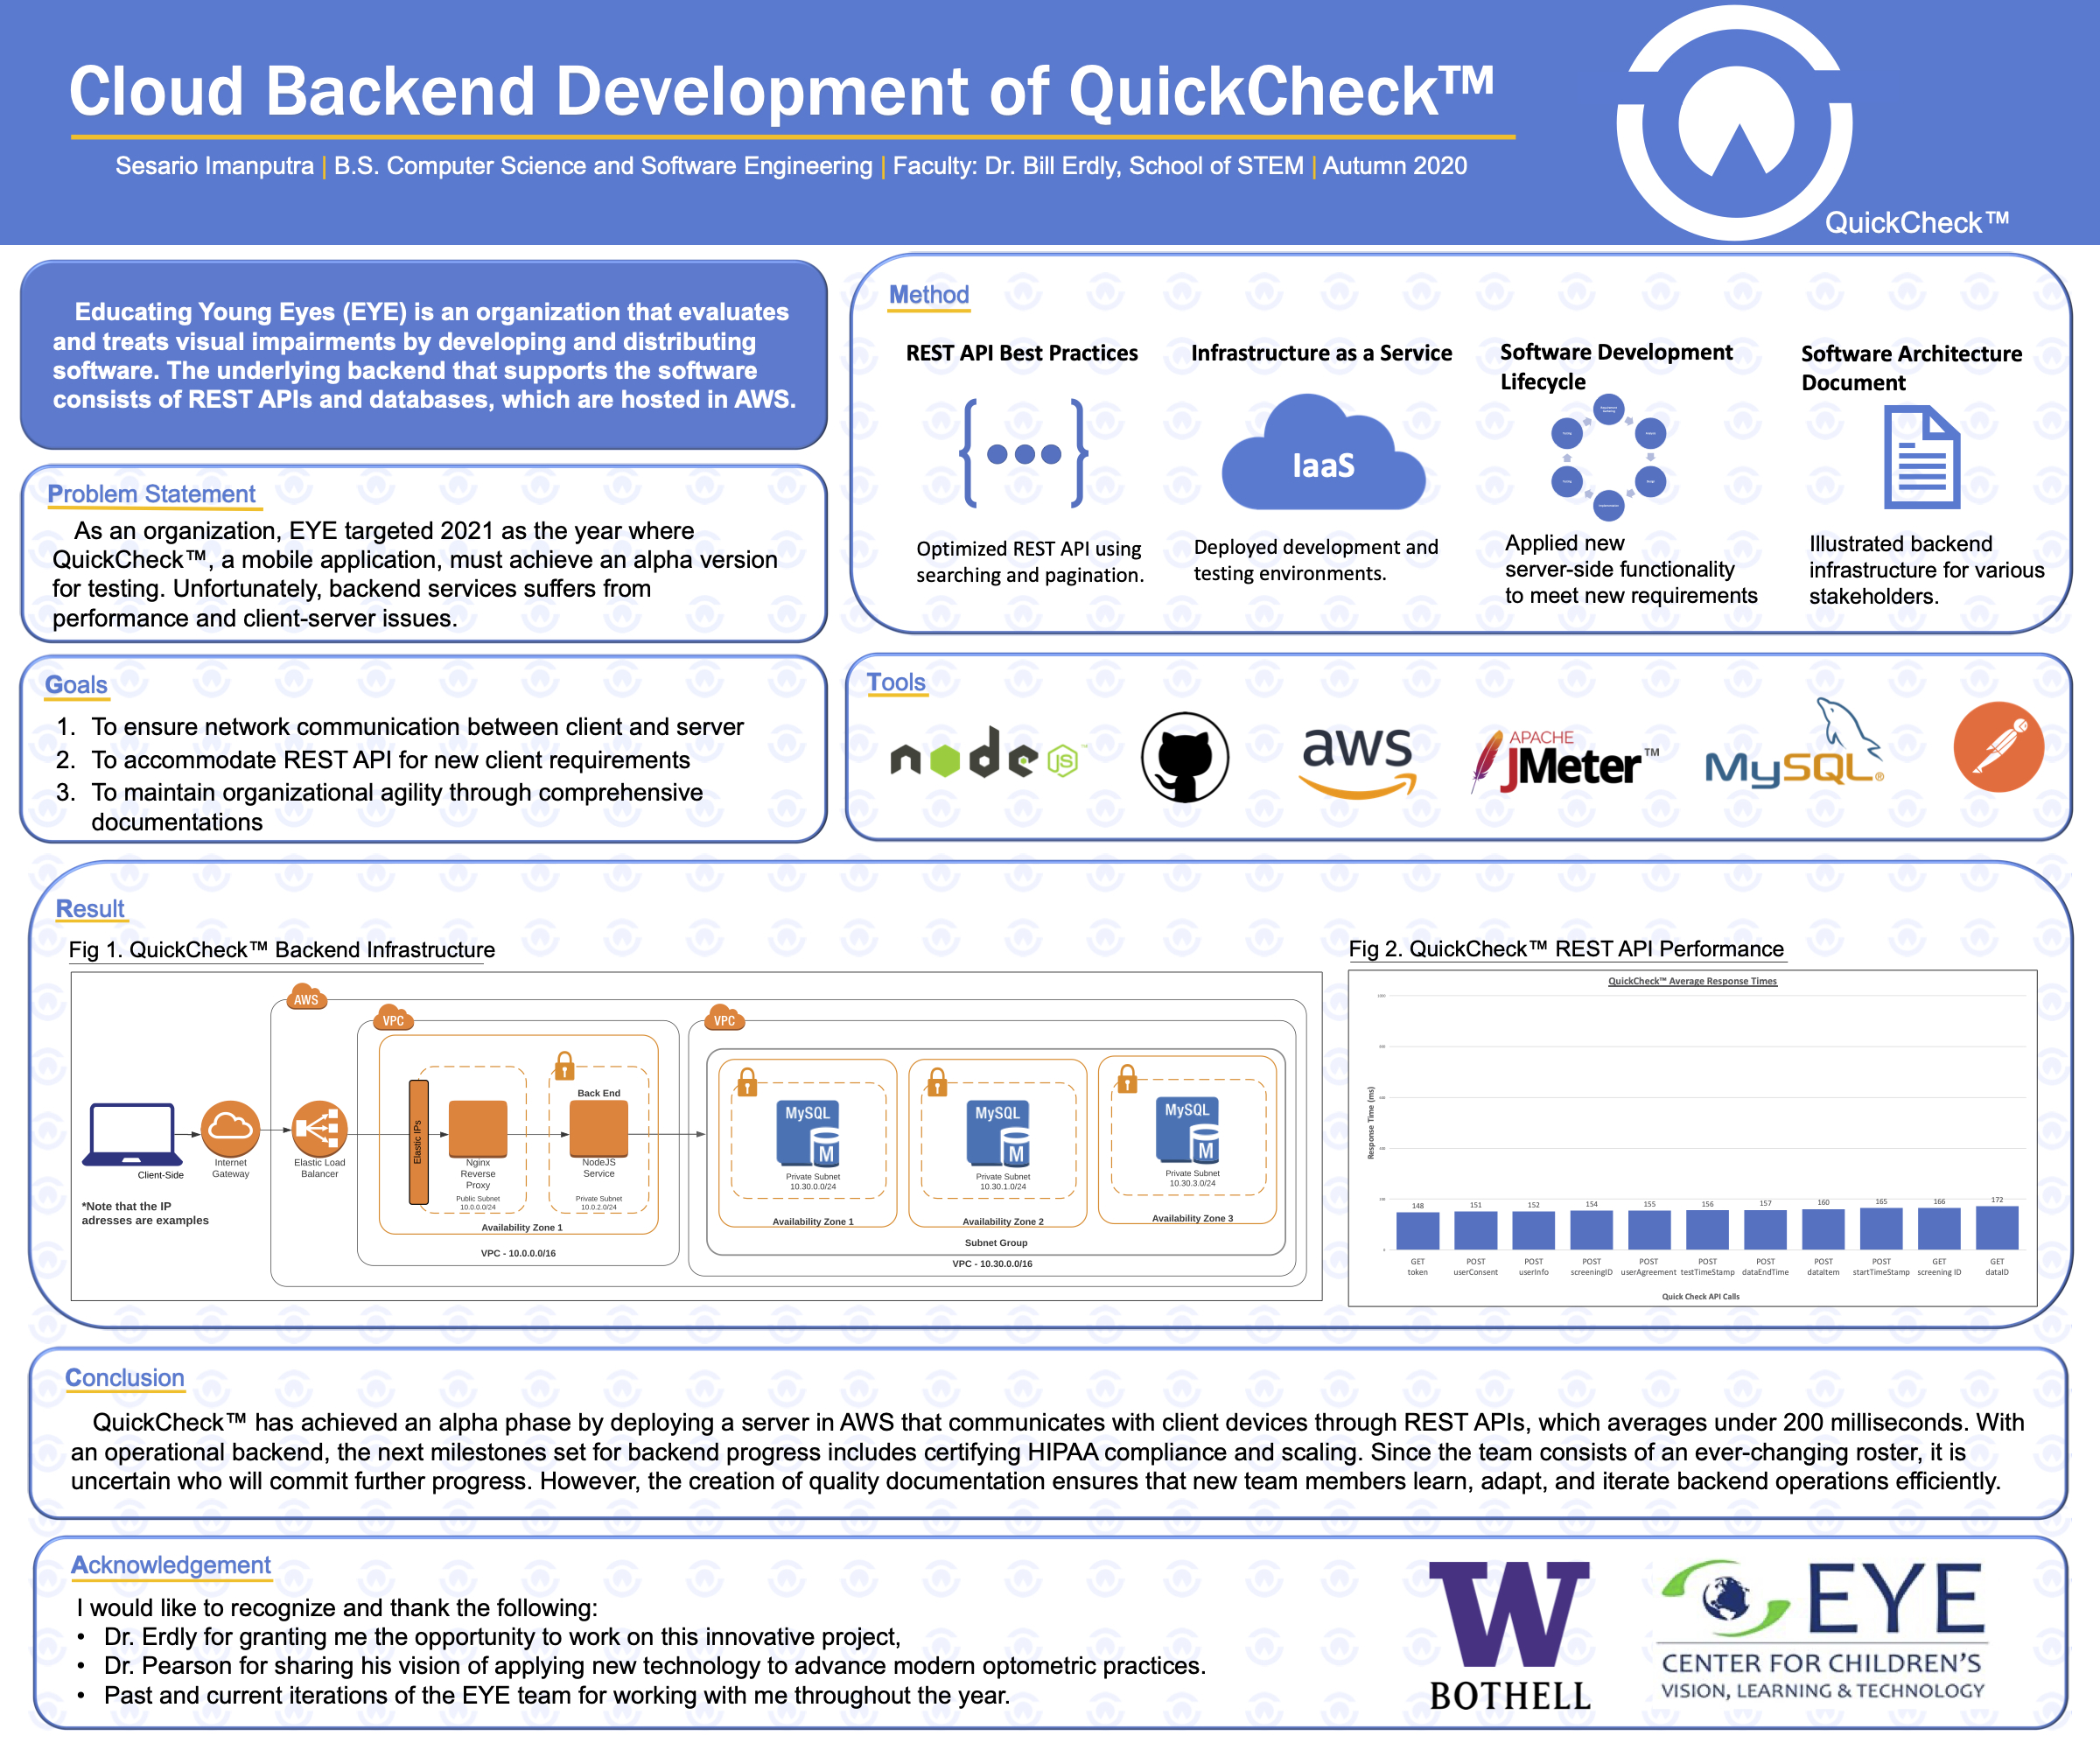

Slide 19
Q & A

