Slide 1
Identifying Individual Travel Activities with Spatiotemporal Movement Patterns and Geographic Context from GPS Trajectories for Alcohol Relapse Risk Monitoring
Xinyi Liu
Alcohol Lapse Risk Project Manuscript Discussion

Slide 2
Outline
Introduction
Related work
Methods
Case study
Conclusion & Future work

Slide 3
Outline
Introduction
Related work
Methods
Case study
Datasets
Results
Conclusion & Future work

Slide 4
Introduction
Individual daily travel activity identification
Provides semantic meaning of individual travel mobilities
Necessary for analyzing high-level travel activity patterns
E.g., working on weekday mornings

Slide 5
Introduction
Individual daily travel activity identification
Provides semantic meaning of individual travel mobilities
Necessary for analyzing high-level travel activity patterns
E.g., working on weekday mornings
Provides innovative signals as contextual information to predict risks of alcohol addicts’ drinking relapse

Slide 6
Introduction
Individual daily travel activity identification
Provides semantic meaning of individual travel mobilities
Necessary for analyzing high-level travel activity patterns
E.g., working on weekday mornings
Provides innovative signals as contextual information to predict risks of alcohol addicts’ drinking relapse
Detect alcohol use activities (e.g., visiting a bar)
Monitor changes of daily travel activity patterns (e.g., longer time spending at workplaces)

Slide 7
Introduction
Individual daily travel activity identification
Provides semantic meaning of individual travel mobilities
Necessary for analyzing high-level travel activity patterns
Provides innovative signals as contextual information to predict risks of alcohol addicts’ drinking relapse
Data sources
Travel surveys
Ubiquitous GPS enabled devices/applications
E.g., mobile phones, social media platforms

Slide 8
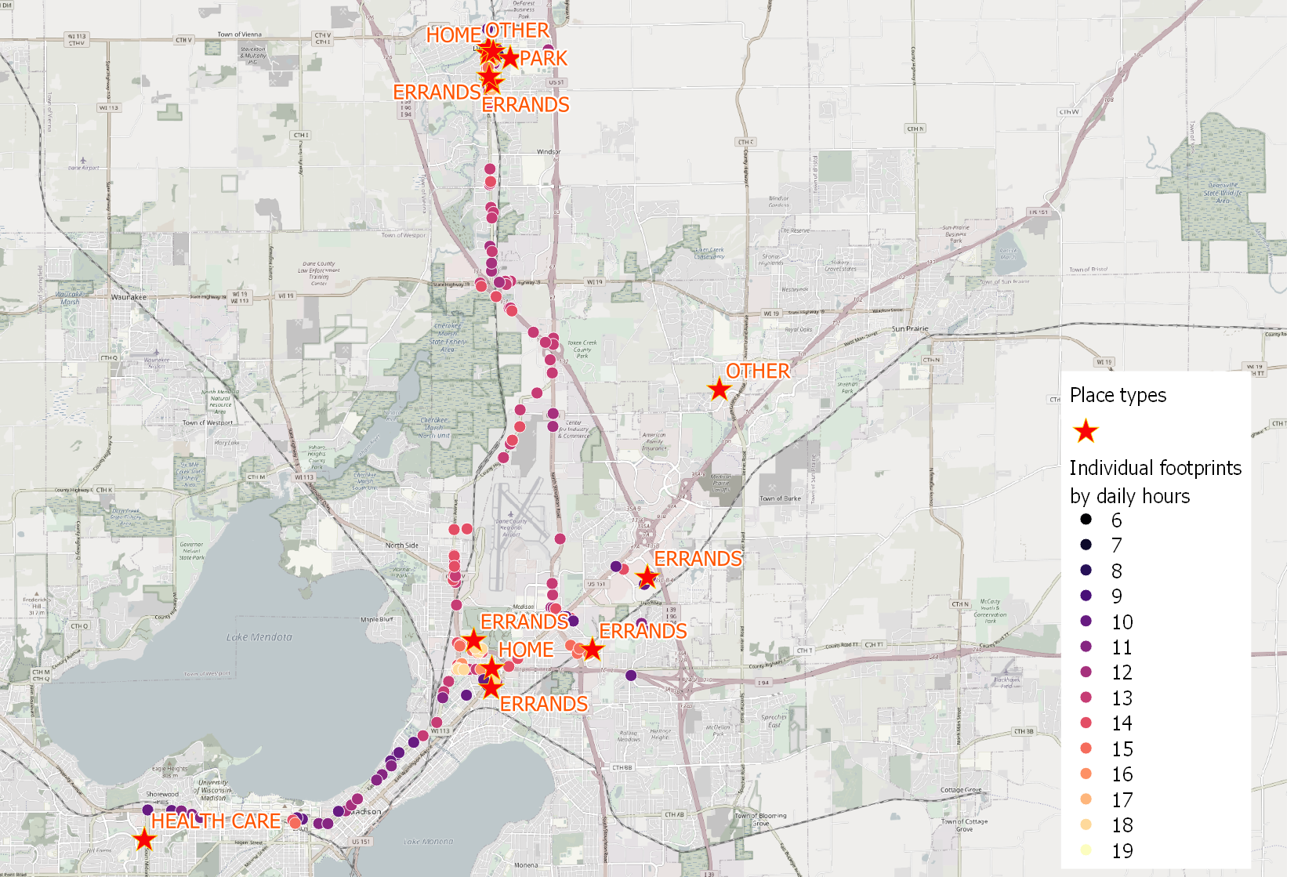
Introduction
GPS trajectories collected via mobile phones

Slide 9
Related Work
Static vs dynamic monitoring of alcohol relapse risks
Static: who will relapse and whether an episode is alcohol-related
Dynamic: precisely predict when a relapse could occur

Slide 10
Related Work
Static vs dynamic monitoring of alcohol relapse risks
Static: who will relapse and whether an episode is alcohol-related
Dynamic: precisely predict when a relapse could occur
Travel activity identification is used for dynamic monitoring

Slide 11
Related Work
Static vs dynamic monitoring of alcohol relapse risks
Static: who will relapse and whether an episode is alcohol-related
Dynamic: precisely predict when a relapse could occur
Travel activity identification is used for dynamic monitoring
Drinking identification relies on meta data (e.g., phone call logs)
Dwelling and Work are identified with temporal travel patterns, imprecise for alcohol addicts who follow more flexible itineraries
Shopping, Eating, and Entertainment identification are not well explored in relapse prediction, challenged by uncertainties of travel locations and manual annotations

Slide 12
Related Work
Activity identification with spatiotemporal movement patterns
Spatial patterns: visit frequencies, radius of gyration, spatial movement scales
Temporal patterns: visit frequencies within different time periods, temporal scales
Heuristic analysis methods

Slide 13
Related Work
Activity identification with spatiotemporal movement patterns
Spatial patterns: visit frequencies, radius of gyration, spatial movement scales
Temporal patterns: visit frequencies within different time periods, temporal scales
Heuristic analysis methods
Cannot be applied to identify Shopping, Eating, etc.

Slide 14
Related Work
Activity identification with spatiotemporal movement patterns
Spatial patterns: visit frequencies, radius of gyration, spatial movement scales
Temporal patterns: visit frequencies within different time periods, temporal scales
Heuristic analysis methods
Cannot be applied to identify Shopping, Eating, etc.
Machine learning techniques
Integrates context information provided by GSM, accelerometers, WiFi, etc.
Activating additional sensors is expensive

Slide 15
Related Work
Activity identification with geographic context
Place categorization as a proxy of activity type classification
Spatial join is applied to correlate land use types and surrounding POIs

Slide 16
Related Work
Activity identification with geographic context
Place categorization as a proxy of activity type classification
Spatial join is applied to correlate land use types and surrounding POIs
Travel activity type identification cannot solely rely on geographic context
Heterogeneous activities are conducted at the same category of places (e.g., Eating or Work at a restaurant)
Disambiguating adjacent places remains a research challenge

Slide 17
Related Work
Activity identification with geographic context
Place categorization as a proxy of activity type classification
Spatial join is applied to correlate land use types and surrounding POIs
Travel activity type identification cannot solely rely on geographic context
Manually annotated POI labels introduce bias and inaccuracy

Slide 18
Related Work
Activity identification with geographic context
Place categorization as a proxy of activity type classification
Spatial join is applied to correlate land use types and surrounding POIs
Travel activity type identification cannot solely rely on geographic context
Manually annotated POI labels introduce bias and inaccuracy
Location services (e.g., Google Places API) exploited are still inconvenient

Slide 19
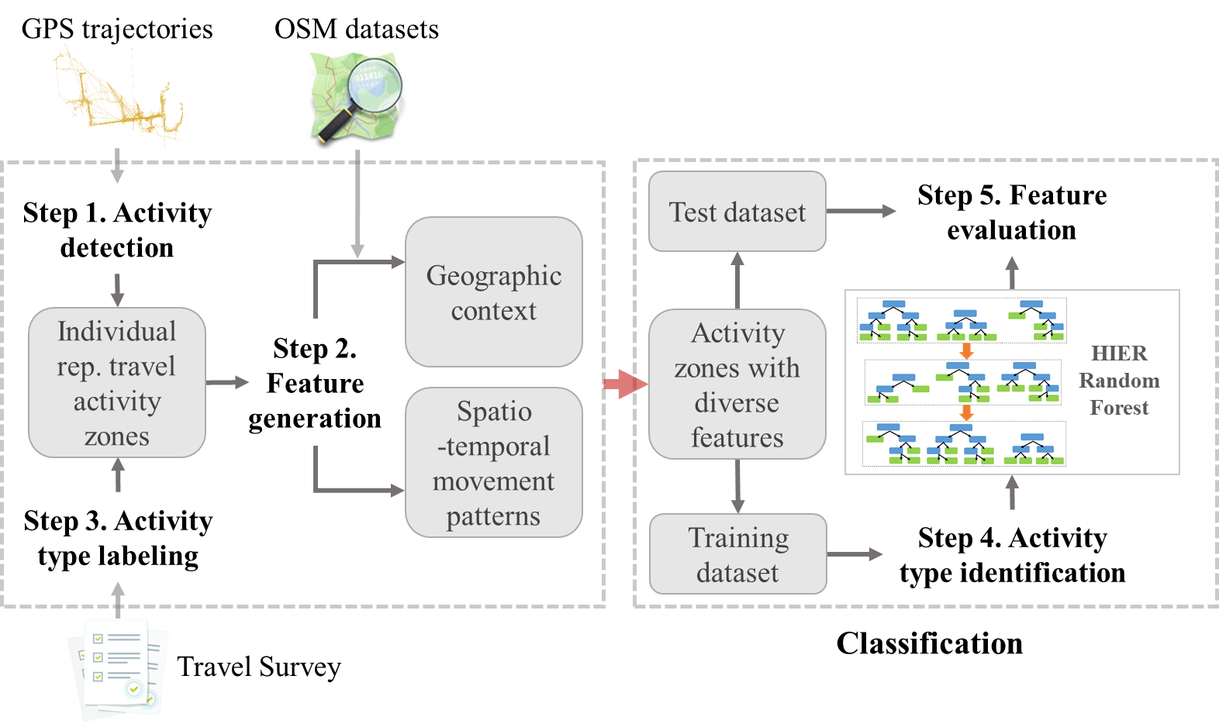
Methods
Workflow
Individual representative travel activity type identification with features representing spatiotemporal movement patterns and geographic context

Slide 20
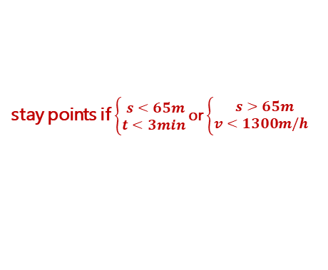
Methods
Activity detection
Stay point detection
stay points if $\left\{\begin{aligned}s<65m \\ t<3min \end{aligned}\right.$or $\left\{\begin{aligned}s>65m \\ v<1300m/h \end{aligned}\right.$
a trip
P₀
a trajectory
(Sun et al. 2021)

Slide 21
Methods
Activity detection
Stay point detection
Spatial aggregation
DBSCAN on stay points
eps = 50m
minPts = 4
spatial cluster
stay points
a trajectory

Slide 22
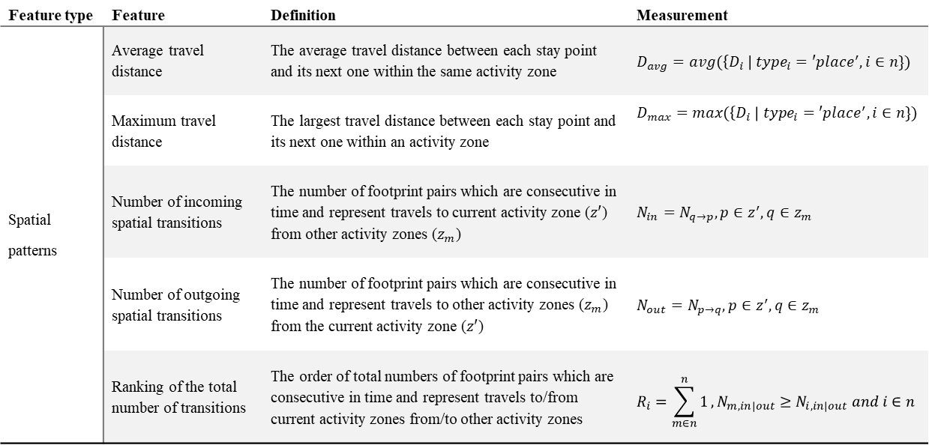
Methods
Spatiotemporal movement patterns
Feature type | Feature | Definition | Measurement
Spatial patterns | Average travel distance | The average travel distance between each stay point and its next one within the same activity zone | $$D_{avg}=avg(\left\{D_{i} \right| {type}_{i}=′place^{′}, i∈n\})$$
 | Maximum travel distance | The largest travel distance between each stay point and its next one within an activity zone | $$D_{max}=max(\left\{D_{i} \right| {type}_{i}=′place^{′}, i∈n\})$$
 | Number of incoming spatial transitions | The number of footprint pairs which are consecutive in time and represent travels to current activity zone ($z′$) from other activity zones ($z_{m}$) | $$N_{in}=N_{q→p}, p∈z^{′},q∈z_{m}$$
 | Number of outgoing spatial transitions | The number of footprint pairs which are consecutive in time and represent travels to other activity zones ($z_{m}$) from the current activity zone ($z′$) | $$N_{out}=N_{p→q}, p∈z^{′},q∈z_{m}$$
 | Ranking of the total number of transitions | The order of total numbers of footprint pairs which are consecutive in time and represent travels to/from current activity zones from/to other activity zones | $$R_{i}=\sum_{m∈n}^{n}{1},N_{m, in|out}≥N_{i,in|out} and i∈n$$
5 features representing spatial patterns

Slide 23
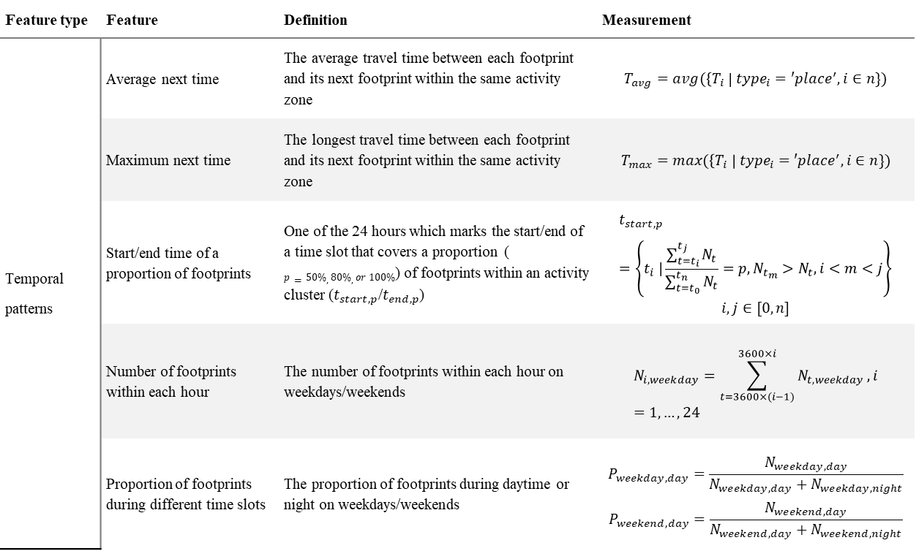
Methods
Spatiotemporal movement patterns
Feature type | Feature | Definition | Measurement
Temporal patterns | Average next time | The average travel time between each footprint and its next footprint within the same activity zone | $$T_{avg}=avg(\left\{T_{i} \right| {type}_{i}=′place^{′}, i∈n\})$$
 | Maximum next time | The longest travel time between each footprint and its next footprint within the same activity zone | $$T_{max}=max(\left\{T_{i} \right| {type}_{i}=′place^{′}, i∈n\})$$
 | Start/end time of a proportion of footprints | One of the 24 hours which marks the start/end of a time slot that covers a proportion ( $p=50\%, 80\%,or 100\%$) of footprints within an activity cluster ($t_{start, p}$/$t_{end, p}$) | $$t_{start,p}=\left\{t_{i} |\frac{\sum_{t=t_{i}}^{t_{j}}{N_{t}}}{\sum_{t=t_{0}}^{t_{n}}{N_{t}}}=p,N_{t_{m}}>N_{t},i<m<j\right\}$$ $$i,j∈[0,n]$$
 | Number of footprints within each hour | The number of footprints within each hour on weekdays/weekends | $$N_{i,weekday}=\sum_{t=3600×(i−1)}^{3600×i}{N_{t,weekday}},i=1,…,24$$
 | Proportion of footprints during different time slots | The proportion of footprints during daytime or night on weekdays/weekends | $$P_{weekday,day}=\frac{N_{weekday,day}}{N_{weekday,day}+N_{weekday,night}}$$ $$P_{weekend,day}=\frac{N_{weekend,day}}{N_{weekend,day}+N_{weekend,night}}$$

Slide 24
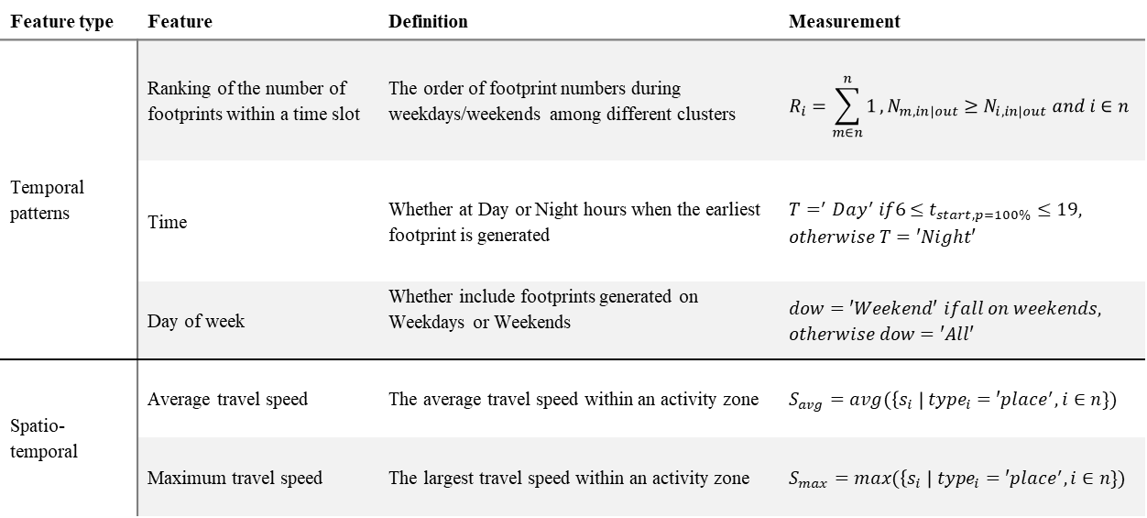
Methods
Spatiotemporal movement patterns
Feature type | Feature | Definition | Measurement
Temporal patterns | Ranking of the number of footprints within a time slot | The order of footprint numbers during weekdays/weekends among different clusters | $$R_{i}=\sum_{m∈n}^{n}{1},N_{m,in|out}≥N_{i,in|out} and i∈n$$
 | Time | Whether at Day or Night hours when the earliest footprint is generated | $$T=^{′}Day^{′} if6≤t_{start,p=100\%}≤19,$$ $$otherwise T=′Night′$$
 | Day of week | Whether include footprints generated on Weekdays or Weekends | $$dow=′Weekend′ ifall on weekends,$$ $$otherwise dow=′All′$$
Spatio-temporal | Average travel speed | The average travel speed within an activity zone | $$S_{avg}=avg(\left\{s_{i} \right| {type}_{i}=′place^{′},i∈n\})$$
 | Maximum travel speed | The largest travel speed within an activity zone | $$S_{max}=max(\left\{s_{i} \right| {type}_{i}=′place^{′},i∈n\})$$
64 features representing temporal patterns

Slide 25
Methods
Geographic context
Manual interpretation of land use and POI features of OSM dataset
Daily travel activity type | Distinct Feature Classes of OSM Land Use Dataset | Distinct Feature Classes of OSM POI Dataset
Dwelling | residential | dormitory, houses, …, house, family_house, shed, condominium, townhouse, apartment, home
Eating | NA | bakery, cafe, fast_food, …, restaurant, food_court, caboose, cafeteria
Entertainment | recreation_ground, vineyard, park, orchard | alpine_hut, artwork, …, archaeological, attraction, arts_centre, bar, battlefield, bench, biergarten
Health | health | dentist, doctors, …, hospital, pharmacy, chemist, optician, nursing_home
Service | cemetery | bicycle_rental, atm, …, post_box, car_repair, fort, car_wash, graveyard, guesthouse, hostel, laundry
Shopping | retail | beauty_shop, bookshop, …, clothes, beverages, bicycle_shop, butcher, computer_shop, florist
Work | farm, meadow, military, industrial, quarry | embassy, courthouse, …, bank, community_centre, fire_station, police, factory, barn, industrial
Education | NA | college, kindergarten, …, library, school, academic, university, academic_building
Drinking | NA | bar, night_club, nightclub, pub, liquor_store
Transportation | NA | dock, ferry_terminal, …, dam, ford, taxi_stand, travel_agency
Transportation network | NA | canal, taxi, …, parking_shelter, stop, camera_surveillance
NA | commercial | NA

Slide 26
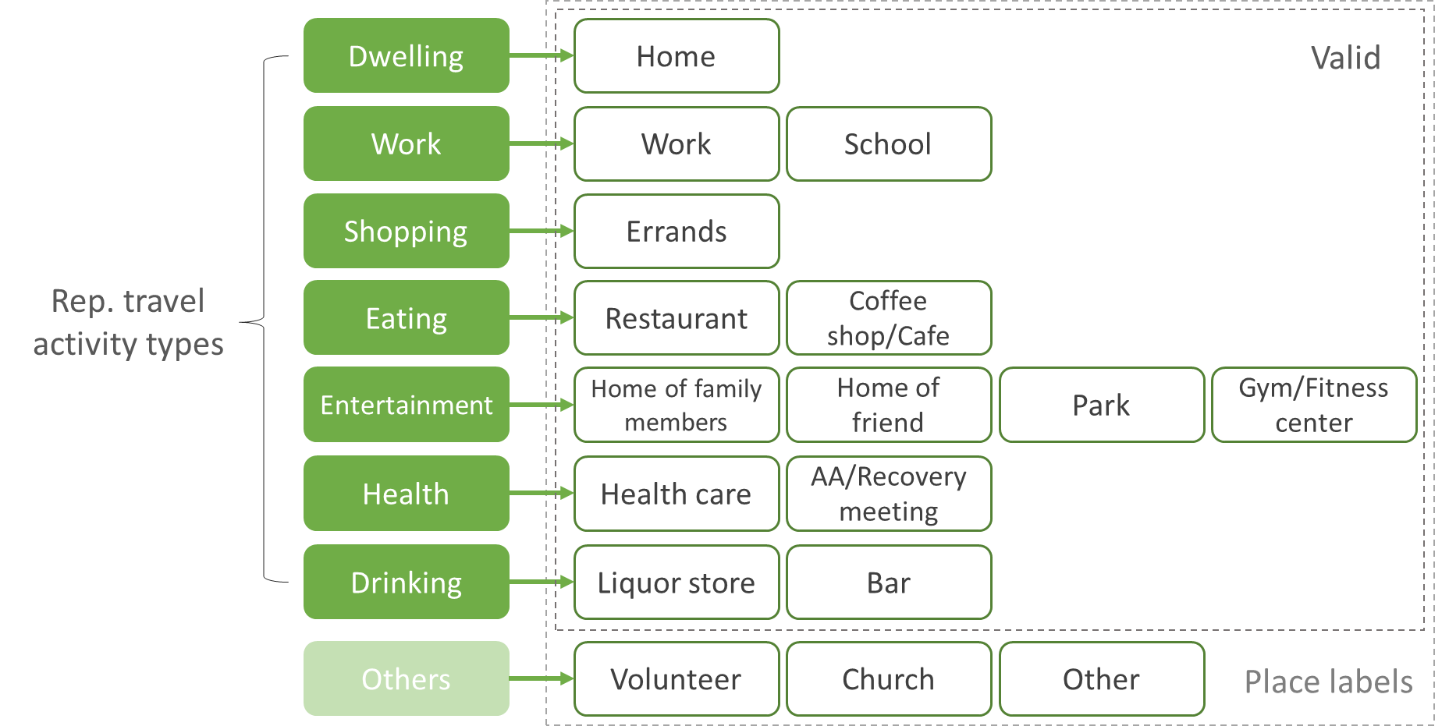
Methods
Activity type identification
Representative travel activity type labeling

Slide 27
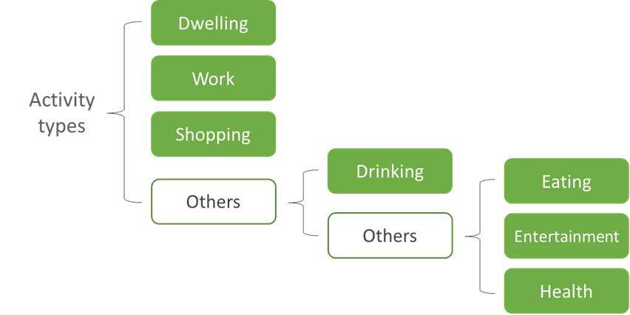
Methods
Activity type identification
Representative travel activity type labeling
Hierarchical travel activity type identification

Slide 28
Methods
Activity type identification
Representative travel activity type labeling
Hierarchical travel activity type identification
Split all individual travel activities into training/testing sets
K-fold cross validation for fitting random forest models

Slide 29
Case study
Datasets
A total of 167 participants are recruited
Alternatively, can select individuals mostly from those who have 1-2 distinct work locations
Number of work locations | Number of individuals
0 | 35
1 | 42
2 | 32
3 | 19
4 or more | 41
Sum | 169

Slide 30
Case study
Datasets
A total of 167 participants are recruited
Currently, 56 participants are selected who live in WI or IL and left 407,066 travel footprints
Discarded travel footprints outside of WI and IL
1,240,944 footprints (167 individuals) → 1,155,422 footprints (167 individuals)
Removed individuals with multiple work activities after labeling their detected activities with self-reported place types
167 individuals → 56 individuals

Slide 31
Case study
Datasets
A total of 167 participants are recruited
56 participants are selected who live in WI or IL and left 407,066 travel footprints
Discarded travel footprints outside of WI and IL
Removed individuals with multiple work locations
Approximately 1750 distinct locations with place labels are collected through travel surveys

Slide 32
Case study
Results
Confusion matrix of activity type identification at the first level
Real\predicted | Dwelling | Work | Shopping | Others
Dwelling | 0.946 | 0.011 | 0 | 0.043
Work | 0.016 | 0.762 | 0 | 0.223
Shopping | 0 | 0.006 | 0.765 | 0.228
Others | 0.006 | 0 | 0.155 | 0.838
Confusion matrix of activity type identification at the second level
Real\predicted | Drinking | Others
Drinking | 0.3 | 0.7
Others | 0.005 | 0.995
Confusion matrix of activity type identification at the third level
Real\predicted | Eating | Entertainment | Health | Others
Eating | 0.394 | 0.091 | 0.030 | 0.485
Entertainment | 0 | 0.4 | 0.05 | 0.55
Health | 0.095 | 0.048 | 0.571 | 0.286
Others | 0.025 | 0.041 | 0.008 | 0.926

Slide 33
Case study
Activity type identification for activity zones
Analysis of the precision, recall, and f1 score for identifying different activity types using multiple classification models
Activity type | Precision |  |  | Recall |  |  | F1 score |  |  | Avg support
 | RF | ST | GeoCtx | RF | ST | GeoCtx | RF | ST | GeoCtx
Dwelling | 0.94 | 0.79 | 0.23 | 0.95 | 0.88 | 0.76 | 0.94 | 0.83 | 0.36 | 17
Work | 0.96 | 0.20 | 0.18 | 0.76 | 1.00 | 0.19 | 0.85 | 0.33 | 0.19 | 21
Shopping | 0.78 | NA | 0.49 | 0.77 | NA | 0.30 | 0.77 | NA | 0.37 | 67
Drinking | 0.75 | NA | 0.19 | 0.30 | NA | 0.70 | 0.43 | NA | 0.30 | 10
Eating | 0.72 | NA | 0.31 | 0.39 | NA | 0.45 | 0.51 | NA | 0.37 | 33
Entertainment | 0.47 | NA | 0.23 | 0.40 | NA | 0.15 | 0.43 | NA | 0.18 | 20
Health | 0.80 | NA | 0.15 | 0.57 | NA | 0.10 | 0.67 | NA | 0.12 | 21

Slide 34
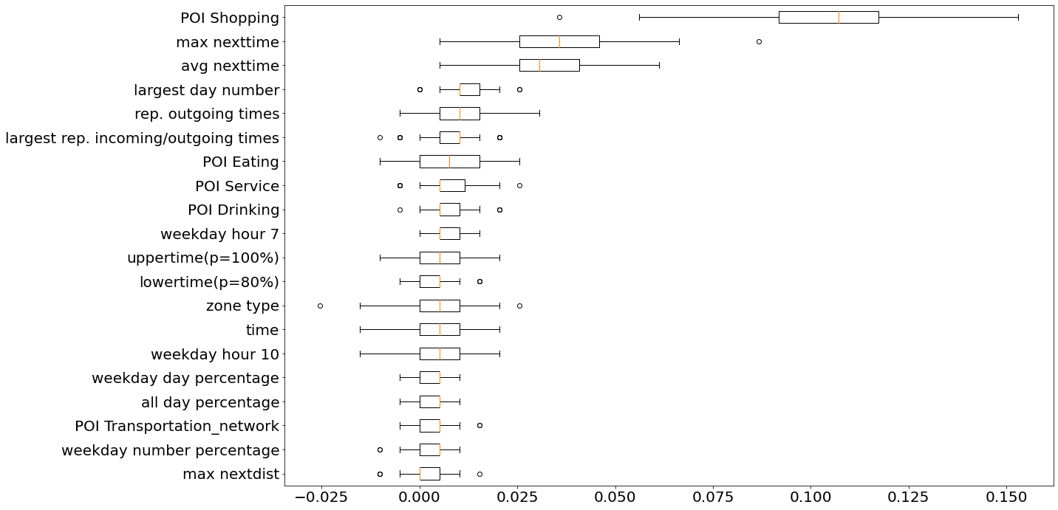
Case study
Feature importance
Top 20 features with the highest permutation importance for identifying Dwelling, Work, and Shopping activities in the test set

Slide 35
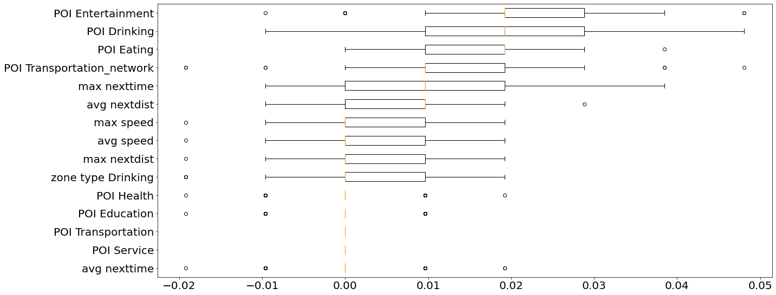
Case study
Feature importance
Top 15 features with the highest permutation importance for identifying Drinking activities in the test set

Slide 36
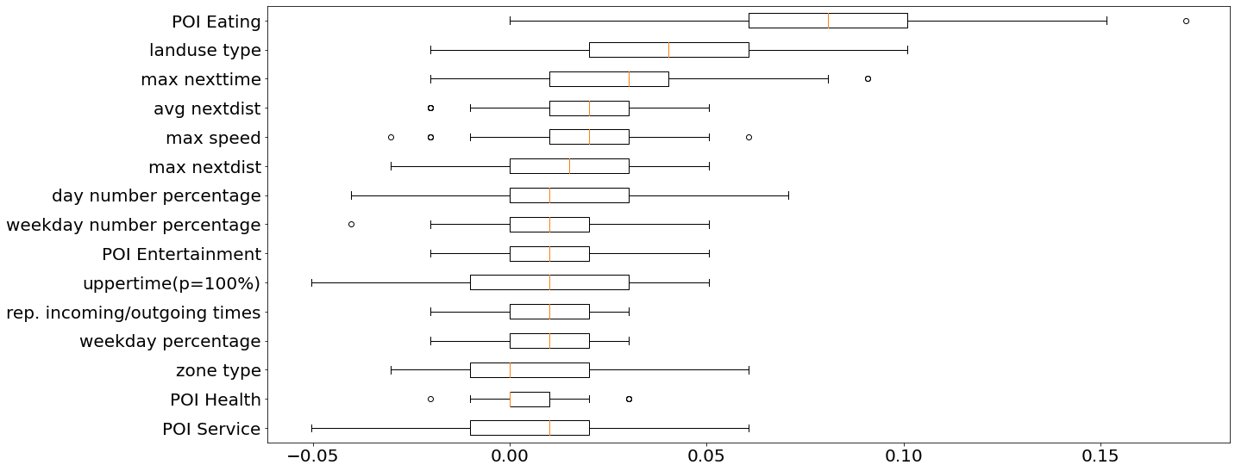
Case study
Feature importance
Top 15 features with the highest permutation importance for identifying Eating, Entertainment, and Health activities in the test set

Slide 37
Case study
Class imbalance
Number of labels for each travel activity type
Random forest classifiers are biased towards the majority class
Travel activity type |  | Number of labels | Total
Level 1 | Dwelling | 60 | 670 | 1437
 | Work | 127
 | Shopping | 483
Level 2 | Drinking | 114 | 114
Level 3 | Eating | 272 | 653
 | Entertainment | 263
 | Health | 118
Others |  | 315 | 315 | 315

Slide 38
Case study
Class imbalance
Number of labels for each travel activity type
Random forest classifiers are biased towards the majority class
One-vs-all classification is applied at the first identification level
Manually defined weights are applied at the second level
Inverse weighting is applied at the third level
Travel activity type |  | Number of labels | Total
Level 1 | Dwelling | 60 | 670 | 1437
 | Work | 127
 | Shopping | 483
Level 2 | Drinking | 114 | 114
Level 3 | Eating | 272 | 653
 | Entertainment | 263
 | Health | 118
Others |  | 315 | 315 | 315

Slide 39
Conclusion and future work
With our proposed travel activity type identification model,
Dwelling, Work, and Shopping activities can be identified with high evaluation scores
Drinking, Eating, Health, and Entertainment can be identified with high precision
Temporal patterns play an important role in identifying every travel activity type
Spatial patterns mostly contribute to classifying the primary activities
Geographic context features are especially crucial for identifying remaining activities
Accuracy of activity type identification can be enhanced with more advanced models

Slide 40
Thanks!
Notes:

