Slide 1
GPS!
Notes:
The goal of the gps project is to take a subset of data from RISK to attempt to predict binge drinking. There is a benefit to parsing out smaller pieces of this project so that we can start publications before the grant is up, investigate what data sources may be viable on their own (if someone didn’t have all of them). This project looks specifically at GPS data along with context gathered from in person interviews.

Slide 2
Data
Surveys 4x per day with option to report a lapse
Phone GPS data
Contextualized place info
*TYPE *Drank alcohol here *Alcohol is available
*Emotion *Risky *Avoid *Vacation
After a lapse: Is your goal still to remain abstinent in the future?
*YES *UNCERTAIN *NO
Notes:
They don’t have to report the lapse on the day it happens, they report whenever they remember and tell us the start and end times for drinking sessions
TYPES: HOME, work, friend/family home, school, bar, restaurant, coffeshop, errands, gym/fitness, health care, AA /recovery meeting,volunteer, religious, park, other

Slide 3
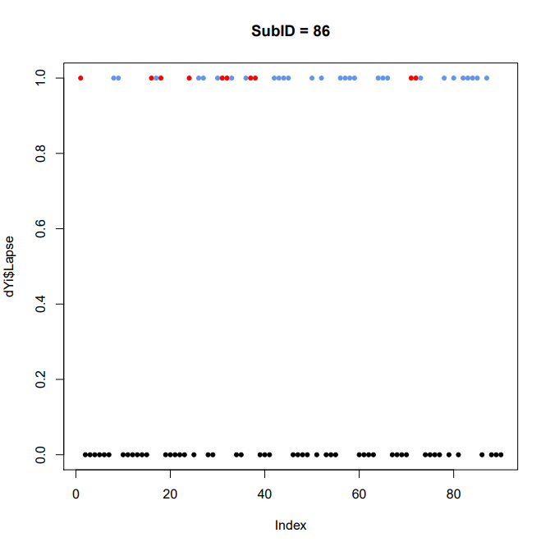
What is a Lapse?
Notes:
So these graphs display lapse reports chronologically for the about 90 days participants are on study. Days that do not have a lapse reported for them are assumed to be

Slide 4
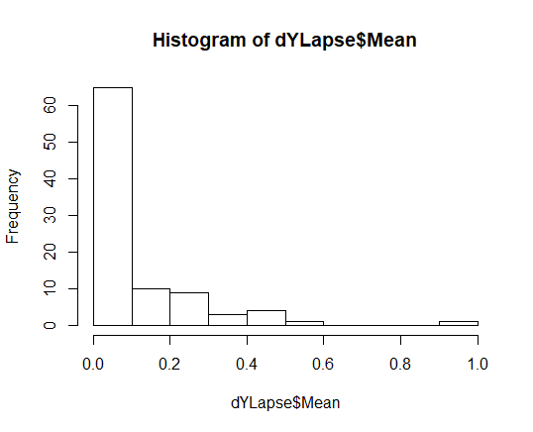
Raw data
N = 93
Never Lapsed: 34
Total Lapses: 766
Total Observations: 8015
Mean Lapse rate: 10 %

Slide 5
1) Remove if > 33% Lapse rate
N=7; Sub IDs: 37, 48, 58, 86, 98, 104, 128
Everyone except 37 is above 40%
Total Lapses: 459 / 766 (60%)
Total Observations: 7416 / 8015 (92.5%)
Mean Lapse rate: 6% (vs 10%)

Slide 6
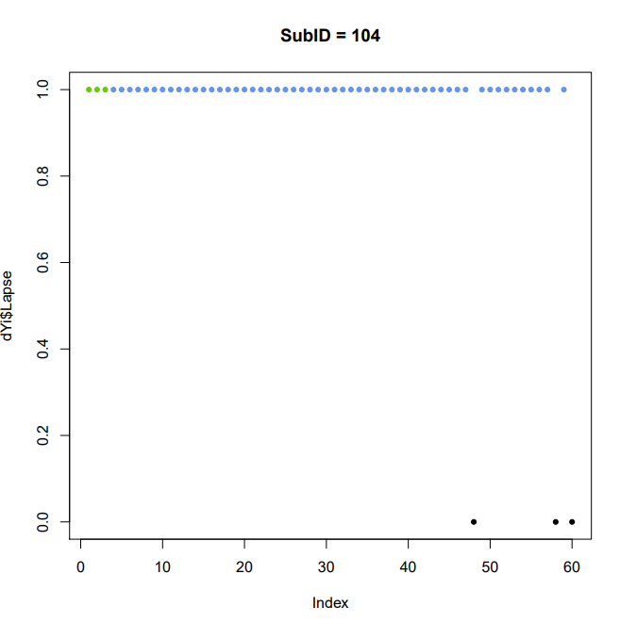
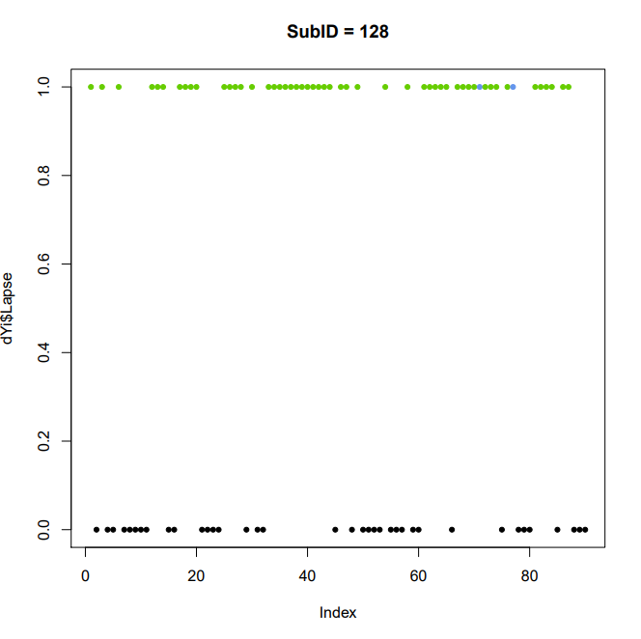
Notes:
Really high lapsers removed

Slide 7
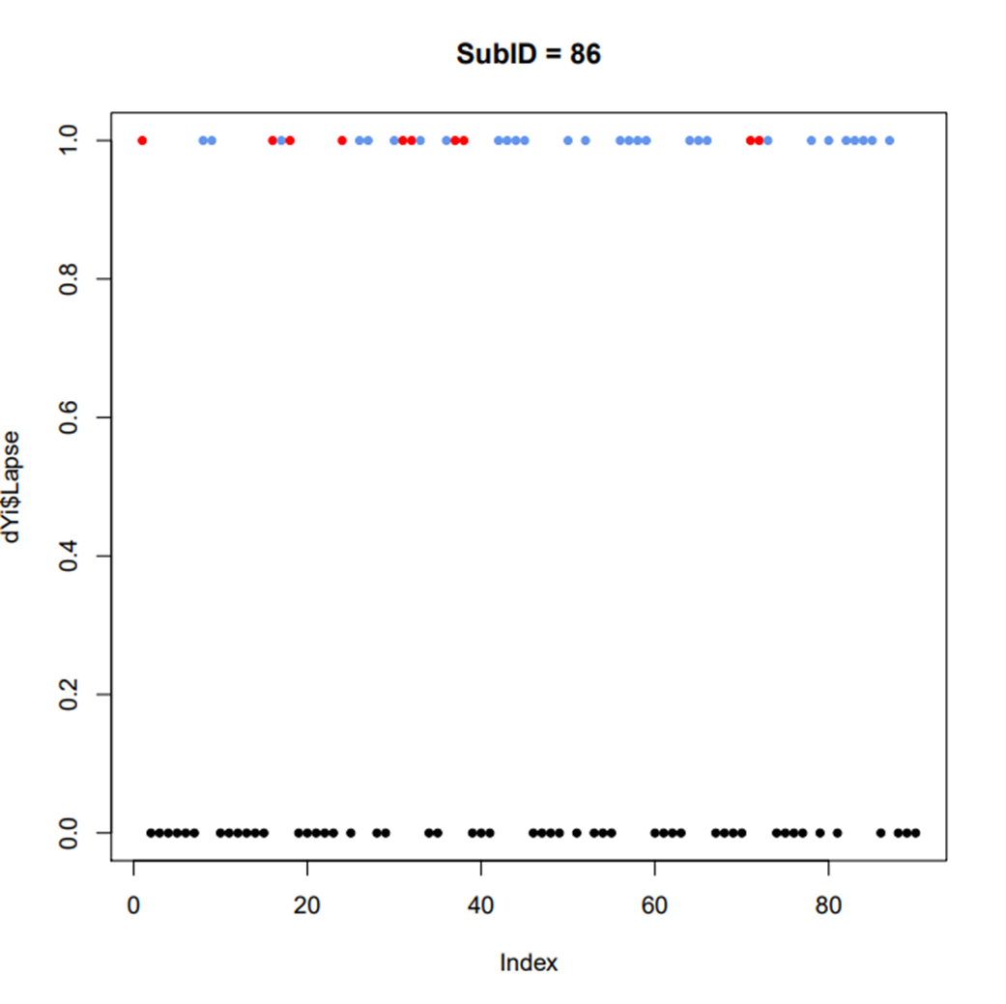
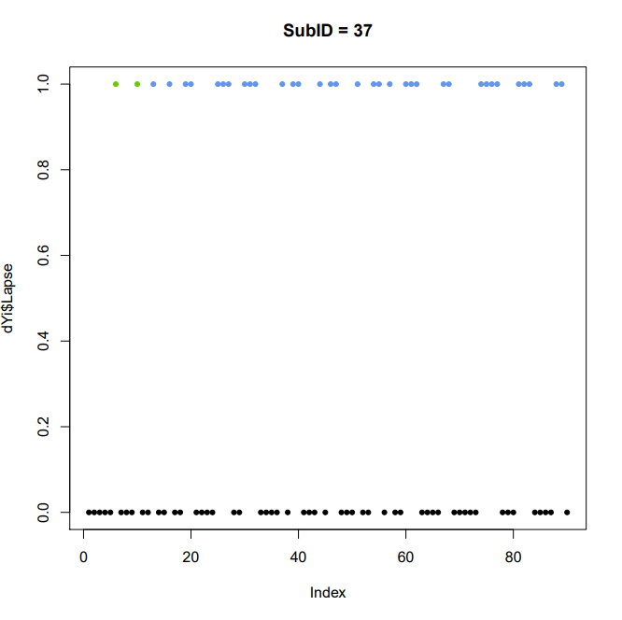

Slide 8
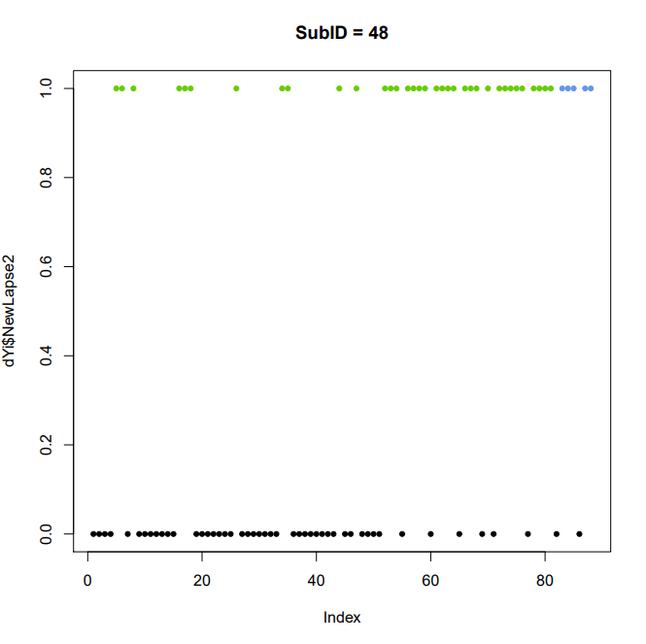
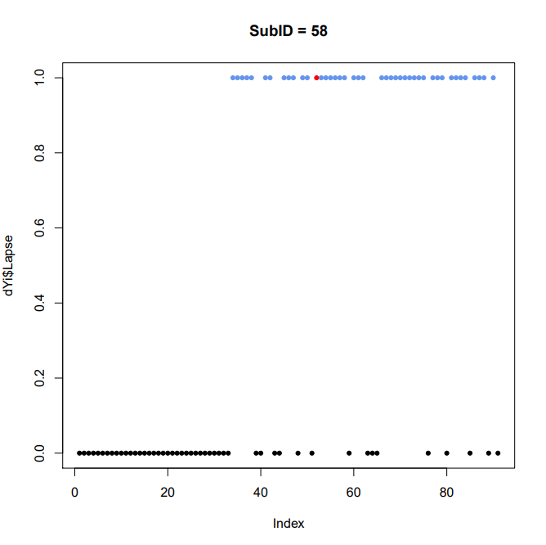
Notes:
Lapses focused at the end

Slide 9
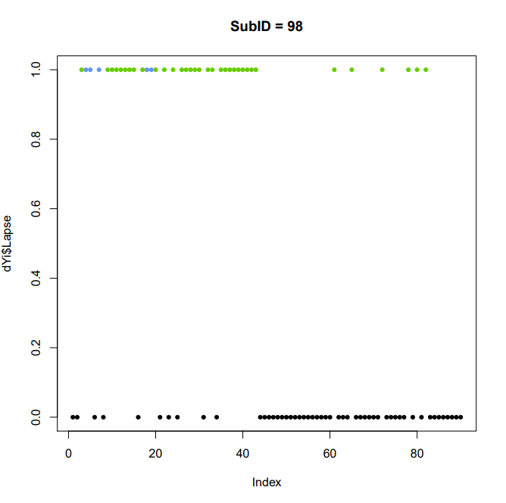
Notes:
Lapse focused at the beginning

Slide 10
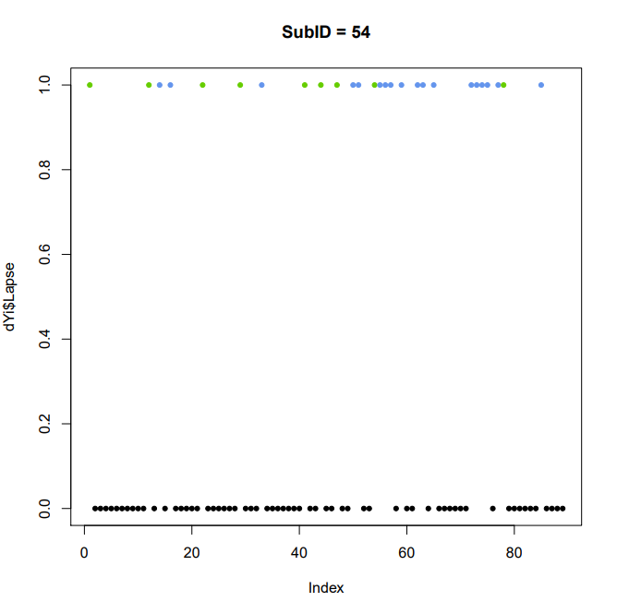
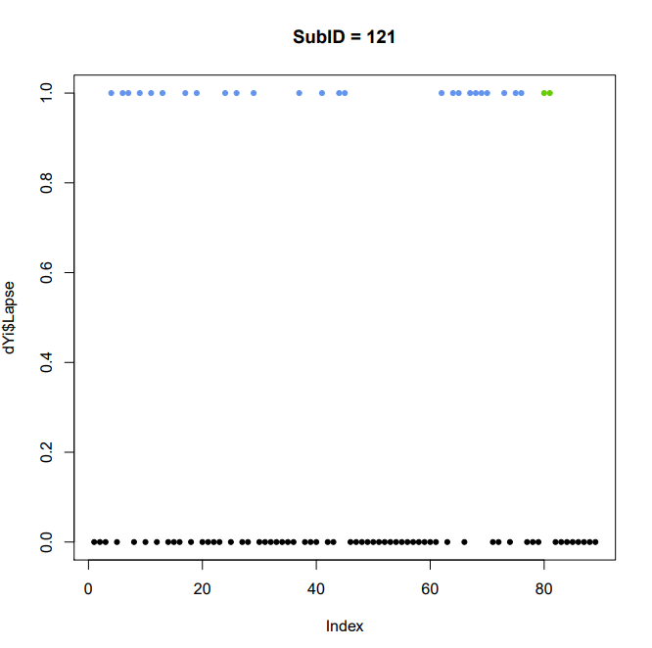
Notes:
Still leaves is with these subjects. Multiple lapses in a row

Slide 11
2) Remove until 7 days abstinent
Observations and lapses are dropped from file until 7 days of abstinence reached
Total Lapses: 144 / 766 (18.7%)
Total Observations: 5714 / 8015 (71%)
Mean Lapse rate: 11% (vs 10%)
Notes:
Lapse rate goes up because we now have people with 100% LR

Slide 12
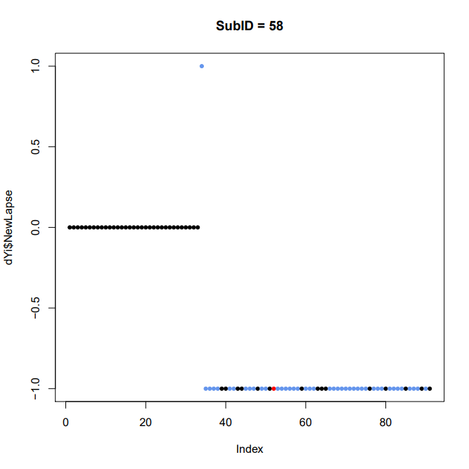
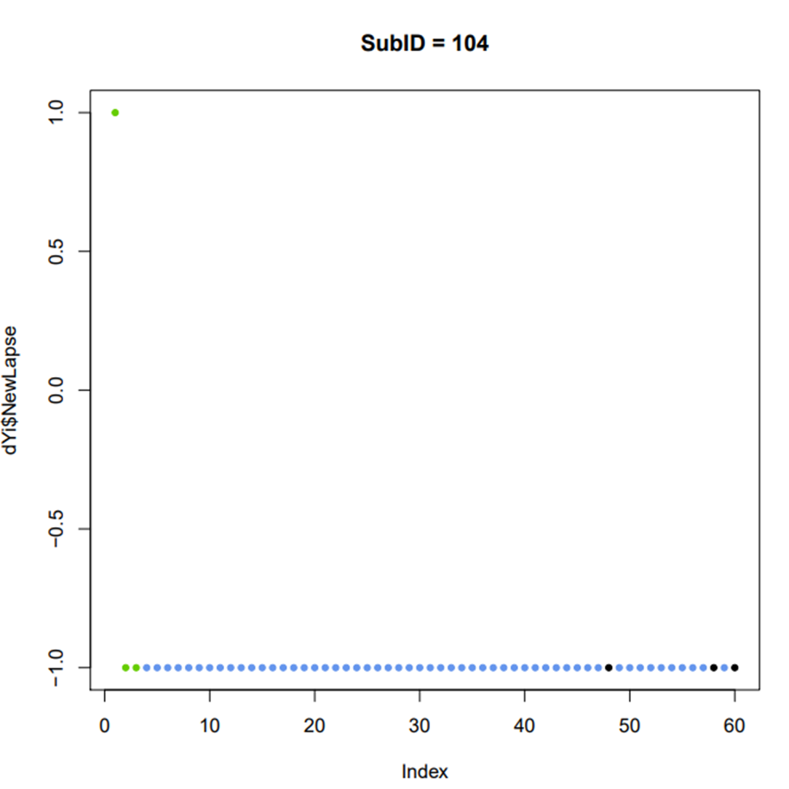

Slide 13
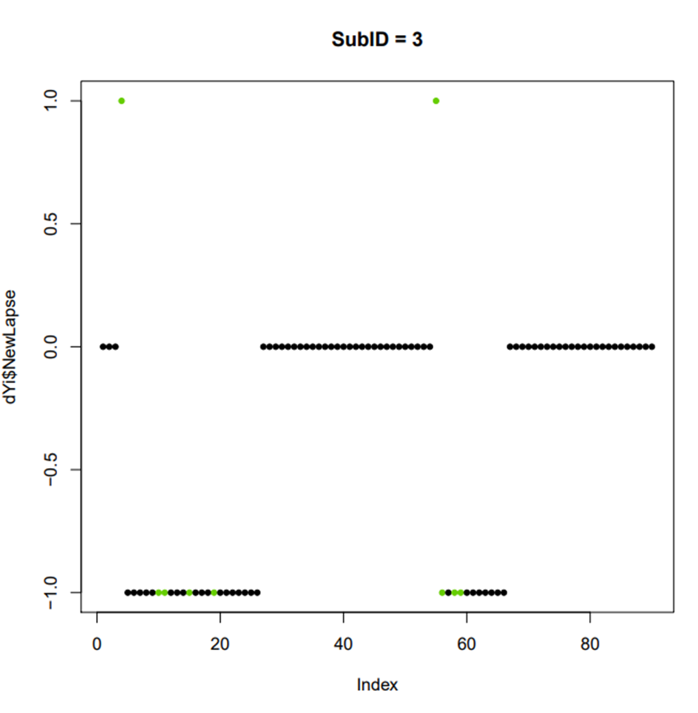
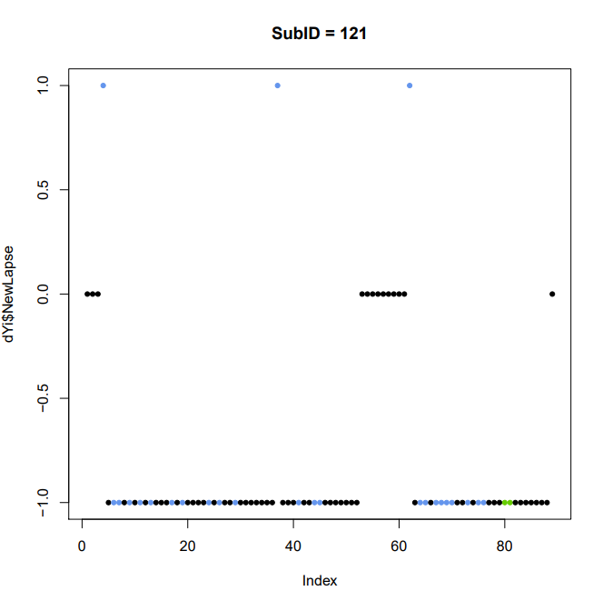
Notes:
Couple of people it targets missed by the 33% cut

Slide 14
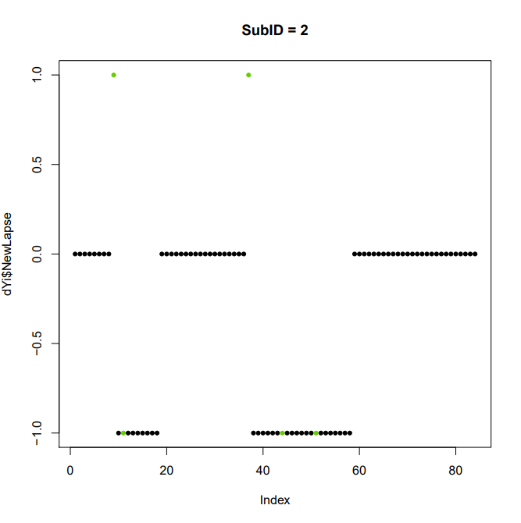
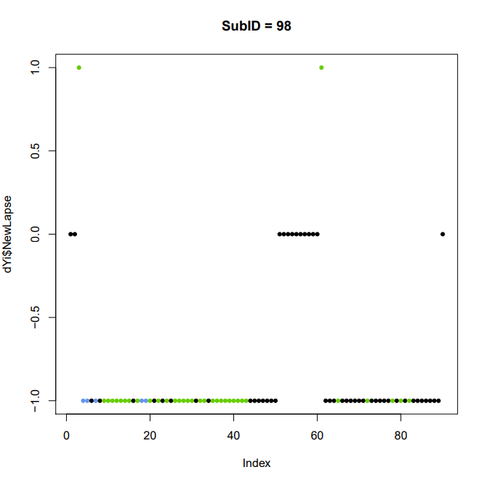
Notes:
Unsure if this method works?

Slide 15
3) Remove after a red lapse
Observations and lapses are dropped from file until a green lapse or 7 days of abstinence
N = 8; SubIDs: 11, 16, 43, 47, 56, 58, 86, 93
Total Lapses: 673 / 766 (87%)
Total Observations: 7758 / 8015 (96%)
Mean Lapse rate: 11% (vs 10%)
Notes:
Lapse rate goes up because we now have people with 100% LR

Slide 16
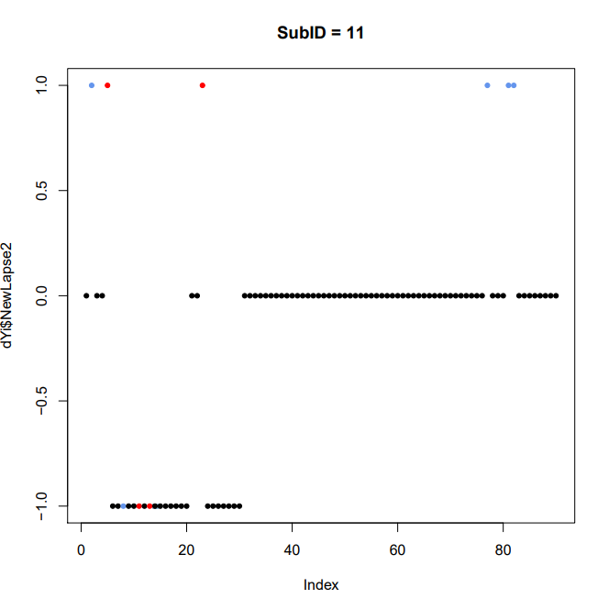
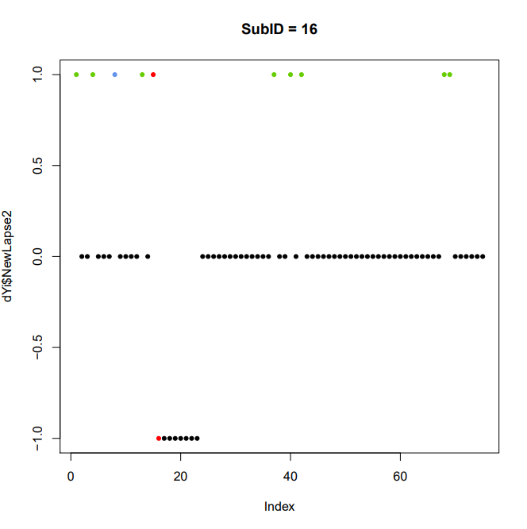
Notes:
SO I’m going to show you all of the people with red lapses. Here it did OK

Slide 17
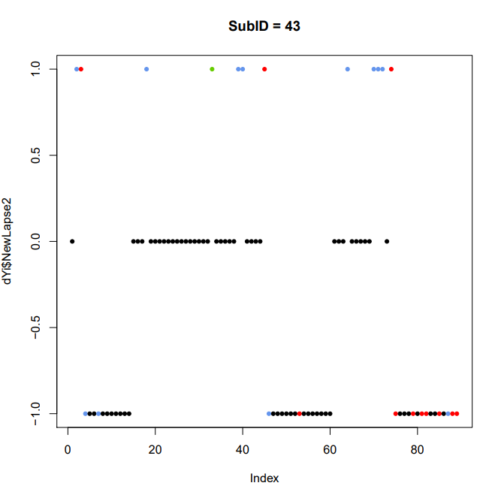
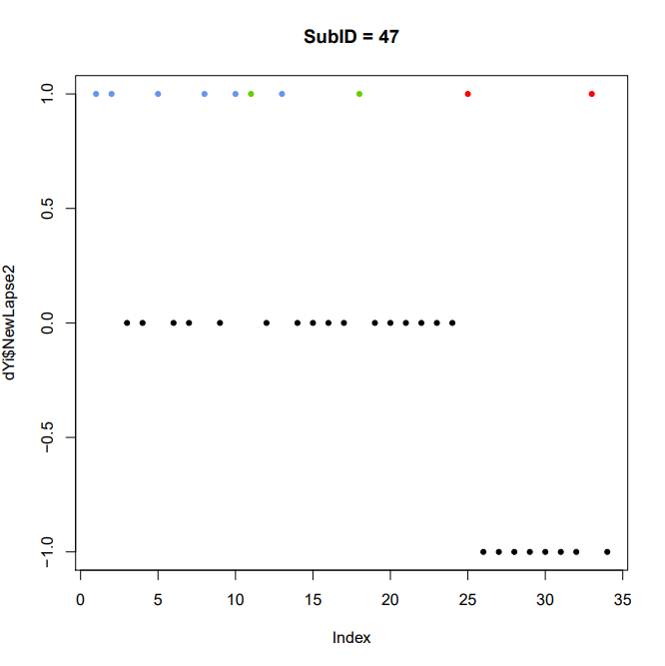
Notes:
Caught the relapse at the end of 43, but just removed abstinence observations for 47

Slide 18
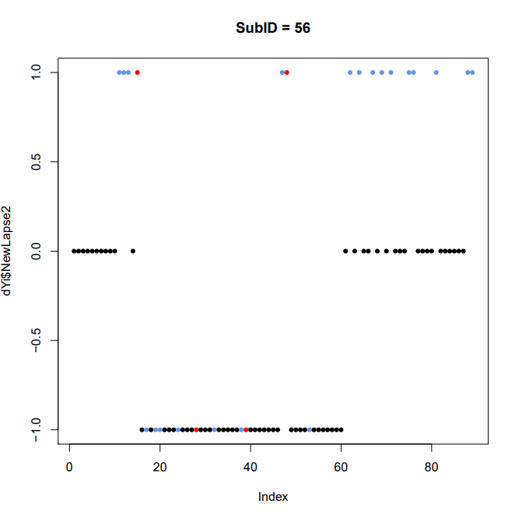
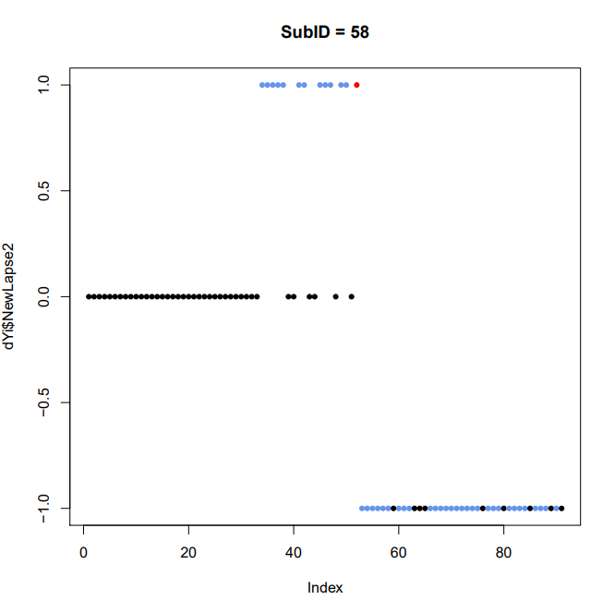
Notes:
These probably a goo job, but missing some long periods of abstinence for 56

Slide 19
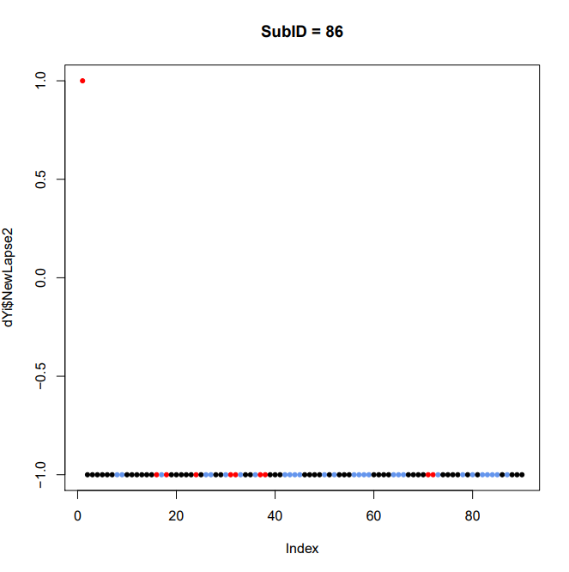
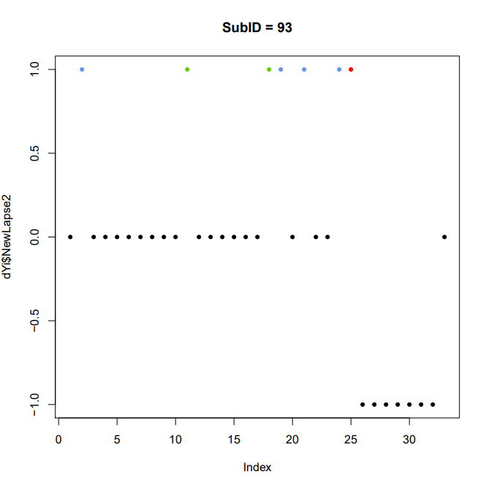
Notes:
Probably good for 86, though some strings of six days abstinent at the beginning.

Slide 20
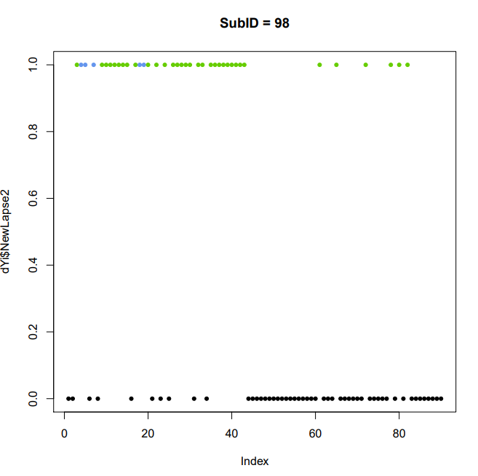
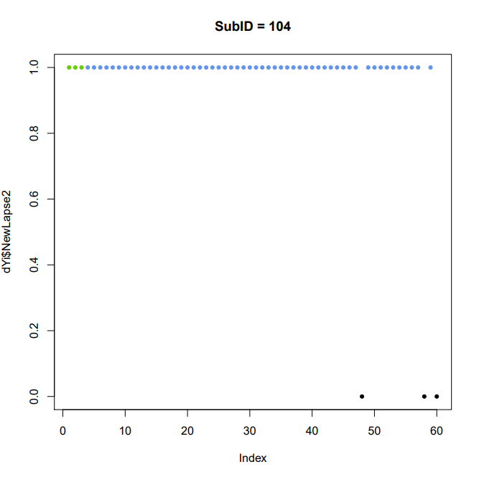
Notes:
But people like this remain

Slide 21
4) Remove after a red or blue lapse
Observations and lapses are dropped from file until a green lapse or 7 days of abstinence
26 people have a red or blue lapse
Total Lapses: 432 / 766 (56.4%)
Total Observations: 7092 / 8015 (88%)
Mean Lapse rate: 11% (vs 10%)
Notes:
Lapse rate goes up because we now have people with 100% LR

Slide 22
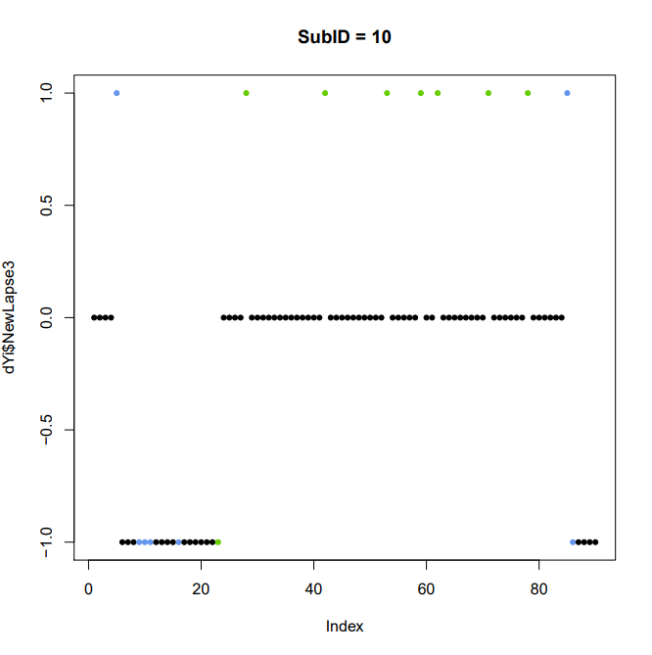
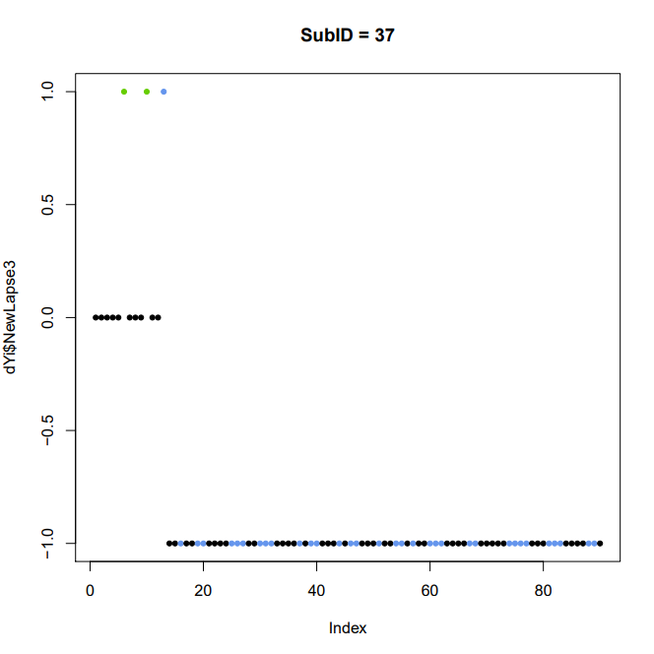
Notes:
Couple of people where I think this model did a good job – cut out lapses where we have multiples an a row or uncertainty about abstinence. Still get some of those important day after lapse observations

Slide 23
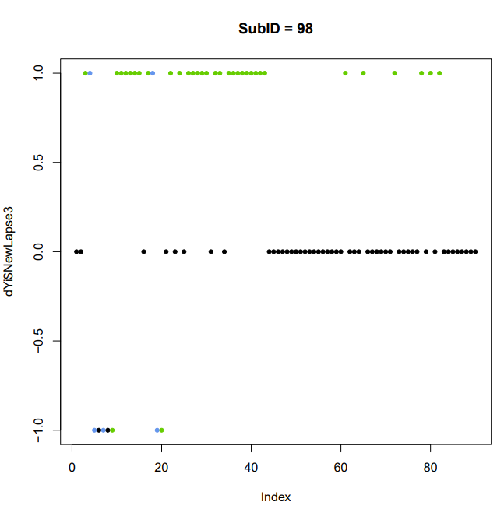
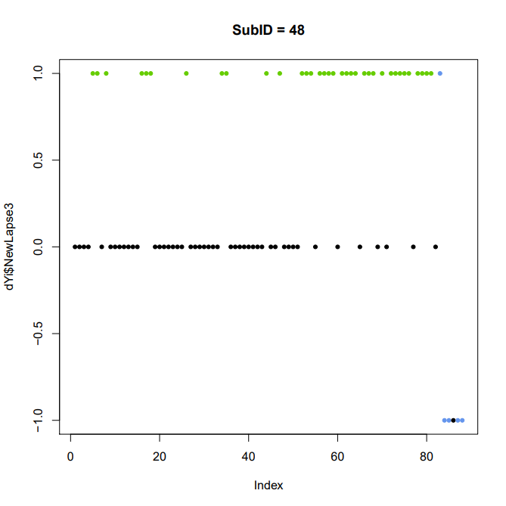
Notes:
But it doesn’t do anything to help these people

Slide 24
Lapse removal techniques
TECHNIQUE | TOTAL LAPSES | TOTAL OBSERVATIONS | MEAN LAPSE RATE
Raw Data | 766 | 8015 | 10%
1) Remove >33% LR | 459 (60%) | 7416 (92%) | 6%
2) 7 Days abstinent | 144 (18%) | 5714 (71%) | 11%
3) Red lapse removal | 673 (87%) | 7758 (96%) | 11%
4) Red/Blue Lapse removal | 432 (56%) | 7092 (88%) | 11%
Notes:
Quick review of all techniques lined up together

Slide 25
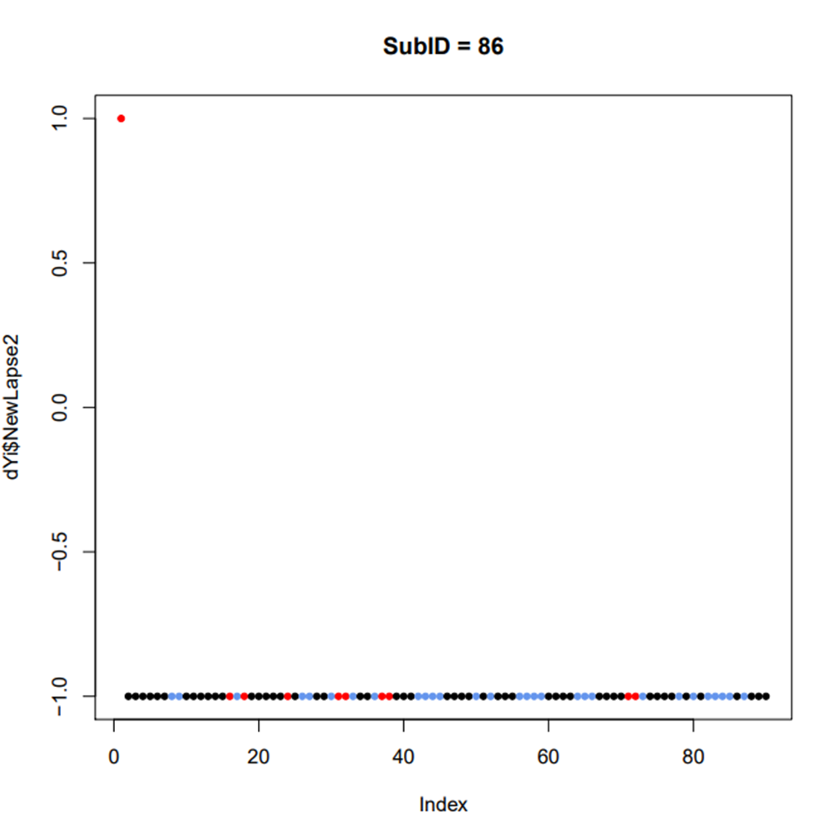
7 Days abstinent
Remove after red lapse
Remove after red or blue lapse
Notes:
Or remove all together with 33% cut. All cuts perform the same

Slide 26
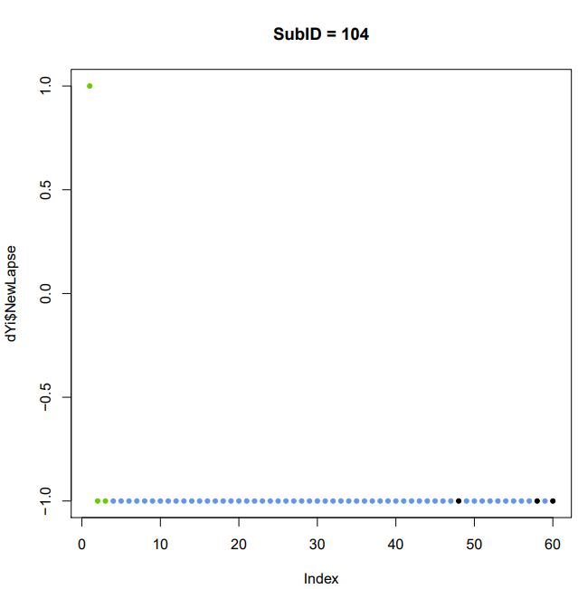
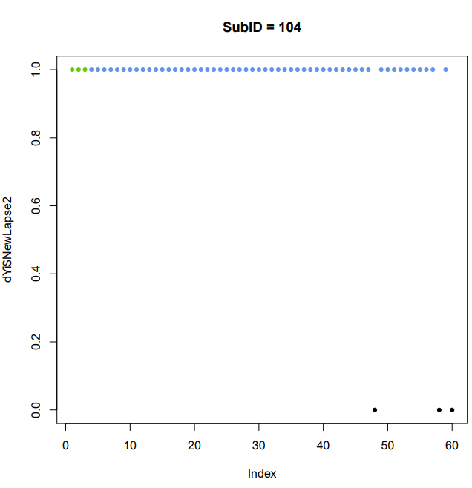

7 Days abstinent
Remove after red lapse
Remove after red or blue lapse
Notes:
Or remove all together with 33% cut. Variability here. No lapses at all for this person? A few? Or all lapses?

Slide 27
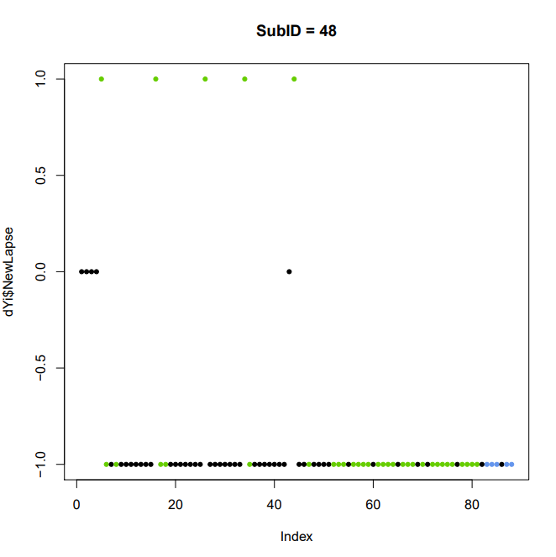


7 Days abstinent
Remove after red lapse
Remove after red or blue lapse
Notes:
Or remove all together with 33% cut. Which one of these will be most useful to our model?

Slide 28
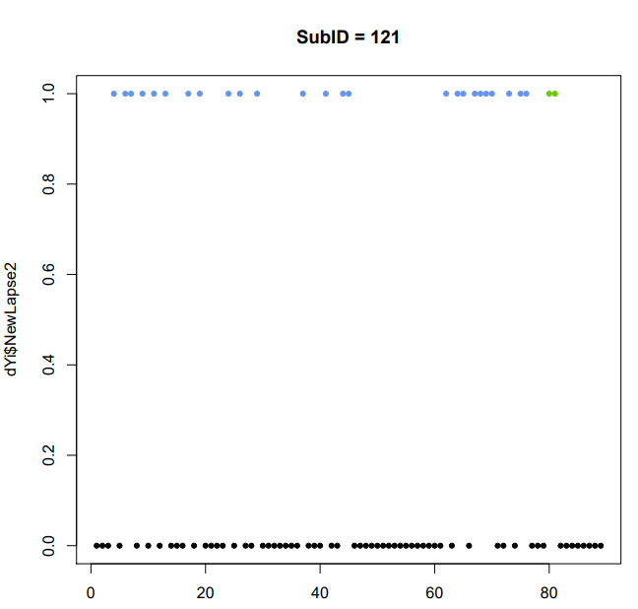
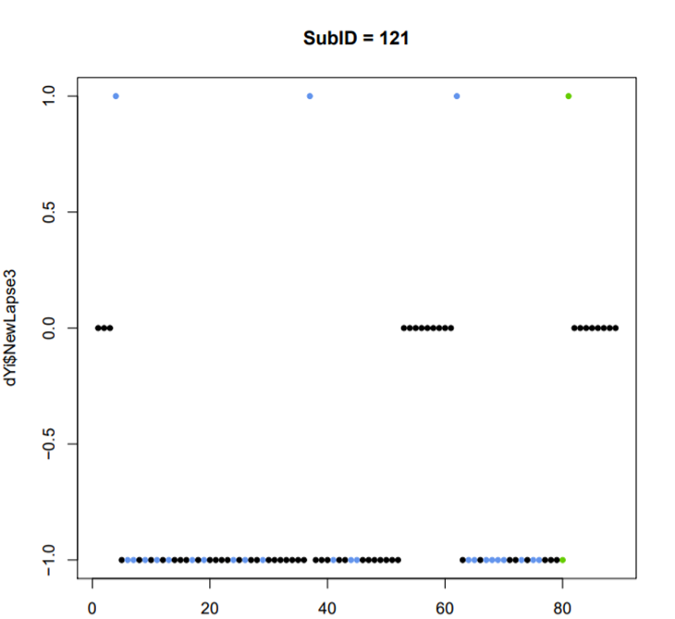
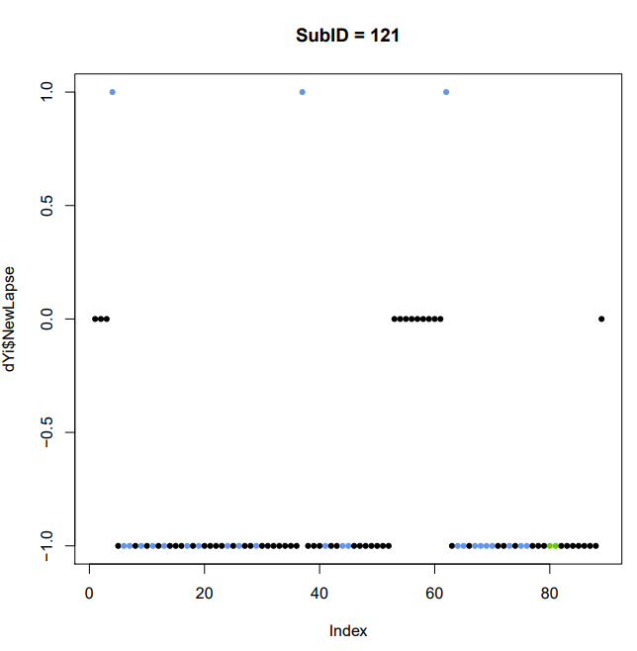
7 Days abstinent
Remove after red or blue lapse
Remove after red lapse
Kept with 33% cut!
Notes:
Again, is this person someone who should be reduced to just a few lapses?

Slide 29
One more thing…
On their daily morning surveys, participants are asked “How likely are you to drink alcohol in the next week?”
1 – 11; Unlikely – very likely
Took predictions from morning after
Non Lapse Days: Mean = 2.86 Lapse days: Mean = 3.43
Green Lapses: Mean = 3.27 Blue Lapses: Mean = 4.01
Red Lapses: Mean = 3.54
Notes:
Much like using reports of commitment to abstinence we did think about looking at predictions from the morning after lapse/no lapse reports (if they missed an ema the next morning, we just took the nearest report after)
Ranges (non lapse .38 – 10; lapse 0 -9.3, greenL 0 – 8, blueL 0 -9.44, redL 0 – 9.6

