Slide 1

IMAGE PROCESSING & COMPUTER VISION · PROJECT
Automated Detection of
AI-Generated Images
Telling real photographs apart from synthetic, AI generated images.
Group Member
Group Member
Group Member
Tavish Pagore
Seshadhiri Ganesh Ananthi
Etienne Landry

Slide 2
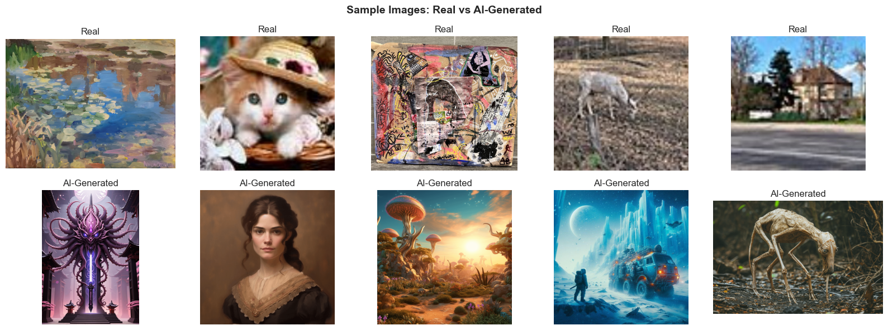
MOTIVATION · 1 OF 3
Real or generated? The line is vanishing
Modern generative models (DALL·E) now produce images that are visually indistinguishable from real photographs. The same scene can be a genuine capture or a synthetic fabrication , and to the eye, both look equally plausible.
The core problem: given a single image and no metadata, decide whether a camera or a model created it.
Sample images from the DALL·E dataset , real photographs (top row) vs AI-generated (bottom row).
02

Slide 3



MOTIVATION · 2 OF 3
Why it matters
When synthetic images pass as real, the cost is not cosmetic , it lands on information, money, and trust.
Misinformation
Fraud & deception
Erosion of digital trust
Fabricated photos of events, people, and places spread faster than fact-checks. A convincing fake can shape opinion before it is ever questioned.
Synthetic identities, forged documents, and fake product or property images enable scams, insurance fraud, and account takeovers at scale.
If any image could be fake, people stop trusting all images , including genuine evidence. The credibility of visual media itself is undermined.
03

Slide 4



MOTIVATION · 3 OF 3
Humans can't keep up , so the machine must
The generation–verification asymmetry
Creating is now effortless
~50%
Anyone can generate thousands of photorealistic fakes in minutes, for free.
Verifying is hard and slow
human accuracy at spotting the best AI-generated images , barely better than a coin flip
Manually inspecting each image for tell-tale artefacts doesn't scale to that volume.
Automated detection closes the gap
A trained model checks every image consistently, instantly, and at scale , the only response that matches the pace of generation.
04

Slide 5




APPROACH 1
Baseline CNN, trained from scratch
Our first attempt: build a small convolutional network from the ground up and let it learn the real-vs-AI decision directly from pixels , a clean baseline before reaching for anything heavier.
DALL·E dataset
›
Preprocess
›
SimpleCNN
›
Evaluate
05

Slide 6

APPROACH 1 · DATA
Dataset & preprocessing
DALL·E Recognition Dataset (Kaggle)
Preprocessing pipeline
Full dataset: 3,781 real vs 17,857 AI-generated , a heavy ~1 : 4.7 class imbalance
1
Resize every image to 224 × 224 RGB
Balanced sampling at the source , equal images drawn per class so training starts balanced
2
Random horizontal flip (p = 0.5)
3
Random rotation (±10°)
Class-weighted loss as a safety net , minority class weighted up inside CrossEntropyLoss
4
Convert to tensor
SMOTE deliberately avoided , interpolating pixels yields blurry, meaningless images , it suits tabular data, not photos
5
Normalize to ImageNet mean / std
Augmentation only on the training split; the test split is resized & normalized only.
06

Slide 7
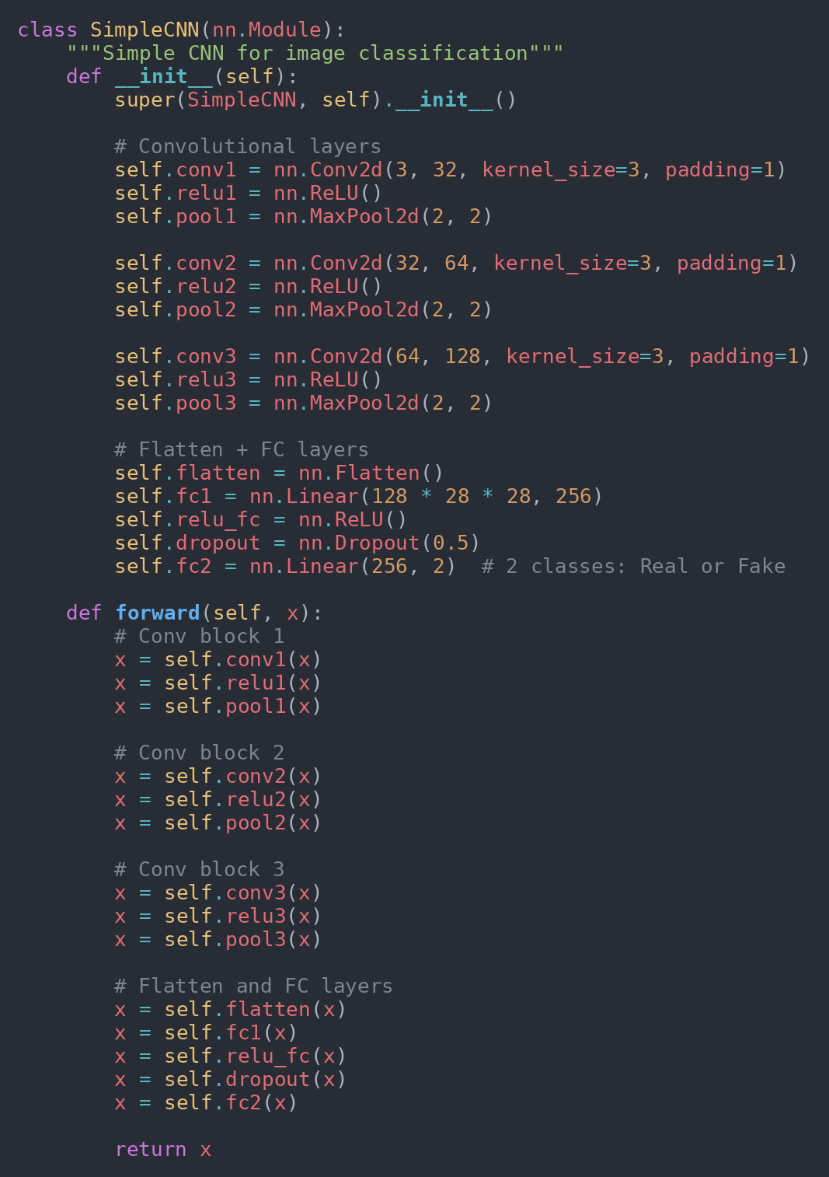
APPROACH 1 · ARCHITECTURE
A simple 3-block convolutional network
Exact code from the notebook
Input
224 × 224 × 3 RGB image
Conv block 1
Conv 3→32 · ReLU · MaxPool
Conv block 2
Conv 32→64 · ReLU · MaxPool
Conv block 3
Conv 64→128 · ReLU · MaxPool
FC + Dropout
Flatten → 256 · ReLU · Dropout 0.5
Output
2 logits , Real / AI-Generated
07

Slide 8
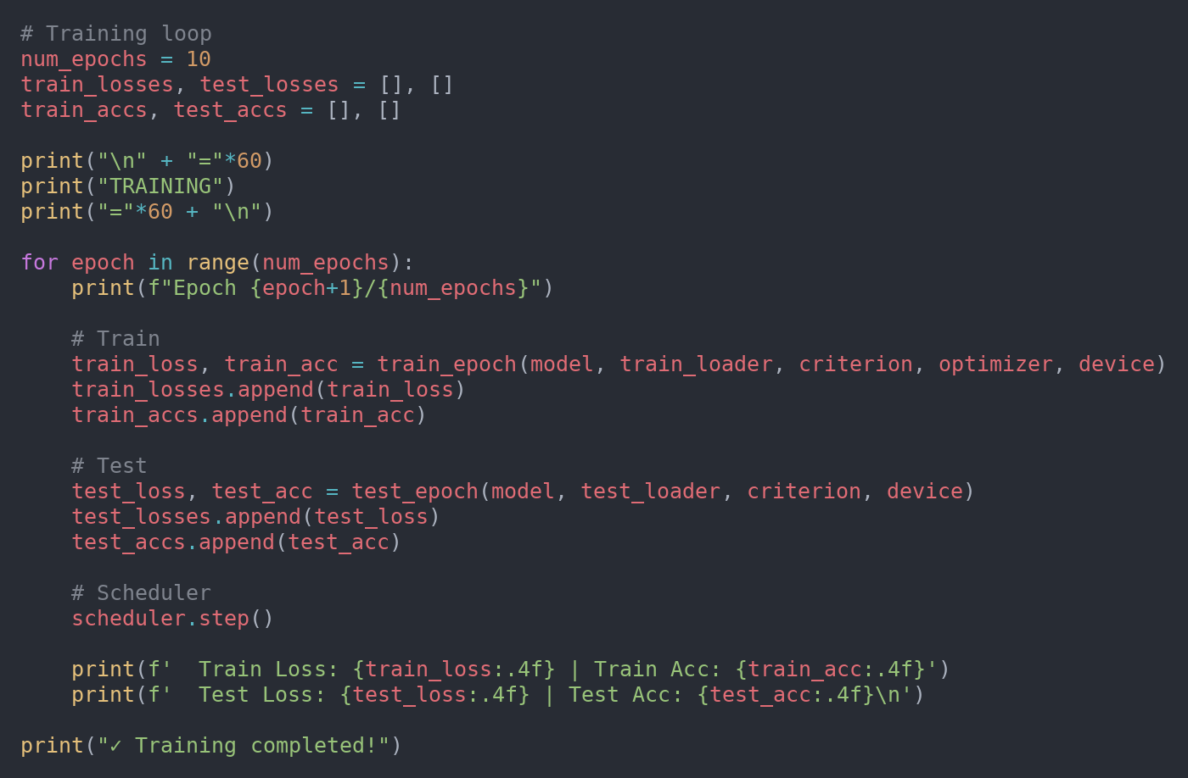
APPROACH 1 · TRAINING
Training setup
Loss
CrossEntropyLoss (class-weighted)
Exact code from the notebook
Optimizer
Adam · learning rate 1e-3
Scheduler
StepLR , halve LR every 5 epochs
Epochs
10
Batch size
32
Split
80 / 20 train–test, stratified
Class weights are computed from the train split, so the minority class counts more during back-propagation.
08

Slide 9
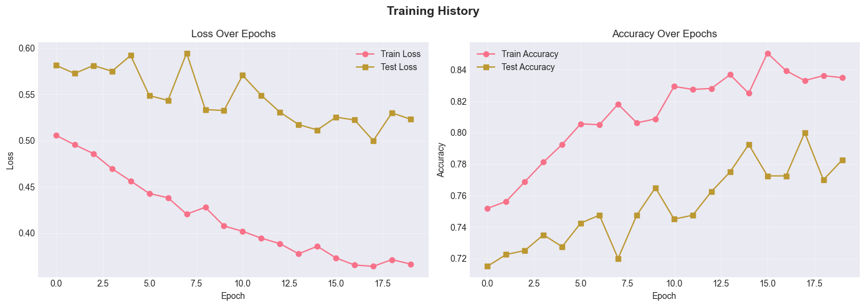
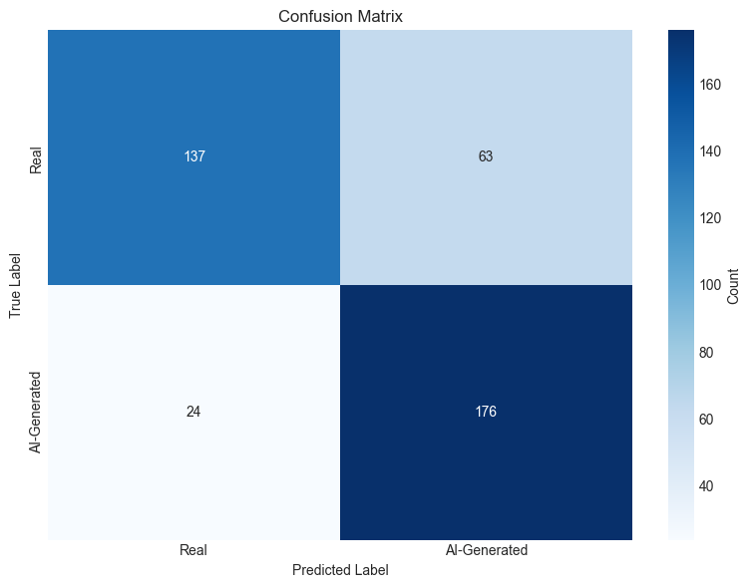
APPROACH 1 · PRELIMINARY RESULTS
Baseline works , but only just
78.3%
20
2.0k
Test accuracy
Epochs trained
Images (1k+1k)
Read-out
A from-scratch CNN learns the task to roughly four-in-five correct , usable, but well short of dependable.
With ~2,000 training images (1,000 per class as configured), the network learns its visual features from a near-cold start in just 20 epochs.
Clear headroom remains , motivating the move to a pretrained backbone in Approach 2.
Training history , loss & accuracy across the 20 epochs.
Confusion matrix on the test set (Real vs AI-Generated).
09

Slide 10
APPROACH 2 · WHAT CHANGED
From scratch → transfer learning with ResNet-50
COMPONENT
APPROACH 1
APPROACH 2
Model
SimpleCNN, 3 conv layers
Pretrained ResNet-50, fine-tuned
Augmentation
Flip + small rotation
+ RandomResizedCrop + ColorJitter
Optimizer
Adam, lr 1e-3
AdamW, lr 1e-4, weight decay 1e-4
Data split
Train / Test only
Train / Val / Test (proper held-out)
Model selection
Final epoch
Best validation accuracy (checkpointed)
LR schedule
StepLR (halve every 5)
CosineAnnealingLR (smooth decay)
10

Slide 11
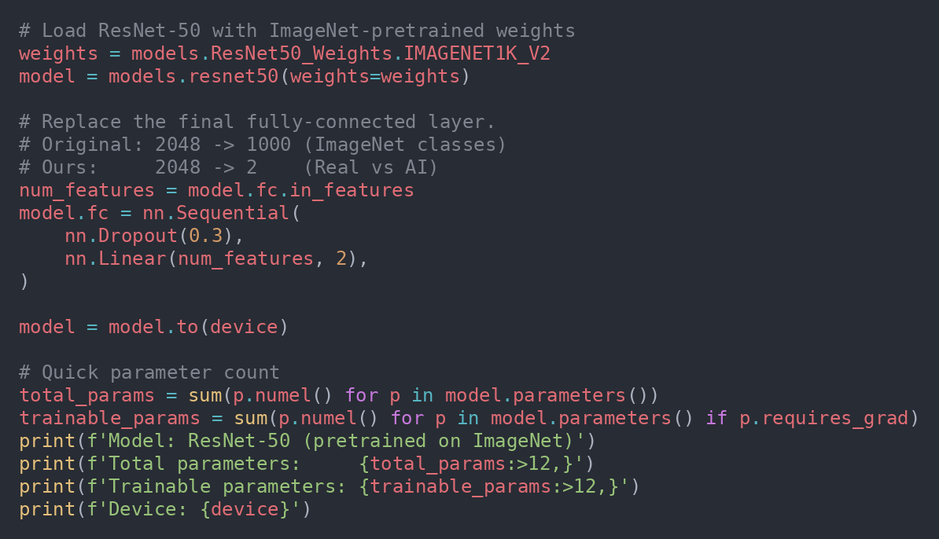



APPROACH 2 · ARCHITECTURE
Why pretrained ResNet-50?
Rather than learning visual features from a cold start, we reuse a network that already understands images , and teach it only the final decision.
Exact code from the notebook
Pretrained on ImageNet
1.2M images , already detects edges, textures, materials, shapes
Replace only the head
Final layer swapped from 2048→1000 to 2048→2 (Real / AI), with dropout 0.3
50 layers vs 3
~23.5M parameters carry rich, transferable visual knowledge
11

Slide 12
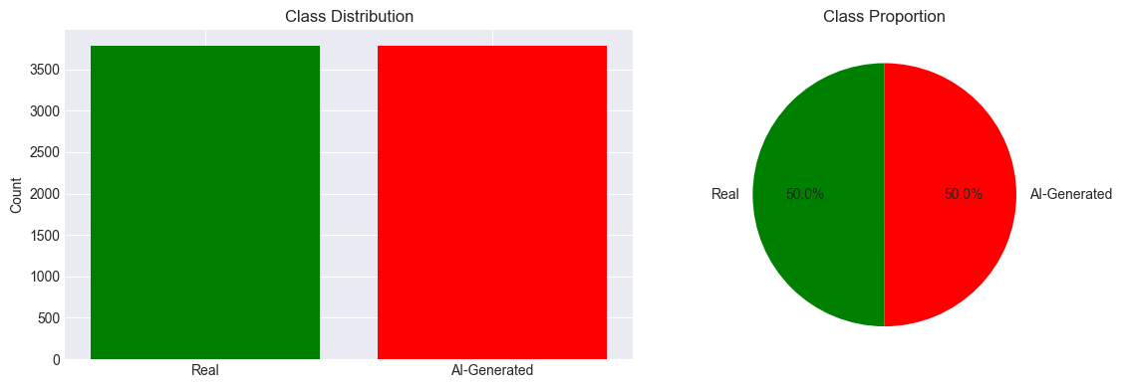
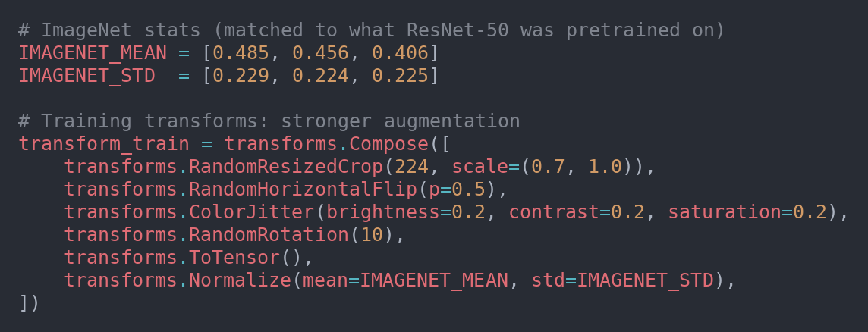
APPROACH 2 · DATA STRATEGY
Balanced 50 / 50 sample, honest splits & augmentation
50% real / 50% AI-generated used to train the model
real: picked 3780 of 3780 images
fake: picked 3781 of 17855 images
Proper 3-way split (stratified)
Train 70%
Val 15%
Test 15%
Class distribution of the balanced sample (notebook EDA).
Exact code from the notebook
Train , model learns from
Val , picks the best epoch
Test , touched only at the end
Fixes the earlier leak where the test set was used both to pick the best epoch and to report the final number.
12

Slide 13
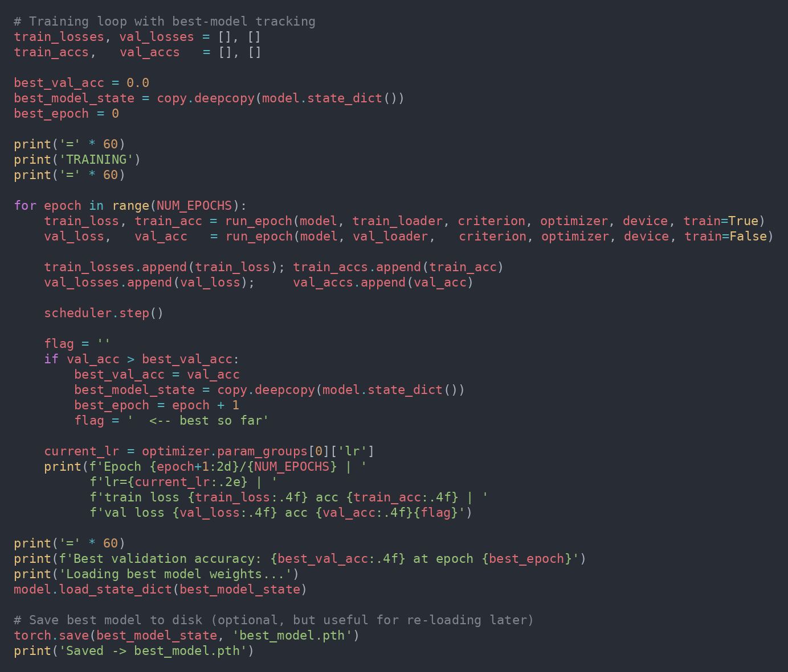
APPROACH 2 · TRAINING
Careful fine-tuning + best-model checkpointing
Exact code from the notebook
1
Low learning rate
1e-4 , small, careful updates so the valuable pretrained weights aren't smashed
2
AdamW + weight decay
1e-4 decay for slightly better generalization than plain Adam
3
CosineAnnealingLR
smooth LR decay over the 4 epochs instead of abrupt halving
4
Best-model checkpoint
save weights whenever validation accuracy improves; reload the best at the end
13

Slide 14
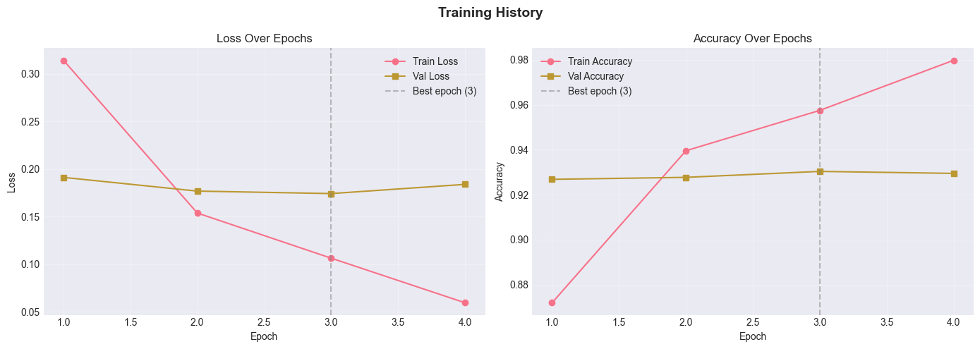
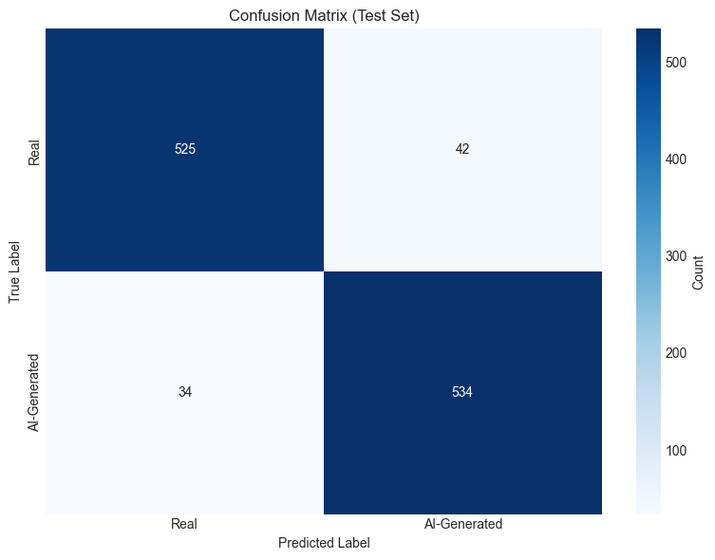
APPROACH 2 · FINAL RESULTS
Honest accuracy on the untouched test set
93.3%
92.7%
94.0%
0.934
Accuracy
Precision
Recall
F1-Score
Per-class: Real 525/567 (92.6%) · AI-Generated 534/568 (94.0%)
Best validation accuracy of 0.930 reached at epoch 3 of 4 and checkpointed; test set never seen during training or model selection , so this is the generalizable number.
Training & validation loss / accuracy (best epoch marked).
Confusion matrix , untouched test set.
14

Slide 15
FINDINGS
Approach 1 vs Approach 2
Test accuracy
What drove the +13-point jump
Pretrained features beat from-scratch learning on a small (~7.5k-image) dataset.
Stronger augmentation reduced overfitting and improved generalization.
AdamW + low LR + cosine schedule made stable, careful updates to good weights.
A proper held-out test set makes the 93.3% trustworthy , no leakage from model selection.
Best-epoch checkpointing kept the strongest model rather than the last one.
15

Slide 16

KEY TAKEAWAYS
What we learned
Automated detection is necessary
Humans hover near chance on the best fakes; a trained model is the only response that scales to the volume of generated imagery.
Transfer learning is the bigger lever
Swapping a from-scratch CNN for a pretrained ResNet-50 lifted accuracy from ~80% to 93.3% , more than any single hyperparameter tweak.
Methodology decides credibility
Balanced sampling, a true held-out test split, and best-epoch checkpointing are what make the final number honest, not just high.
16

Slide 17

CLOSING
Limitations & future work
Limitations
Future work
Trained mainly on DALL·E-style images , may not transfer to Midjourney, Stable Diffusion, or newer generators.
Subsampled to 3,781 fakes for balance; most of the 17,857 available fakes went unused.
Only 4 fine-tuning epochs at 224×224 resolution.
No insight yet into which image cues the model relies on.
Adversarially edited or compressed fakes were not stress-tested.
Train on all 17,857 fakes using class weights instead of subsampling.
Higher resolution (320–384) and stronger backbones , EfficientNet-B0, ConvNeXt-Tiny.
Add Grad-CAM to visualize the regions driving each decision.
Two-stage fine-tuning: freeze the backbone first, then unfreeze.
Evaluate cross-generator generalization and robustness to compression.
17

