Slide 1
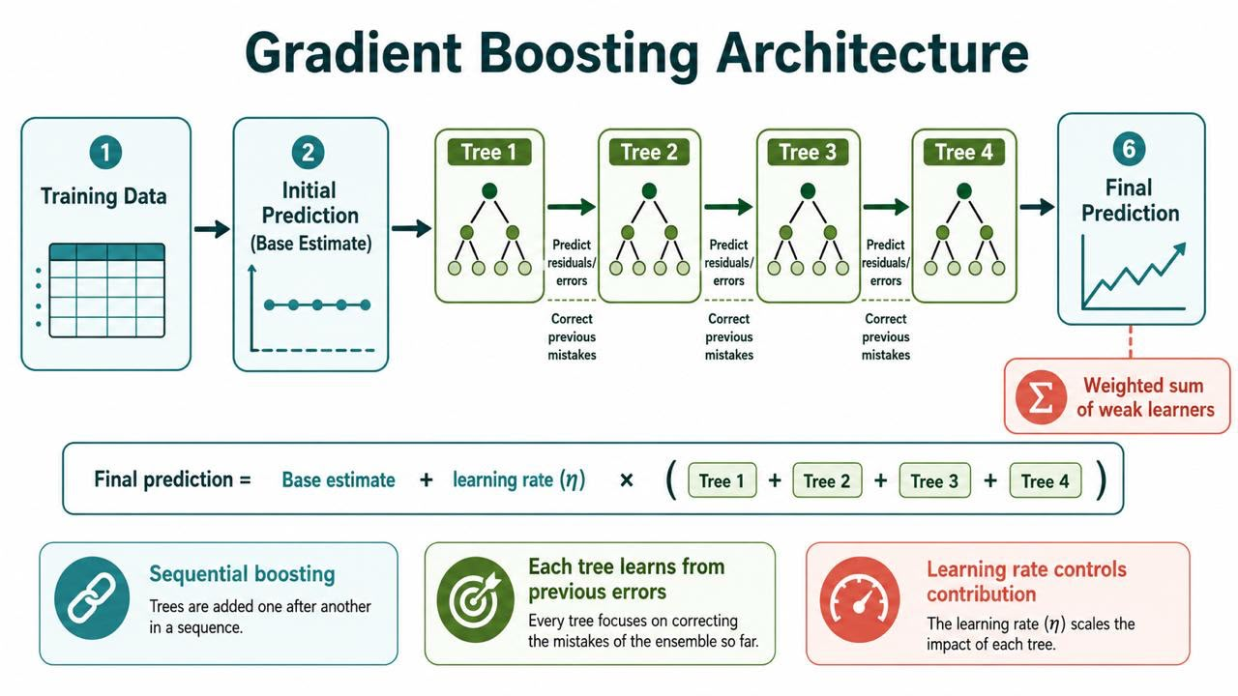
Gradient Boost — ML Algorithm Description
Description · 1/2
DESCRIPTION
What is Gradient Boosting?
Gradient Boosting Architecture
A Gradient Boosting Regressor builds decision trees one after another. It starts from a single simple guess — the average cost — then each new tree is trained to predict the errors left behind by all the trees so far.
Every tree corrects the previous one, so the model keeps squeezing more signal out of the route, contract, vehicle and load features.
Boosting:
It shallow trees built in sequence, each fixing the last — usually lower error, but more sensitive to its settings.
Key Observations
Gradient Boosting sits at the higher-accuracy, higher-sensitivity end of tree ensembles — each stage focuses only on what the previous stages got wrong.
This fits FreightIQ well: cost is continuous and driven by a mix of route, vehicle, product, geography, time, distance and load.
FreightIQ · Team GR01 · Gradient Boosting · AIM SoSe 2026
1

Slide 2
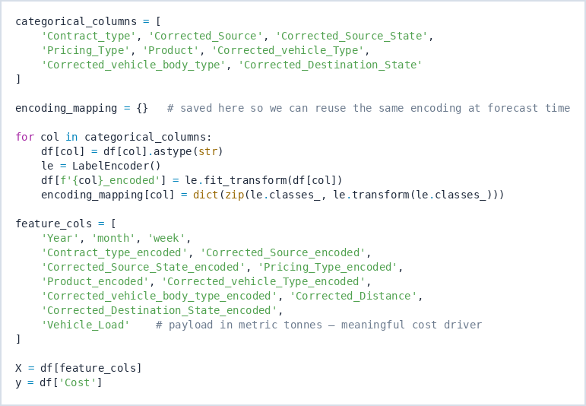
Gradient Boost — Encoding & Train / Validation / Test Split
Model Design · 1/2
MODEL DESIGN
Notebook Cell 8 — categorical label encoding
80 / 10 / 10 split — Notebook Cell 12
TRAIN
VALIDATION
TEST
80%
10%
10%
308,857
38,607
38,608
rows
rows
rows
Why a separate validation set?
Train (80%) fits the tree splits. Validation (10%) runs early-stopping and picks baseline vs tuned. Test (10%) is touched only once, for the final unbiased figures.
8 categorical columns are label-encoded; the encoding map is saved and reused later for the April forecast.
Key Observations
13 numeric + encoded features feed the model; a fixed random_state = 42 makes the split and both trained models reproducible from run to run.
The same encoding_mapping is applied at forecast time, so unseen April routes are encoded exactly as in training.
FreightIQ · Team GR01 · Gradient Boosting · AIM SoSe 2026
2

Slide 3
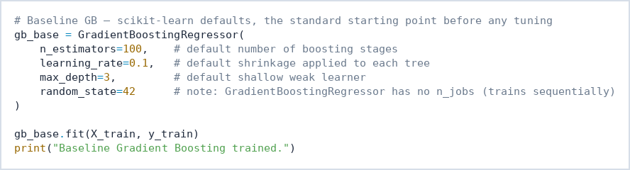
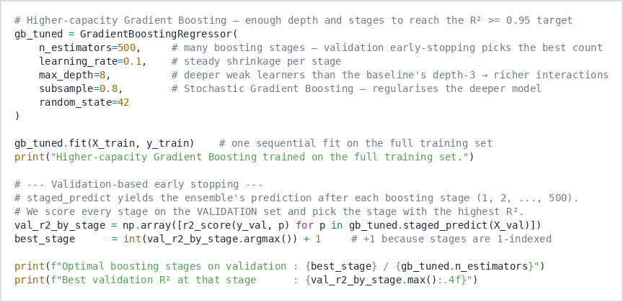
Gradient Boost — Parameters & Hyperparameters
Description · 2/2
DESCRIPTION
Hyperparameter | Baseline | Tuned | What it controls
n_estimators | 100 | 500 | Number of boosting stages
learning_rate | 0.1 | 0.1 | Shrinks each tree's contribution
max_depth | 3 | 8 | Depth of each weak learner
subsample | 1.0 | 0.8 | Row fraction per tree (regularises)
random_state | 42 | 42 | Reproducible result
Notebook Cell 13 — baseline configuration
Notebook Cell 21 — higher-capacity tuned model
Parameter = learned during .fit() (split thresholds, leaf values). Hyperparameter = set before training; controls structure and how aggressively the model learns.
Key Observations
Unlike Random Forest, scikit-learn's GradientBoostingRegressor trains one tree at a time and has no n_jobs — it cannot parallelise across cores.
learning_rate and n_estimators trade off: a lower rate needs more stages to reach the same fit.
FreightIQ · Team GR01 · Gradient Boosting · AIM SoSe 2026
3

Slide 4
Model Design — Model Selection Justification
Justification · 1/1
JUSTIFICATION
Freight cost does not rise in a straight line with distance — it also depends on vehicle, product, contract type and route. Gradient Boosting models exactly this kind of mixed, non-linear data.
1
Predictive accuracy
2
Non-linear pricing
3
Mixed & robust
4
Explainable (XAI)
Sequential error-correction beats simple averaging on tabular data — squeezing maximum signal from route/contract/vehicle patterns.
Additive shallow trees model complex curves and interactions; cost does not scale linearly with distance.
Works directly on label-encoded integers (8 categorical + 5 numeric); threshold splits resist extreme high-cost outliers.
Built-in MDI importance plus native SHAP TreeExplainer — business users can audit which factors drive each price.
Non-linear
Mixed types
Outliers
Explainability
Handled
Handled
Resisted
MDI + SHAP
Key Observations
Linear Regression captures distance alone but misses vehicle- and contract-specific interactions — Gradient Boosting captures those automatically and reaches the R² ≥ 0.95 target.
It fits structured logistics data well while staying interpretable enough for a non-technical audience.
FreightIQ · Team GR01 · Gradient Boosting · AIM SoSe 2026
4

Slide 5
Model Design — Dataset & Feature Selection
Model Design · 2/2
MODEL DESIGN
386,072
13
308,857
77,215
Rows after dedup
Features used
Training rows
Val + Test rows
The model trains on the cleaned dataset from Part I — every retained shipment has non-null Cost, Distance, Load and all required route fields.
Feature group | Columns used | Why it matters
Route geography | Source, Source State, Destination State | Captures lane-specific supply and demand
Operational | Contract type, Product, Pricing type, Vehicle type, Body type | Captures pricing structure and cargo handling
Commercial | Distance, Vehicle Load | Direct driver of fuel, time and toll cost
Time | Year, month, week | Captures seasonal and yearly pricing patterns
Encoding is reused, not relearned
Each categorical column is turned into an integer with LabelEncoder, and the mapping is stored in encoding_mapping.
Pricing_Type carries almost no signal in this cleaned data (≈0% importance) but is kept for consistency with the shared team feature set.
Key Observations
All 386,072 cleaned shipments are used — no extra rows drop out, confirming the earlier cleaning stage already removed nulls and invalid values.
Distance and Vehicle Load are the strongest commercial drivers and dominate the later importance rankings.
FreightIQ · Team GR01 · Gradient Boosting · AIM SoSe 2026
5

Slide 6
Performance Analysis — Baseline Gradient Boost
Performance · 1/2
PERFORMANCE ANALYSIS
Split | R² | RMSE (Rs.) | MAE (Rs.) | MAPE
Train | 0.7984 | 628.94 | 414.20 | 29.91%
Validation | 0.8026 | 621.05 | 408.87 | 29.47%
Test | 0.8020 | 623.33 | 409.57 | 29.53%
Notebook Cell 13 — baseline fit
Interpreting the metrics
Train − Test R² gap = −0.0036 (threshold 0.05) → not overfitting
MAE — average Rupee error per shipment. RMSE — penalises large misses more. R² — share of cost variance explained. MAPE — average % error per shipment.
The shallow baseline (100 trees, depth 3) underfits — it leaves cost signal uncaptured.
Key Observations
The baseline explains about 80% of freight-cost variance on unseen test data, with an average error near Rs.410 per shipment.
Training and test scores are almost equal (gap −0.0036), so the weak learner generalises but leaves accuracy on the table — motivating the higher-capacity model next.
FreightIQ · Team GR01 · Gradient Boosting · AIM SoSe 2026
6

Slide 7
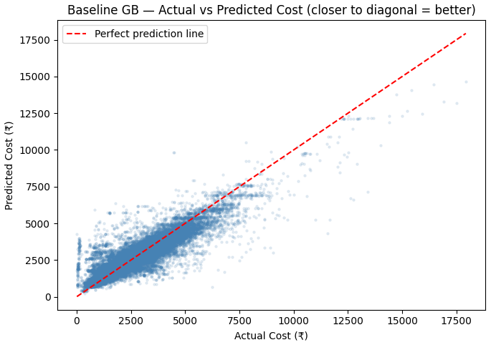
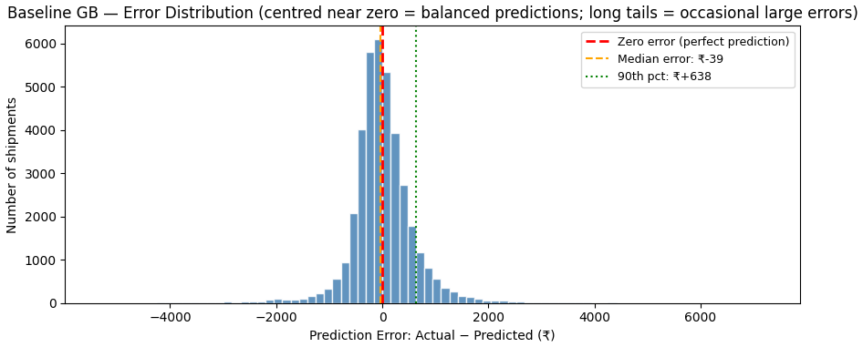
Performance Analysis — Baseline Error Behaviour
Performance · 2/2
PERFORMANCE ANALYSIS
Actual vs Predicted — test shipments
Error distribution (Actual − Predicted)
Rs. −39
Rs. 877
74.5%
Rs. 623
Median error
90th pct. abs error
Predictions within Rs.500
Test RMSE
Key Observations
Errors cluster near zero (median Rs.−39) with no systematic bias — the baseline neither over- nor under-prices on average; the long tail comes from rare, high-value routes.
FreightIQ · Team GR01 · Gradient Boosting · AIM SoSe 2026
7

Slide 8
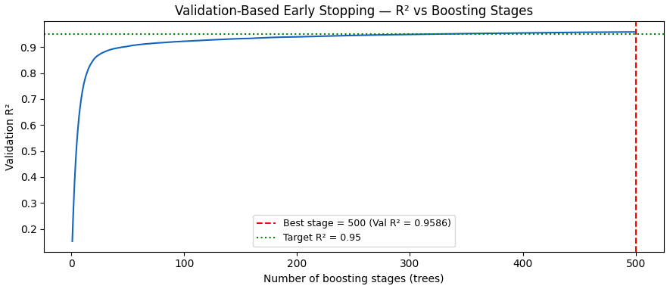
Improvements — Hyperparameter Tuning (RandomizedSearchCV)
Improvements · 1/3
IMPROVEMENTS
Notebook Cell 21 — higher-capacity model + early stopping
Validation curve — R² vs boosting stages
Validation-based early stopping
500
depth 8
0.8
staged_predict scores the ensemble after every boosting stage on the validation set; the stage with the highest validation R² is kept, so trees that would only overfit are never added.
boosting stages
weak learners
subsample
Key Observations
Raising capacity — depth 3 → 8 and 100 → 500 stages with subsample = 0.8 — lifts validation R² from 0.80 to 0.9586, clearing the 0.95 target.
The test set stays untouched during tuning; only train and validation are used, so the final test score remains an honest estimate.
FreightIQ · Team GR01 · Gradient Boosting · AIM SoSe 2026
8

Slide 9
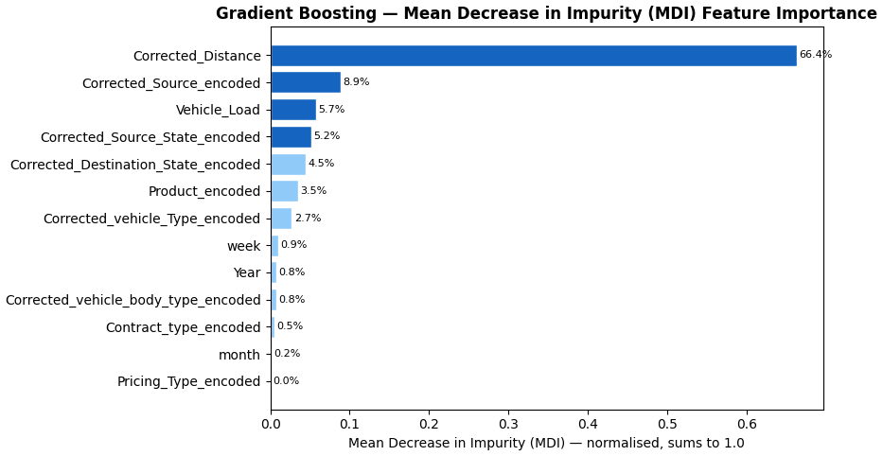
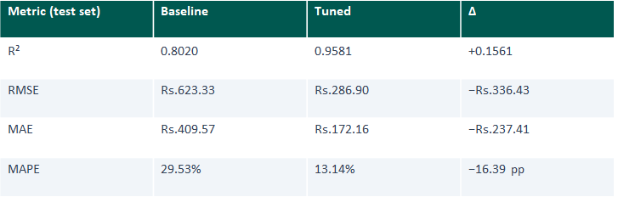
Improvements — Baseline vs Tuned Gradient Boost
Improvements · 2/3
IMPROVEMENTS
Split | Baseline R² | Tuned R² | Baseline MAE | Tuned MAE
Train | 0.7984 | 0.9715 | Rs. 411.19 | Rs. 155.84
Validation | 0.8026 | 0.9586 | Rs. 412.23 | Rs. 174.11
Test | 0.8020 | 0.9581 | Rs.409.57 | Rs. 172.16
Tuned model — MDI feature importance
The selection rule favours the model with the higher validation R² — here the tuned model wins on every split.
+0.156
−Rs.336
−Rs.237
Tuning genuinely improves the model
Deeper trees plus more boosting stages capture the route/load interactions the shallow baseline missed — without overfitting (train−test gap only 0.0135).
R² gain (test)
RMSE reduction
MAE reduction
Key Observations
Every metric — R², MAE, RMSE and MAPE — favours the tuned model on both validation and test, not just one metric in isolation.
The choice is made on validation R² before the test set is consulted, so it reflects genuine generalisation rather than a lucky test split. *Train MAE shown for reference.
FreightIQ · Team GR01 · Gradient Boosting · AIM SoSe 2026
9

Slide 10
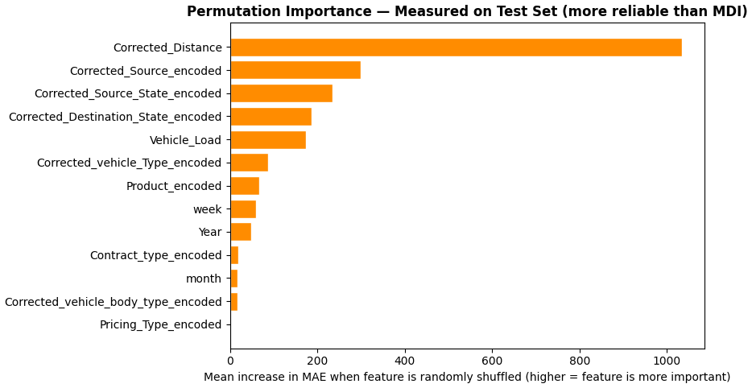
Improvements — Feature Importance (MDI & Permutation)
Improvements · 3/3
IMPROVEMENTS
MDI Feature Importance — Tuned GB
Permutation Importance — measured on test set
66.4%
8.9%
5.7%
0.0%
Distance — MDI share
Source city — MDI share
Vehicle Load — MDI share
Pricing Type — MDI share
Key Observations
Distance dominates both rankings (66.4% MDI), followed by source city and state, then destination geography and load — two independent methods agree, so the ranking is not an artifact of high-cardinality columns.
Pricing_Type contributes ≈0%, exactly as expected for this cleaned dataset; SHAP adds direction on top of these magnitudes.
FreightIQ · Team GR01 · Gradient Boosting · AIM SoSe 2026
10

Slide 11
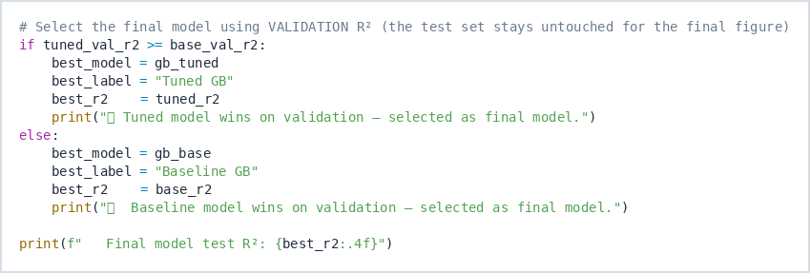
Final Performance Analysis — Model Selection
Final Performance · 1/2
FINAL PERFORMANCE ANALYSIS
Notebook Cell 38 — final model selection (validation-first)
0.9581
Rs.286.90
Final Test R²
Test RMSE
Rs.172.16
13.14%
Test MAE
Test MAPE
Selection process
Final model: Tuned Gradient Boosting
→
→
1
2
3
Selected using the higher validation R² — not chosen from the test result. This makes the conclusion stronger: the tuned model generalises better rather than simply scoring well by chance on the held-out test set.
Train baseline & tuned GB on the same split
Compare validation R² only
Report the test score for the winner, once
Key Observations
Validation-first selection: the baseline-vs-tuned choice was locked in on validation R² before test data was consulted — the process finds whichever configuration performs best; it doesn't confirm a result after the fact.
FreightIQ · Team GR01 · Gradient Boosting · AIM SoSe 2026
11

Slide 12
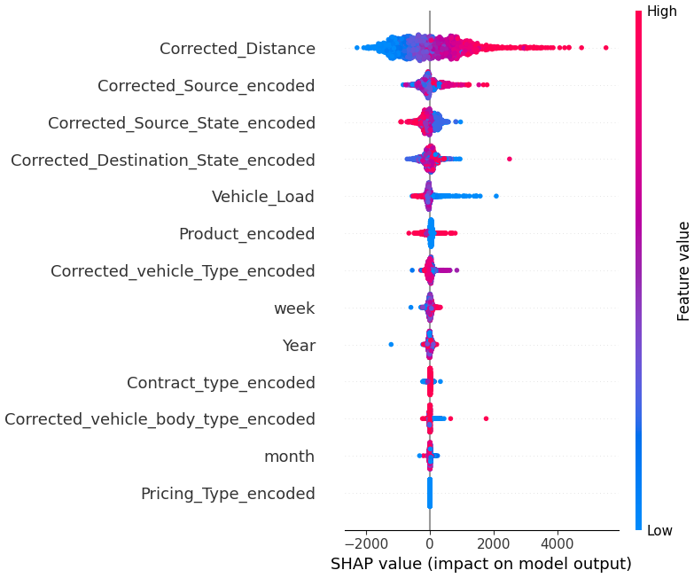
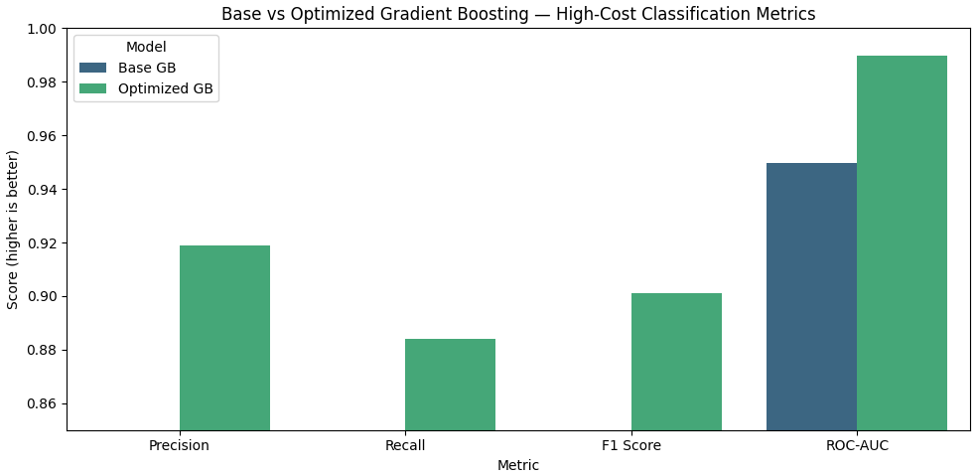
Final Performance Analysis — Residuals & SHAP Model Trust
Final Performance · 2/2
FINAL PERFORMANCE ANALYSIS
High-cost detection — Base vs Tuned GB
SHAP beeswarm — 2,000 test predictions
Key Observations
On high-cost detection (top-20% shipments) the tuned model reaches precision 0.919, recall 0.884, F1 0.901 and ROC-AUC 0.990 — well above the baseline (F1 0.766).
SHAP confirms the same ranking as MDI and permutation: Distance dominates, followed by source geography and load, and it adds direction — high distance pushes predicted cost up.
FreightIQ · Team GR01 · Gradient Boosting · AIM SoSe 2026
12

