Slide 1

Note: The data and information in this document is reflective of a hypothetical situation and client. This document is to be used for KPMG Virtual Internship purposes only.
Sprocket Central Pty Ltd
Data analytics approach

Slide 2
Note: The data and information in this document is reflective of a hypothetical situation and client. This document is to be used for KPMG Virtual Internship purposes only.
Agenda
Introduction
Data Exploration
Model Development
Interpretation

Slide 3

Note: The data and information in this document is reflective of a hypothetical situation and client. This document is to be used for KPMG Virtual Internship purposes only.
Introduction
Customer target modelling
Assumption
Old customers with transaction history are assigned as targeted candidates.
Inconsistencies and missing captures are handled using data distribution and similar customer data.
Place any supporting images, graphs, data or extra text here.

Slide 4
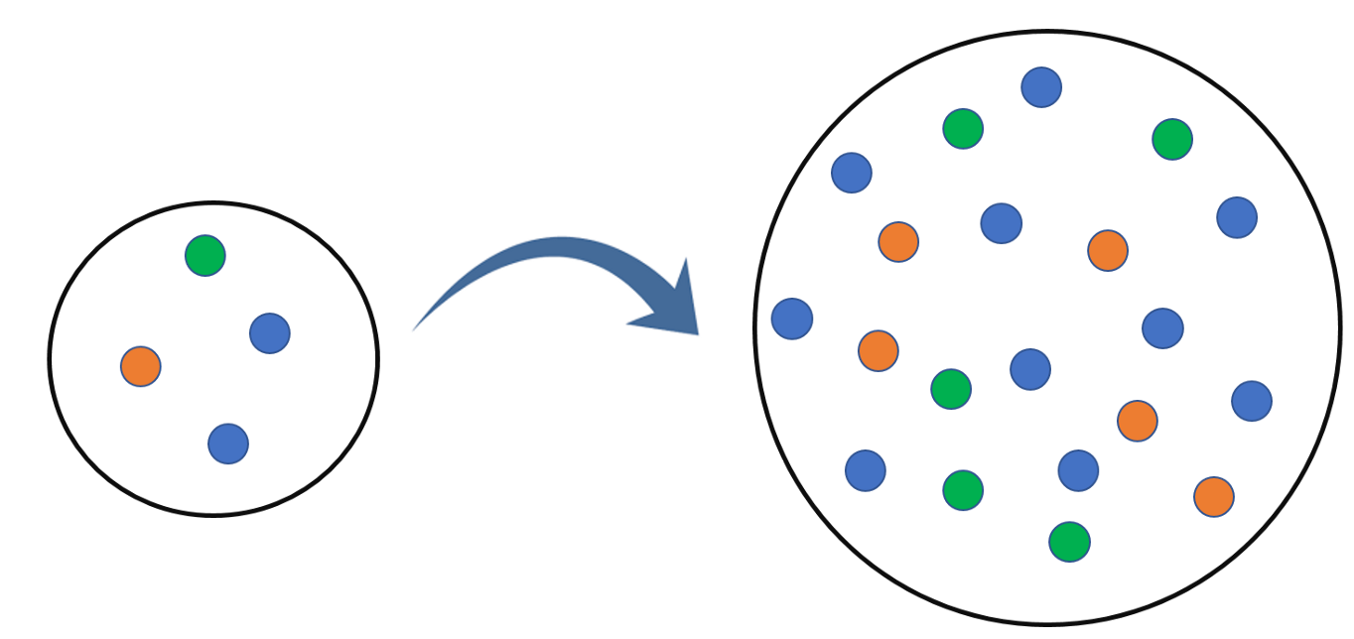
Note: The data and information in this document is reflective of a hypothetical situation and client. This document is to be used for KPMG Virtual Internship purposes only.
Data Exploration
Customer are categorised based on age as Young(<30) ,Adult (<55) and Elderly(>55)
Data Imbalance - Majority of the customers are potential target. Mitigated using up sampling.
Job Title doesn’t influence customer behavior.

Slide 5
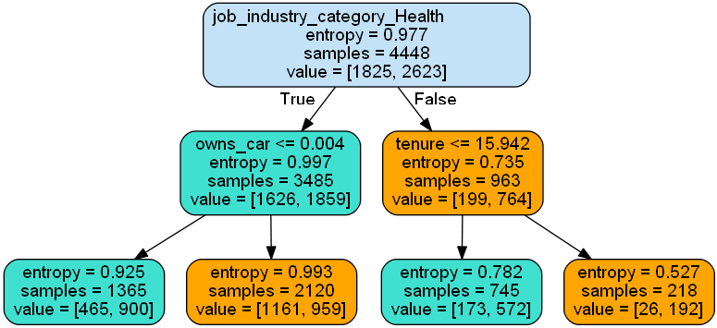
Note: The data and information in this document is reflective of a hypothetical situation and client. This document is to be used for KPMG Virtual Internship purposes only.
Model Development
Decision Tree Customer Classification
Partial Tree
Model Accuracy is 85%
855 potential customers to be targeted.
Nearly 12 – 16% of customers doesn’t make any transactions.

Slide 6
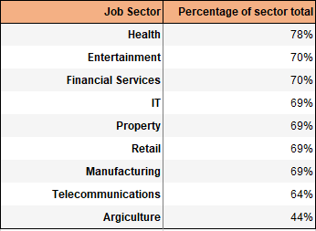
Note: The data and information in this document is reflective of a hypothetical situation and client. This document is to be used for KPMG Virtual Internship purposes only.
Interpretation
Customer Job Sector is the important feature to target a customer
Target customers across various sectors
Health sector customers are active
Elderly customers can be targeted
Employees of IT, Property and telecommunication sector with property value above 7 have higher chance of purchasing.

Slide 7
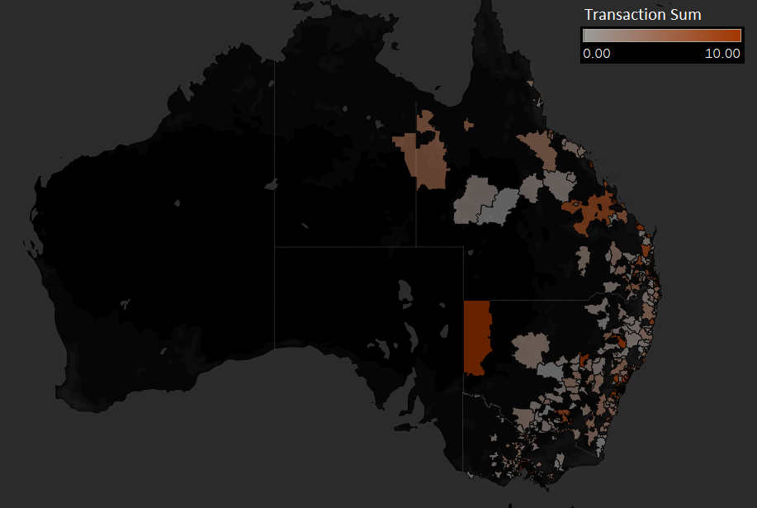
Note: The data and information in this document is reflective of a hypothetical situation and client. This document is to be used for KPMG Virtual Internship purposes only.
Appendix
Active customers as per the pin code

