Slide 1

Canvas Instructor Dashboard
Data Analytics Hackathon
MDSSSSharks

Slide 2
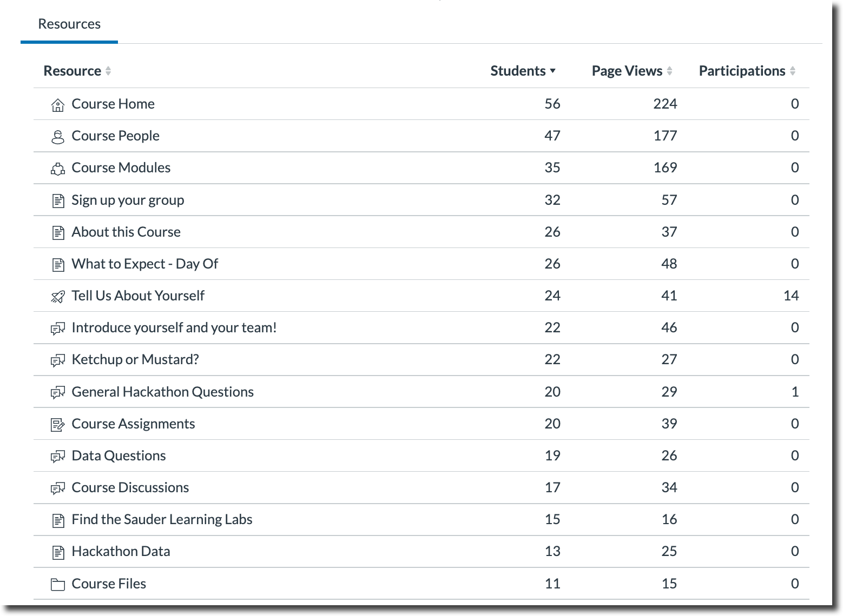
Background
Canvas provides instructors with “Live Events” data
The events data is difficult to interpret
Table view requires high cognitive load
It is difficult for instructors to compare between courses
A dashboard view would make this data useful

Slide 3
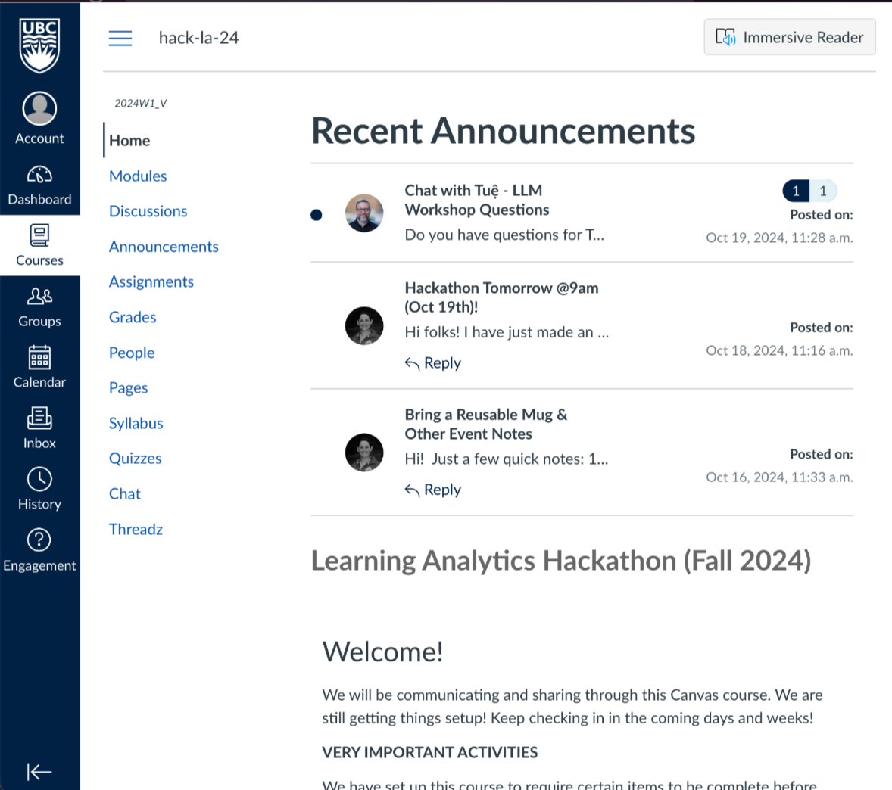

Slide 4
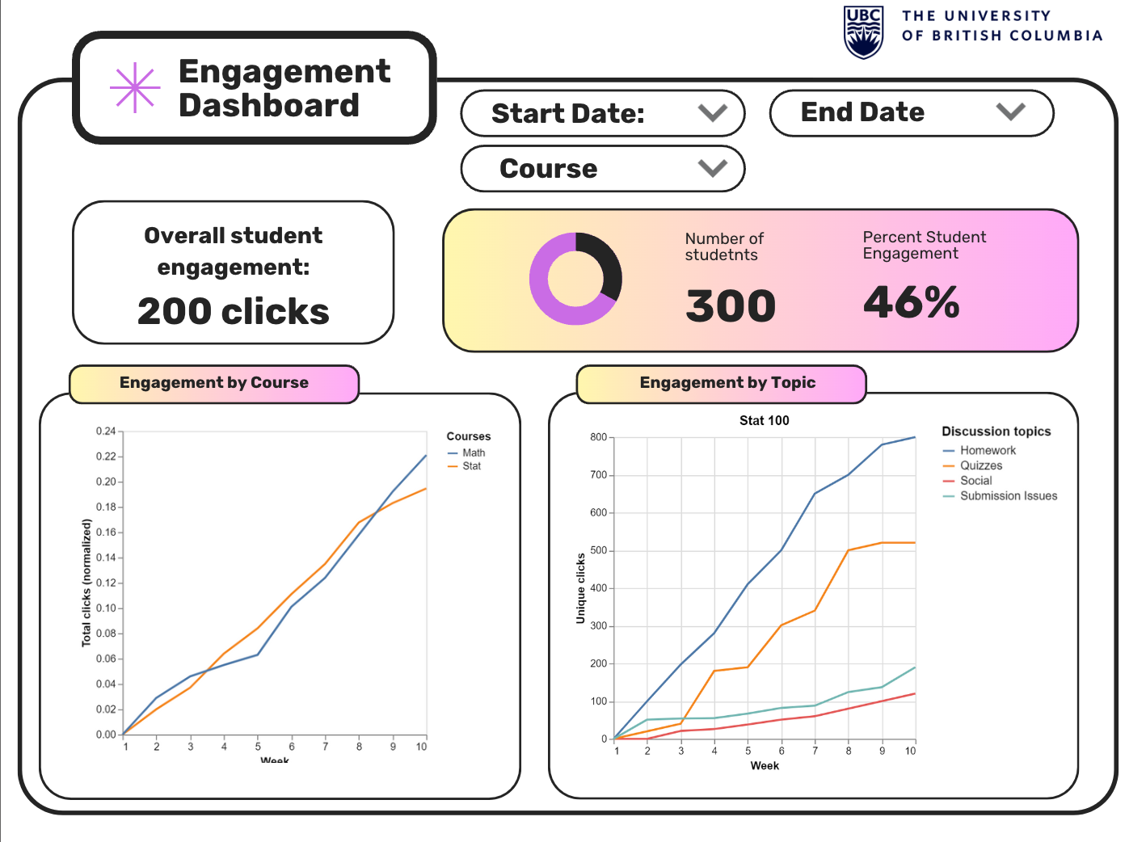

Slide 5
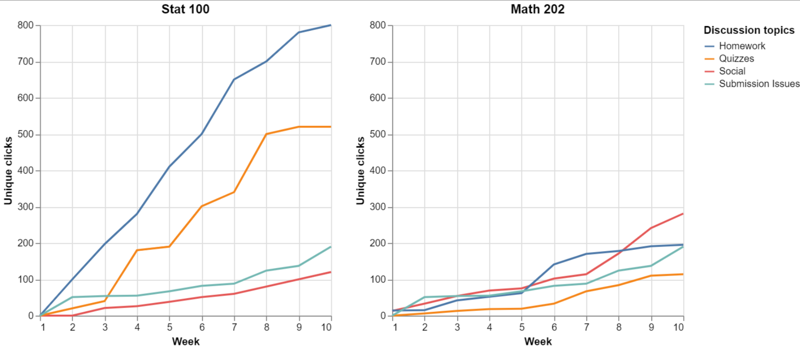

Slide 6
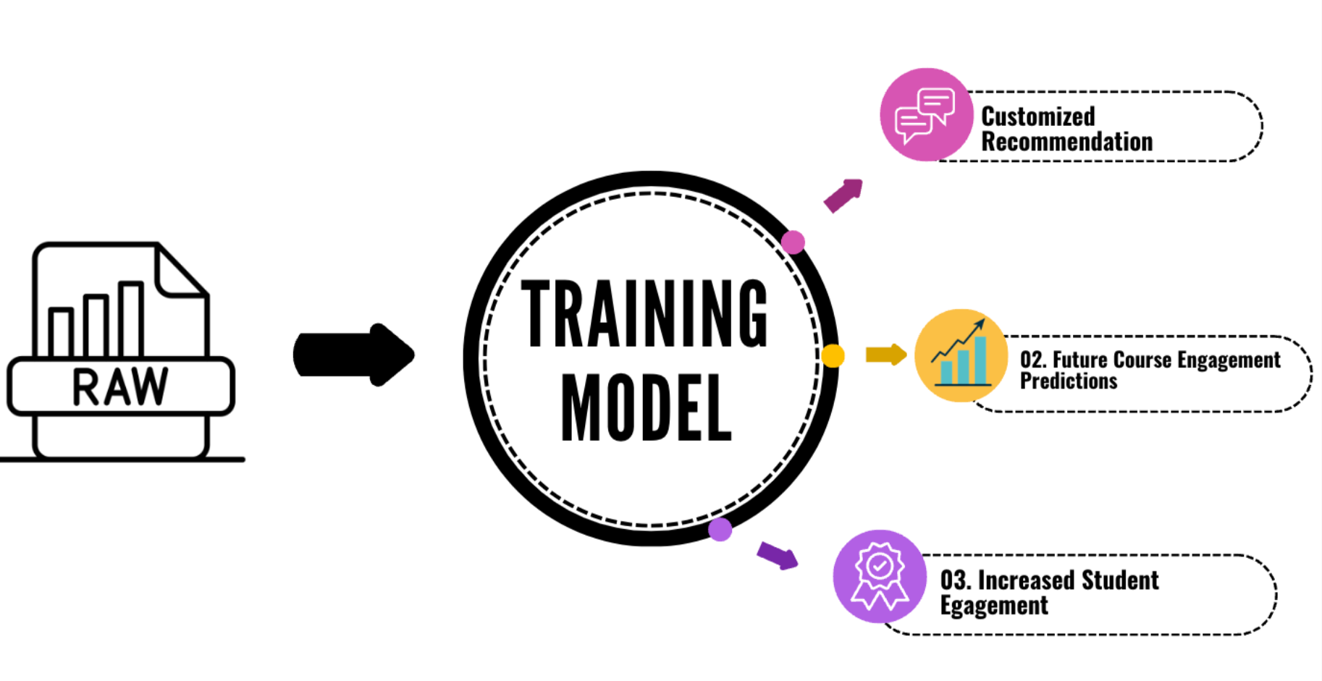
Next Steps

