Slide 1
M.TECH MINI PROJECT
FinGenius AI
Smart Personal Finance Tracker Powered by Gemini AI
MERN Stack • Budgets • Goals • Analytics • AI Chat • Receipt OCR • Voice Entry
Presented by
[Student Name] | Reg. No. [Register Number]
M.Tech, Computer Science Engineering
Department of Computer Science and Engineering
[College Name]

Slide 2
MOTIVATION
Problem Statement & Objectives
The Problem
Project Objectives
▸ Scattered records: people track expenses in notebooks or spreadsheets, with no single place for income, budget, and goals.
▸ No intelligent insight: free tools simply store numbers without explaining spending patterns or suggesting improvements.
▸ Manual entry is tedious: typing every transaction by hand causes many users to abandon tracking within weeks.
▸ No natural language help: users cannot simply ask "How much did I spend on food?" and get a direct answer.
▸ Privacy concerns: many finance apps need access to bank SMS or account details to work.
▸ Unified tracking: record expenses and income and organise them into clear categories.
▸ Budget and goal planning: set monthly category budgets and savings goals with progress tracking.
▸ AI powered chat: integrate Google Gemini AI to answer questions using the user's own data.
▸ Faster data entry: support receipt scanning (OCR) and voice based expense entry.
▸ Visual analytics: present spending and saving trends through interactive charts.
FinGenius AI • M.Tech Mini Project • [Student Name] • [College Name]
1

Slide 3
SYSTEM DESIGN
System Architecture - Frontend & Backend
CLIENT SIDE • React.js Frontend
SERVER SIDE • Node.js Backend
▸ React 18 + Vite: component based single page application
▸ Tailwind CSS: responsive glassmorphism styling, dark/light theme
▸ Framer Motion: smooth page and card animations
▸ Recharts: interactive analytics charts
▸ React Router v6: client side routing between pages
▸ Axios: REST API communication with the backend
▸ Pages: Landing, Login, Register, Dashboard, Expenses, Income, Budget, Goals, Analytics, Chat, Settings
▸ Node.js + Express.js: REST API server with route-controller structure
▸ MongoDB Atlas + Mongoose: cloud database and schema modelling
▸ JWT + bcryptjs: token based authentication, hashed passwords
▸ Google Gemini AI: AI chat assistant with financial context
▸ Tesseract.js: OCR engine for receipt scanning
▸ Multer: file upload handling for receipt images
▸ Middleware: JWT auth guard, rate limiter, input validator, error handler
FinGenius AI • M.Tech Mini Project • [Student Name] • [College Name]
2

Slide 4
HOW IT WORKS
Methodology - From Login to AI Insight
Register & Login
JWT + bcrypt
Dashboard
Balance overview
Add Transaction
Manual/OCR/Voice
Budget & Goals
Category limits
Analytics
Recharts trends
AI Chat
Gemini financial Q&A
▸ User Authentication: a user registers with name, email, and password; passwords are hashed with bcryptjs (12 salt rounds) and login issues a 7-day JWT token used to authorise every later request.
▸ Recording Transactions: expenses and income can be entered manually, extracted from a receipt photo using Tesseract.js OCR, or logged by speaking through the Web Speech API.
▸ Budget and Goal Tracking: users set category wise monthly budgets and savings goals with a target amount; the system tracks actual spending and contribution progress automatically.
▸ Analytics Generation: Recharts renders monthly expense trend, income vs expense, category breakdown, and savings trend charts from the stored MongoDB data.
▸ AI Powered Chat: the backend sends the user’s financial summary (expenses by category, income, budget status, goals, recent transactions) to Google Gemini 1.5 Flash, which answers questions in plain language.
FinGenius AI • M.Tech Mini Project • [Student Name] • [College Name]
3

Slide 5
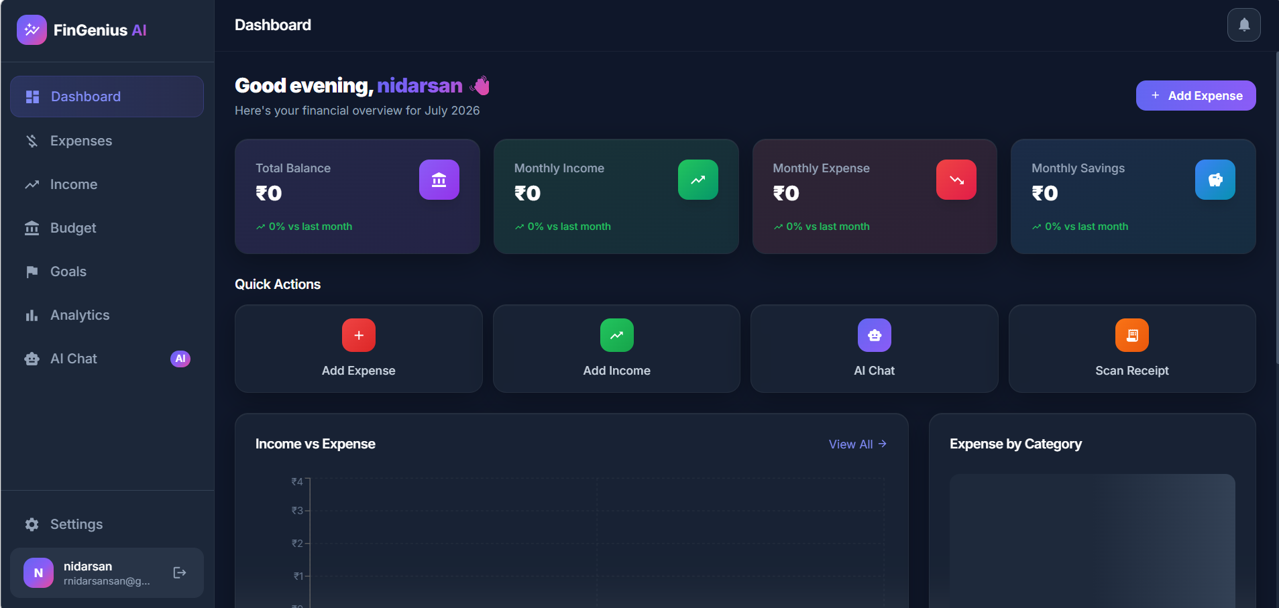
IMPLEMENTATION
Technology Stack
Frontend and Backend Technologies
Dashboard • Financial Overview
Technology | Purpose
React 18 + Vite | Frontend UI
Tailwind CSS | Responsive styling
Node.js + Express.js | Backend REST APIs
MongoDB + Mongoose | Database & schema
JWT + bcryptjs | Auth & security
Google Gemini AI | AI chat assistant
Tesseract.js | Receipt OCR
Web Speech API | Voice entry
Recharts | Analytics charts
FinGenius AI • M.Tech Mini Project • [Student Name] • [College Name]
4

Slide 6
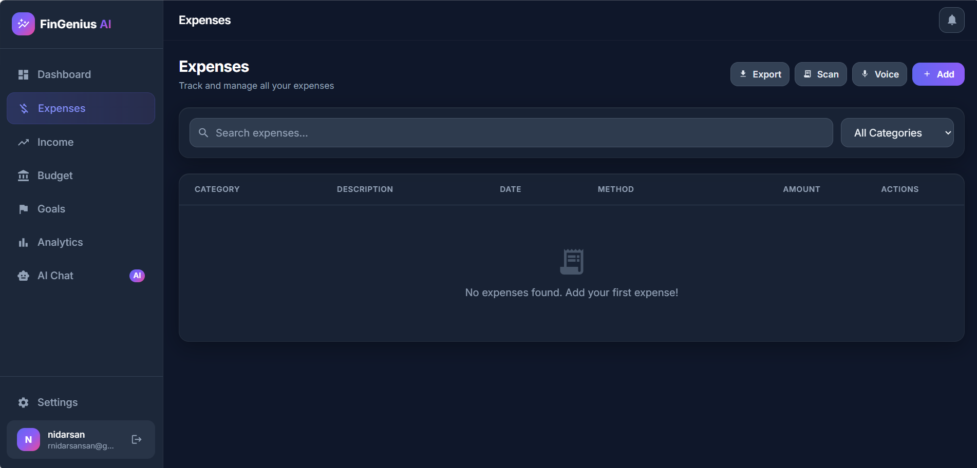
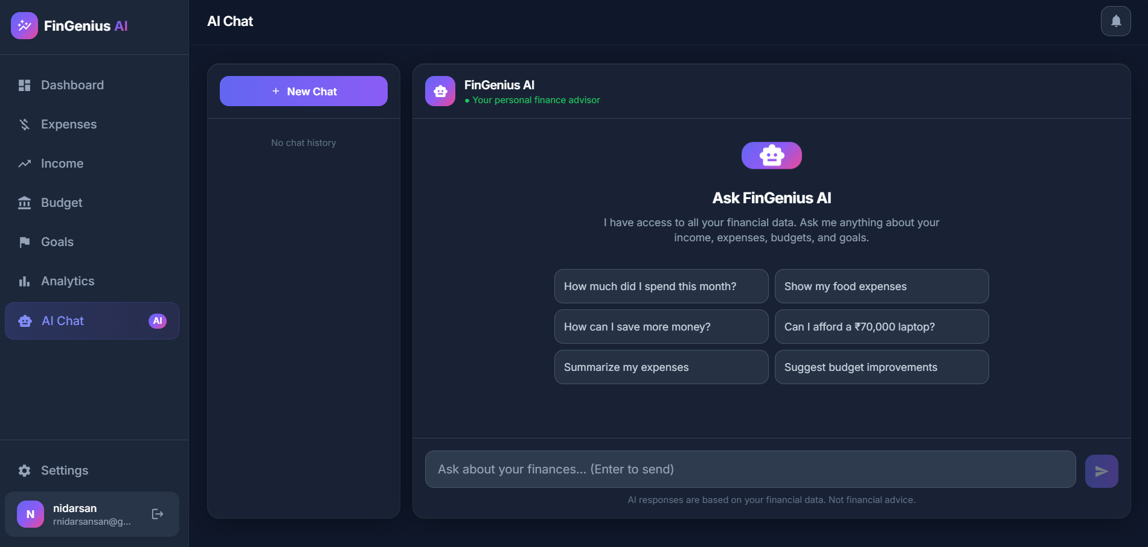
LIVE SYSTEM
Application Walkthrough
Expenses • Search • Filter • Scan • Voice
AI Chat • Gemini Powered Assistant
FinGenius AI • M.Tech Mini Project • [Student Name] • [College Name]
5

Slide 7
COMPARISON
Comparison with Existing Systems
Existing Methods vs. FinGenius AI
Feature | Manual / Excel | Typical Finance Apps | FinGenius AI
Security | None / basic | Varies by app | JWT + bcrypt hashing
AI Assistance | Not available | Rare or basic | Gemini AI chatbot
Expense Entry | Manual only | Manual entry | Manual, OCR, and voice
Cost | Free | Free to paid | Free for this project
Merits
Limitations
▸ AI powered insights based on the user’s real financial data
▸ Multiple ways to log expenses - manual, receipt scan, voice
▸ Completely free with all features unlocked
▸ Secure - JWT authentication and hashed passwords
▸ No direct bank account integration yet - entries are manual or scanned
▸ Requires an internet connection for all operations
▸ OCR accuracy depends on the quality of the receipt image
▸ Voice recognition works best in Chrome or Edge browsers
FinGenius AI • M.Tech Mini Project • [Student Name] • [College Name]
6

Slide 8
WRAP-UP
Conclusion & Future Work
Conclusion
Future Work
▸ Delivered a full-stack personal finance tracker combining expense, income, budget, and goal management with an AI chat assistant.
▸ Integrated Google Gemini AI so users get personalised, data based answers instead of generic financial tips.
▸ Added Receipt OCR and Voice Entry to reduce the effort of manual data entry.
▸ Implemented secure JWT authentication and a fully responsive, modern user interface.
▸ Provides a practical, free, all-in-one alternative to scattered manual and spreadsheet based tracking.
▸ Bank account and UPI integration for automatic transaction import
▸ Improving OCR accuracy for a wider variety of receipt formats
▸ Multi-language support for the UI and voice entry
▸ Investment tracking alongside income and expenses
▸ Predictive expense forecasting using past spending patterns
▸ A dedicated mobile application with push notifications
Thank You
FinGenius AI • M.Tech Mini Project • [Student Name] • [College Name]
7

