Slide 1

M.TECH SUMMER PROJECT
Privacy-Preserving Federated Autoencoder Framework for Explainable IoT Botnet Anomaly Detection
Dashboard: Federated IoT Threat Intelligence Dashboard
Presented by
Seshapriyan T | Reg. No. 127033016
M.Tech, Computer Science Engineering
School of Computing
SASTRA Deemed University, Thanjavur

Slide 2
MOTIVATION
Problem Statement & Objectives
The Problem
Project Objectives
▸ IoT botnets: Mirai and Gafgyt exploit weak, default-credential IoT devices to launch large-scale DDoS attacks.
▸ Signature-based IDS fails: cannot detect previously unseen (zero-day) attack variants.
▸ Supervised ML needs labels: labelled attack traffic is costly and quickly becomes outdated.
▸ Centralised learning risks privacy: raw traffic must leave edge devices, violating data-minimisation norms.
▸ Naive multi-device scaling fails: a scaler fit on one device misclassifies benign traffic from the rest.
▸ Unsupervised detection: train a Deep Autoencoder on benign-only traffic — no attack labels required.
▸ Privacy preservation: use Federated Learning so raw traffic never leaves any device.
▸ Robust preprocessing: fit one shared scaler across all 9 IoT devices to prevent false positives.
▸ Severity + explainability: generate a normalised Threat Score and top-5 feature-level explanations.
▸ Usable interface: deliver results through an interactive Flask threat-intelligence dashboard.
M.Tech Summer Project | Seshapriyan T | SASTRA Deemed University
2

Slide 3
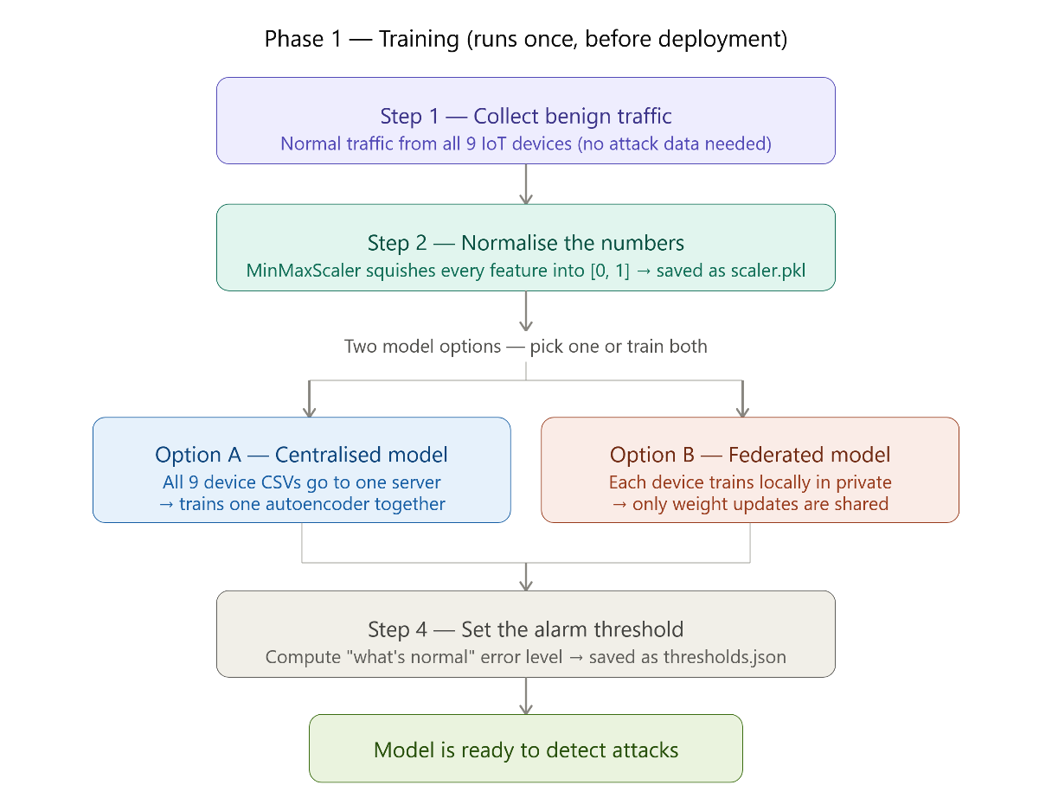
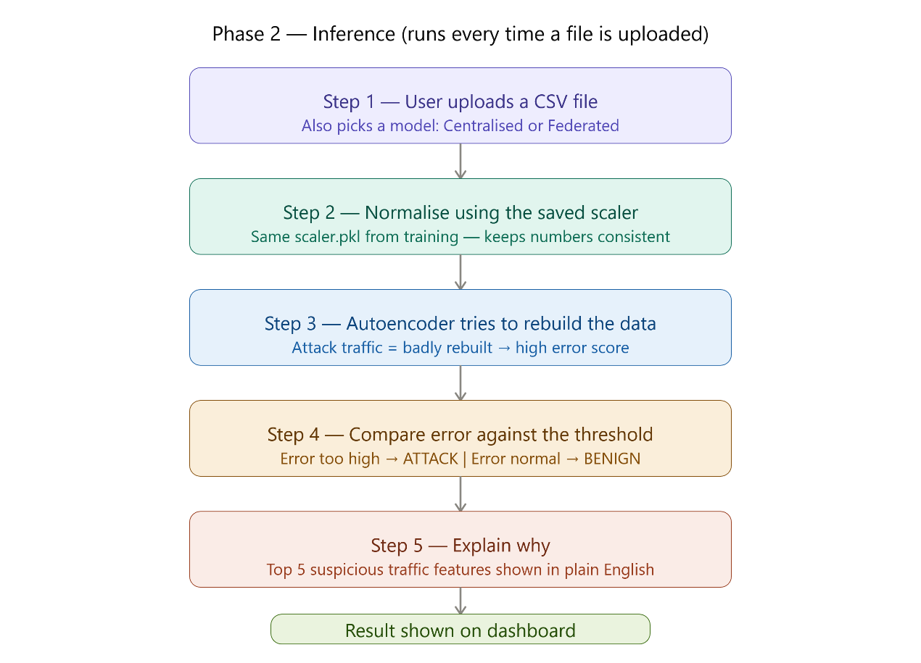
SYSTEM DESIGN
System Architecture — Training & Inference
PHASE 1 — TRAINING (offline, once)
PHASE 2 — INFERENCE (every upload)
M.Tech Summer Project | Seshapriyan T | SASTRA Deemed University
3

Slide 4
HOW IT WORKS
Methodology
Dataset
N-BaIoT, 9 devices
Shared Scaler
MinMaxScaler, all 9
Autoencoder
115→16→115
Federated Training
Flower + FedAvg
Threshold
μ + 3σ
Threat Score
0–100
Explainable AI
Top-5 features
▸ Dataset & shared preprocessing: N-BaIoT dataset — 9 IoT devices, 115 statistical traffic features; a single MinMaxScaler is fit once on benign traffic pooled from ALL 9 devices (not just Device 1), eliminating the multi-device false-positive problem.
▸ Autoencoder architecture: symmetric dense network 115→64→32→16→32→64→115, ReLU hidden activations, Sigmoid output, trained with Adam optimiser and Mean Squared Error loss for 20 epochs (batch size 256), on benign traffic only.
▸ Federated Learning: implemented with the Flower (flwr) framework; each of the 9 devices trains locally and shares only model weights with the server, which aggregates them using FedAvg: w_global = Σₖ (nₖ/N)·wₖ, over 3 communication rounds.
▸ Threshold & Threat Score: detection threshold τ = μ(MSE_benign) + 3×σ(MSE_benign); Threat Score = min((avg_error / τ) × 100, 100), giving an intuitive 0–100 severity reading.
▸ Explainable AI: per-feature reconstruction error eᵢ = (1/m)Σⱼ(Xⱼᵢ − X̂ⱼᵢ)² is computed; the 5 highest-error features are mapped to human-readable descriptions and shown as a ranked contribution chart.
M.Tech Summer Project | Seshapriyan T | SASTRA Deemed University
4

Slide 5
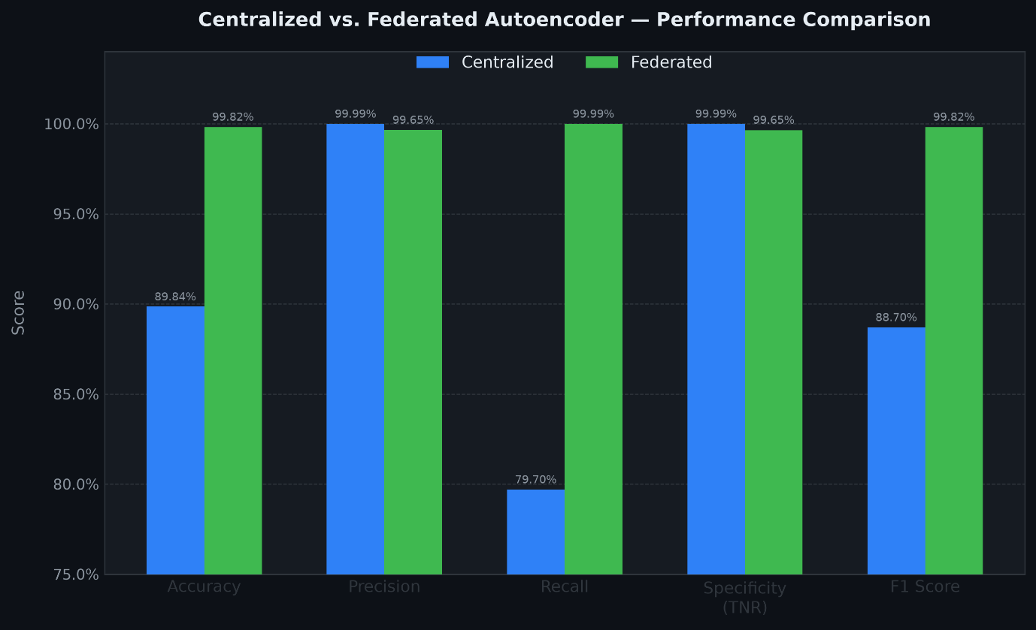
EXPERIMENTAL RESULTS
Results — Centralised vs. Federated
Performance Table (N-BaIoT test set)
Model Comparison — Accuracy / Precision / Recall / Specificity / F1
Metric | Centralised | Federated | Winner
Accuracy | 89.84% | 99.82% | Federated
Precision | 99.99% | 99.65% | Centralised*
Recall | 79.70% | 99.99% | Federated
Specificity | 99.99% | 99.65% | Centralised*
F1 Score | 88.70% | 99.82% | Federated
*margin ≈ 0.34% — practically negligible
Observations
▸ Federated Autoencoder outperforms Centralised on Accuracy (+9.98 pts), Recall (+20.29 pts) and F1 (+11.12 pts).
▸ Centralised has marginally higher Precision and Specificity (≈ 0.34% — negligible in practice).
▸ Federated model gives stronger attack detection AND preserves privacy — raw traffic never leaves any device.
M.Tech Summer Project | Seshapriyan T | SASTRA Deemed University
5

Slide 6
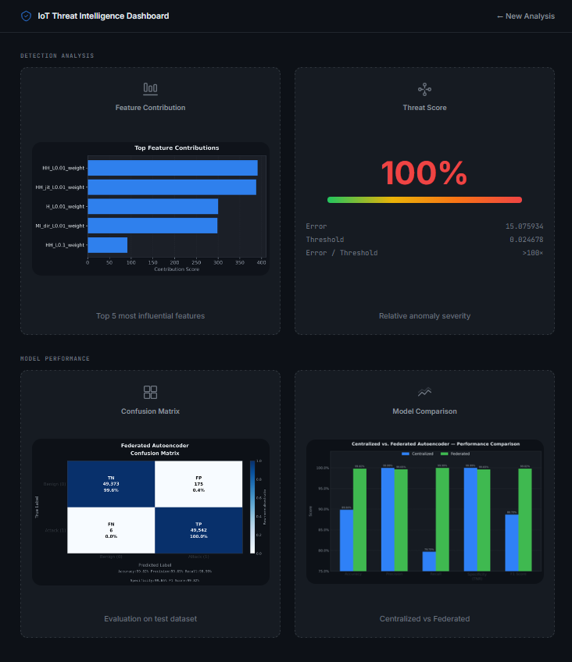
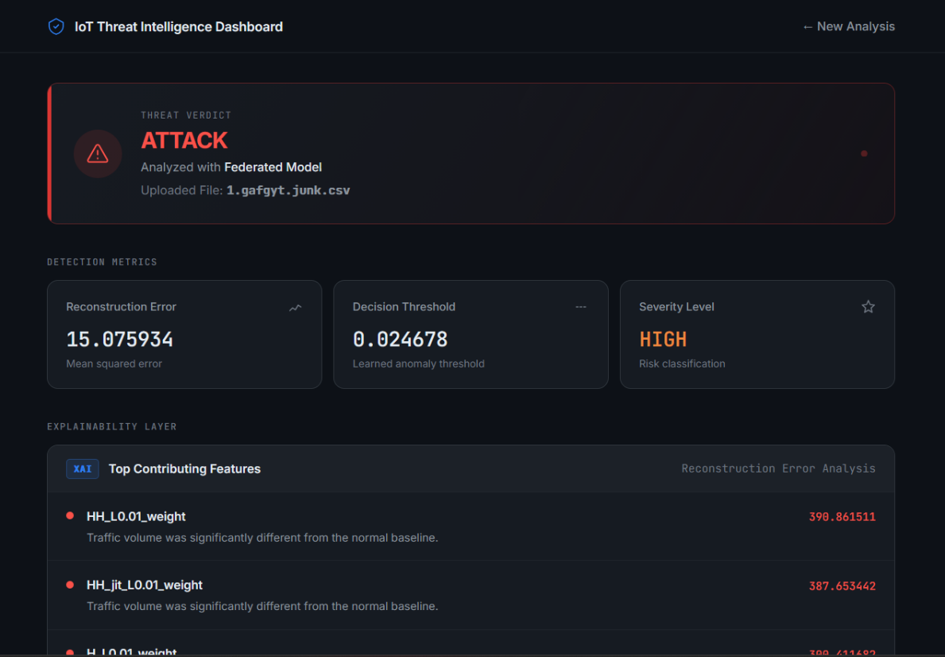
LIVE SYSTEM
Dashboard Demonstration
Prediction • Verdict • Top Features
Threat Score • Feature Chart • Confusion Matrix • Comparison
M.Tech Summer Project | Seshapriyan T | SASTRA Deemed University
6

Slide 7
NOVELTY & CONTRIBUTIONS
Comparison with Existing Work
Base Paper vs. This Implementation
Merits
Dimension | Base Paper | This Work
System type | Offline research scripts | Deployable Flask app
Preprocessing | Single/unclear-device scaler | Shared scaler — all 9 devices
Explainable AI | Conceptual only | Top-5 feature attribution + chart
Threat Score | Not present | Normalised 0–100 score
Model options | Federated only | Centralised + Federated (selectable)
Interface | None (CLI) | Interactive dashboard, real-time CSV
▸ High accuracy (≈99.68% overall) with no attack labels needed
▸ Privacy-preserving: only model weights transmitted (GDPR-aligned)
▸ Multi-device robustness — no distribution-mismatch false positives
▸ Explainable, interpretable verdicts for security analysts
▸ Dual-model (Centralised vs. Federated) side-by-side comparison
Limitations
My Key Contributions
▸ Shared multi-device MinMaxScaler (fixes false-positive bug)
▸ Improved, reproducible preprocessing pipeline
▸ Interactive Flask dashboard with real-time CSV inference
▸ Explainable AI, Threat Score & live model comparison
▸ Offline, CSV-only — no live packet-stream monitoring yet
▸ Static threshold does not adapt to gradual concept drift
▸ File-level verdict only — no per-flow granularity
▸ Federated clients simulated on a single machine
M.Tech Summer Project | Seshapriyan T | SASTRA Deemed University
7

Slide 8
WRAP-UP
Conclusion & Future Work
Conclusion
Future Work
▸ Delivered a Federated IoT Threat Intelligence Dashboard combining Autoencoder-based unsupervised detection, Federated Learning, and Explainable AI.
▸ Achieved ≈99.68% overall accuracy on N-BaIoT without any labelled attack data.
▸ Fixed a real multi-device preprocessing bug with a shared MinMaxScaler, improving consistency across all 9 heterogeneous devices.
▸ Delivered feature-level explanations, a Threat Score, and an interactive dashboard — a practical, privacy-preserving IDS tool.
▸ Real-time traffic capture (Scapy/libpcap) instead of CSV-only analysis
▸ Live IDS integration with Suricata / Zeek for SOC deployment
▸ Differential privacy (gradient noise) for formal FL privacy guarantees
▸ Edge AI deployment via TensorFlow Lite on resource-constrained devices
▸ Cloud deployment (Docker + AWS/GCP/Render) for scalable public access
▸ Cross-dataset evaluation (IoT-23, MQTTset, UNSW-NB15) for generalisation
Thank You
M.Tech Summer Project | Seshapriyan T | SASTRA Deemed University
8

