Slide 1

SYS_SECURE_INIT // 0X7F_SOLVIX
SOLVIX'26 // 24H HACKATHON
INTRODUCTION
Team name : <Team name>
Team members + roles:
Member 1 & role: <Name> – Backend & PostGIS
Member 2 & role: <Name> – Flutter mobile app
Member 3 & role: <Name> – Web portal & pitch
College/organization : <College name>
Problem statement : HAC-6 Disaster Damage Assessment
TRACK: 01 // CORE_TECH

Slide 2
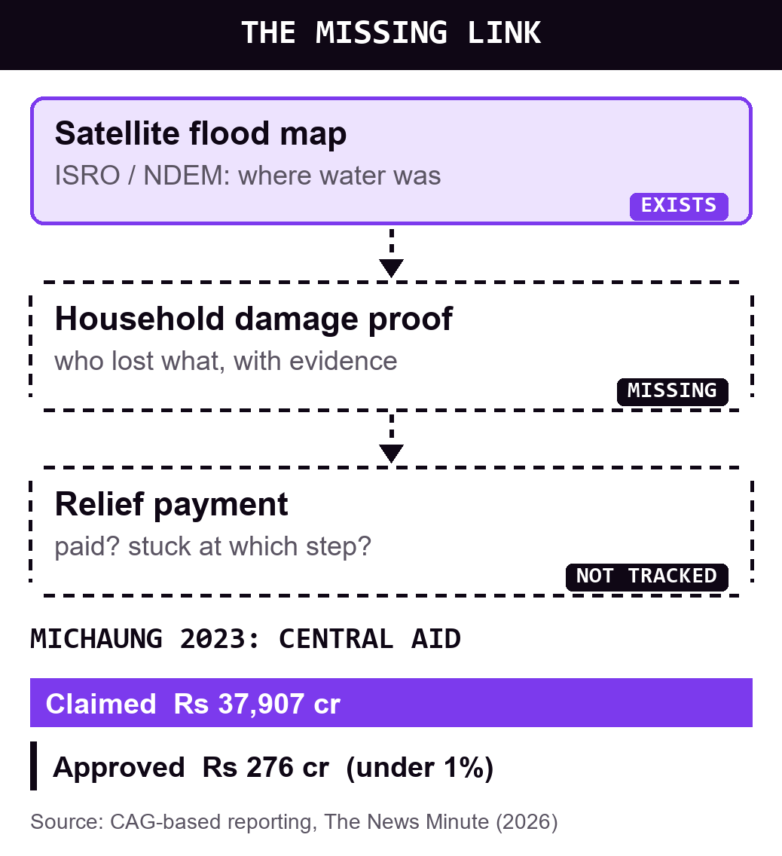
SYS_SECURE_INIT // 0X7F_SOLVIX
SOLVIX'26 // 24H HACKATHON
Problem Statement
  Problem: no proof of damage
  Who: flood-hit families, VAOs
  Why: relief needs verified proof
  Gap: maps show water only
  Stat: Michaung 2023: Rs 37,907 cr claimed, Rs 276 cr approved
TRACK: 01 // CORE_TECH

Slide 3
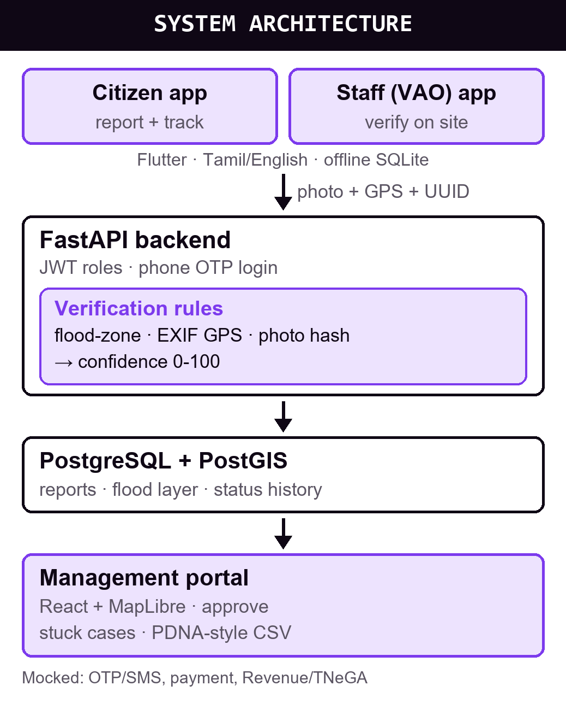
SYS_SECURE_INIT // 0X7F_SOLVIX
SOLVIX'26 // 24H HACKATHON
Proposed Solution
  Meetpu: one record, photo to payment
  Fix: links flood map, proof, relief
  Features: offline Tamil app, auto checks, VAO queue, stuck-case map
  Flow: citizen → VAO → collector → paid
  I/P/O: photo + GPS → checks → status, CSV
  Stack: Flutter, FastAPI, PostGIS, React →
  AI: rules score risk; a human decides

Slide 4
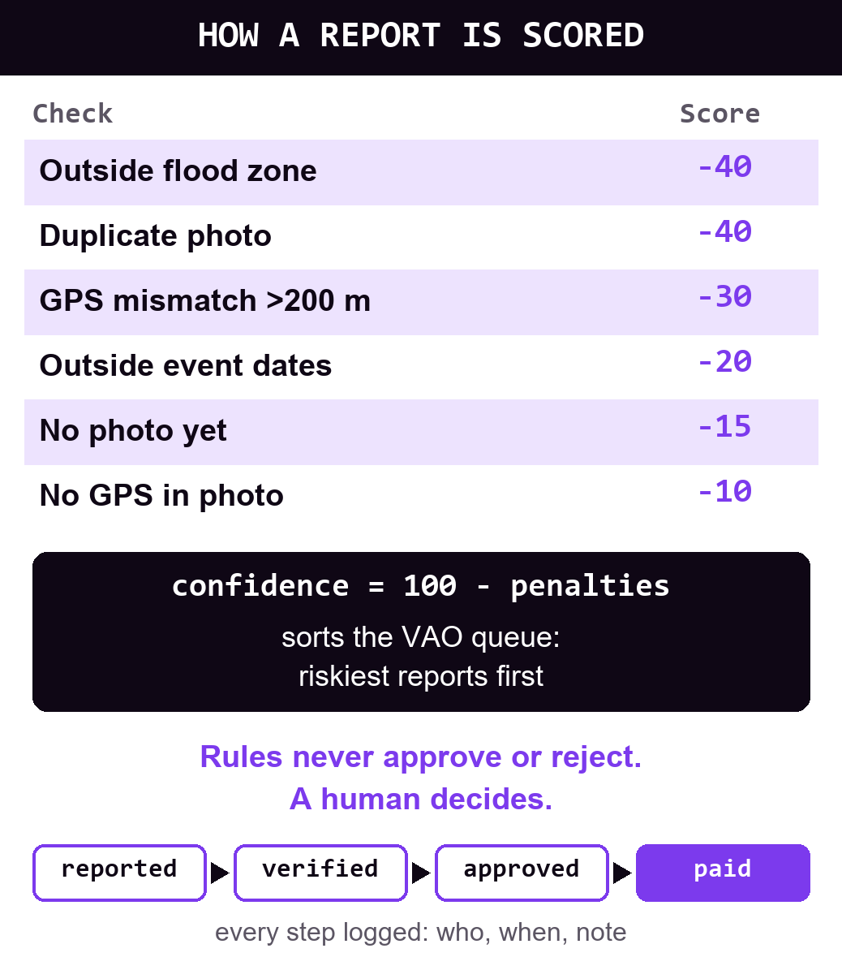
SYS_SECURE_INIT // 0X7F_SOLVIX
SOLVIX'26 // 24H HACKATHON
Technology & Implementation
  Stack: all open source
  Frontend: Flutter, React
  Backend: FastAPI, JWT
  Database: PostGIS, SQLite
  AI/ML: rules now, AI next
  Cloud: Render, Bhuvan

Slide 5
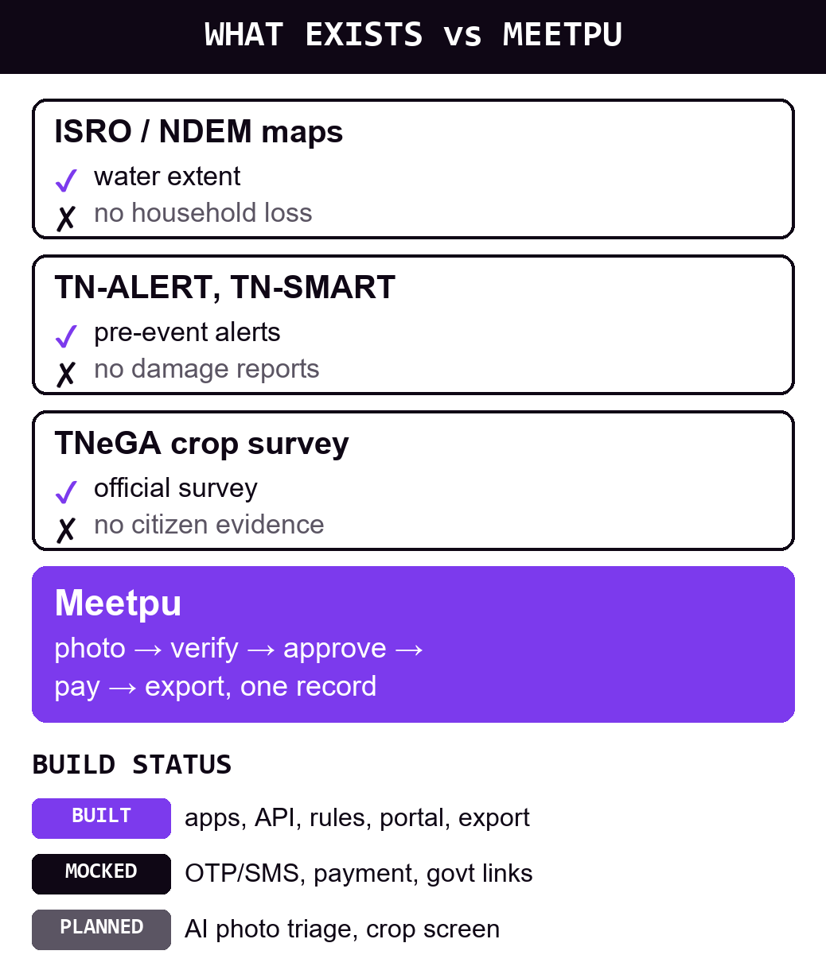
SYS_SECURE_INIT // 0X7F_SOLVIX
SOLVIX'26 // 24H HACKATHON
Impact, Innovation & Feasibility
  Unique: photo-to-payment trail
  Impact: faster, fairer relief
  Users: citizens, VAOs, officials
  Scale: any district or flood
  Use: floods, cyclones, crops
  Value: proof for aid claims
  Next: AI triage, SMS alerts

Slide 6
SYS_SECURE_INIT // 0X7F_SOLVIX
SOLVIX'26 // 24H HACKATHON
Reference / Demo / Closing
  Reference: NDEM flood maps; NIDM PDNA SOP (2019)
  Deploy: Render (API + PostGIS + portal); Android APK
  Links: ndem.nrsc.gov.in · nidm.gov.in/PDF/pubs/sop_pdna.pdf
  Demo: offline report → VAO verify → approve → export
  Closing: satellites show water; Meetpu shows who lost what

